Slide 1

DriverPass System Analysis
Adrian Tull
Notes:
[No speaker notes required for this slide.]

Slide 2

System Requirements
Functional Requirements:
Customers register, book, modify, or cancel lessons online
Package management (enable/disable, flexible hours)
Nonfunctional Requirements:
Accessible from any device, online only
Secure access with role‑based permissions
Notes:
[In your speaker notes, include an explanation of the different requirements you determined for DriverPass’s system. What are the functional requirements you selected to describe? What are the nonfunctional requirements you selected to describe? Be sure to explain how these requirements meet DriverPass’s needs.]
These features let your driving students make their own bookings while making sure that only authorized staff can admin lessons and accounts. The site runs in the cloud so you’ll never worry about downtime.

Slide 3
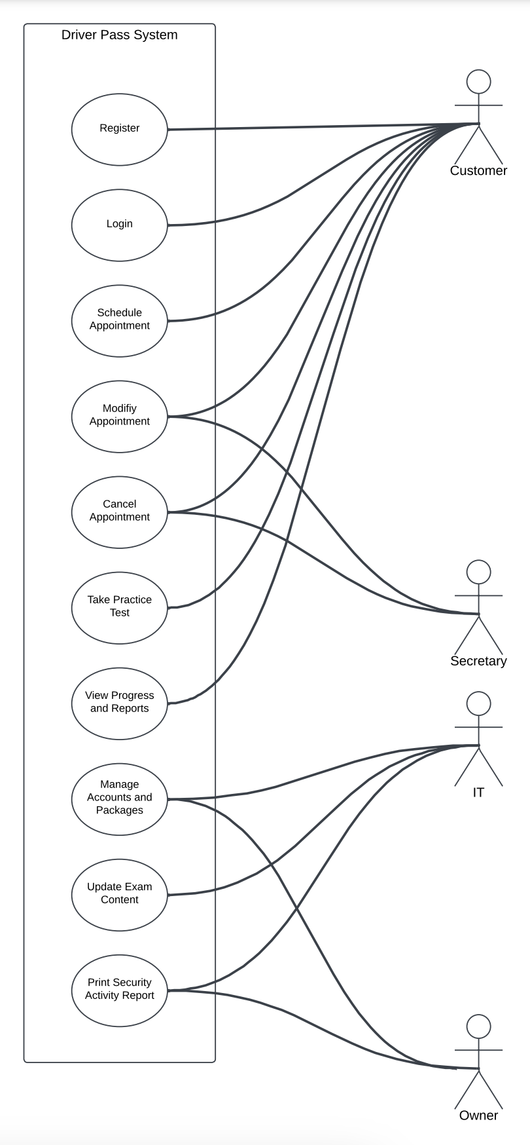
Use Case Diagram
Notes:
[Explain your diagram. Who are the different actors in the system? What are the different use cases? How did you account for DriverPass’s needs in your design? In your explanation, keep your audience in mind. Avoid the use of terms like “actors” and “use cases” in your explanation.]
This diagram maps out who does what in the DriverPass system. There are four roles, the Customers who are the students, the Secretary, the IT Admin, and the Owner, each connected to the tasks they need to perform.
- Customers can register and log in, book, change, or cancel their driving lessons, take practice tests online, and view their progress reports.
Secretaries can modify and cancel appointments so they can adjust appointments on behalf of customers.
IT Admins handle behind the scenes work; they manage user accounts and packages, upload new exam content when DMV rules change, and generate security activity reports.
Owner can also print activity reports and manages accounts and packages.

Slide 4
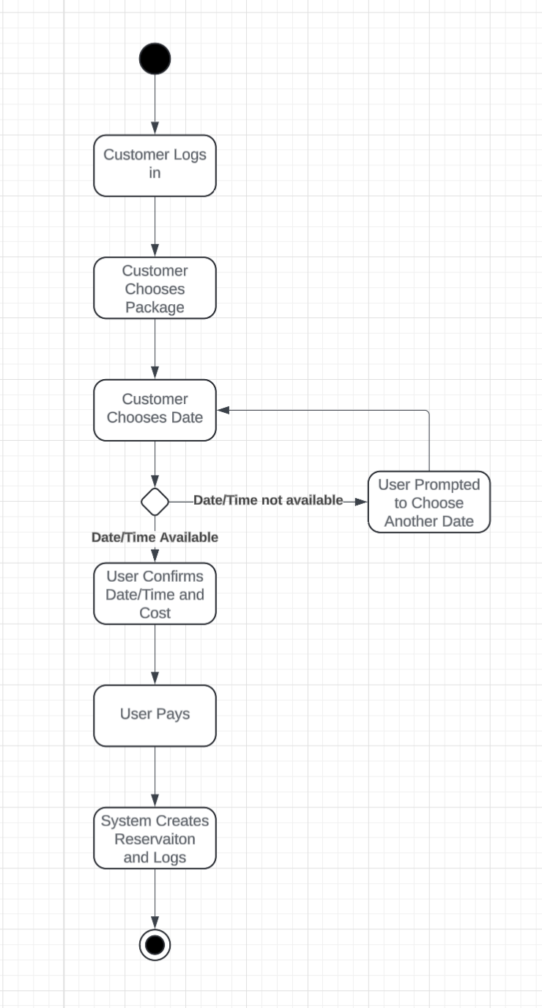
Activity Diagram
Notes:
[Explain your diagram. Which use case are you breaking down? What are the steps for this use case? How did you account for DriverPass’s needs in your design? In your explanation, keep your audience in mind. Avoid the use of technical terms such as “nodes,” “control flows,” and so on.]
Here’s how a reservation flows: the student picks a package and time, the system checks driver availability, processes payment, and confirms—all logged automatically.

Slide 5
Security
Role based access control
Encrypted data in transit and in the database
Automated logs
Secure, time limited password resets
Notes:
[How did you consider security in your design? In your explanation, keep your audience in mind by avoiding the use of technical terms.]
To protect your customer data, we built in multiple layers: strong permissions, full encryption, and detailed logs to trace any change.

Slide 6
System Limitations
Offline edits aren’t allowed
Package creation or disabling requires developer support
DMV updates depend on external API schedules
reporting Excel exports only
Notes:
[What are the limitations of your design? In your explanation, keep your audience in mind by avoiding the use of technical terms.]
By design, all updates happen online to keep data consistent. Some advanced things—like adding new package types, regions, or custom non excel reports—could be added in the future.

