Slide 1

PS

Slide 2
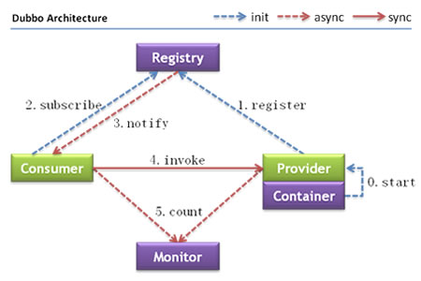
Dubbo Architecture

Slide 3
Dubbo Protocol

Slide 4
Notes:
https://dubbo.apache.org/zh-cn/blog/tracing-with-skywalking.html

Slide 5
Reference
http://dubbo.apache.org/zh-cn/
http://dubbo.apache.org/zh-cn/docs/user/quick-start.html
https://dubbo.apache.org/zh-cn/blog/dubbo-protocol.html
https://dubbo.apache.org/zh-cn/blog/tracing-with-skywalking.html

