Slide 1
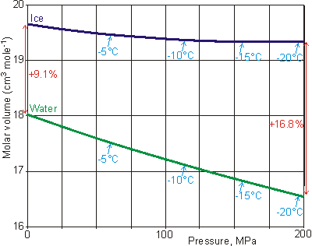
Introduction – Anomalous Expansion of Water
Water's anomalous expansion upon freezing is a fascinating phenomenon that has sparked interest in various fields. This document presents a novel heat engine concept that leverages the anomalous expansion of water upon freezing. This innovative approach has the potential to convert low-quality dissipated heat energy into useful work, challenging the fundamental limits set by Carnot's theorem. It implies, a possibility to improve the quality of energy spontaneously when combined with a suitable Heat Pump.
At standard conditions (0°C and 1 atm), water expands by approximately 9% when transitioning from liquid to solid state. Moreover, when water is spatially constrained, upon freezing, it exhibits a remarkable pressure increase up to 220 MPa before it becomes another form of ice. Notably, increased pressure further lowers the melting point, thereby amplifying the expansion
Density Anomalies of Water.
Source: https://water.lsbu.ac.uk/water/density_anomalies.html
At a pressure of 200 MPa, water freezes at about 253 Kelvin and undergoes a remarkable 16.8% expansion.

Slide 2
Arrangement and Working of the Proposed Heat Engine
Consider 1 kg of water at STP (approximately 1000 cc). When subjected to 200 MPa, its volume reduces to approximately 922 cc. Cooling this water to 253 K under 200 MPa pressure defines the initial condition.
Start with
Initial Condition
Expands by Freezing
Returns by Melting
200 MPa
Work = 200 MPa X 155 cc = 31 kJ
200 MPa
200 MPa
Piston
≈
Piston
Piston
16.8 %
155 cc
Piston
Solidifies to 1077 cc Ice at 253 K
Liquifies to 922 cc Water at 253 K
q₂
1000 cc Water
Water at 253 K, 922 cc
Sink at 252 K Receives 334 kJ
Source at 254 K Supplies 365 kJ
The cycle begins with the freezing process when the water container contacts the sink at 252 K (T₂), 1 Kelvin below the freezing point. The latent heat fusion of 1 kg of water is 334 kJ - gets released as heat to the sink (q₂ = 334 kJ/kg).

Slide 3
A Novel Heat Engine’s Efficiency Comparison
As the fluid freezes, it expands by approximately 16.8%, resulting in a volume increase to 1077 cc. The expanded ice delivers mechanical work, w₁ = 200 MPa × (1077 cc - 922 cc) = 200 MPa x 155 cc = 31,000 Nm = 31 kJ.
Expands by Freezing
Work = 200 MPa X 155 cc = 31 kJ ( 1 cc = 1e-6 m³ )
Returns by Melting
The total change in internal energy (ΔU) during the freezing process is ΔU = w₁ + q₂ = 31 kJ + 334 kJ = 365 kJ. The cycle completes when the frozen water absorbs energy (q₁ = ΔU = 365 kJ) from the hot body (Source) at 254 K (T₁) for melting.
200 MPa
200 MPa
Piston
≈
16.8 %
155 cc
Piston
Solidifies to 1077 cc Ice at 253 K
Liquifies to 922 cc Water at 253 K
q₂
q1
Sink at 252 K Receives 334 kJ
Source at 254 K Supplies 365 kJ
The Carnot cycle efficiency (E₁) is calculated as E₁ = 1 - (252/254) ≈ 0.8%, given the source temperature (T₁) of 254 K and sink temperature (T₂) of 252 K. In contrast, the proposed heat engine's efficiency (E₂) is E₂ = w₁/q₁ = 31 kJ / 365 kJ ≈ 8.5%. Notably, E₂ surpasses E₁, appearing to defy *Carnot's theorem.
Carnot's theorem: No heat engine can exceed the efficiency of a Carnot engine operating within the same temperature limits.

Slide 4
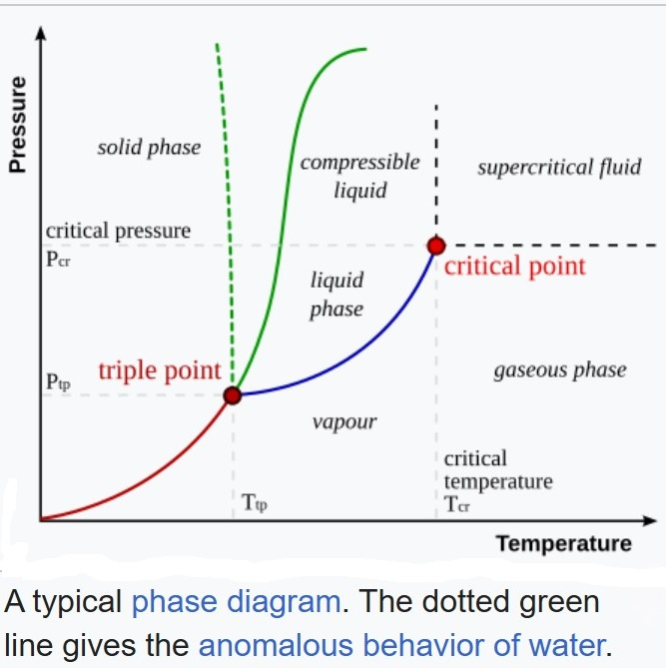

Analysis
Ice uniquely expands while releasing heat. Water's anomalous behaviour during solidification when volumetrically constrained by excess pressure enables cyclic phase changes, (solidifying, expanding, melting etc. intermittently) generating work under seemingly constant pressure and temperature conditions.
One of the sources of inspiration: A YouTube video titled ‘Freezing water expands. What if you do not let it?’ https://youtube.com/watch?v=_bcfxty39Cw&si=o3S4lnh3szZAgqg9
Cooling :: Freezes : Expands : Melts
Heating :: Melts : Contracts : Freezes
Expands by Freezing
Melts by excess Pressure
*R_{a} is an averaged R
Melts by Heating
200 MPa
253 Kelvin
ΔV = 16.8 %
ΔS = R_{a} ln (1.168)
P
T
Liquid
Solid
Solid
Liquid
V
S
The deduced Carnot-Clausius-Clapeyron relation dP/dT = Δs/Δv explains the anomalous behaviour of water as dP/dT is negative of the curve separating solid liquid states. Source: Clausius–Clapeyron relation - Wikipedia

Slide 5
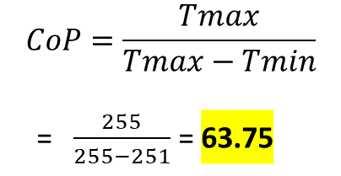
With Augmented Heat Pump : Spontaneous Conversion of Heat into Work
Net = w₁–w₂ = 31 – 5.3 = 25.7 kJ
To enable heat transfer (heat energy from the sink at 252 K back to the source at 254 K) a Heat Pump is chosen to operate between 251 and 255 Kelvin. Heat Pump’s coefficient of performance (CoP) is approximately 63.5, calculated from the ideal relation:
When the Atmosphere is above 254 K, it supplies the Net (w₁–w₂) to the Source in the form of Heat.
Considering 1 kg of Water, ≈ 1000 cc
Assuming the Heat Pump’s CoP is close to that of an ideal reversed Stirling cycle’s operating between the same temperature limits.
Source receives w₁–w₂ from atmosphere and q₂ + w₂ from the Heat Pump, total = w₁+q₂
200 MPa
Hot Body is at T1 = 254 K
Source
Piston
155 cc
q₂ + w₂ = 334 + 5.3 = 339.3 kJ gets transferred to the Source at 255 K
Contracts by Melting
q₁ = w₁+q₂ = 31 + 334 = 365 kJ
$$CoP=\frac{Tmax}{Tmax−Tmin}$$
= $\frac{255}{255−251}$ = 63.75
w₁ = P X ΔV = 200 MPa x 155 cc = 31,000 Nm = 31 kilo Joules
Source at 254 K Supplies 365 kJ
Heat Engine Freezing and
Melting at 253 K
CoP = 255 / (255-251) = 63.75
Net = w₁–w₂ = 31 – 5.3 = 25.7 kJ
w₁
Heat Pump operates between 251 K to 255 K
w₂
200 MPa
w₂ = q₂ / CoP = 334 / 63.75 ≈ 5.3 kJ
q₂ = latent heat of fusion = 334 kJ
The work required by the Heat Pump is obtained from dividing the latent heat of fusion 334 kJ/kg (which is the energy to be transferred) by the CoP 63.75 ≈ 5.3 kJ/kg of water.
Piston
q₂ = 334 kJ gets transferred to Heat Pump at 251 K
16.8 %
Cool Body is at T2 = 252 K
Sink
Expands by Freezing
w₂
Sink at 252 K Receives 334 kJ
Reference: https://water.lsbu.ac.uk/water/density_anomalies.html -Density Anomalies of Water

Slide 6
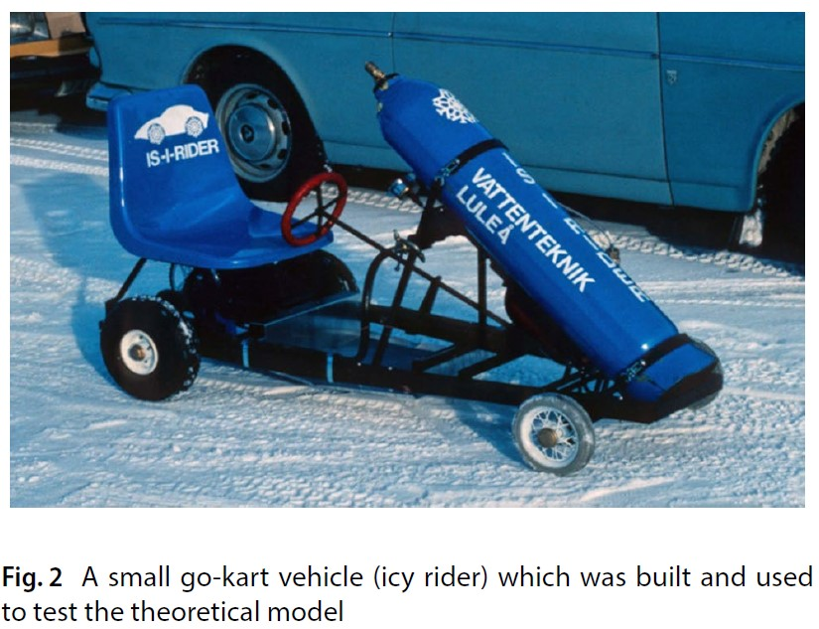
Practical and the Evidence
Prof Dr. Mohamad Kharseh had conceptualised and practically tested in generating energy using the freezing water, here is a snippet from the 6th page of the published document. Source: https://doi.org/10.1007/s42452-018-0139-z
Hence, the developed conceptual model is an acceptable
model to simulate the utilization of water freezing
for creating mechanical energy. Another important result
can be obtained from the developed model here is that
the maximum amount of energy that can be generated by
the freezing of 1 l of water can be up to 22.1 kJ.
Reference : https://doi.org/10.1007/s42452-018-0139-z Utilizing Freezing Water to Generate Energy

Slide 7
The Scope of Research
Lowest efficiency path due to constant slope
Plausible higher efficiency paths of the Phase-Change;
The expansion rate of freezing water is not necessarily linear in the phase transition path with respect to the change in its internal energy, shown here as A-C-A cycle path; meaning, dV/dU is not necessarily a constant. Its rate of expansion might vary, accelerating either water end or solid end. Experimentations can identify the optimal energy exchange zone, where the largest volumetric change (ΔV) occurs with minimal energy change (ΔU). This "sweet zone" of phase transition enhances efficiency by the maximized ΔV/ΔU ratio. One thought experiment based on the non-linearity of the expansion rate showed, an efficiency as high as 50% is possible.
Furthermore, eutectic techniques such as doping the fluid with salt sugar paraffin-wax etc may be experimented with, to enhance ΔV/ΔU.
C
B
Liquid side
ΔV
D
Solid side
0 %
A
ΔU
Anticipated zones of accelerated paths, A-B-A or C-D-C paths are preferred rather than A-C-A

Slide 8
A Thought Experiment 1of 2
Let us assume that the volumetric change in the phase transition occurs rapidly at the solid end, meaning, the transition is like the path A-D-C-D-A shown in the previous slide. Consider 1 kg of ice (1090 cc) that has fully formed at standard atmospheric pressure (1 atm) and a temperature of approximately 273 K. At this stage, the ice has expanded by about 9%. This state is marked as point ‘a’ along the phase change path ‘Aa’ on the volume-internal energy (V-U) diagram shown below.
Let us apply a pressure of 200 MPa to the ice, which compresses and performs mechanical work and increasing its internal energy. This results in the melting of the ice, shifting the melting point to 253 K. Consequently, the fluid state must align with a point on the high-pressure path ‘Bb,’ denoted as ‘c.’ This transition signifies that the system moves from the low-pressure phase change path ‘Aa’ to the high-pressure path ‘Bb.’ Note that, the phase change path ‘Bb’ represents water freezing under a pressure of 200 MPa at 253 K.
a
1090 cc
1077 cc
b
Let, ‘a’ be the reference to track the internal energy of the fluid.
From ‘a’ to ‘c’, fluid gets , +15 kJ due to pressure loading. By the end of cooling at ‘b’, the fluid has 15 – 30 = -15 kJ.
The ‘Source’ supplies 30 kJ to complete the cycle and the fluid has -15 +30 = +15 kJ, marking the beginning of the cycle as ‘c’.
The Engine cycles between ‘b’ and ‘c’.
1 atm, 273 K path
ΔV = 75 cc
9 %
8 %
1002 cc
1000 cc
A
U
c
200 MPa, 253 K path
7.8 %
q₃ + PΔV = 30 kJ
ΔU
922 cc
B
Efficiency = P ΔV / ΔU = 15/30 = 0.5 = 50 %

Slide 9
A Thought Experiment 2 of 2
Next, the cooling process begins. When the fluid is brought into contact with a thermal sink at 252 K, heat is extracted, causing the fluid to freeze. By the end of the cooling process, the sink absorbs approximately 15 kJ of heat, and the fluid solidifies along the ‘Bb’ path, reaching its final state ‘b.’ As the fluid freezes, it expands by approximately 75 cc, performing mechanical work against the 200 MPa pressure, resulting in a work output of 15 kJ.
Start with
Melted by Loading
Expands by Freezing
Returns by Melting
1 atm
200 MPa
Work = 200 MPa X 75 cc = 15 kJ
1 atm
200 MPa
200 MPa
Piston
Piston
Piston
8 %
Piston
75 cc
75 cc
Piston
~9 %
Solidifies to 1077 cc Ice at 253 K
1002 cc Water at 253 K
1090 X 0.92 ≈ 1002 cc
A
a
c
b
= c
Frozen to 1090 cc Ice at 273 K
mostly Water at 253 K
Sink at 252 K Receives 15 kJ
Source at 254 K Supplies 30 kJ
1000 cc Water
ΔV = 8% of 1090 cc
To complete the cycle, the system is brought into contact with a heat source at 254 K. The source provides approximately 30 kJ of energy, equivalent to the sum of the heat rejected to the sink and the mechanical work output. This input energy allows the fluid to return to its original state, thus completing the cycle. Consequently, the system operates in a cyclic manner between states ‘b’ and ‘c,’ producing 15 kJ of work output for every 30 kJ of heat input.

Slide 10
Power Density and the Life
Compared to the earlier setup where source supplies 365 kJ for a net of 25.7 kJ; the thought experiment results in a net of 14.76 kJ for 30 kJ supplied.
From Ambience 11.5 kJ
Source at 254 K
18.5 kJ
From Ambience 14.76 kJ
30 kJ
≈ 11.5 kJ
CoP = 255 / 4 ≈ 63
Source at 254 K
Peltier Heat Pump, CoP is ≈ 80% of the Ideal
≈ 0.4 kJ
Piezo-electric
Engine , ≈ 80% efficient.
15.24 kJ
30 kJ
14.76 kJ
CoP = 255 / 4 ≈ 63
Work needed = 18.1 / (63 x 0.8) ≈ 0.4 kJ
Local Non-Linear Freezing and
Melting at 253 K
q₃ ≈ 18.1 kJ
HP 251 K to 255 K
0.24 kJ
q₃ ≈ 18.1 kJ
Sink at 252 K
Work needed = 15 / 63 ≈ 0.24 kJ
q₃ = 15 kJ
To minimize the number of moving parts and to enhance the life of the equipment we can use solid-state electronics to convert pressure pulses to ‘charge’ by Piezoelectric effect for the engine design and the Peltier’s phenomenon of magneto caloric effect in designing the Heat Pump.
q₃ = 15 kJ
Sink at 252 K
The Power Density Improvement is (14.76/30) / (25.7/365) = 14.76 X 365 / (30 X 25.7 ) = 5387.4 / 771 ≈ 7 times;

