Slide 1
DECART Summer School 2018:
Causal Inference Module
Differences in Differences Estimator

Slide 2
Basic setup
Two groups, two time periods.
At t=0, neither group is treated and in time t=1, one (and only one) of groups is treated.
Differences: changes in group from t=0 to t=1.
Differences in differences (DID): difference in the changes in treatment and control groups from t=0 to t=1.

Slide 3
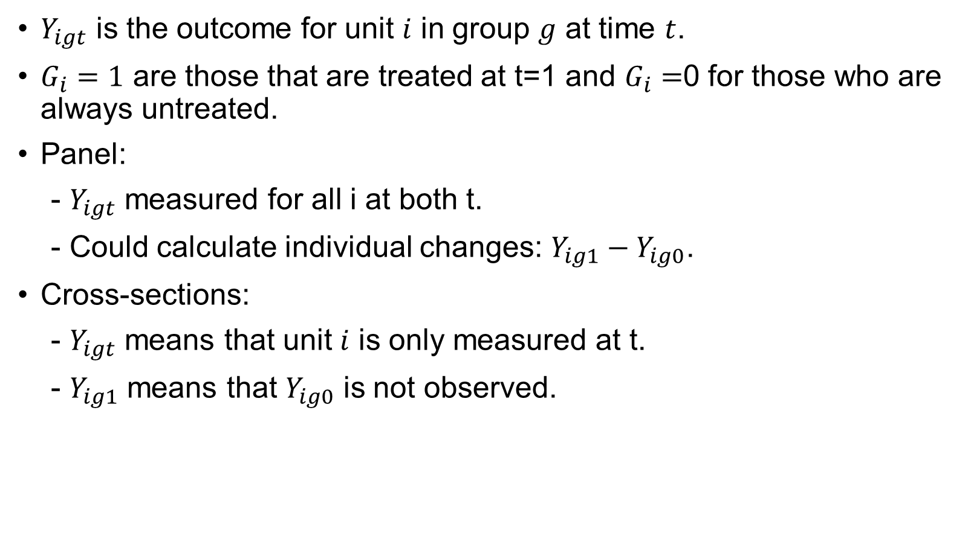
DID can be applied with panel data or two cross-sections
$Y_{igt}$ is the outcome for unit $i$ in group $g$ at time $t$.
$G_{i}=1$ are those that are treated at t=1 and $G_{i}=$0 for those who are always untreated.
Panel:
- $Y_{igt}$ measured for all i at both t.
- Could calculate individual changes: $Y_{ig1}−Y_{ig0}$.
Cross-sections:
- $Y_{igt}$ means that unit $i$ is only measured at t.
- $Y_{ig1}$ means that $Y_{ig0}$ is not observed.
Notes:
panel data refers to multi-dimensional data that generally involves measurements over some period of time.

Slide 4
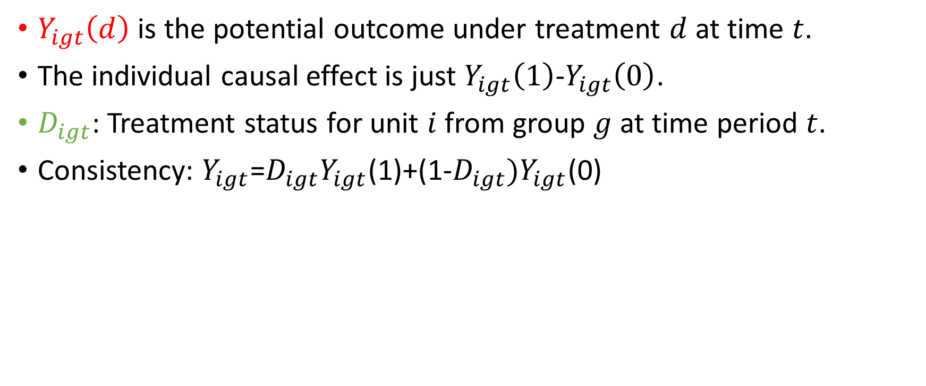
Potential outcomes approach to DID
$Y_{igt}\left(d\right)$ is the potential outcome under treatment $d$ at time $t$.
The individual causal effect is just $Y_{igt}\left(1\right)$-$Y_{igt}\left(0\right)$.
$D_{igt}$: Treatment status for unit $i$ from group $g$ at time period $t$.
Consistency: $Y_{igt}$=$D_{igt}Y_{igt}$(1)+(1-$D_{igt})Y_{igt}$(0)
Notes:
Is $D_{igt}$ same as Gi? Basically the interaction between treatment and time, such as I(treated)*I(post)

Slide 5

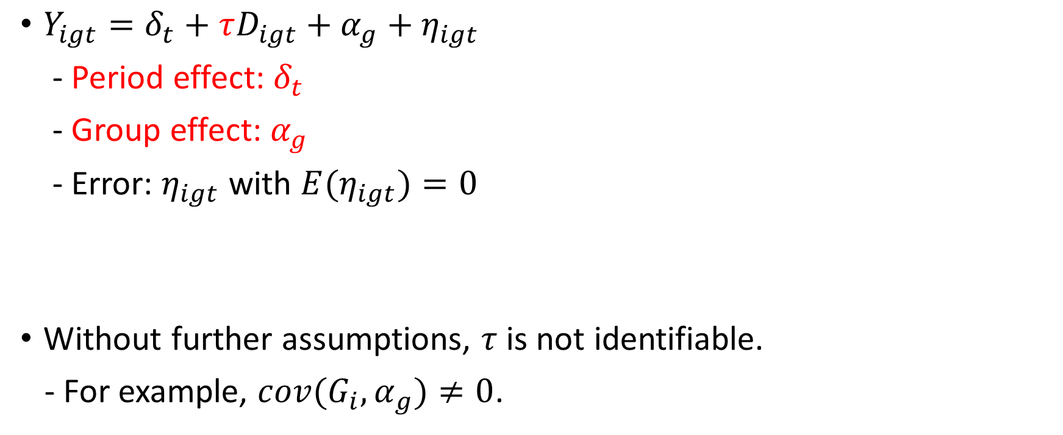
Constant effects linear DID model
$Y_{igt}=δ_{t}+τD_{igt}+α_{g}+η_{igt}$
- Period effect: $δ_{t}$
- Group effect: $α_{g}$
- Error: $η_{igt}$ with ${E(η}_{igt})=0$
Without further assumptions, $τ$ is not identifiable.
- For example, ${cov(G_{i},α}_{g})≠0$.

Slide 6
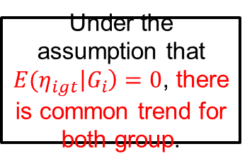
Under the assumption that ${E(η}_{igt}\left|G_{i}\right)=0$, there is common trend for both group.
Notes:
${E(η}_{igt}\left|G_{i}\right)=0$ means same things as ${cov(G_{i},α}_{g})=0$?
We want to see the E[error] = 0 given both treatment variable and time period since that indicates the two lines in above graph has parallel trend but we are not saying they have to have exactly same trend, otherwise, we would like to see error = 0.

Slide 7
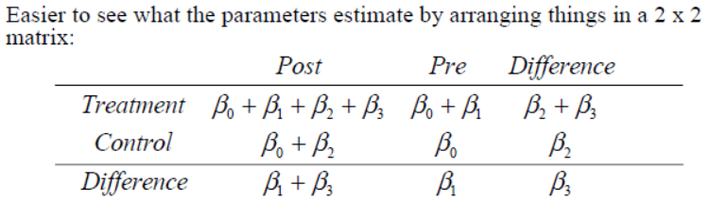
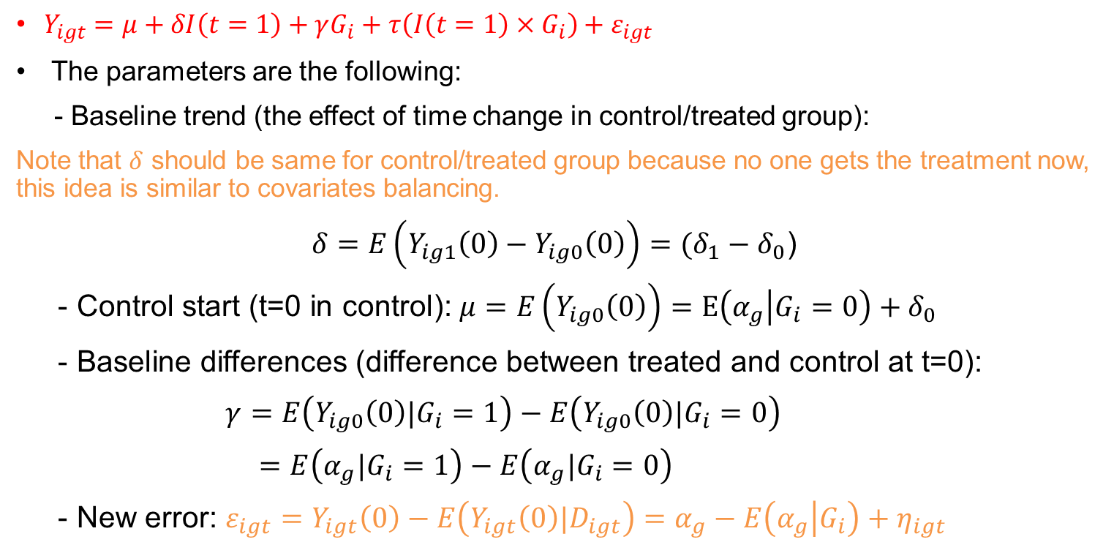
Rewrite the above model under baseline trend assumption
$Y_{igt}=μ+δI\left(t=1\right)+γG_{i}+τ\left(I\left(t=1\right)×G_{i}\right)+ε_{igt}$
The parameters are the following:
- Baseline trend (the effect of time change in control/treated group):
Note that $δ$ should be same for control/treated group because no one gets the treatment now, this idea is similar to covariates balancing.
$δ=E\left(Y_{ig1}\left(0\right)−Y_{ig0}\left(0\right)\right)=(δ_{1}−δ_{0}$)
- Control start (t=0 in control): $μ=E\left(Y_{ig0}\left(0\right)\right)=E\left(α_{g} | G_{i}=0\right)+δ_{0}$
- Baseline differences (difference between treated and control at t=0):
$γ=E\left(Y_{ig0}\left(0\right)|G_{i}=1\right)−E\left(Y_{ig0}\left(0\right)|G_{i}=0\right)$
$=E\left(α_{g}|G_{i}=1\right)−E\left(α_{g}|G_{i}=0\right)$
- New error: $ε_{igt}=Y_{igt}\left(0\right)−E\left(Y_{igt}\left(0\right)|D_{igt}\right)=α_{g}−E\left(α_{g} | G_{i}\right)+η_{igt}$
The new error is independent of treatment assignment!
Notes:
Does the Gi only indicate group now? I thought it also includes the time effect.

Slide 8
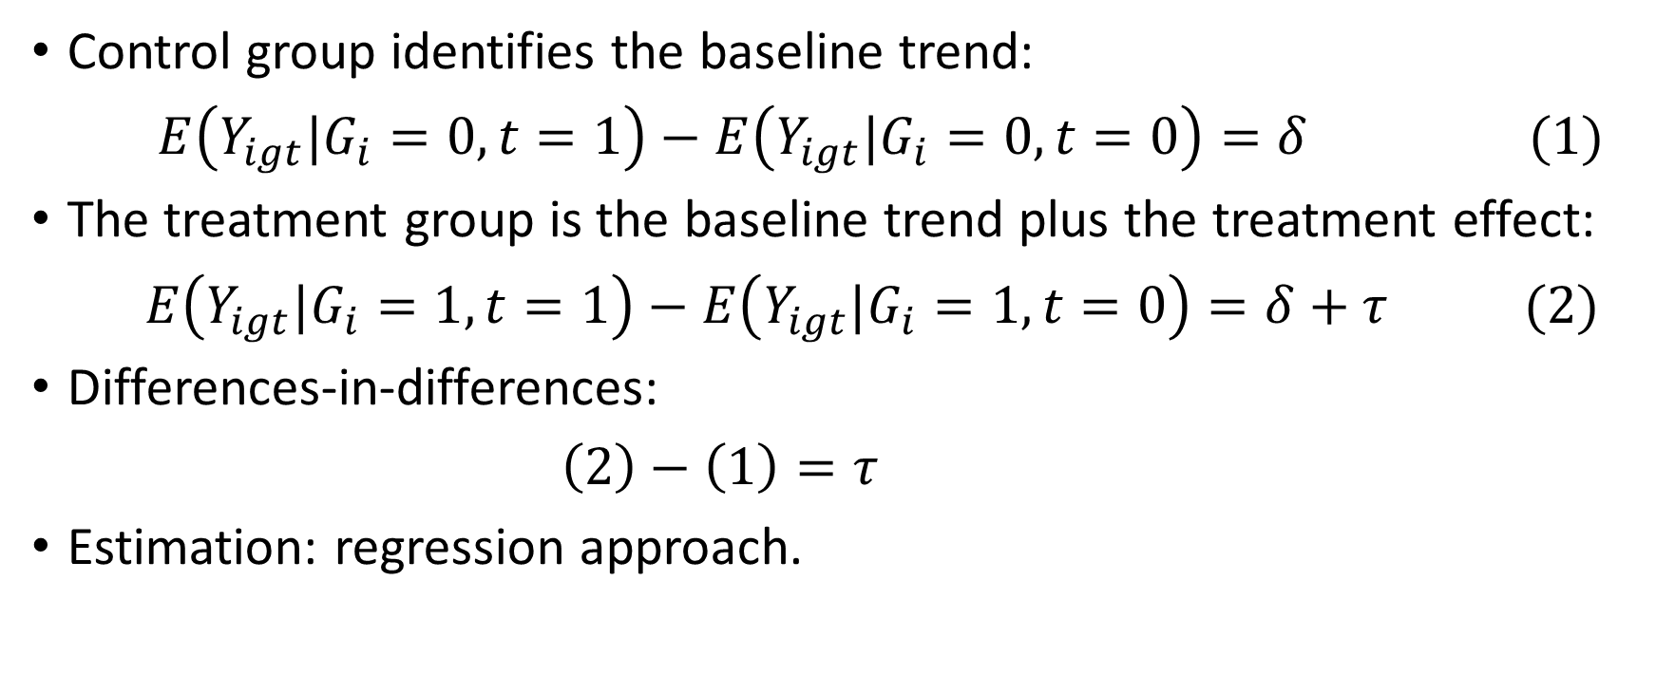
Under common trend assumption
$$Y_{igt}=μ+δI\left(t=1\right)+γG_{i}+τ\left(I\left(t=1\right)×G_{i}\right)+ε_{igt}$$
Control group identifies the baseline trend:
$E\left(Y_{igt}|G_{i}=0, t=1\right)−E\left(Y_{igt}|G_{i}=0,t=0\right)=δ (1)$
The treatment group is the baseline trend plus the treatment effect:
$E\left(Y_{igt}|G_{i}=1, t=1\right)−E\left(Y_{igt}|G_{i}=1,t=0\right)=δ+τ (2)$
Differences-in-differences:
$\left(2\right)−\left(1\right)=τ$
Estimation: regression approach.

Slide 9
Panel data
$$E\left(Y_{ig1}−Y_{ig0}|G_{i}=1\right)−E\left(Y_{ig1}−Y_{ig0}|G_{i}=0\right)$$
If we have panel data, then we can estimate this in a different, more direct way. Note that:
We can estimate the effect by regressing the change for each unit on the treatment.

Slide 10
Threats to identification
Obviously, the treatment needs to be independent of the error so that the variation of the outcome is the same for the treated and control groups, but this might not be plausible.
Thus, the independence of the treatment and error might only hold conditional on covariates. This will lead to a key assumption “parallel trends”, which says that the potential trend under control is the same for the control and treated groups, conditional on covariates.
No ignorability assumption, and could only rely on parallel trend assumption.
With covariates, we could use 1) Regression DID, 2) Matching and 3)Weighted based on propensity score.

