Slide 1
DECART Summer School 2018:
Causal Inference Module
Counterfactual Outcomes and Assumptions

Slide 2
Counterfactual or Potential Outcome Framework for Causal Inference
Early Work on Experimental Design:
J Neyman (1990 [from 1923]) On the application of probability theory to agricultural experiments. Essay on principles. Section 9. Statistical Science 5:465-480.
J Neyman (1935) Statistical problems in agricultural experimentation, JRSS B, 2:107-180
R Fisher (1935) The Design of Experiments. Edinburgh: Oliver and Boyde.
Modern Approach:
D Rubin (1974) Estimating causal effects of treatments in randomized and nonrandomized studies. J Educational Psychology 66:688-701

Slide 3
Example of Potential Outcomes and Causal Effects
i | Y_{i}(0) | Y_{i}(1) | A_{i} | Y_{i} = Y_{i}(A_{i}) | Y_{i}(1) – Y_{i} (0)
1 | 3 | 5 | 0 | 3 | 2
2 | 5 | 5 | 1 | 5 | 0
3 | 4 | 7 | 1 | 7 | 3
4 | 9 | 8 | 0 | 9 | -1
5 | 2 | 7 | 0 | 2 | 5
6 | 6 | 10 | 1 | 10 | 4
Average | 4.833 | 7 | 0.5 | 6 | 2.167 = 7 – 4.833

Slide 4
Why Randomization Works
Randomization assures that A_{i} is statistically independent of all subject characteristics
This includes Y_{i}(a) for all a
We write this as A_{i} |Y_{i}(a) for all a
The Y_{i}(a) that we get to observe are an unbiased random sample of all of the Y_{i}(a)
Thus, E[Y_{i}|A_{i}=a] = E[Y_{i}(a)|A_{i}=a] (consistency)
= E[Y_{i}(a)] (randomness)
For 2-valued treatments, we thus have
E[Y_{i}|A_{i}=1] - E[Y_{i}|A_{i}=0] = E[Y_{i}(1)] - E[Y_{i}(0)] = E(Y_{i}(1) – Y_{i}(0)]
Notes:
Potential outcomes is the baseline characteristics for a subject, so it is subject characteristics.
Y_{i}(a) is the baseline characteristics, it is not same as Y_{i}.
Randomization is a much stronger assumption than exchangeability: randomization implies Ai is independent to all subjects characteristics, but exchangeability only implies Ai is indep. to Y_{i}(a).

Slide 5
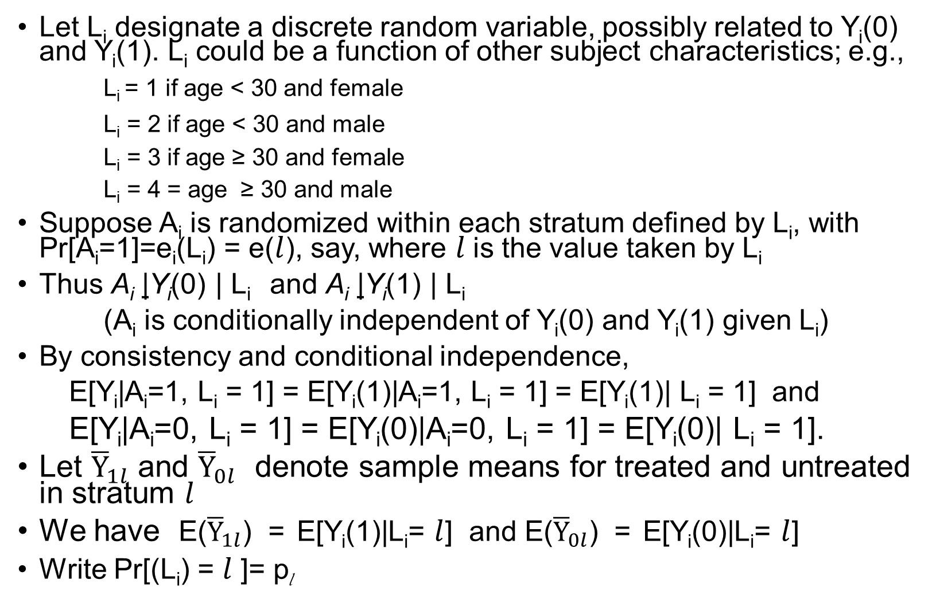
Conditional Randomization (for 2-valued treatments)
Let L_{i} designate a discrete random variable, possibly related to Y_{i}(0) and Y_{i}(1). L_{i} could be a function of other subject characteristics; e.g.,
L_{i} = 1 if age < 30 and female
L_{i} = 2 if age < 30 and male
L_{i} = 3 if age ≥ 30 and female
L_{i} = 4 = age ≥ 30 and male
Suppose A_{i} is randomized within each stratum defined by L_{i}, with Pr[A_{i}=1]=e_{i}(L_{i}) = e($l$), say, where $l$is the value taken by L_{i}
Thus A_{i} |Y_{i}(0) | L_{i} and A_{i} |Y_{i}(1) | L_{i}
(A_{i} is conditionally independent of Y_{i}(0) and Y_{i}(1) given L_{i})
By consistency and conditional independence,
E[Y_{i}|A_{i}=1, L_{i} = 1] = E[Y_{i}(1)|A_{i}=1, L_{i} = 1] = E[Y_{i}(1)| L_{i} = 1] and
E[Y_{i}|A_{i}=0, L_{i} = 1] = E[Y_{i}(0)|A_{i}=0, L_{i} = 1] = E[Y_{i}(0)| L_{i} = 1].
Let ${\overline{Y}}_{1l}$ and ${\overline{Y}}_{0l}$ denote sample means for treated and untreated in stratum $l$
We have E(${\overline{Y}}_{1l}$) = E[Y_{i}(1)|L_{i}= $l$] and E(${\overline{Y}}_{0l}$) = E[Y_{i}(0)|L_{i}= $l$]
Write Pr[(L_{i}) = $l$ ]= p_{l}

Slide 6
Observational Studies
Treatment assignment A is (almost?) never truly random
In fact, treatment assignment A is (almost?) never truly conditionally random
But, perhaps in some cases, we can find covariates X₁, X₂, …, X_{p} such that the treatment assignment is unrelated to baseline factors that predict the outcome for fixed X₁, X₂, …, X_{p}

Slide 7
Stable Unit Treatment Value Assumption (SUTVA)
SUTVA can be expressed as:
Y_{i}(a₁,k₁, a₂,k₂, …, a_{n},k_{n}) = Y_{i}(a_{i})
irrespective of the values of k_{j}, j = 1, 2, …, n, and irrespective of the values of a_{j}, j ≠ i.
In other words, SUTVA asserts that the potential outcome for subject i is not affected by either the mode of delivery of the treatment or by the treatments received by the remaining subjects.
Big simplification: If SUTVA holds, we can express the potential outcome for subject i simply as Y_{i}(a_{i}).
Notes:
SUTVA: Potential outcomes neither depend on the method of treatment nor other subjects’ treatment.

Slide 8
Standard Assumptions of Causal Inference
Conditional Exchangeability: A is statistically independent of Y(1) and Y(0) conditional on X₁, X₂, …, X_{p.}
Conditional independence is often written as
A |Y(1) and A |Y(0) given X₁, X₂, …, X_{p} .
Intuitively, conditional exchangeability implies that the p covariates included in the analysis are sufficient to control confounding
Conditional randomization would imply that A is conditionally independent of all other subject characteristics given X₁, X₂, …, X_{p.}. For causal inferences concerning the effects of A on Y, it is sufficient that A is conditionally independent of Y(1) and Y(0) given X₁, X₂, …, X_{p}.
In other words, conditional randomization is a stronger condition than conditional exchangeability. But conditional exchangeability is enough for the purposes of causal inference.

Slide 9
Illustration of Conditional Exchangeability
Pr(A=1) can depend on
X. However, for any given
X, the subjects with A=1
must be unrelated to Y(1).
The same most hold for
Y(0).
Y(1)
0
1
2
X
A=1
A=0

Slide 10
Standard Assumptions of Causal Inference
Positivity: 0 < Pr(A = 1| X₁, X₂, …, X_{p}) < 1 for all values of X₁, X₂, …, X_{p} that occur in the study population.
Positivity requires that all possible values of the treatment (treated and untreated for the examples we have been considering) may occur for every combination of values for the covariates that occur in the study population
Positivity can be thought of as a type of equipoise condition.
Positivity is not absolutely required when performing causal inference using regression analysis. However, if positivity is violated, the analysis will require extrapolation of the regression model beyond the range of the data, which is very risky and usually is not appropriate.

Slide 11
Illustration of Positivity Assumption
Pr(A=1) must be > 0
but < 1 for each value of X.
Y(1)
0
1
2
X
A=1
A=0

