Slide 1
DECART Summer School 2018:
Causal Inference Module
Matching

Slide 2
Why match?
We need to adjust for covariate $X_{i}$ in observational study, even when the assumption of no unmeasured confounding holds.
Easy solution: Use a parametric model for $E\left(Y_{i}\left(A\right) | X_{i}\right).$
But misspecified parametric model will lead to wrong causal estimates.
Matching is alternative solution with two benefits:
1. Reduces the dependence of estimates on parametric models.
2. Can simplify the analysis of causal effects.
Notes:
Matching is a non-parametric method

Slide 3
Why parametric model failed?
Parametric model will extrapolate to regions with only treated or only control.
Modeling assumption will affect these extrapolation.
Often lead to large variation in the estimates of interest.
Why does this occur?

Slide 4
What matching do?
Just allows for relatively nonparametric ways of estimating the casual effect.
Caution: Matching doesn’t justify a causal effect automatically.
Keep in mind: Without strong design (such as clinical trial), no statistical modeling could completely make the move from correlation to causation persuasive.

Slide 5
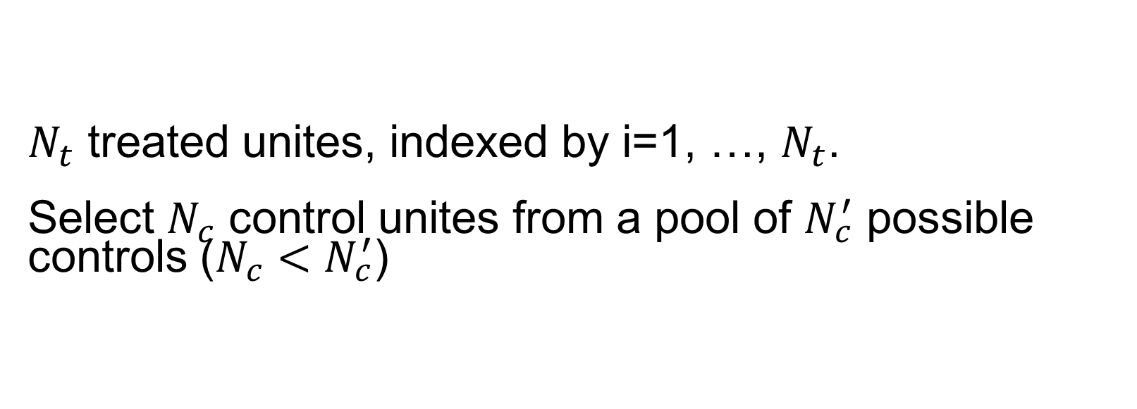
Problem Setup
$N_{t}$ treated unites, indexed by i=1, …, $N_{t}$.
Select $N_{c}$ control unites from a pool of $N_{c}^{′}$ possible controls ($N_{c}<N_{c}^{′}$)

Slide 6
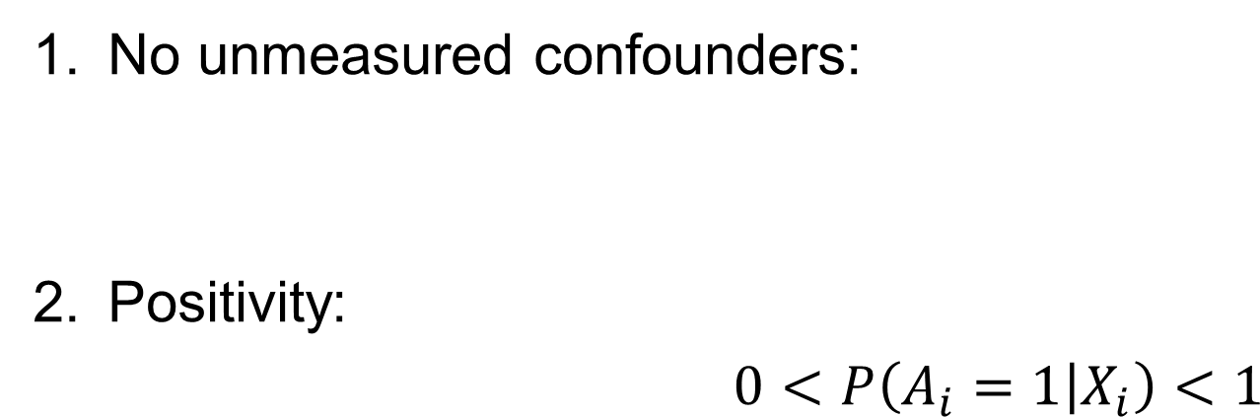

Assumptions
No unmeasured confounders:
Positivity:
$0<P\left(A_{i}=1 | X_{i}\right)<1$
$$A_{i}⊥(Y_{i}\left(0\right), Y_{i}\left(1\right))|X_{i}$$

Slide 7
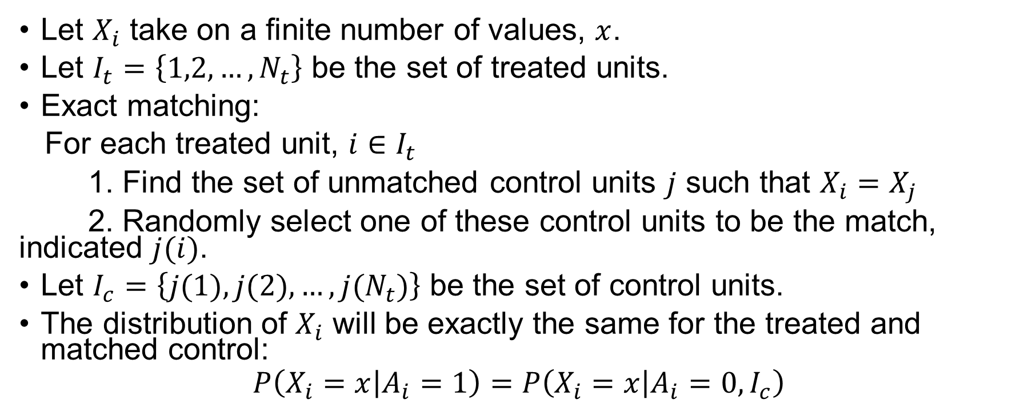
Exact matching
Let $X_{i}$ take on a finite number of values, $x$.
Let $I_{t}=\left\{1,2,…,N_{t}\right\}$ be the set of treated units.
Exact matching:
For each treated unit, $i∈I_{t}$
1. Find the set of unmatched control units $j$ such that $X_{i}=X_{j}$
2. Randomly select one of these control units to be the match, indicated $j(i)$.
Let $I_{c}=\left\{j(1),j(2),…,{j(N}_{t})\right\}$ be the set of control units.
The distribution of $X_{i}$ will be exactly the same for the treated and matched control:
$$P\left(X_{i}=x | A_{i}=1\right)=P\left(X_{i}=x | A_{i}=0, I_{c}\right)$$

Slide 8
Quiz for matching
Q: Please show that if the data is exactly matched, the ATT is identified
$$τ_{ATT}=E\left[Y_{i}\left(1\right) | A_{i}=1\right]−E\left[Y_{i}\left(0\right) | A_{i}=1\right]$$
$=E\left[Y_{i} | A_{i}=1\right]−E\left[Y_{i} | A_{i}=0,I_{c}\right]$
Hints: Use consistency, no unmeasured confounders, iterated expectation and exact matching property.

Slide 9
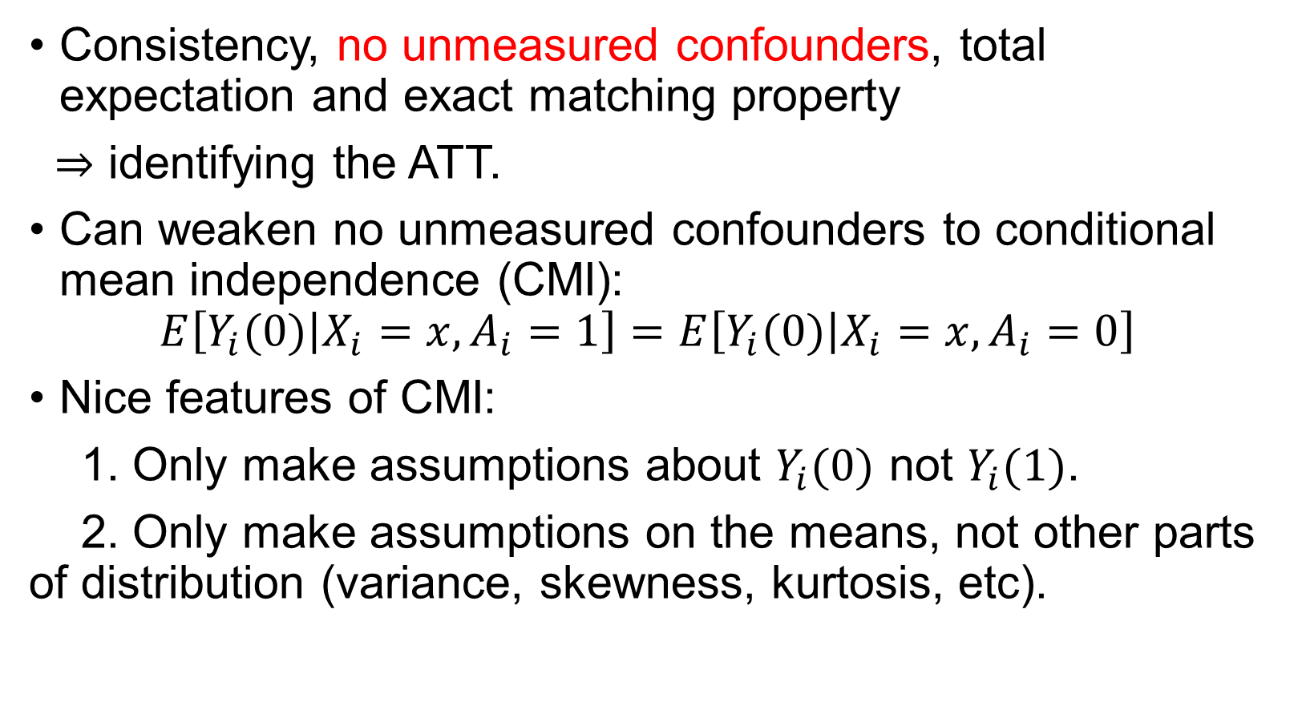
Weakening the identification assumptions
Consistency, no unmeasured confounders, total expectation and exact matching property
$⇒$ identifying the ATT.
Can weaken no unmeasured confounders to conditional mean independence (CMI):
$$E\left[Y_{i}(0) | {X_{i}=x,A}_{i}=1\right]=E\left[Y_{i}(0) | {X_{i}=x,A}_{i}=0\right]$$
Nice features of CMI:
1. Only make assumptions about $Y_{i}(0)$ not $Y_{i}(1)$.
2. Only make assumptions on the means, not other parts of distribution (variance, skewness, kurtosis, etc).

Slide 10
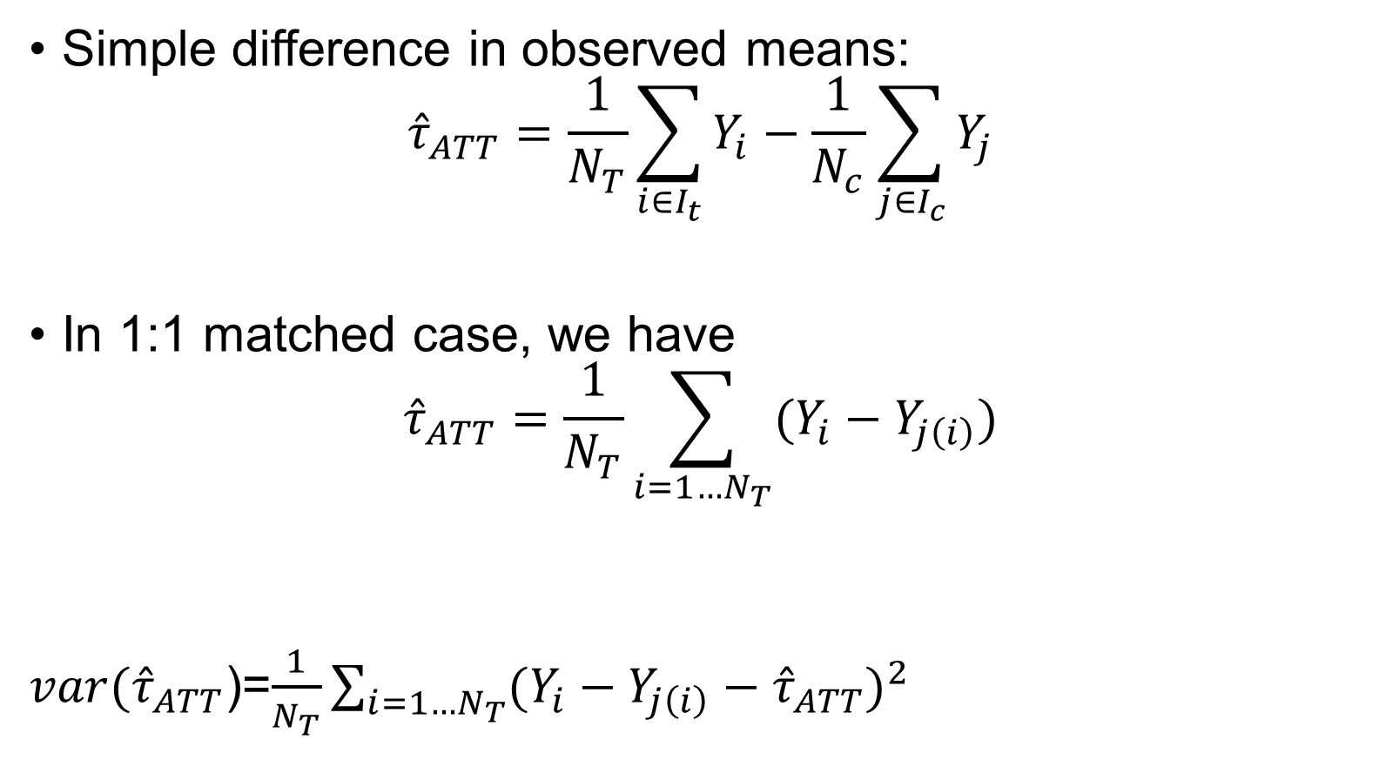
Analyzing exactly matched data
Simple difference in observed means:
$${\hat{τ}}_{ATT}=\frac{1}{N_{T}}\sum_{i∈I_{t}}{Y_{i}}−\frac{1}{N_{c}}\sum_{j∈I_{c}}{Y_{j}}$$
In 1:1 matched case, we have
$${\hat{τ}}_{ATT}=\frac{1}{N_{T}}\sum_{i=1…N_{T}}{(Y_{i}}−Y_{j\left(i\right)})$$
$var({\hat{τ}}_{ATT}$)=$\frac{1}{N_{T}}\sum_{i=1…N_{T}}{{(Y_{i}−Y_{j\left(i\right)}−{\hat{τ}}_{ATT})}^{2}}$

Slide 11
Go beyond exact matching
Exact matching approach is not feasible with high-dimensional $X_{i}$.
Let $𝒮$ be a matching solution: a subset of the data produced by the matching procedure.
If the procedure produces balance:
$A_{i}⊥X_{i}|𝒮$
This implies that no unmeasured confounders holds in that subset:
$(Y_{i}\left(0\right),$ $Y_{i}\left(1\right)$)$⊥A_{i}|𝒮$

Slide 12
The general matching procedure
Choose a number of matches
Choose a distance metric
Find matches (drop non-matches)
Check balance
Repeat 1-4 until balance is acceptable
Calculate the effect of the treatment on the outcome in the matched dataset.

Slide 13
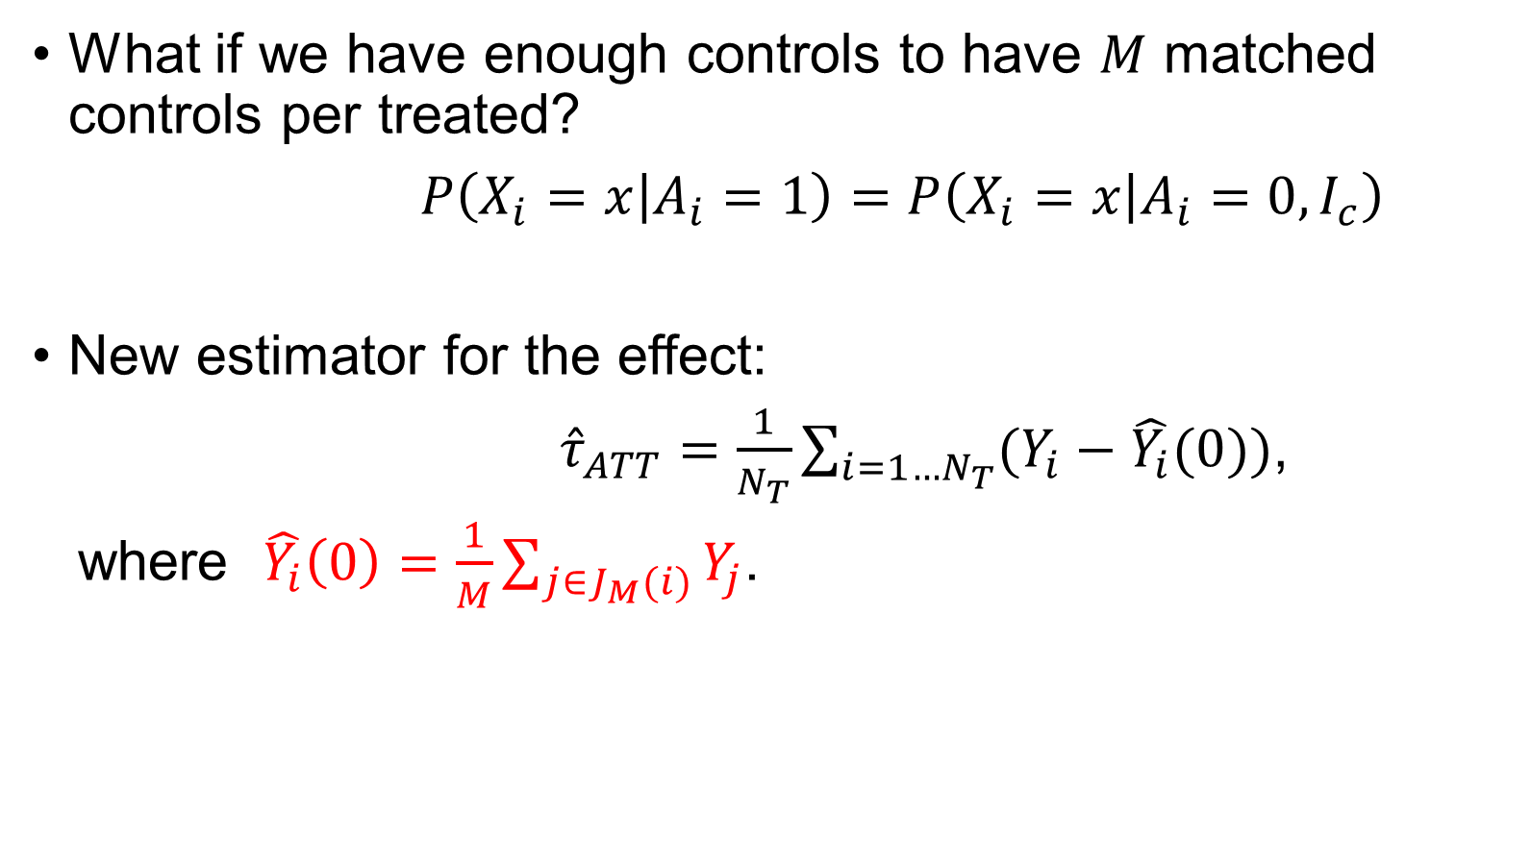
More than 1 control match
What if we have enough controls to have $M$ matched controls per treated?
$P\left(X_{i}=x | A_{i}=1\right)=P\left(X_{i}=x | A_{i}=0, I_{c}\right)$
New estimator for the effect:
${\hat{τ}}_{ATT}=\frac{1}{N_{T}}\sum_{i=1…N_{T}}{(Y_{i}}−\hat{Y_{i}}(0))$,
where $\hat{Y_{i}}\left(0\right)=\frac{1}{M}\sum_{j∈J_{M}(i)}{Y_{j}}$.
Notes:
We average among M controls corresponding to each treated then compute the ATT in a similar as 1 to 1 matching.

Slide 14
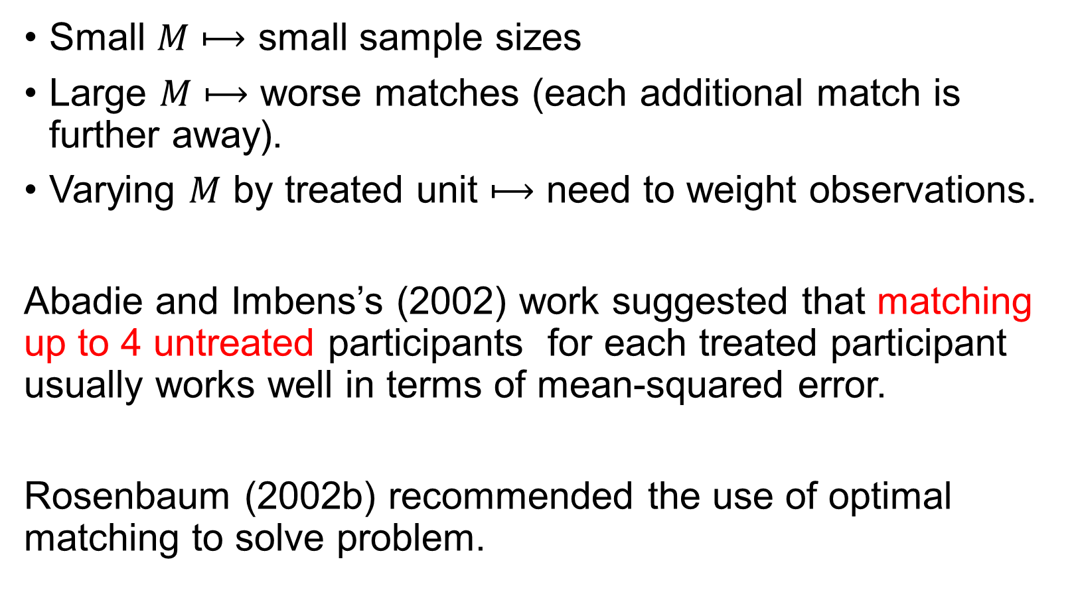
How many $M$ should we include?
Small $M$ $⟼$ small sample sizes
Large $M$ $⟼$ worse matches (each additional match is further away).
Varying $M$ by treated unit $⟼$ need to weight observations.
Abadie and Imbens’s (2002) work suggested that matching up to 4 untreated participants for each treated participant usually works well in terms of mean-squared error.
Rosenbaum (2002b) recommended the use of optimal matching to solve problem.

Slide 15
With or without replacement
Matching with replacement: a single control unit could be matched repeatedly with multiple treated units.
Pro:
1. Better matches!
2. Order of matching does not matter.
Con:
1. need more complicated inference.
2. need to account for multiple appearances with weights.
3. potentially higher uncertainty (using the same data multiple times=relying on less data)

Slide 16
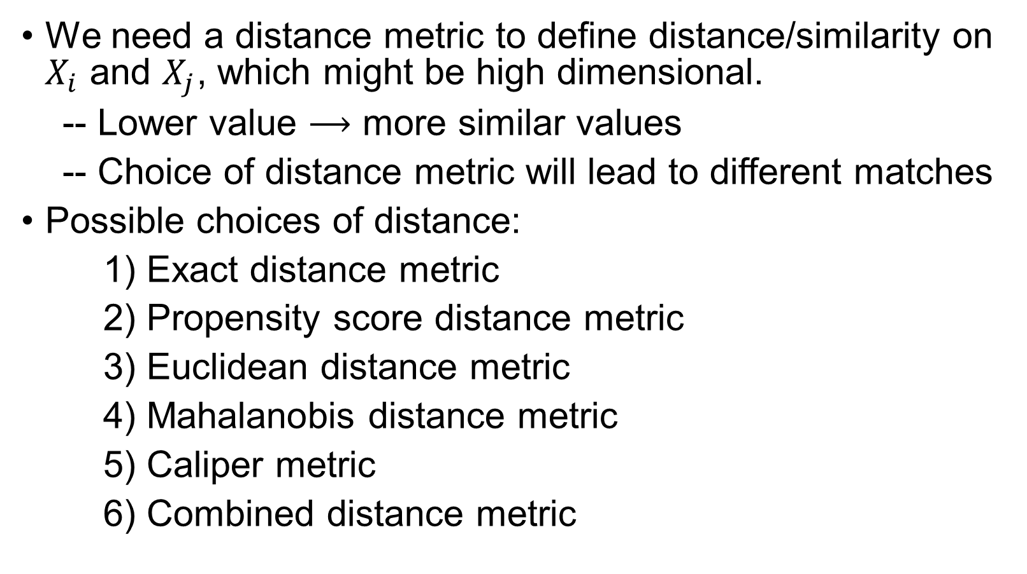
Distance metrics
We need a distance metric to define distance/similarity on $X_{i}$ and $X_{j}$, which might be high dimensional.
-- Lower value $⟶$ more similar values
-- Choice of distance metric will lead to different matches
Possible choices of distance:
1) Exact distance metric
2) Propensity score distance metric
3) Euclidean distance metric
4) Mahalanobis distance metric
5) Caliper metric
6) Combined distance metric

Slide 17
Exact distance metric
Only match units to other units that have the same exact values of $X_{i}$.
$D_{ij}=\left\{\begin{aligned}0 \\ ∞\end{aligned}\right.$ $\begin{matrix}if X_{i}=X_{j} \\ if X_{i}≠X_{j}\end{matrix}$

Slide 18
Propensity score distance
Propensity score: $e\left(X_{i}\right)=P(A_{i}=1|X_{i})$
Rubin et al have shown that propensity score matching has good properties if covariates are roughly normal.
Propensity score distance:
Option 1: $D_{ij}=\left|e\left(X_{i}\right)−e\left(X_{j}\right)\right|$
Option 2: $D_{ij}=\left|logit(e\left(X_{i}\right))−logit(e\left(X_{j}\right))\right|$
Notes:
Option 2 is preferred.

Slide 19
Euclidean distance
Suppose that $X_{i}=(X_{i1},…,X_{iK}).$
The Euclidean distance metric is
$D_{ij}=\sqrt{\sum_{k=1}^{K}{\frac{{\left(X_{ik}−X_{jk}\right)}^{2}}{{\hat{σ}}_{k}^{2}}}}$ ,
where ${\hat{σ}}_{k}^{2}=\frac{1}{N−1}\sum_{i=1}^{N}{{(X_{ik}−{\overline{X}}_{k})}^{2}}$.

Slide 20
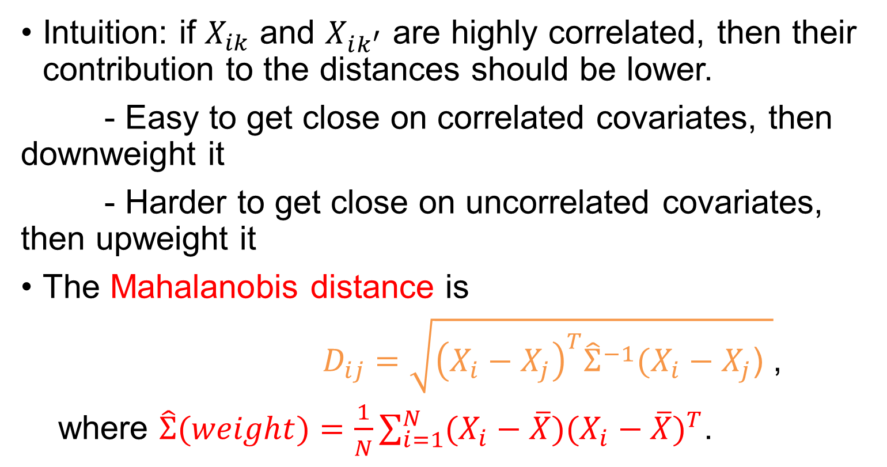
Mahalanobis distance
Intuition: if $X_{ik}$ and $X_{ik^{′}}$ are highly correlated, then their contribution to the distances should be lower.
- Easy to get close on correlated covariates, then downweight it
- Harder to get close on uncorrelated covariates, then upweight it
The Mahalanobis distance is
$D_{ij}=\sqrt{{\left(X_{i}−X_{j}\right)}^{T}{\hat{Σ}}^{−1}(X_{i}−X_{j}\text{)} }$,
where $\hat{Σ}(weight)=\frac{1}{N}\sum_{i=1}^{N}{(X_{i}−\overline{X}){(X_{i}−\overline{X})}^{T}}$.
Notes:
The weight is a variance-covariance matrix, and if data are correlated, the determinant of the matrix will be larger than the variance then will be smaller if we take the reciprocal, so “downweight”.

Slide 21
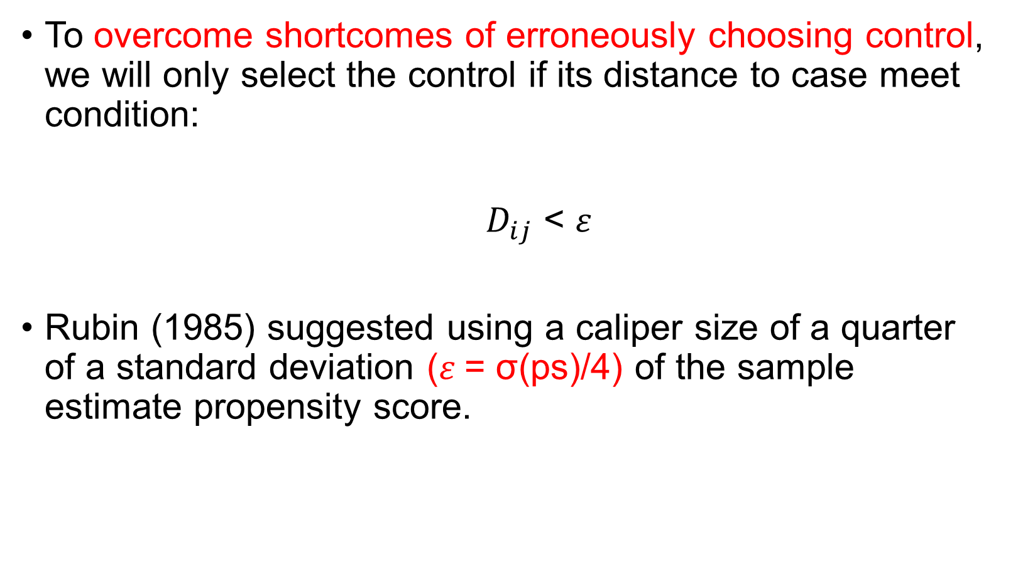
Caliper
To overcome shortcomes of erroneously choosing control, we will only select the control if its distance to case meet condition:
$D_{ij}$ < $ε$
Rubin (1985) suggested using a caliper size of a quarter of a standard deviation ($ε$= σ(ps)/4) of the sample estimate propensity score.

Slide 22
Hybrid metrics
Example:
Exact on race/gender, Mahalanobis on the rest.

Slide 23
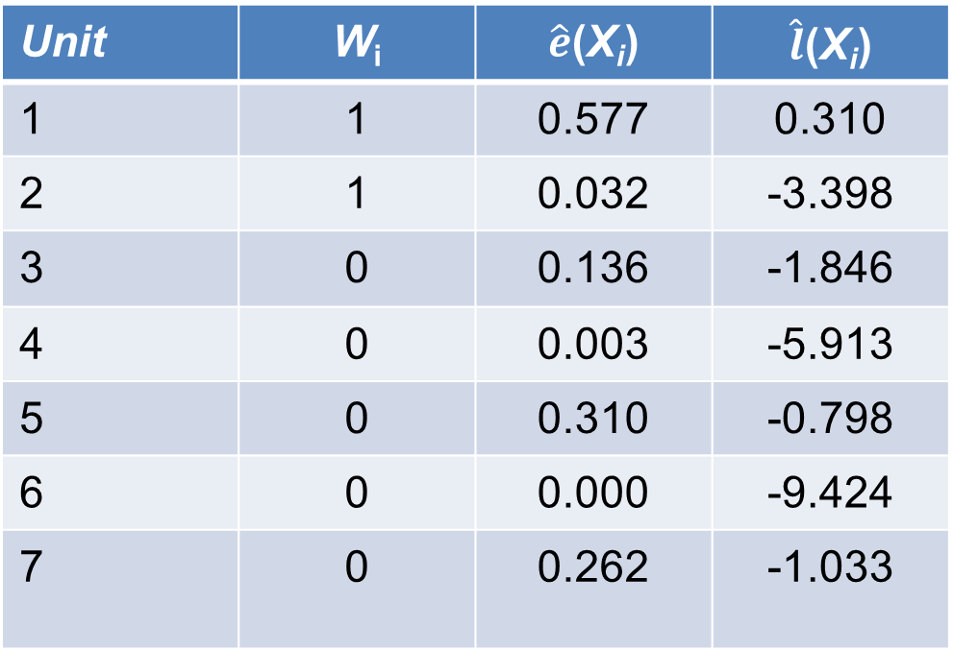
An Illustration of Propensity Score Matching
Some Units from the Barbituate Dataset
Using Estimated lps
Unit 1 matches to {3,4,5,6,7}
Unit 1 --》 Unit 5
Unit 2 matches to {3,4,6,7}
Unit 2 --》 Unit 3
Unit | W_{i} | $\hat{e}$(X_{i}) | $\hat{l}$(X_{i})
1 | 1 | 0.577 | 0.310
2 | 1 | 0.032 | -3.398
3 | 0 | 0.136 | -1.846
4 | 0 | 0.003 | -5.913
5 | 0 | 0.310 | -0.798
6 | 0 | 0.000 | -9.424
7 | 0 | 0.262 | -1.033

Slide 24
Matching approach
Now we have distances between all units, we just need to match!
For a particular unit, the nearest neighbor matching try to find the control unit with the smallest distance metric, $j\left(i\right)=argmin(D_{ij})$.
Do the same for all treated units.
What about ties? Randomly choose between them.
Main issue: order effect
Optimal matching: find the matching solution that minimize overall distance $\sum_{i=1}^{N_{t}}{D_{ij(i)}}$.
Notes:
Different order to match the treated subjects yields different matching scheme.

Slide 25
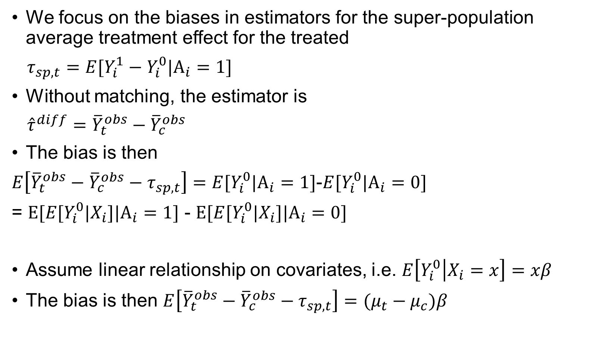
Theoretical Consideration
We focus on the biases in estimators for the super-population average treatment effect for the treated
$τ_{sp,t}=E[Y_{i}^{1}−Y_{i}^{0}|A_{i}=1]$
Without matching, the estimator is
${\hat{τ}}^{diff}={\overline{Y}}_{t}^{obs}−{\overline{Y}}_{c}^{obs}$
The bias is then
$E\left[{\overline{Y}}_{t}^{obs}−{\overline{Y}}_{c}^{obs}−τ_{sp,t}\right]=E[Y_{i}^{0}|A_{i}=1]$-$E[Y_{i}^{0}|A_{i}=0]$
= $E[E[Y_{i}^{0}|X_{i}]|A_{i}=1]$ - $E[E[Y_{i}^{0}|X_{i}]|A_{i}=0]$
Assume linear relationship on covariates, i.e. $E\left[Y_{i}^{0} | X_{i}=x\right]=xβ$
The bias is then $E\left[{\overline{Y}}_{t}^{obs}−{\overline{Y}}_{c}^{obs}−τ_{sp,t}\right]=(μ_{t}−μ_{c})β$

Slide 26
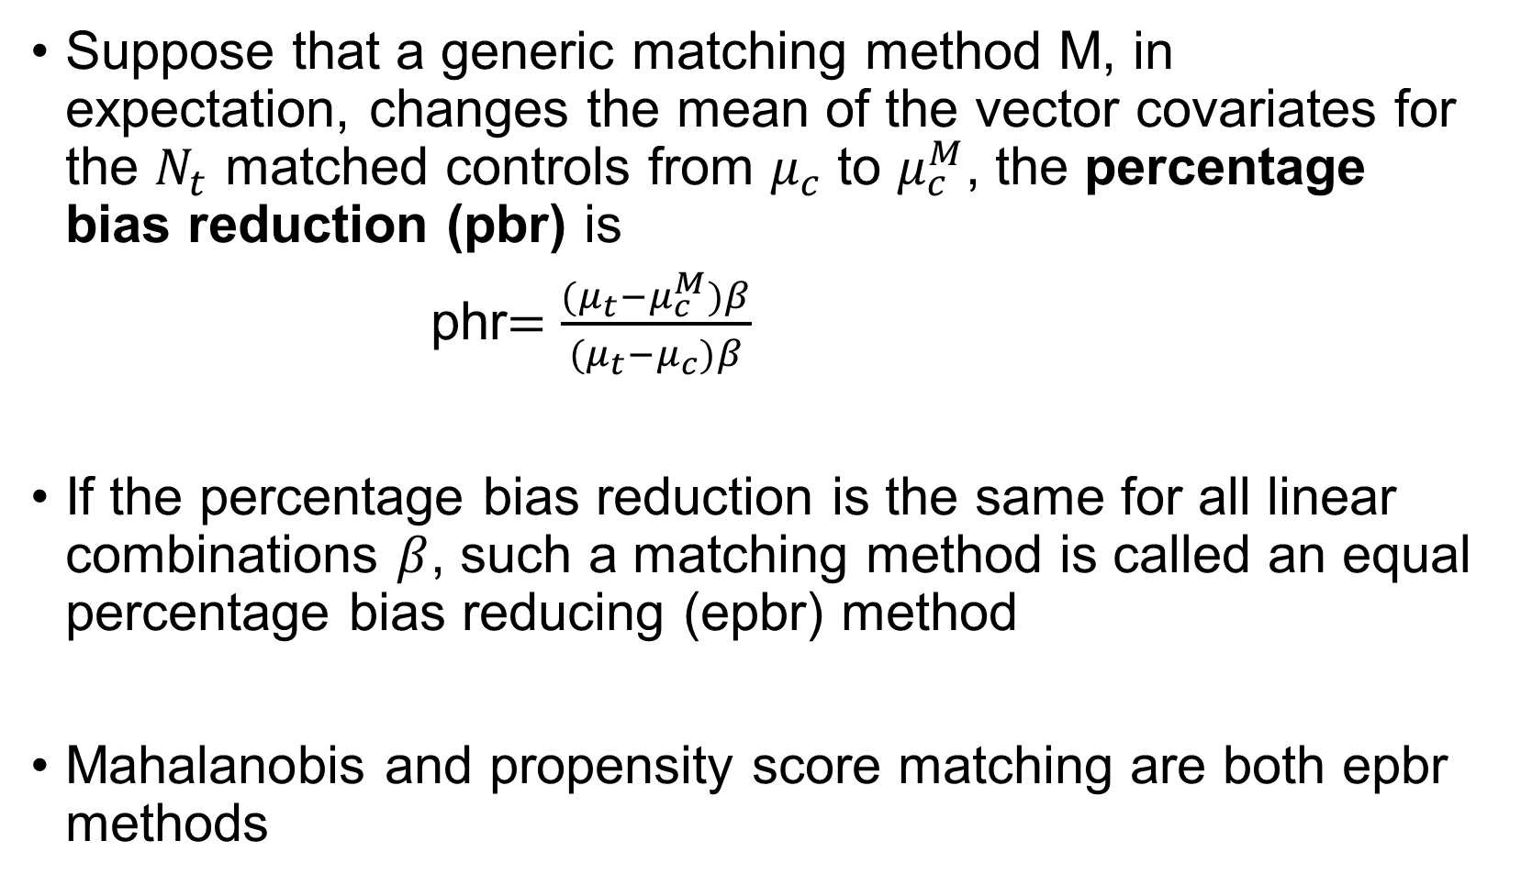
Theoretical Consideration
Suppose that a generic matching method M, in expectation, changes the mean of the vector covariates for the $N_{t}$ matched controls from $μ_{c}$ to $μ_{c}^{M}$, the percentage bias reduction (pbr) is
phr$=\frac{(μ_{t}−μ_{c}^{M})β}{(μ_{t}−μ_{c})β}$
If the percentage bias reduction is the same for all linear combinations $β$, such a matching method is called an equal percentage bias reducing (epbr) method
Mahalanobis and propensity score matching are both epbr methods

Slide 27
Assessing balance
All matching methods seek to find the balance:
$P\left(X_{i}=x | A_{i}=1,𝒮\right)=P\left(X_{i}=x | A_{i}=0,𝒮\right)$
Choice of balance metric will determine which matching method does better.
Options: estimation of matching performance
1. Differences in mean/medians, standardized.
2. QQ plot/K-S statistics for comparing the entire distribution.
3. multivariate histogram ??
Notes:
“s” stands for the matching schema
Shapiro–Wilk test or Anderson–Darling test are more powerful than K-S test in testing normality.
Why do we need QQ plot? Testing normality? Two sample K-S test?
K-S test can be used to test how close the distribution of one sample is to the reference distribution (CDF), and it is also used for comparing the distribution of two samples’ distribution, it is sensitive to both shape and scale parameters.
QQ plot is a better way to check the matching performance in the sense of more straightforward and doesn’t depend on sample size. We can plot the distribution of treated and untreated on x and y axis separately, and see if they overlap on the 45 degree line.

Slide 28
Estimand
Matching easiest to justify for the ATT.
Can also justify the ATU by finding matched treated units for the controls.
Combined the two to get ATE:
$τ=τ_{ATT}P\left(A_{i}=1\right)+τ_{ATU}P\left(A_{i}=0\right)$
Estimated:
$\hat{τ}={\hat{τ}}_{ATT}\left(\frac{N_{t}}{N}\right)+{\hat{τ}}_{ATU}\left(\frac{N_{c}}{N}\right)$
Notes:
Matching discrepancy ???

