Slide 1
DECART Summer School 2018:
Causal Inference Module
Mediation Analysis

Slide 2
Mediation Analysis Outline
Mediation and Moderation
Counterfactual framework for mediation
Controlled direct effects
Natural direct and indirect effects
Assumptions
Design considerations
Mediation analysis methods for standard models with a single mediator
Continuous mediator, continuous outcome
Continuous mediator, binary outcome
Binary mediator, binary outcome
Paradoxes and sensitivity analyses
Multiple mediators

Slide 3
Mediation Analysis References
VanderWeele, Tyler. Explanation in causal inference: methods for mediation and interaction. Oxford University Press, 2015.
Baron, R. M., & Kenny, D. A. (1986). The moderator–mediator variable distinction in social psychological research: Conceptual, strategic, and statistical considerations. Journal of Personality and Social Psychology, 5, 1173–1182

Slide 4
Mediation and Moderation
Mediation: Addresses how a treatment affects the outcome
Mechanisms or pathways by which a treatment affects outcome
Goals include a) scientific explanation and understanding, b) refining an intervention by discarding ineffective components of the intervention and focusing on effective components, c) evaluating the extent to which a detrimental effect of an exposure on an outcome can be blocked by intervening on the mediator

Slide 5
Mediation and Moderation
Effect Moderation: In whom does the treatment affect the outcome
Or, more generally, what is the effect of the treatment on the outcome in different subgroups
Key pragmatic goal is to define which patients will benefit the most from a treatment (or be harmed the most by an exposure)
Can also provide insights regarding mechanism
Notes:
Moderation is basically saying the interaction term is not 0, and mediation means the NIE is not 0.

Slide 6
Examples of Questions Addressed by Median Analyses
A genetic variation has been shown to be associated both with smoking behavior and with lung cancer.
Do the variants affect lung cancer only because they affect smoking behavior, or do the variants affect lung cancer in part by other pathways not related to smoking?
Low SES during childhood is associated with both low SES later in life and with adverse health outcomes later in life.
Does low childhood SES affect later health outcomes only because it affects SES later in life which in turn affects later health outcomes, or does childhood SES affect adult health outcomes through other pathways, not related to adult SES, or some combination of both?

Slide 7
Examples of Questions Addressed by Median Analyses
Preeclamspia during pregnancy has been shown to be associated both with premature birth and with retinopathy of prematurity (ROP).
Does preeclampsia adversely affect ROP only because it leads to premature birth, or does preeclampsia also affect ROP by other pathways, not related specifically to premature birth?
A clinical trial is being design to determine if the drug topiramate improves quality of life of patients with peripheral neuropathy.
A mediation analysis is included in the study protocol to evaluate if the effect of topiramate on QOL results solely due to its affect on progression of neuropathy, or whether topiramate also affects QOL by other mechanisms, such as effects of the drug on pain or risk of falls

Slide 8
DAG for Simple Mediation Analysis
Indirect
Effect
Putative
Mediator
Treatment or
Exposure
Outcome
Direct
Effect
What is missing from this DAG?

Slide 9
DAG for Simple Mediation Analysis
C3
C2
C3
C3
Putative
Mediator
Putative
Mediator
Putative
Mediator
Treatment or
Exposure
Outcome
C1

Slide 10
Counterfactual Notation and Framework
A = treatment or exposure
M = putative mediator
Y = outcome
Let Y(a,m) denote the potential outcome for Y if A is set to a and M is set to M
Let M(a) denote the potential outcome for M if A is set to a

Slide 11
Counterfactual Notation and Framework
The controlled direct effect (CDE) represents the effect of changing A from a* to a on Y while intervening to fix M at a fixed value m. The individual controlled direct effect of changing A to a from a* at m is:
CDE(m) = Y(a,m) – Y(a*,m)
The average CDE in the population is E[Y(a,m) – Y(a*,m)]
The average CDE conditional on covariates C = c is E[Y(a,m) – Y(a*,m) | c]
The natural direct effect (NDE) represents the effect of changing A from a* to a on Y while intervening to fix M at the value M(a*) that M would have had if A had been a*. The natural direct effect is defined as:
NDE = Y(a,M(a*)) – Y(a*,M(a*))
The average NDE in the population is E[Y(a,M(a*)) – Y(a*,M(a*))]
The average NDE conditional on covariates C = c is
E[Y(a,M(a*)) – Y(a*,M(a*)) | c]

Slide 12
Counterfactual Notation and Framework
The natural indirect effect (NIE) represents the effect of comparing fixing the mediator to M(a) vs. M(a*) while intervening to set the exposure to A = a. The individual NIE is defined as:
NIE = Y(a,M(a)) - Y(a,(M(a*))
A non-zero NIE requires first that the exposure affects the mediator, and then that changing the mediator while holding the exposure constant affects the outcome.
The average NIE in the population is:
E[Y(a,M(a)) - Y(a, M(a*))]
The average NIE conditional on covariates C = c is
E[Y(a,M(a)) - Y(a, M(a*)) | c]

Slide 13
Decomposition of Total Effect
Total Effect = Y(a,M(a)) – Y(a*,M(a*)
[Y(a,M(a)) – Y(a,M(a*)] + [Y(a,M(a*) – Y(a*,M(a*)]
Corresponding decompositions for population average and conditional average versions of these effects
Natural Indirect effect
Natural Direct effect

Slide 14
Counterfactual Notation and Framework
Describe the CDE, NDE, and NIE for the genetic variant, smoking and lung cancer example
Notes:
Practice with four examples on how to express these three causal effects in good English.

Slide 15
Assumptions for Effect Estimates to Have Causal Interpretation
To estimate the controlled direct effect:
A1) No unmeasured confounding for exposure-outcome relationship
A2) No unmeasured confounding for mediator-outcome relationship
To estimate natural direct and indirect effects:
A3) No unmeasured confounding for exposure-mediator relationship
A4) No confounder of the mediator-outcome relationship is affected by the exposure

Slide 16
DAG for Simple Mediation Analysis
A3: Covariates in C3 are sufficient to control for confounding between exposure and mediator
A4: No arrow from Exposure to C2
C3
C2
A2: Covariates in C2 are sufficient to control for confounding between mediator and outcome
Putative
Mediator
Exposure
Outcome
C1
A1: Covariates in C1 are sufficient to control for confounding between exposure and outcome

Slide 17
Counterfactual Notation and Framework
Describe A1, A2, A3, and A4 for the genetic variant, smoking and lung cancer example

Slide 18
No-Confounding Assumptions to Estimate Causal Effects
Type of Effect | RCT | Observational Study
Natural Direct and Indirect Effects | A2, A4 | A1, A2, A3, A4
Controlled Direct Effect | A2 | A1, A2
Total Effect | None | A1 Only
A1) No unmeasured confounding for exposure-outcome relationship
A2) No unmeasured confounding for mediator-outcome relationship
A3) No unmeasured confounding for exposure-mediator relationship
A4) No confounder of the mediator-outcome relationship is affected by the exposure
Notes:
Why A4 assumption doesn’t matter in CDE? Read Tyler’s book.

Slide 19
Design Considerations
Usually, mediation assumptions are best justified if:
Baseline levels of mediator and outcome are obtained, and either controlled for as covariates or used so that the mediator and outcome are expressed as pre-post differences
Measurements of exposure, mediator and outcome follow the time ordering 1) exposure, 2) mediator, 3) outcome
The mediator is assed relatively soon after the occurrence of the exposure, and well before the outcome
Notes:
When mediator comes soon after treatment, we are less worried about A2 and A4 assumptions.

Slide 20
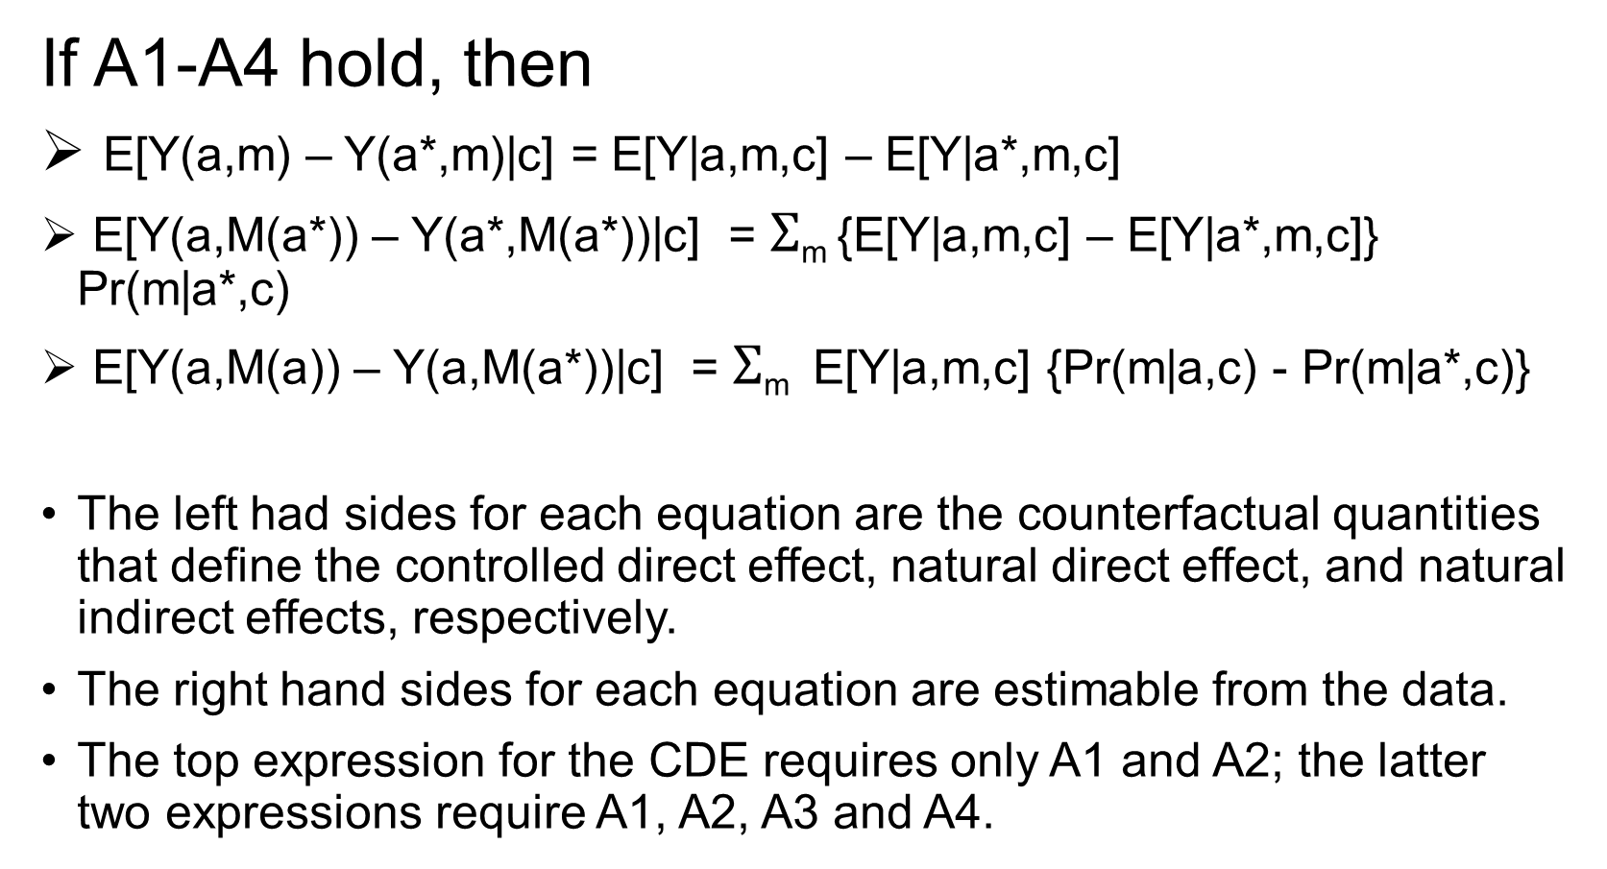
Non-Parametric Causal Effect Estimates
If A1-A4 hold, then
E[Y(a,m) – Y(a*,m)|c] = E[Y|a,m,c] – E[Y|a*,m,c]
E[Y(a,M(a*)) – Y(a*,M(a*))|c] = $Σ$_{m} {E[Y|a,m,c] – E[Y|a*,m,c]} Pr(m|a*,c)
E[Y(a,M(a)) – Y(a,M(a*))|c] = $Σ$_{m} E[Y|a,m,c] {Pr(m|a,c) - Pr(m|a*,c)}
The left had sides for each equation are the counterfactual quantities that define the controlled direct effect, natural direct effect, and natural indirect effects, respectively.
The right hand sides for each equation are estimable from the data.
The top expression for the CDE requires only A1 and A2; the latter two expressions require A1, A2, A3 and A4.

Slide 21
Mediation Analysis with Linear Models (Continuous Outcomes and Continuous Mediators)
Standard errors using delta method or bootstrap
No-Interaction Model:
E(M|A=a,C=c) = β₀ + β₁a + β₂ c
E(Y|A=a,M=m,C=c) = θ₀ + θ₁a + θ₂m + θ₄ c
CDE(m) = θ₁ (a – a*)
NDE = θ₁ (a – a*)
NIE = β₁ θ₂ (a – a*)

Slide 22
Mediation Analysis with Linear Models (Continuous Outcomes and Continuous Mediators)
Standard errors using delta method or bootstrap
Interaction Model:
E(M|A=a,C=c) = β₀ + β₁a + β₂ c
E(Y|A=a,M=m,C=c) = θ₀ + θ₁a + θ₂m + θ₃a•m + θ₄ c
CDE(m) = (θ₁ + θ₃ m) (a – a*)
NDE = (θ₁ + θ₃ • [β₀ + β₁a* + β₂ c ]) (a – a*)
NIE = (β₁ θ₂ + β₁ θ₃ a) (a – a*)
Notes:
Tyler recommends always include the interaction in the model

Slide 23
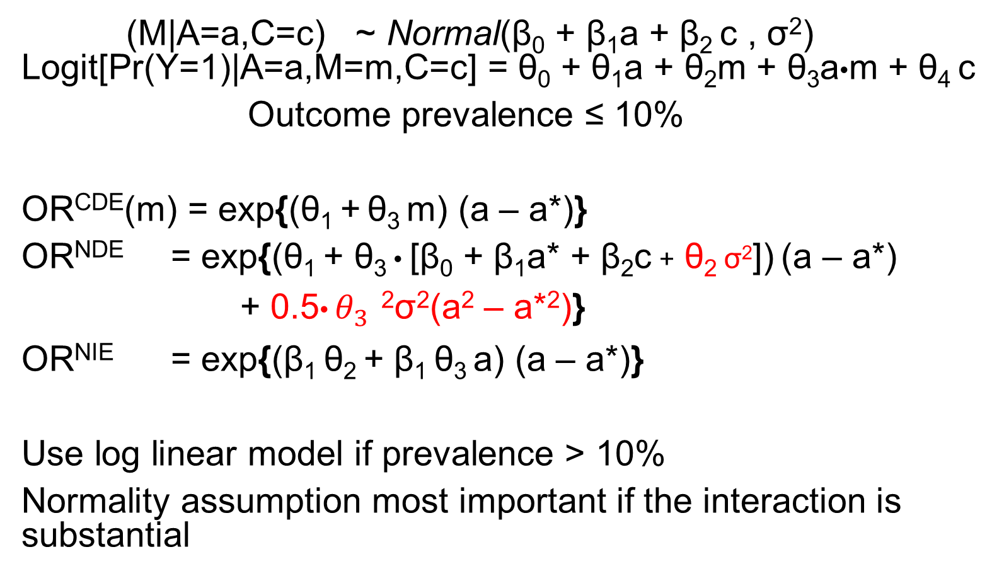
Mediation Analysis with Continuous Mediator and Binary Outcome
Standard errors using delta method or bootstrap
(M|A=a,C=c) ~ Normal(β₀ + β₁a + β₂ c , σ²) Logit[Pr(Y=1)|A=a,M=m,C=c] = θ₀ + θ₁a + θ₂m + θ₃a•m + θ₄ c
Outcome prevalence ≤ 10%
OR^{CDE}(m) = exp{(θ₁ + θ₃ m) (a – a*)}
OR^{NDE} = exp{(θ₁ + θ₃ • [β₀ + β₁a* + β₂c + θ₂ σ²]) (a – a*)
+ 0.5${\text{•} θ}_{3}^{}$²σ²(a² – a*²)}
OR^{NIE} = exp{(β₁ θ₂ + β₁ θ₃ a) (a – a*)}
Use log linear model if prevalence > 10%
Normality assumption most important if the interaction is substantial

Slide 24
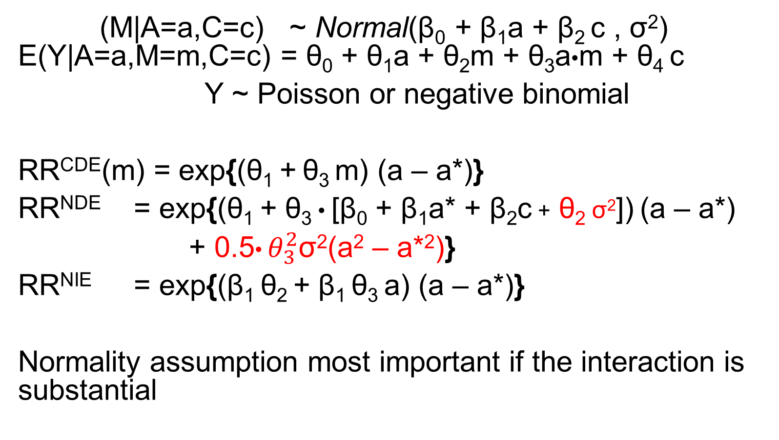
Mediation Analysis with Continuous Mediator and Count Outcome
Standard errors using delta method or bootstrap
(M|A=a,C=c) ~ Normal(β₀ + β₁a + β₂ c , σ²) E(Y|A=a,M=m,C=c) = θ₀ + θ₁a + θ₂m + θ₃a•m + θ₄ c
Y ~ Poisson or negative binomial
RR^{CDE}(m) = exp{(θ₁ + θ₃ m) (a – a*)}
RR^{NDE} = exp{(θ₁ + θ₃ • [β₀ + β₁a* + β₂c + θ₂ σ²]) (a – a*)
+ 0.5${\text{•} θ}_{3}^{2}$σ²(a² – a*²)}
RR^{NIE} = exp{(β₁ θ₂ + β₁ θ₃ a) (a – a*)}
Normality assumption most important if the interaction is substantial
Notes:
The formula depends on normality assumption, but if the moderation is not very strong, it doesn’t affect too much if the normality doesn’t hold

Slide 25
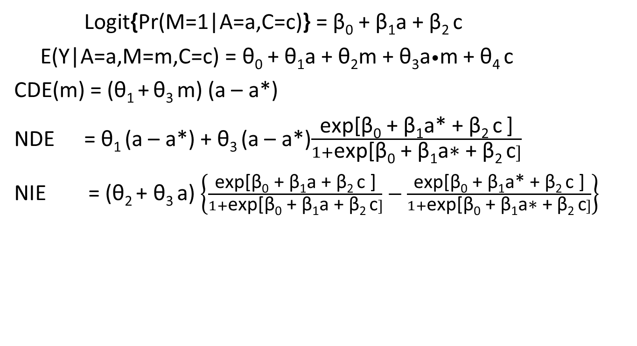
Mediation Analysis with Continuous Outcome and Binary Mediatory
Standard errors using delta method or bootstrap
Logit{Pr(M=1|A=a,C=c)} = β₀ + β₁a + β₂ c
E(Y|A=a,M=m,C=c) = θ₀ + θ₁a + θ₂m + θ₃a•m + θ₄ c
CDE(m) = (θ₁ + θ₃ m) (a – a*)
NDE = θ₁ (a – a*) + θ₃ (a – a*)$\frac{\text{exp}\text{[}\text{β}\text{0}\text{ + }\text{β}\text{1}\text{a}\text{∗ + }\text{β}\text{2 }\text{c} \text{]}}{1+\text{exp}\text{[}\text{β}\text{0}\text{ + }\text{β}\text{1}\text{a}\text{∗ + }\text{β}\text{2 }\text{c}]}$
NIE = (θ₂ + θ₃ a) $\left\{\frac{\text{exp}\text{[}\text{β}\text{0}\text{ + }\text{β}\text{1}\text{a}\text{ + }\text{β}\text{2 }\text{c}\text{ ]}}{1+\text{exp}\text{[}\text{β}\text{0}\text{ + }\text{β}\text{1}\text{a}\text{ + }\text{β}\text{2 }\text{c}]}−\frac{\text{exp}\text{[}\text{β}\text{0}\text{ + }\text{β}\text{1}\text{a}\text{∗ + }\text{β}\text{2 }\text{c}\text{ ]}}{1+\text{exp}\text{[}\text{β}\text{0}\text{ + }\text{β}\text{1}\text{a}\text{∗ + }\text{β}\text{2 }\text{c}]}\right\}$

Slide 26
Other Measures
Difference method for estimation of the indirect effect in no-interaction model: Fit two regression models:
(1) E(Y|A=a,M=m,C=c) = θ₀ + θ₁a + θ₂m + θ₄ c
(2) E(Y|A=a, C=c) = θ’₀ + θ’₁a + θ’₄ c
Indirect effect is taken as θ’₁ - θ_{1.}
Product and difference methods coincide for linear models with continuous outcomes.
Proportion mediated: PM = NIE/TE
Proportion explained: PE(m) = (TE – CDE(m))/TE
Notes:
With linear model and no interaction, we have above. The CDE is same as NDE if the assumption hold (linear model + no interaction), so TE-CDE(m) is also the indirect effect.

Slide 27
Software for Mediation Analyses Using Causal Inference Perspective
Mediation macro in SAS
(Valeri and VanderWeele, 2013)
Mediation script in SPSS
paramed package in STATA
“mediation” package in R

Slide 28
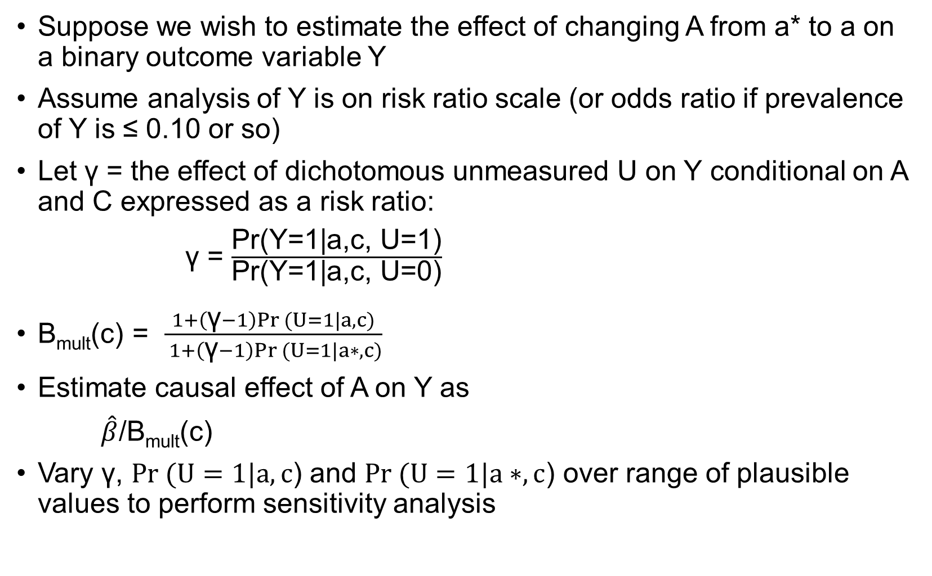
Sensitivity Analysis
Suppose we wish to estimate the effect of changing A from a* to a on a binary outcome variable Y
Assume analysis of Y is on risk ratio scale (or odds ratio if prevalence of Y is ≤ 0.10 or so)
Let γ = the effect of dichotomous unmeasured U on Y conditional on A and C expressed as a risk ratio:
γ = $\frac{\text{Pr}\text{(}\text{Y}\text{=1|}\text{a}\text{,}\text{c}\text{, }\text{U}\text{=1)}}{\text{Pr}\text{(}\text{Y}\text{=1|}\text{a}\text{,}\text{c}\text{, }\text{U}\text{=0)}}$
B_{mult}(c) = $\frac{1+\left(\text{γ}−1\right)Pr (U=1|a,c)}{ 1+\left(\text{γ}−1\right)Pr (U=1|a∗,c)}$
Estimate causal effect of A on Y as
$\hat{β}$/B_{mult}(c)
Vary γ, $Pr (U=1|a,c$) and $Pr (U=1|a∗,c$) over range of plausible values to perform sensitivity analysis

Slide 29
Multiple Mediators
Suppose the confounding assumptions A1-A4 hold for the vector of mediators M = (M⁽¹⁾, …, M^{(K)}) and the M and Y are continuous variables that satisfy:
E[Y|a,m,c] = θ₀ + θ₁ + θ₂⁽¹⁾ m⁽¹⁾ + θ₂⁽²⁾m⁽²⁾ + … + θ₂^{(K)}m^{(K)}+ θ₄ c
E[M^{(i)}|a,c] = β₀^{(i)} + β₁^{(i)} a + β₂^{(i)} c, i = 1, 2, …, K.
Then overall CDE, NDE, and NIE’s are given by:
CDE(m) = θ₁(a – a*)
NDE = θ₁(a – a*)
NIE = [β₁⁽¹⁾ θ₂⁽¹⁾ + β₁⁽²⁾ θ₂⁽²⁾ + β₁^{(K)} θ₂^{(K)} ](a – a*)
Note (1): If there is a confounder C* of a mediator and outcome which is influenced by the treatment, this can be addressed in the multiple mediator framework by adding the confounder to the list of mediators M.
Note (2): On the other hand, Assumptions A1-A4 must now hold for K different mediators, which is harder to justify than that Assumptions A1-A4 hold for a single mediator.

Slide 30
Multiple Mediators
Suppose the confounding assumptions A1-A4 hold for the vector of mediators M = (M⁽¹⁾, …, M^{(K)}) and the M and Y are continuous variables that satisfy:
E[Y|a,m,c] = θ₀ + θ₁ + θ₂⁽¹⁾ m⁽¹⁾ + θ₂⁽²⁾m⁽²⁾ + … + θ₂^{(K)}m^{(K)}+ θ₄ c
E[M^{(i)}|a,c] = β₀^{(i)} + β₁^{(i)} a + β₂^{(i)} c, i = 1, 2, …, K.
Then overall CDE, NDE, and NIE’s are given by:
CDE(m) = θ₁(a – a*)
NDE = θ₁(a – a*)
NIE = [β₁⁽¹⁾ θ₂⁽¹⁾ + β₁⁽²⁾ θ₂⁽²⁾ + β₁^{(K)} θ₂^{(K)} ](a – a*)
Note (3): If there is a multiplicative linear interaction between a and M^{(i)} given by addition of θ₃^{(i)}m^{(i)} on the RHS of E[Y|a,m,c], then add θ₃^{(i)}m^{(i)} (a – a*) to the CDE, θ₃^{(i)}[β₀^{(i)} + β₁^{(i)} a* + β₂^{(i)} c] (a – a*) to the NDE, and θ₃^{(i)} β₁^{(i)} a(a-a*) to the NIE.

Slide 31
Multiple Mediators
This approach to mediation analysis does not attempt to estimate indirect effects which are specific to each mediator.
This avoids the need to make difficult (usually untenable) assumptions about the causal effects of each mediator on the other.
M1
M2
Y
A
M3
By considering the indirect effect of M1, M2,
M3, and M4 together, rather than
trying to estimate indirect effects through
each individually, we do not have to articulate
directions of causal effects among the Ms.
M4

Slide 32
Multiple Mediators
M1
M2
Y
A
M3
M4
If causal ordering among M1, M2, …., MK is known, we can carry out a sequence of separate mediation analyses to first estimate direct and indirect effects mediated through M1; then to estimate direct and indirect effects mediated through M1 and M2, and so on.

