Slide 1
DECART Summer School 2018:
Causal Inference Module
IP Weighting and Marginal Structural Model

Slide 2
Statistical Inference with Propensity Score Weighting (for binary treatments)
If we used the “true” propensity scores to form weights, exact inference could be performed using weighted t-tests or linear regression for a binary treatment (for continuous outcomes) or weighted logistic regression (for binary outcomes).
Note: Must use survey sampling weighting software for computation of SEs (if not using bootstrap resampling)
However, we don’t know the true propensity scores and must use weights based on propensity scores estimated from logistic regression or other binary outcome regression methods instead

Slide 3
Statistical Inference with Propensity Score Weighting (for binary treatments)
Surprisingly, using estimated propensity scores to define weights produces more precise estimates of average causal effects than using the true propensity scores
And, as a corollary to this, the standard errors provided by standard software in which the weights obtained from estimated propensity scores are treated as the “true weights” are larger than the true standard errors, so that statistical inferences based on application of standard software are conservative.

Slide 4
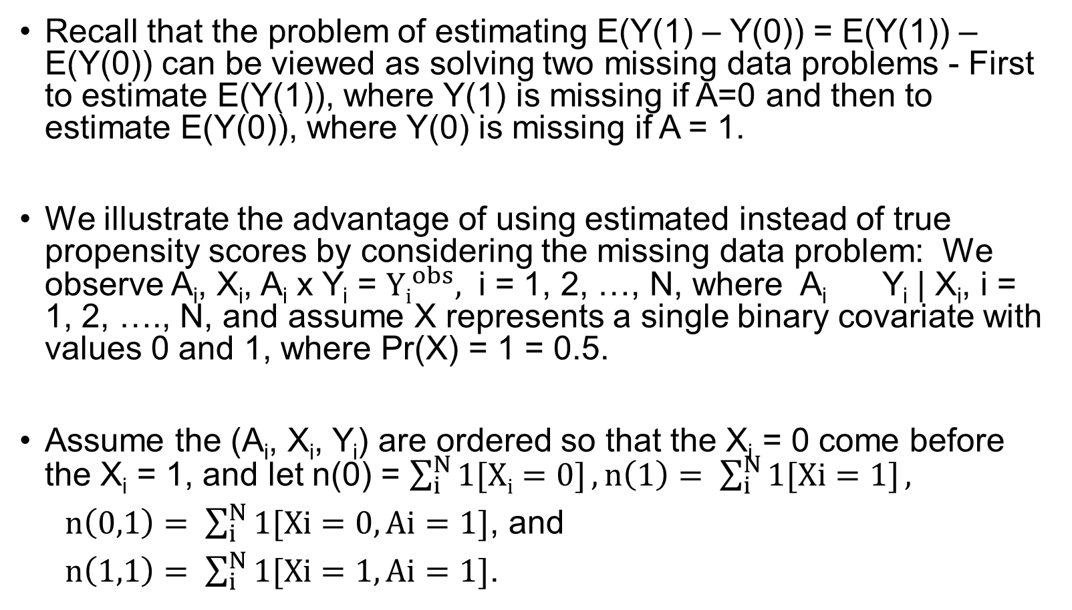
Illustration of Advantage of Estimated Propensity Scores over True Propensity Scores
Recall that the problem of estimating E(Y(1) – Y(0)) = E(Y(1)) – E(Y(0)) can be viewed as solving two missing data problems - First to estimate E(Y(1)), where Y(1) is missing if A=0 and then to estimate E(Y(0)), where Y(0) is missing if A = 1.
We illustrate the advantage of using estimated instead of true propensity scores by considering the missing data problem: We observe A_{i}, X_{i}, A_{i} x Y_{i} = ${Yi}_{}^{obs},$ i = 1, 2, …, N, where A_{i} Y_{i} | X_{i}, i = 1, 2, …., N, and assume X represents a single binary covariate with values 0 and 1, where Pr(X) = 1 = 0.5.
Assume the (A_{i}, X_{i}, Y_{i}) are ordered so that the X_{i} = 0 come before the X_{i} = 1, and let n(0) = $\sum_{i}^{N}{1[Xi=0]}, n\left(1\right)=$ $\sum_{i}^{N}{1[Xi=1]},$
$n\left(0,1\right)= \sum_{i}^{N}{1[Xi=0, Ai=1]}$, and
$n\left(1,1\right)= \sum_{i}^{N}{1[Xi=1, Ai=1]}$.
Notes:
n(0) stands for the number of X=0, under both Y observed and Y unobserved situation.

Slide 5
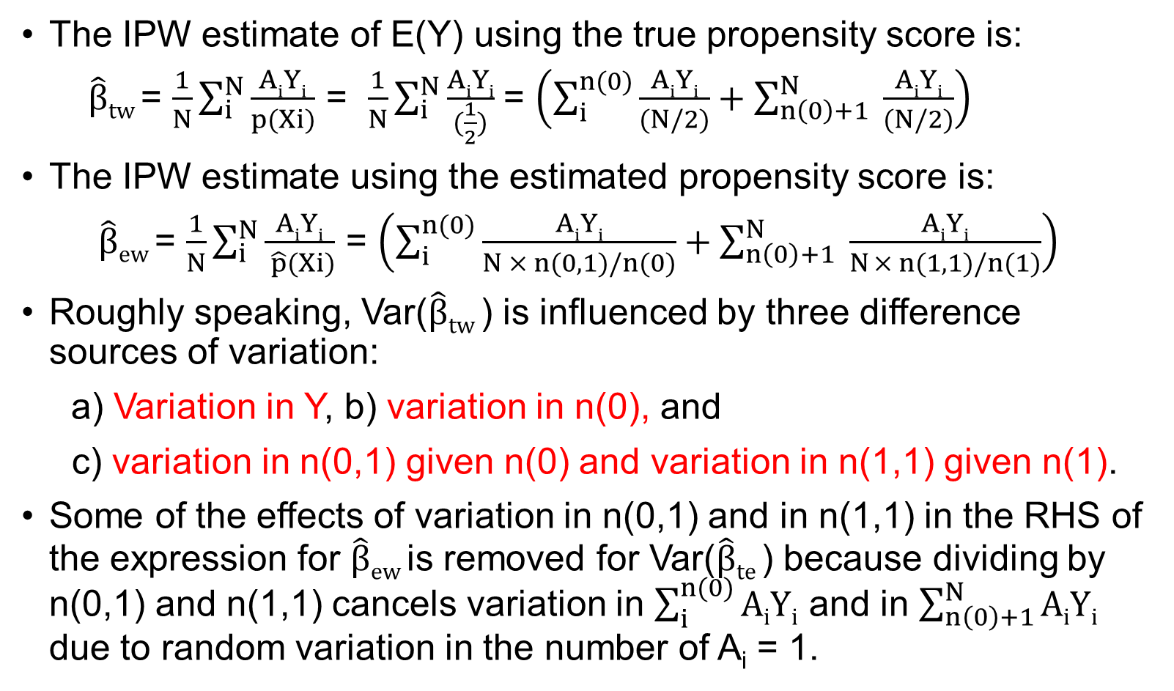
Illustration of Advantage of Estimated Propensity Scores over True Propensity Scores
The IPW estimate of E(Y) using the true propensity score is:
$\hat{β}tw$= $\frac{1}{N}\sum_{i}^{N}{\frac{AiYi}{p(Xi)}}$ = $\frac{1}{N}\sum_{i}^{N}{\frac{AiYi}{(\frac{1}{2})}}$ = $\left(\sum_{i}^{n(0)}{\frac{AiYi}{(N/2)}}+\sum_{n\left(0\right)+1}^{N}{ \frac{AiYi}{(N/2)}}\right)$
The IPW estimate using the estimated propensity score is:
$\hat{β}ew$= $\frac{1}{N}\sum_{i}^{N}{\frac{AiYi}{ \hat{p}(Xi)}}$ = $\left(\sum_{i}^{n(0)}{\frac{AiYi}{N × n(0,1)/n(0)}}+\sum_{n\left(0\right)+1}^{N}{ \frac{AiYi}{N × n(1,1)/n(1)}}\right)$
Roughly speaking, Var($\hat{β}tw$) is influenced by three difference sources of variation:
a) Variation in Y, b) variation in n(0), and
c) variation in n(0,1) given n(0) and variation in n(1,1) given n(1).
Some of the effects of variation in n(0,1) and in n(1,1) in the RHS of the expression for $\hat{β}ew$is removed for Var($\hat{β}te$) because dividing by n(0,1) and n(1,1) cancels variation in $\sum_{i}^{n(0)}{AiYi}$ and in $\sum_{n\left(0\right)+1}^{N}{AiYi}$ due to random variation in the number of A_{i} = 1.

Slide 6
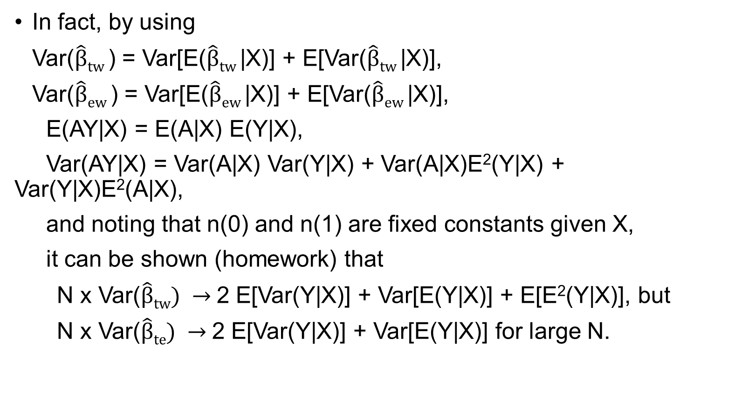
Illustration of Advantage of Estimated Propensity Scores over True Propensity Scores
In fact, by using
Var($\hat{β}tw$) = Var[E($\hat{β}tw$|X)] + E[Var($\hat{β}tw$|X)],
Var($\hat{β}ew$) = Var[E($\hat{β}ew$|X)] + E[Var($\hat{β}ew$|X)],
E(AY|X) = E(A|X) E(Y|X),
Var(AY|X) = Var(A|X) Var(Y|X) + Var(A|X)E²(Y|X) + Var(Y|X)E²(A|X),
and noting that n(0) and n(1) are fixed constants given X,
it can be shown (homework) that
N x Var($\hat{β}tw) →$2 E[Var(Y|X)] + Var[E(Y|X)] + E[E²(Y|X)], but
N x Var($\hat{β}te) →$2 E[Var(Y|X)] + Var[E(Y|X)] for large N.

Slide 7
Statistical Inference When Performing Analyses with Propensity Score Matching
The close correspondence between propensity score matching and propensity weighting suggests that inference based on propensity matched analyses can be performed using standard t-tests or linear regression (for a single dichotomous treatment) for normal outcomes and logistic regression for binary outcomes, without accounting for the matching in the analysis
This seems to be verified in simulation studies

Slide 8
Extension to More Than 2 Discrete Treatments
Straightforward in principle; just use multinomial logistic regression (instead of binary logistic regression) to estimate Pr[A_{i}=a|X_{i}] for each treatment a
Must check overlap and balance for multiple pairwise comparisons among groups
Usually statistical inference is performed to provide pairwise comparisons among the counterfactual outcome means in different groups
So if there are 3 groups (indexed by a = 1, 2, 3), test
H₁₂: E(Y(2)) = E(Y(1)), H₁₃: E(Y(3)) = E(Y(1)), H₂₃: E(Y(3)) = E(Y(2))
Notes:
Multinomial regression

Slide 9
Extension to More Than 2 Discrete Treatments
Final statistical inference step usually performed using ANOVA or regression for multiple treatment groups for continuous outcomes, and logistic or other form of binary regression for multiple treatment groups for binary outcomes.
This becomes problematic if there are many treatment levels, and impossible if the treatment is continuous

Slide 10
Extension to Numeric Treatments: Marginal Structural Models
If the treatment can be quantified on at least an interval scale, we may consider models of the form:
(MSM1) E[Y(a)] = β₀ + β₁a, or
(MSM2) E[Y(a)] = β₀ + β₁a + β₂a², or
(MSM3) E[Y(a)] = f(a) for some nonparametric f()
Under (MSM1), ATE contrasting treatment a’ to treatment a is β₁(a’ – a). Under (MSM3), it is f(a’) – f(a).
These are called marginal structural models.
Structural because the models are based on the counterfactual outcomes Y(a)
Marginal because the models are based on the marginal distributions of each Y(a)

Slide 11
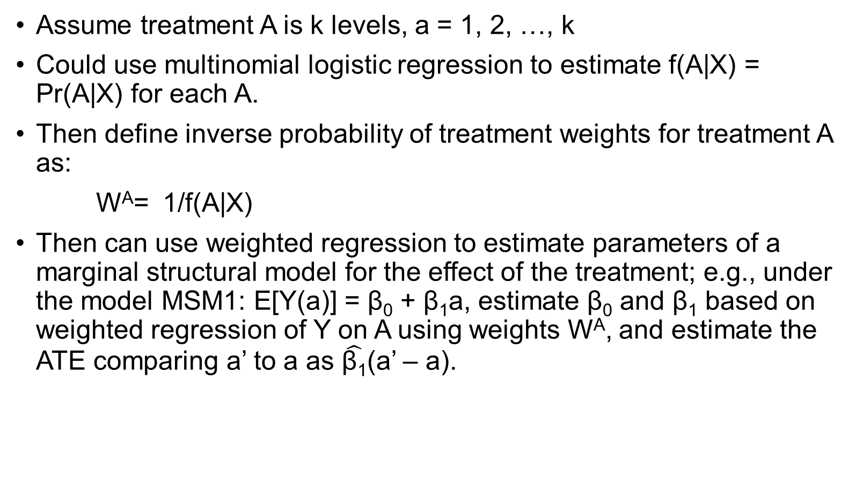
Evaluating the Causal Effect of a Discrete Numeric Treatment
Assume treatment A is k levels, a = 1, 2, …, k
Could use multinomial logistic regression to estimate f(A|X) = Pr(A|X) for each A.
Then define inverse probability of treatment weights for treatment A as:
W^{A}= 1/f(A|X)
Then can use weighted regression to estimate parameters of a marginal structural model for the effect of the treatment; e.g., under the model MSM1: E[Y(a)] = β₀ + β₁a, estimate β₀ and β₁ based on weighted regression of Y on A using weights W^{A}, and estimate the ATE comparing a’ to a as $\hat{\text{β}\text{1}}$(a’ – a).
Notes:
Stabilized weight works better when we have more than 2 treatment levels, we want to

Slide 12
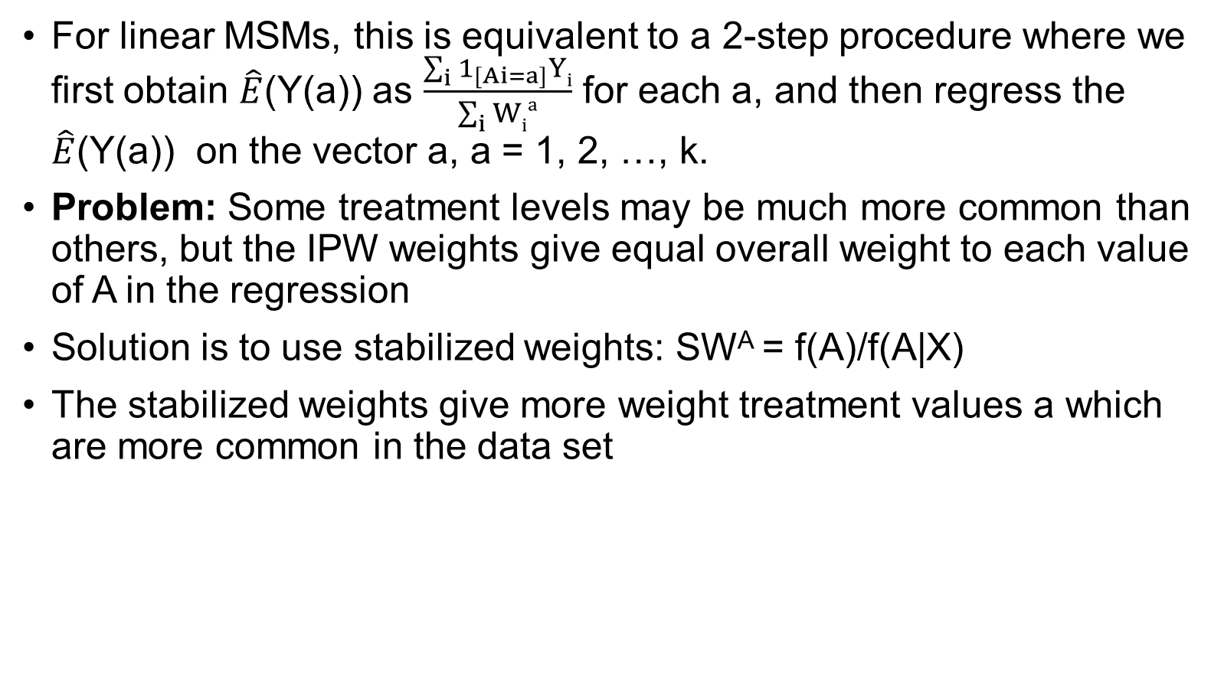
Evaluating the Causal Effect of a Discrete Numeric Treatment
For linear MSMs, this is equivalent to a 2-step procedure where we first obtain $\hat{E}$(Y(a)) as $\frac{\sum_{i}{1_{[Ai=a]}Yi}}{\sum_{i}{Wia}}$ for each a, and then regress the $\hat{E}$(Y(a)) on the vector a, a = 1, 2, …, k.
Problem: Some treatment levels may be much more common than others, but the IPW weights give equal overall weight to each value of A in the regression
Solution is to use stabilized weights: SW^{A} = f(A)/f(A|X)
The stabilized weights give more weight treatment values a which are more common in the data set

Slide 13
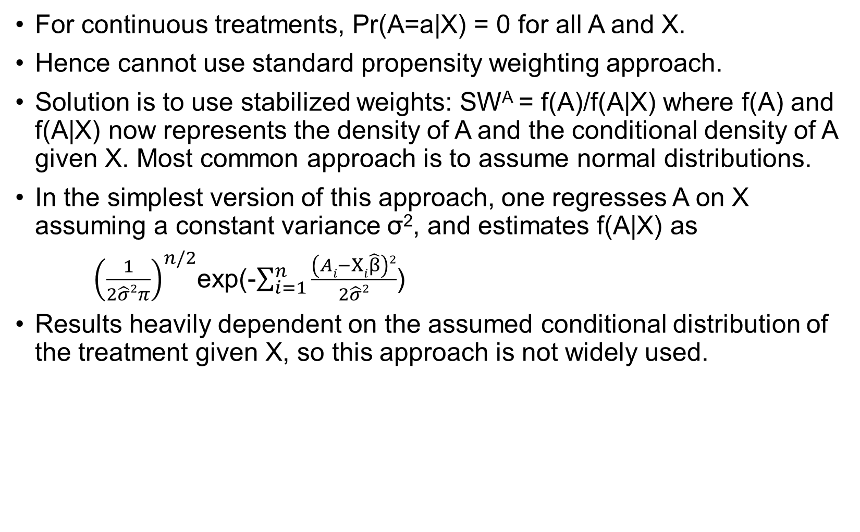
Evaluating the Causal Effect of a Discrete Numeric Treatment
For continuous treatments, Pr(A=a|X) = 0 for all A and X.
Hence cannot use standard propensity weighting approach.
Solution is to use stabilized weights: SW^{A} = f(A)/f(A|X) where f(A) and f(A|X) now represents the density of A and the conditional density of A given X. Most common approach is to assume normal distributions.
In the simplest version of this approach, one regresses A on X assuming a constant variance σ², and estimates f(A|X) as
${\left(\frac{1}{2\hat{σ}2π}\right)}^{n/2}$exp(-$\sum_{i=1}^{n}{\frac{\left(Ai−Xi\hat{β}\right)2}{2\hat{σ}2}}$)
Results heavily dependent on the assumed conditional distribution of the treatment given X, so this approach is not widely used.

Slide 14
Marginal Structural Models with Effect Modification
V = baseline factors
Models of the form E[Y(a)|V] = f(a,V) can be used to model modification of the causal effect of A by the factors in V
For example,
E[(Y(a))|V] = β₀ + β₁a + β₂V + β₃ a × V
Causal effect of changing A from a to a’ is (a’ – a) × (β₁ + β₃V)
Estimate model parameters by fitting regression model
E(Y|V,A) = β₀ + β₁A + β₂V + β₃ A × V
using weighted regression with weights W^{A} or SW^{A}
Include V among the covariates L used to control confounding when estimating the weights
Generally best to define stabilized weights as SW^{A}(V) = f(A|V)/f(A|L,V)
Question: If V is an effect modifier of A, but the investigator is not interested in expressing the effect of A as a function of V, is it necessary to include V in the MSM when estimating the ATE of A?

Slide 15
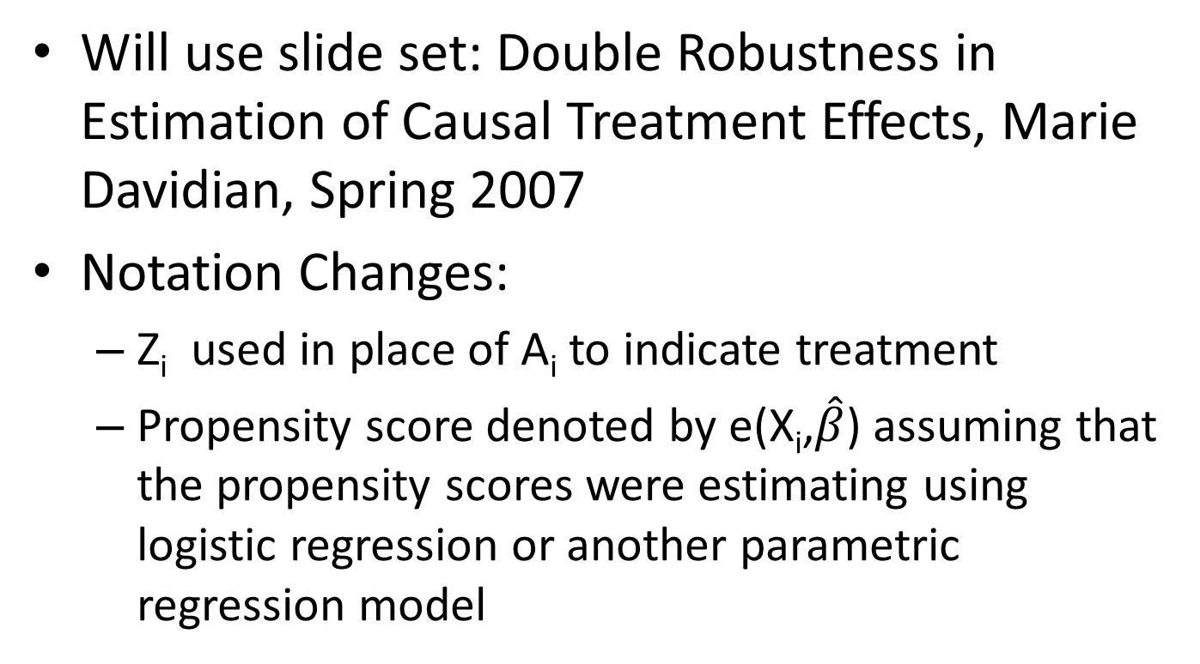
Doubly Robust Estimation of the ATE
Will use slide set: Double Robustness in Estimation of Causal Treatment Effects, Marie Davidian, Spring 2007
Notation Changes:
Z_{i} used in place of A_{i} to indicate treatment
Propensity score denoted by e(X_{i},$\hat{β}$) assuming that the propensity scores were estimating using logistic regression or another parametric regression model

Slide 16
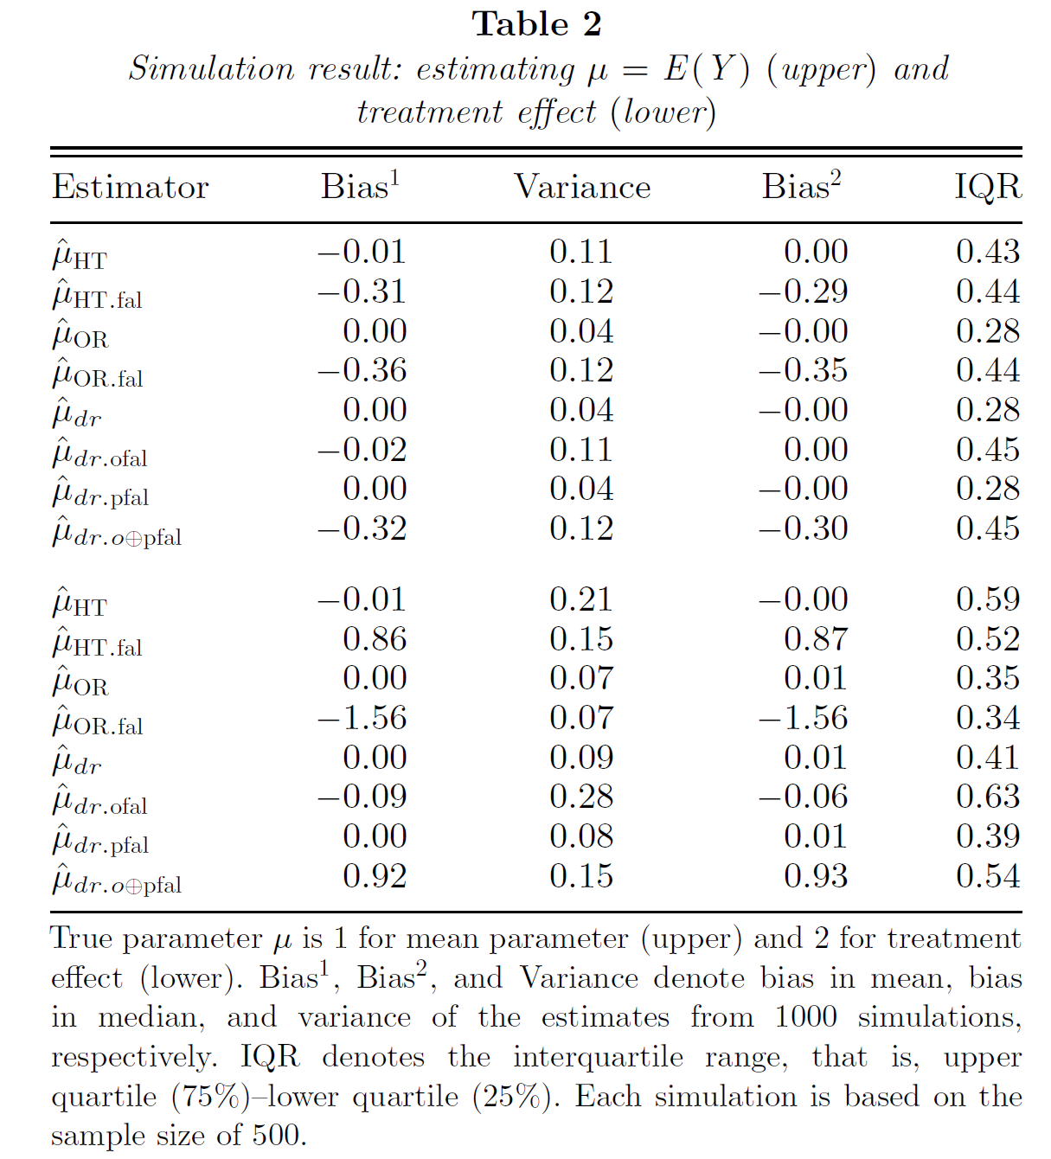
Simulation of Bang and Robins, Biometrics, 2005

Slide 17
Kang and Schafer: Demystifying Double Robustness: A Comparison of Alternative Strategies for Estimating a Population Mean from Incomplete Data (Statistical Science, 2007): Considered problem of estimating a population mean in situations where probability of missingess is high and strongly predicted by covariates, and outcome correctly predicted by linear regression. Regression does much better than standard DR
estimate in this case.

Slide 18
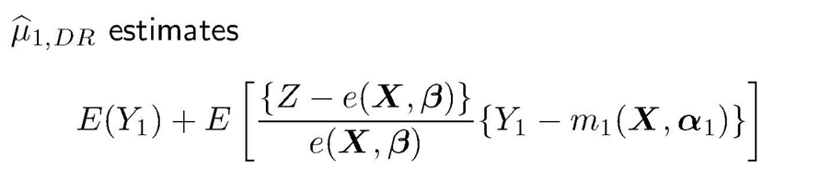
Alternatives to Standard AIPW Estimation
Cao, Tsiatis, Davidian: Improving efficiency and robustness of the doubly robust estimator for a population mean with incomplete data, Biometrika 2009:
Apply standard form of the AIPW estimator, but perform weighted regression for the outcome model using weights (1 – e(X_{i}))/e²(X_{i}) – gives more weight to patients with high probabilities of having missing data – reduces amount of extrapolation in the outcome regression model
Rationale:
Notes:
Make the denominator square , we try to fit the data more closer to the regression line, so the OR error will be smaller.

