Slide 1
DECART Summer School 2018:
Causal Inference Module
Instrumental Variable Related Methods

Slide 2
Why do we need IV?
By now, we show how to identify and estimate casual effects under no unmeasured confounding assumption.
Are we doomed if this assumption is violated?
Not necessary if we find some exogenous sources of variation that drives the treatment.
An instrument is a variable that does not itself belong in the explanatory equation of response but is correlated with the explanatory variables, conditional on other variables.
The variation in the instrument is not confounded by unmeasured confounders.

Slide 3
IV in DAG
U
Z
A
Y
Z is the instrument, A is the treatment, and U is the unmeasured confounder
Exclusion restriction:
1. non common causes of the instrument and the outcome.
2. no direct and indirect of the instrument on the outcome not through the treatment.
Finding a believable instrument is incredibly difficult and some people never believe any IV setups.

Slide 4
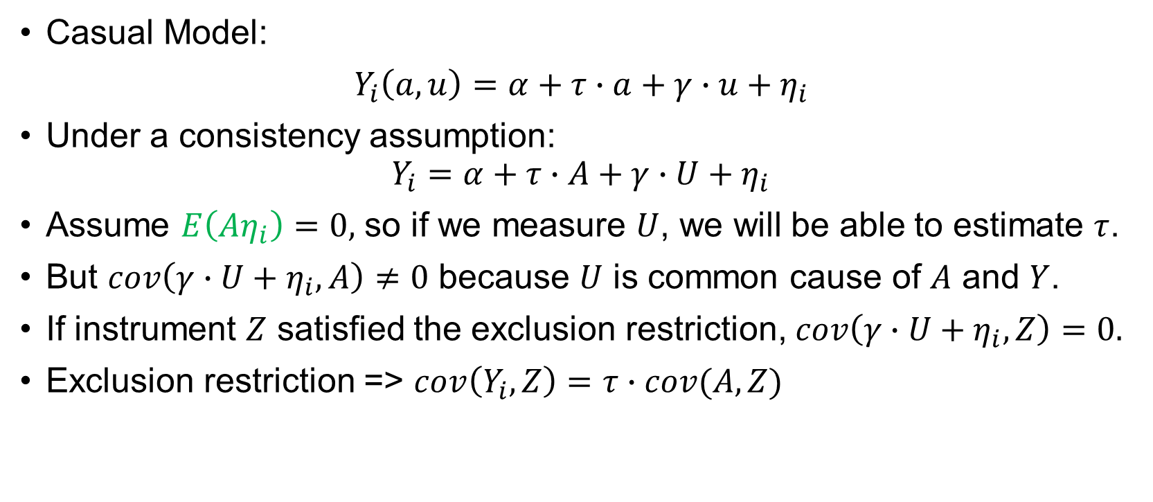
IV estimator with constant effect
Casual Model:
$Y_{i}\left(a,u\right)=α+τ∙a+γ∙u+η_{i}$
Under a consistency assumption:
$$Y_{i}=α+τ∙A+γ∙U+η_{i}$$
Assume $E\left(Aη_{i}\right)=0,$ so if we measure $U$, we will be able to estimate $τ$.
But $cov\left(γ∙U+η_{i},A\right)≠0$ because $U$ is common cause of $A$ and $Y$.
If instrument $Z$ satisfied the exclusion restriction, $cov\left(γ∙U+η_{i},Z\right)=0.$
Exclusion restriction => $cov\left(Y_{i},Z\right)=τ∙cov(A,Z)$

Slide 5
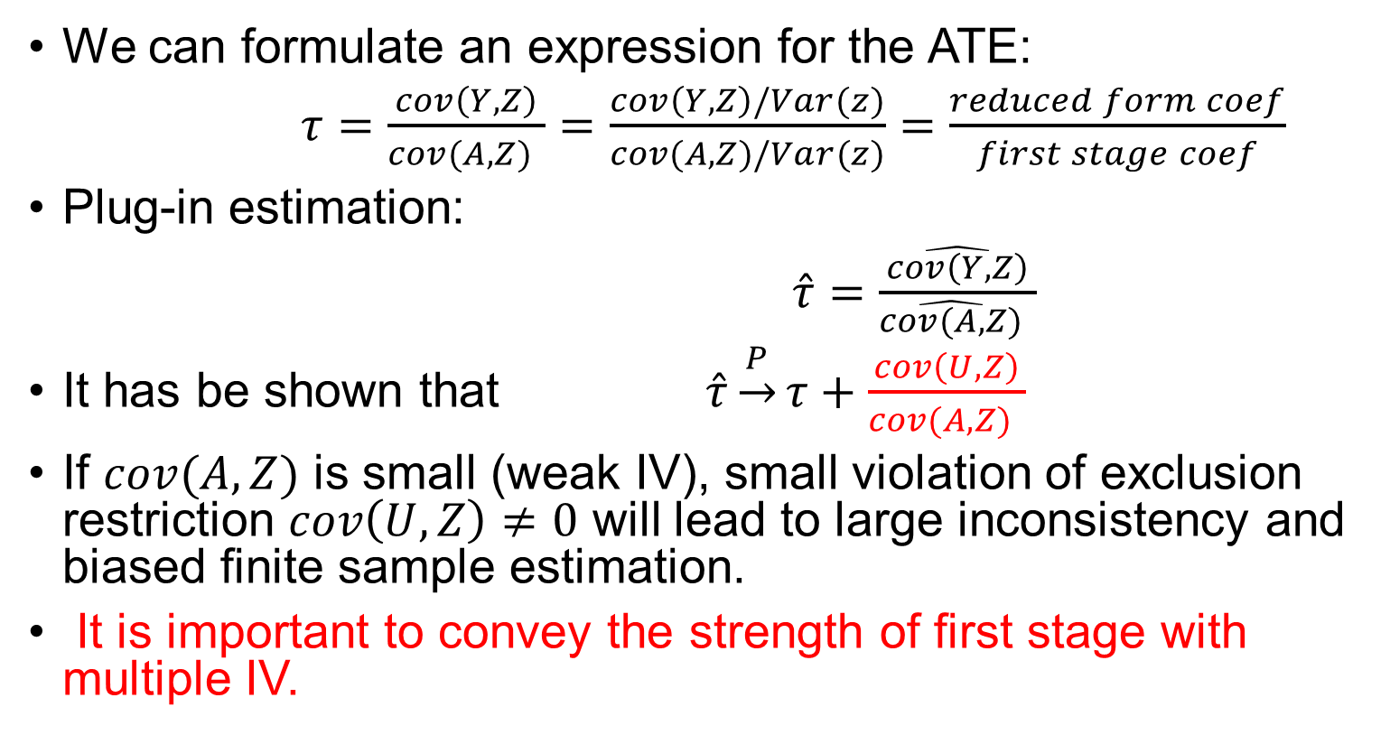
IV estimator with constant effect
We can formulate an expression for the ATE:
$τ=\frac{cov\left(Y,Z\right)}{cov(A,Z) }=\frac{cov\left(Y,Z\right)/Var(z)}{cov(A,Z)/Var(z)}=\frac{reduced form coef}{first stage coef}$
Plug-in estimation:
$\hat{τ}=\frac{\hat{cov\left(Y,Z\right)}}{\hat{cov(A,Z)} }$
It has be shown that $\hat{τ}\underset{→}{P}τ+\frac{cov\left(U,Z\right)}{cov(A,Z) }$
If $cov(A,Z)$is small (weak IV), small violation of exclusion restriction $cov\left(U,Z\right)≠0$ will lead to large inconsistency and biased finite sample estimation.
It is important to convey the strength of first stage with multiple IV.
Notes:
Exclusion restriction: no correlation between Z and Y except through A

Slide 6
When there are covariates?

Slide 8
Two-stage least square

Slide 9
Two-stage least square (2SLS)

Slide 10
General 2SLE

Slide 11
Matrix algebra

Slide 12
How to estimate in 2SLS?

Slide 13
Variance estimation

