Slide 1
If you build it, will they come?
And shop???
Insights into the relationship between sessions and transactions

Slide 2
Evidence for insights
Data over 1 year (July 2012 – June 2013)
Monthly counts of:
Number of sessions
Number of transactions
Grouped by the type of device:
Desktops
Tablets
Mobiles

Slide 3
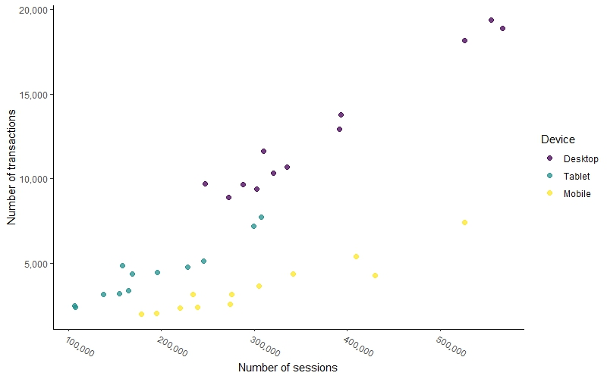
Sessions vs Transactions
The number of transactions is positively associated with the number of sessions.
The observed rate of increase is slightly less for mobile devices.
Among devices, Desktops and Tablets offer a greater number of transactions than Mobiles for the same number of sessions.

Slide 4
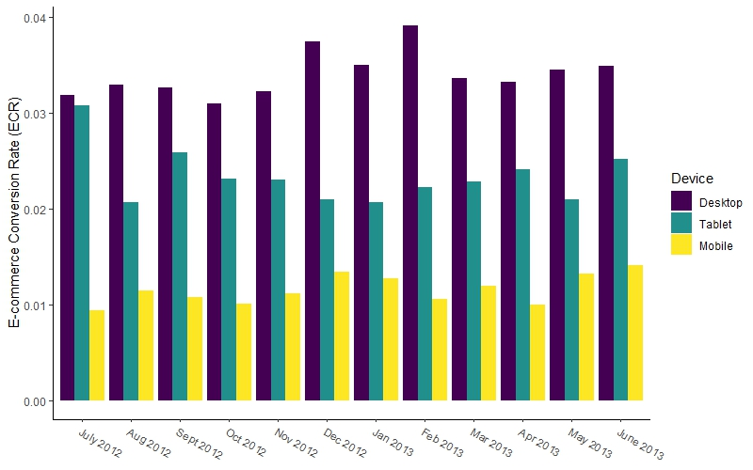
Impact of device on ECR
Overall increase in the ratio of transactions to sessions for Desktops and Mobiles
Increase observed in Mobiles may not offset the loss associated with the decline in ECR for Tablets.

Slide 5
Recommendations
Increase ECR with additional investigations into:
Sessions with transactions to find what works
Features of sessions without transactions to avoid in the future
Hierarchy of focus for developers
Desktops
Tablets
Mobiles

