Slide 1
CRUD DOTNET EF COMPANIES
Blidi Aymen

Slide 2
1
  Technologies
2
  Entity Framework Core
3
  Les Interfaces
4
  Conclusion et Perspectives

Slide 3
1
  Technologies
2
  Entity Framework Core
3
  Les Interfaces
4
  Conclusion et Perspectives

Slide 4




Outils

Slide 5

Langages:

Slide 6
1
  Technologies
2
  Entity Framework Core
3
  Les Interfaces
4
  Conclusion et Perspectives

Slide 7
ENTITY:Employe
public partial class Employee
{ public string Id { get; set; }
public string Name { get; set; }
public string Department { get; set; }
public string Designation { get; set; }
public string City { get; set; }
public string? CompanyID { get; set;}
public virtual Company Company { get; set; }
}

Slide 8
Entity Company:
public partial class Company
{ public Company()
{ Employees= new HashSet<Employee>();
}
public string Id { get; set; }
public string Name { get; set; }
public virtual ICollection<Employee> Employees { get; set; }
}

Slide 9
APPSETTING JSON FILE
{ "Logging": {
"LogLevel": {
"Default": "Information",
"Microsoft": "Warning",
"Microsoft.Hosting.Lifetime": "Information"
} },
"AllowedHosts": "*",
"ConnectionStrings": {
"SqlDbContext":"Server=(localdb)\\mssqllocaldb;Database=CompanyDb;Trusted_Connection=True;MultipleActiveResultSets=true" }
}

Slide 10
IEMPLOYE SERVICE
public interface IEmployeeService
{
Task<List<Employee>> GetEmployees();
Task<bool> CreateEmployee(Employee employee);
Task<bool> EditEmployee(string id, Employee employee);
Task<Employee> SingleEmployee(string id);
Task<bool> DeleteEmployee(string id);
}

Slide 11
DbContext Class
public class SqlDbContext : DbContext
{ public SqlDbContext(DbContextOptions<SqlDbContext> options)
: base(options)
{ }
public DbSet<Employee> Employees { get; set; }
public DbSet<Company> Companies { get; set; }
protected override void OnModelCreating(ModelBuilder modelBuilder)
{ modelBuilder.Entity<Company>()

Slide 12
Migration Example :Table Employe
migrationBuilder.CreateTable(
name: "Employees",
columns: table => new {
Id = table.Column<string>(nullable: false),
Name = table.Column<string>(nullable: true),
Department = table.Column<string>(nullable: true),
Designation = table.Column<string>(nullable: true),
City = table.Column<string>(nullable: true),
CompanyID = table.Column<string>(nullable: true)
},

Slide 13
.HasMany(c => c.Employees)
.WithOne(d=>d.Company).HasForeignKey(d => d.CompanyID)
.HasConstraintName("FK_Employees_Companies_CompanyId");
} }
constraints: table =>
{
table.PrimaryKey("PK_Employees", x => x.Id);
table.ForeignKey(
name: "FK_Employees_Companies_CompanyId",
column: x => x.CompanyID,
principalTable: "Companies",
principalColumn: "Id",
onDelete: ReferentialAction.Restrict);
});

Slide 14
1
  Technologies
2
  Entity Framework Core
3
  Les Interfaces
4
  Conclusion et Perspectives

Slide 15


Welcome Interface

Slide 16
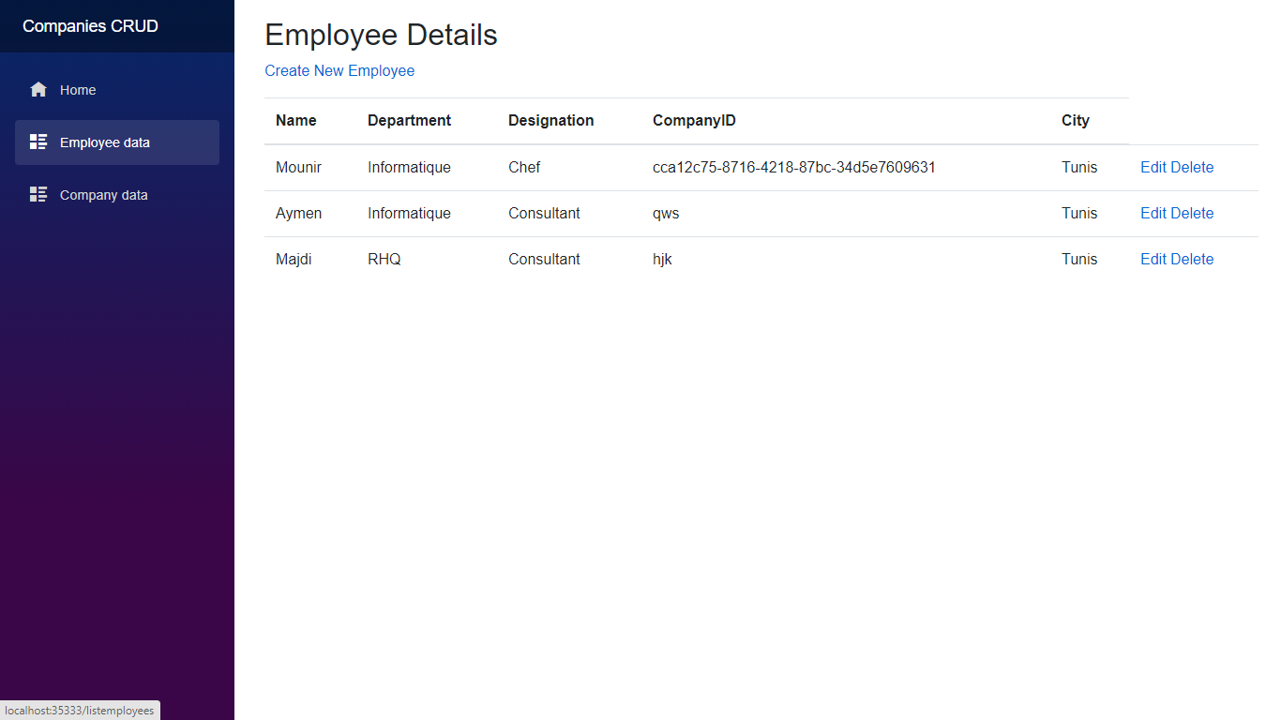
Employe Details

Slide 17
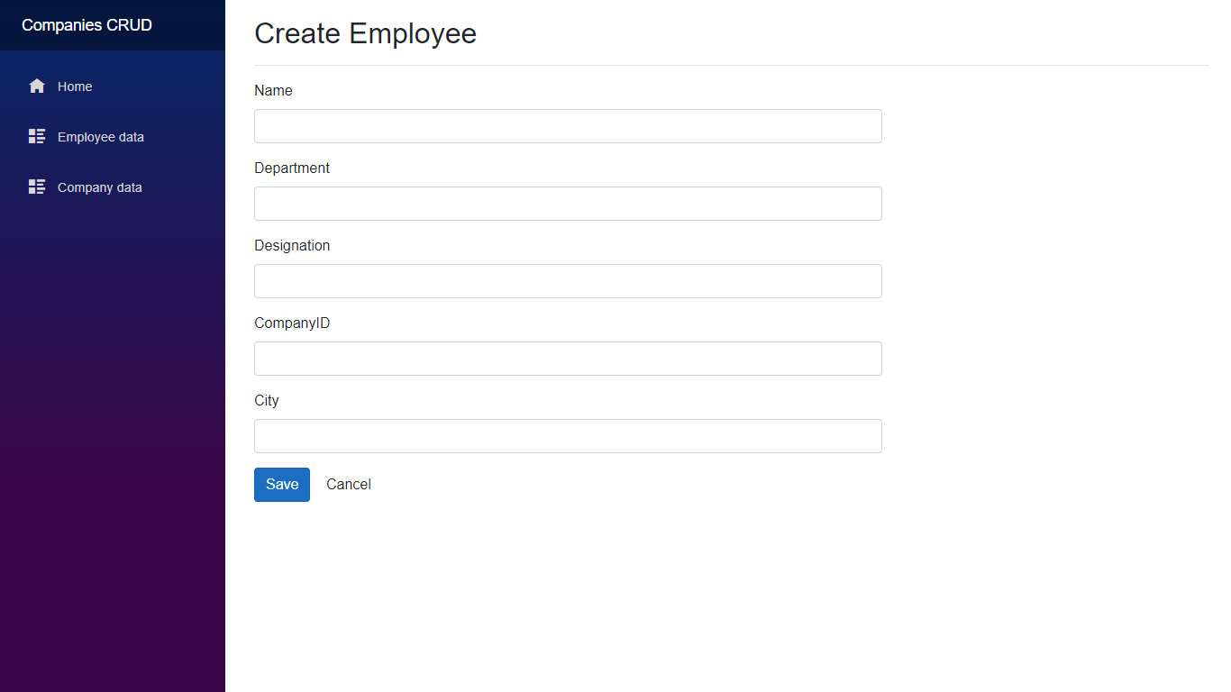
Create Employe

Slide 18
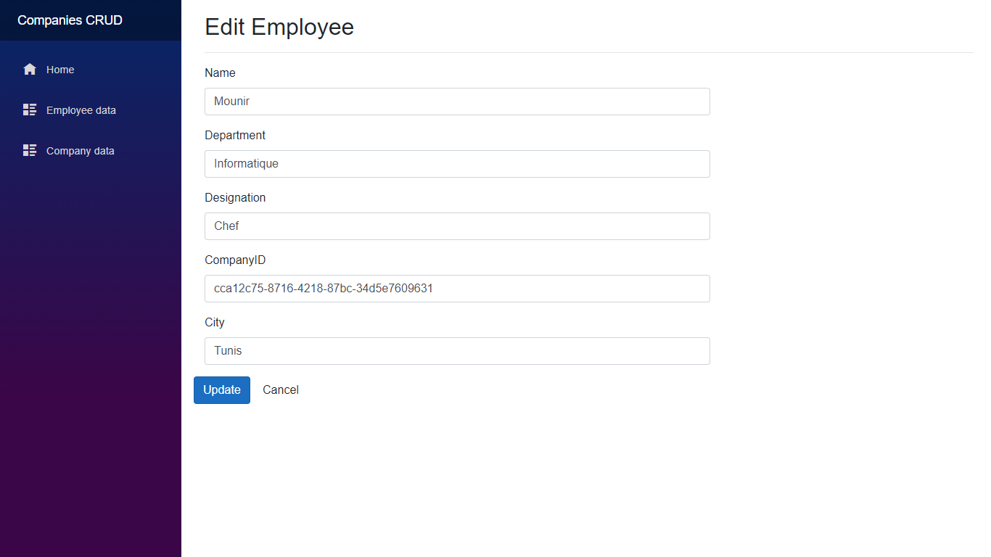
Edit Employe

Slide 19
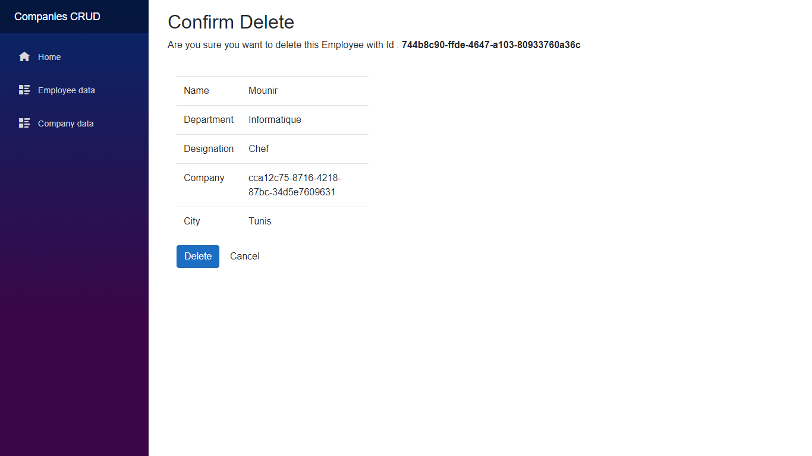
Delete Employe

Slide 20
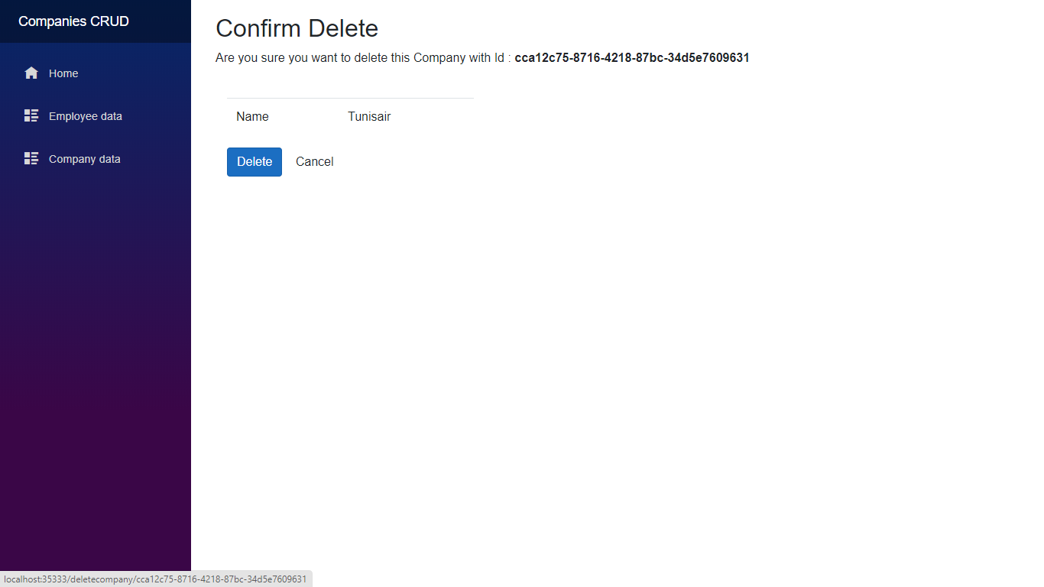
Delete Company

Slide 21
1
  Technologies
2
  Entity Framework Core
3
  Les Interfaces
4
  Conclusion et Perspectives

Slide 22
Conclusion et PERSPECTIVE
  limité l’accés au employé
Améliorations possibles
S’authenifier par login et password
Donner catégorie et type au société et avoir departement

Slide 23
Merci pour votre attention

