Slide 1

FSI Demo Day
API Load Testing using K6
25-1-2024

Slide 2
Load Testing
Load testing is a type of performance testing that tests how the system behaves under varying load conditions, including the impact on responsiveness, throughput and resource utilization.
Why:
Validate reliability under expected traffic.
Discover bottlenecks and system limits
Improve reliability. Release with confidence
How: There are many tools available for load testing (K6 – JMeter – Gatling - and more)
Metrics: Throughput, Response time and Latency
When design your API tests:
What flows or components do you want to test?
How will you run the test?
What criteria determine acceptable performance? (SLOs)

Slide 3
K6
Test types: Supporting performance testing types such as load, stress, spike, and more.
Target Users: Developers and performance engineers seeking a user-friendly, modern tool for performance testing.
Technology Stack: Uses JavaScript and ES6 for scripting, which is widely used, With a relatively low learning curve
Support: Offers community support and a commercial version (k6 Cloud)
Test Plans Dev process: Supports source control (test scripts) and follow dev process (PR – code review)
Metrics: Provides essential performance metrics out of the box, to track Throughput, Response time and Latency
Thresholds: Enables setting of performance thresholds based on your SLO requirements.
Automation CLI: Comes with a CLI for automation, simplifying running k6 locally, in the cloud, or as part of your CI/CD
Cloud Native: Container-friendly, making it suitable for running in cloud environments and container orchestration platforms.
Supported Protocols: HTTP, WebSocket, gRPC
Observability Integration: send test results to Observability systems such as AppInsights, Datadog, Grafana, and more.

Slide 4
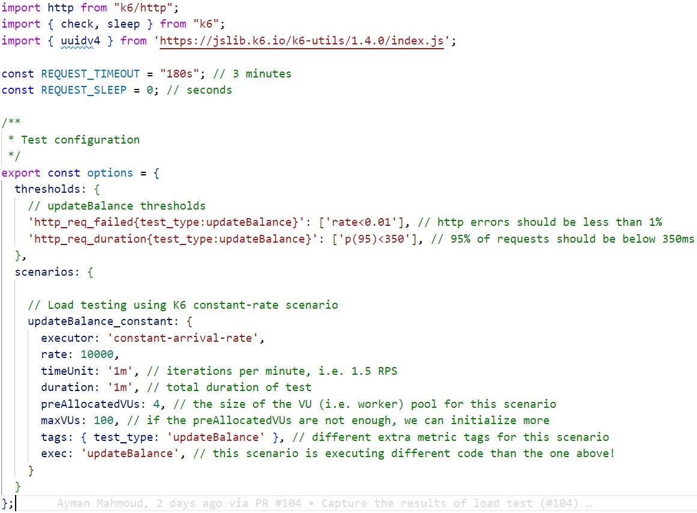
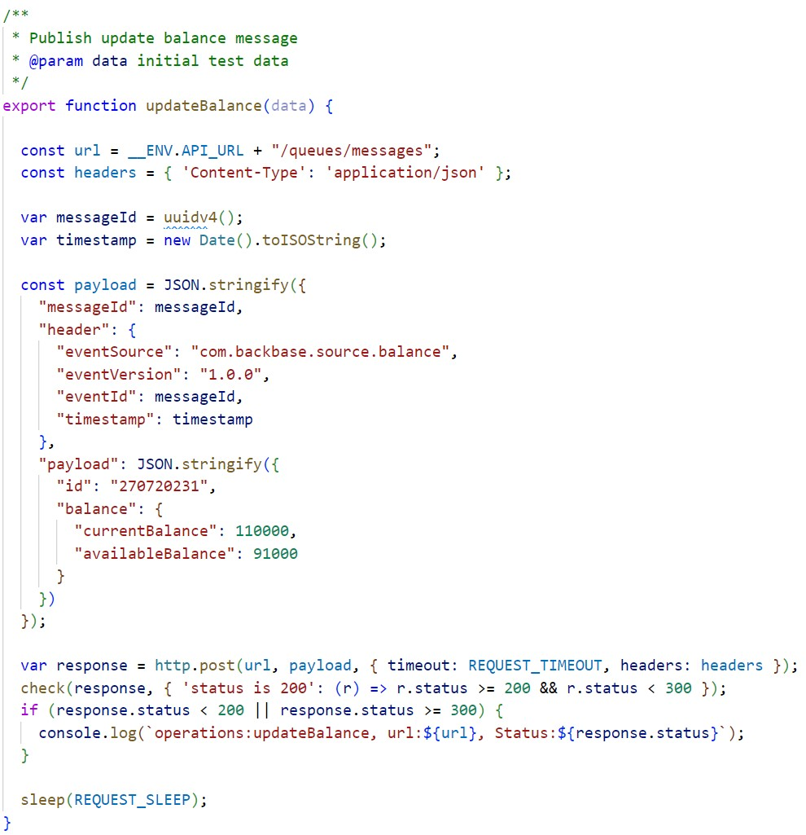
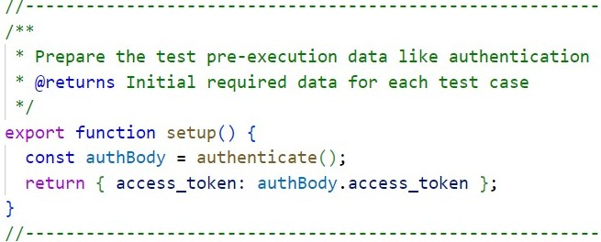
Test Plan Sample
Configuration
Test Scenario
Setup
Notes:
recognizes system bottlenecks under high-volume user stress circumstances before they take place in a production environment and establishes trust in a system's reliability and performance

Slide 5
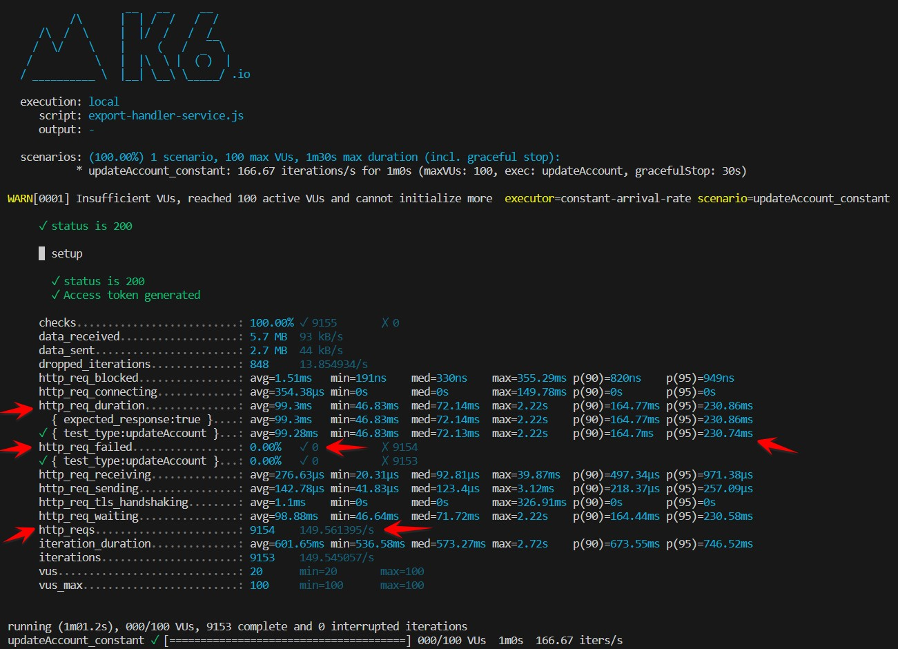
K6 Testing Result
Notes:
recognizes system bottlenecks under high-volume user stress circumstances before they take place in a production environment and establishes trust in a system's reliability and performance

Slide 6
DEMO

