Slide 1

Clustering-NYC-Toronto-Neighborhoods
By Ayman Altaweel
On 29th, June 2021
LinkedIn: https://www.linkedin.com/in/ayman-altaweel-079774169

Slide 2

OUTLINE
Introduction
Data
Methodology
Results
Discussion
Conclusions

Slide 3
INTRODUCTION
This project approaches a commonly faced problem by people who have to move from NYC to Toronto or Vice versa.
The problem they face is that they have to move yet they prefer to move to a similar place to where they are, having the same lifestyle. (ex: similar places, similar venues, ...etc.)
So, we clustered the neighborhoods within the two cities according to their most common venues into 6 clusters.
Having clustered them, those people will be able to identify easily where to go as simple as looking at the clustered neighborhoods map which has been generated and identify similar neighborhoods by colors or check this dashboard.

Slide 4
Data
In this project, we used different data sources which are:
NYC-data from Json file: data about NYC neighborhoods and their respective latitudes and longitudes.
Toronto-data, web scrapped from Wikipedia: data about Toronto neighborhoods.
Geospatial data: data of respective latitudes and longitudes to Toronto’s neighborhoods.

Slide 5

METHODOLOGY
Data Collection from the previously stated sources.
Data Cleaning:
Dropping unneeded columns.
Filtering Canada data to get only Toronto's.
Adding longs and lats to Toronto's data.
Appending both of Toronto's and NYC's data.
One-hot-Encoding venues for further processing (i.e building K-Means clusters)
ML Modeling:
We applied the K-Means algorithm which is a partitioning unsupervised clustering ML model by which we cluster a given set of observations, neighborhoods in our model, according to their features, respective venues appearance likelihood in our model, into non-overlaping clusters without any internal structure.
We clustered the neighborhoods into 6 clusters to minimize the within-cluster sum of squares (i.e WCSS) as reasonable as possible.

Slide 6
Results:
After building the K-Means clustering model, we got a data frame of all neighborhoods with their respective clusters.
Clustered data frame
Also, we made further illustration through this dashboard to add interactivity.

Slide 7

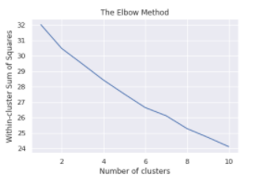
DISCUSSION
While clustering, we used the elbow method to get the optimal no. of clusters that minimizes the WCSS as reasonable as possible while keeping clusters have a meaning.
It turned that 6 clusters will be sufficient to generate distinct clusters.

Slide 8

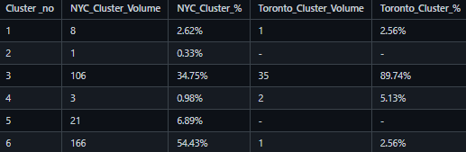
CONCLUSION
Here is a summary table that concludes the clusters.
The vast majority of NYC's neighborhoods fall in the 6th & 3rd clusters.
The vast majority of Toronto's neighborhoods fall in the 3rd cluster which we gonna describe very soon.
In Toronto, there are no neighborhoods fall into neither the 2nd nor the 5th clusters.
(i.e If someone lives either in the 2nd or the 5th clusters in NYC, he/she won't find a similar neighborhood to move to in Toronto.)

Slide 9


