Slide 1

An optimization algorithm for Dial a Ride problems in the context of intermodal route planning
Research Project Defense
Supervisors:
Prof. Jakob Puchinger
Prof. Asmaa Ghaffari
Presented by Ayman MAHMOUD
Master 1 – Ingénierie des systèmes complexes
CentraleSupélec

Slide 2
Overview
Introduction
Key Figures & History
Motivation
Hypothesis
Methodology in Research
State of the art
Problem Definition
Results
Observations & Conclusion

Slide 3
Introduction
Questions to answer:
Where is the research headed in mobility?
What is the relationship between shared mobility and public transport in research?
What is the relationship between shared mobility and mobility on demand in research?
The unjustifiable gap between mobility on demand and public transit systems.
Importance:
The importance is twofold with the increasing transportation demand in the old continent especially because we're going to witness an increase of +42% in passenger mobility and +60% in freight transport by 2050 (21). the increase of public transport, mainlines but never to the micro transit level.
Many suburban and rural areas are not adequately served as they lack the population density to justify public transit, i.e., the public transit is not economically viable
the future of transport for a longer horizon.
We are facing formidable challenges
There is a clear aim in the EU to make this interchange as seamless as possible with common information, an integrated ticket and a multimodal station where passengers feel safe, secure and comfortable.
If successfully implemented intermodal passenger transport will give more options to the traveler, is user-friendly and adds to the overall efficiency of the transport system.
Objectives:
Understand transportation science and mobility modeling
Establish a relationship between classic public transport a new mobility services

Slide 4
Key figures
In the region of Ile de France there's 836km of accessible roads where 25% experience congestion in the peak hour (2). It is no secret that we need an effective solution.
some companies actually operate on this basis but none of them is contributing significantly to the track congestion problem
What are the shared mobility companies that favor intermodality?
Flinc and berkloning in Germany, via transport that has a great presence in US and Europe

Slide 5
History
Shared mobility concept existed before even the coloured television was invented.
The first ride-sharing as in car-sharing program was established in 1948 in Zurich when a housing cooperative began a small car share arrangement, it was called “Sefage program”.
In this period this solution wasn't very attractive. Simply because the automotive production got faster and cheaper and it was more appealing to own your vehicle than to share one.

Slide 6
A point of critique
However, what we're experiencing now is that, although the ride-sharing solutions exists we still have a rise in the traffic congestion and traffic density is worsening (3),
Which can be because of that supply doesn’t meet the rise of demand
Shared mobility is part of the problem?...
additionally there exists no effective method of integrating ride-sharing solutions into transport trip planners as of now, mainly due to the fuzzy and flexible nature (e.g., no fixed stops, possibility of making detours) of carpooling. Some solutions are proposed (4)(5)
Which shows that the shared mobility can be highly criticized, the studies made in new York show that…The numbers of fleet sizing optimization are very promising, without shared mobility almost half of the taxies in Manhattan are empty at normal times, the article in Nature magazine, written by researchers in Senseable city lab(8), shows that we only need 60% of today's taxis. Additionally with autonomous shared mobility, the perfect scenario, we can move all Manhattan with 137,000 vehicles which is half of what's on the road today (8).

Slide 7
Topic & Motivation
Interest of ride sharing and create a seamless intermodal trip for travelers by the EU
In the present context, the passenger intermodal trips, which combine at least two modes of transport in the same trip; for example public transport + the private car ; public transport + public transport etc., are the principal trip of passengers in urban zones or in peripheral urban zones.
In effect, the intermodal trip has only significant weight on these long distances. For example in the greater Paris region, the combination between automobile and a public transport in the same journey has only 1.2% of total trip, indeed, this situation hasn’t changed since thirty years.

Slide 8
Motivation make it one slide with 7
I see a real motivation in integrating both modes and finding a solutions. Many researchers had already investigated this topic (11),
Motivation of the fact that current mobility problems require intelligent solutions.
There is a research gap when it comes to linking on demand mobility with the first and last mile problem and areas underserved with public transport.
The number of dynamic ride sharing relevant for a query increases when allowing routes which bring a passenger to a station where he can use public transport to continue his journey, this is because the passenger will be able to cover a longer distance paying less money, also gaining time because there is a reliable mobility service that will get him to the station of the public transport. (10)

Slide 9


Hypothetis
There is room to improve intermodality between mobility on demand and public transport. ()
People find difficulty to manage their time during the trip especially when it consistes of taking more than one mode of transportation.
Mode 1: extra careful 10-20 of contingency.
Mode 2: wing it and catch the next train.

Slide 10
Methodology in research
The key contributions are the following:
1. Comprehensive surveys that were published on topics of interest.
2. An overview of application areas of DARPs.
3. A detailed taxonomy of the problem variants.
4. Identification of potential research gaps.
The bootloader

Slide 11
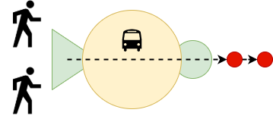
Shared Mobility

Slide 12
Relevant current research that is close to the topic
The literature review had to be segmented into two parts
To be more specific we're interested in DARP problems concerned with the first and last mile problems in multimodal commutes.
A survey of dial-a-ride problems by Ho et al. (9) presented an up-to-date review of recent studies on dial-a-ride problems (DARPs) with their different variants and solution methodologies. (22)
Many approaches are adopted to solve the dial a ride problem, each with a specific design that makes each problem different than the other.
However, some solutions take in to consideration the social welfare and the balance of affecting ride to drivers which makes the optimization relative to the context.

Slide 13
One of the proposed solutions are hybrid solutions frameworks for solving the DARP in (22), this includes two algorithmic components: dynamic programming (DP) and Large Neighborhood Search (LNS). Branch & Cut algorithm isused in (23) to find an exact solution using an LP model. Using re-optimization and an efficient network mixed-integer optimization formulation along with simple heuristics in (24), they were able to find solutions for large scale problems with 5000 taxis and 26; 000 bookings. Some researchers used an insertion algorithm for a DARP problem with narrow time windows (25).

Slide 14
Different theories that may apply to your specific area of research
That's why the state of the art took a natural turn into multimodal trip planning and routing problems.
Inter-modality, also called mixed-mode commuting, involves using two or more modes of transportation in a journey. However, the research that is going to be displayed in the next paragraph doesn't tackle the the optimization of mobility on demand with public transport, it does mention studies that mix ride-sharing with public transport nevertheless from routing problems point of view and feasibility studies.

Slide 15
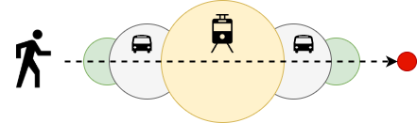
Intermodel passenger mobility

Slide 16
One of the early notable investigation done in this area is the report “Ride-sharing as a Complement to Transit”(28), this report was published in TRB, highlights ride-sharing as an important opportunity for transportation agencies to address the “last mile problem”
The report also shows that despite these important reasons for integrating ride-sharing into transit services, only a modest number of public transit agencies is involved in ride-sharing.
Notable research in this part is found in (4) where they investigated the
possibility of realizing a seamless integration of ride-sharing and public transit
as it may offer fast, reliable, and affordable transfer to and from transit stations in suburban areas thereby enhancing mobility of residents, they investigated the potential benefits of such a system by means of an extensive computational study.
Other researchers contributed by studying the same public transport feeding challenge but with autonomous mobility on demand in highly dense cities not rural areas, they presented a network flow optimization model that captures the joint operations of autonomous mobility on demand systems and public transit (30),

Slide 17
Notable contribution in (10) where they worked on combining dynamic ride sharing and public transport. In their work they address two problems in multimodality; the first is to connect public transport stations by dynamic ridesharing and the second is connecting start and destination of a query to public station routes by dynamic ride-sharing routes, although their contribution to the subject is more on the route planning the paper proposes very good methods for ride-matching and finding connections, they also showed better connections using ride-sharing and two modes of transport in terms of travel duration and cost.

Slide 18
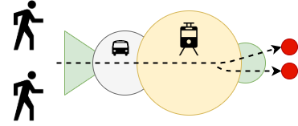
Shared Mobility + Intermodality

Slide 19
What are the areas of weakness and lack of research that are currently highlighted based on your literature review
To conclude this point in one sentence we can say that Inter-modality and multimodality exist in literature but none of the literature mixes between dial a ride problems and multimodal transport although it exists in real life.
Each service has a specific context, there's a clear lack of research output in DARP optimization problems when it comes to intermodal trip planning.
Even in the world of autonomous mobility their results show that an autonomous mobility on demand systems can significantly reduce travel times, pollutant emissions, total number of cars, and overall costs compared to an autonomous mobility on demand system operating in isolation,

Slide 20
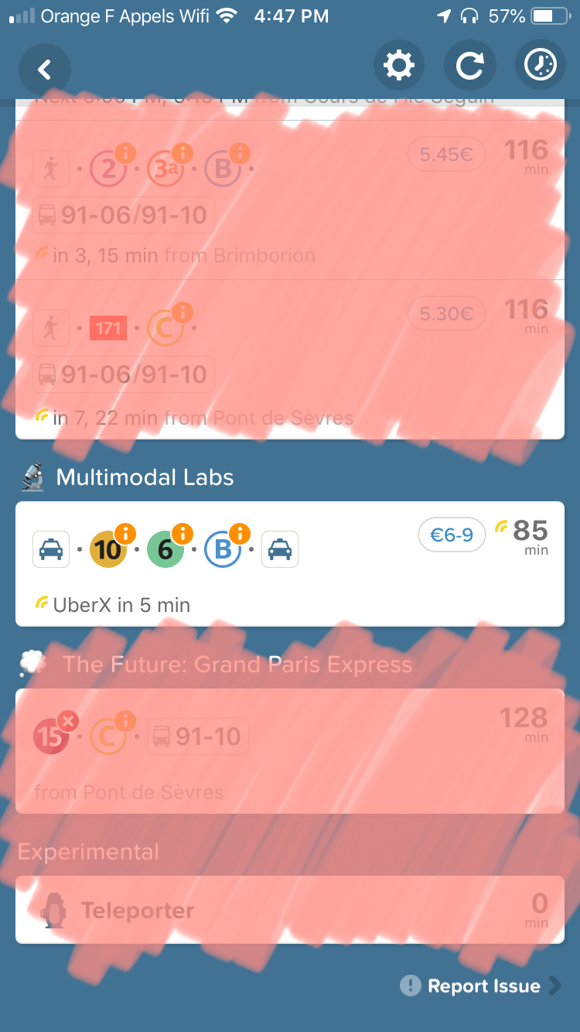
To conclude:
As previously mentioned, no study captures the interplay between multiple externalities arising from the synchronization of dierent modes of transportation.
To date, there exist no optimization frameworks that capture optimal coordination policies for MoD systems whilst assessing their achievable performance (30).
We can safely establish that the maturity of this subject is stagnant, this means that the topic is on the table now for a significant amount of time but the improvements and contributions don't seem to serve the area of first and last mile problems when using public transportation.
One of the common integration options between a fixed-schedule system and an on-demand feeder systems the so-called Demand Responsive Connector (DRC) (4).
Although a research gap has been identified, and despite the fact that in (9) they recommended a unified method for solving different DARP variants. Each DAR system has problem-specific constraints due to its underlying motivating application.

Slide 21
State of the art and hypotesis validation
Show how your idea and hypothetis developped after discovering
Although some of these apps will allow you to book your ride that will get you to the train station, neither the app nor the mobility on demand service provider will be responsible if you arrived late for the train.

Slide 22
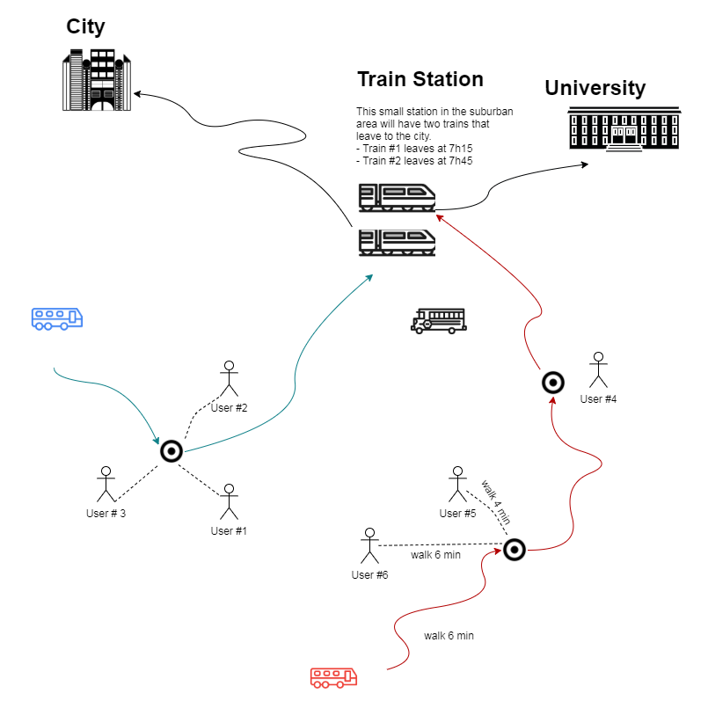
Problem Definition
The dial a ride problem often receives the pick up and drop-o time windows as inputs from the users, for mobility on demand the pick up location is usually the nearest point to the customer, in this problem we're going to introduce dynamic pick up locations taking into consideration the drop-o time windows which we're going to represent in our framework as timeslots and fair walking distance between customers and respective pickup stations.

Slide 23
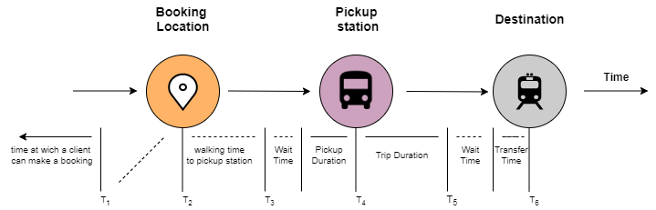
Time Sequence

Slide 24
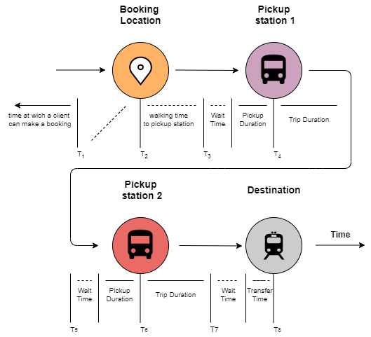

Slide 25
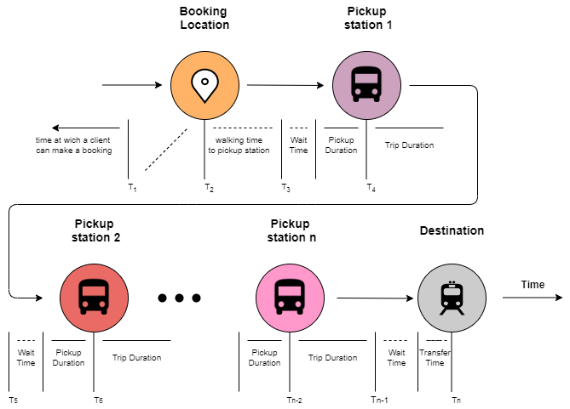

Slide 26
Mathematical formulation and objective functions
2 Parts:
The problem formulation is going to be presented in two mathematical models for the sake of simplicity and clarity; the first is going to handle the first part which is the station allocation problem and the second formulation for the driver allocation problem.
In this DAR problem the drop-off time window is defined by the timetable of the destination and not by the user, which makes the whole experience more reliable and seamless.
The modelling was based on Cordeau & Laporte Three Index Model and mathematical modelling was in general from H. Paul Williams book, model building in mathematical programming

Slide 27
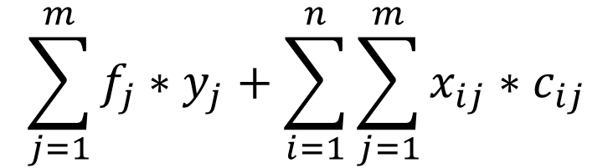
Part I
$$\sum_{j=1}^{m}{f_{j}∗y_{j}}+\sum_{i=1}^{n}{\sum_{j=1}^{m}{x_{ij}∗c_{ij}}}$$
Minimize:
« n » is the number of bookings
« m » is the number of stations
« f » is the variable that represent the opening cost
« c » is the travel cost from booking i to station j

Slide 28
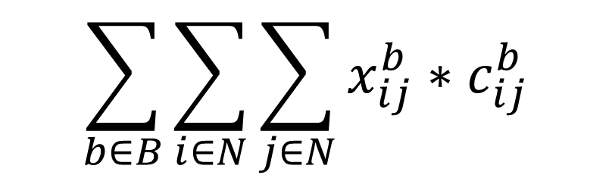
Part II
$$\sum_{b∈B}{\sum_{i∈N}{\sum_{j∈N}{x_{ij}^{b}}}}∗c_{ij}^{b}$$
Minimize:
B is the number of shifts available
N represents the number of pickups, depots and destinations
C is the cost function w.r.t driver b going from booking i (p/d) to booking j (p/d)

Slide 29
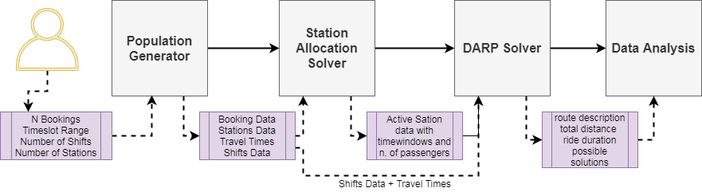
Structure & flow
Population generator
Station assignment problem
Driver assignment and routing problem
Data analysis
This structure helps me build the framework as I can focus on improving each part separately

Slide 30
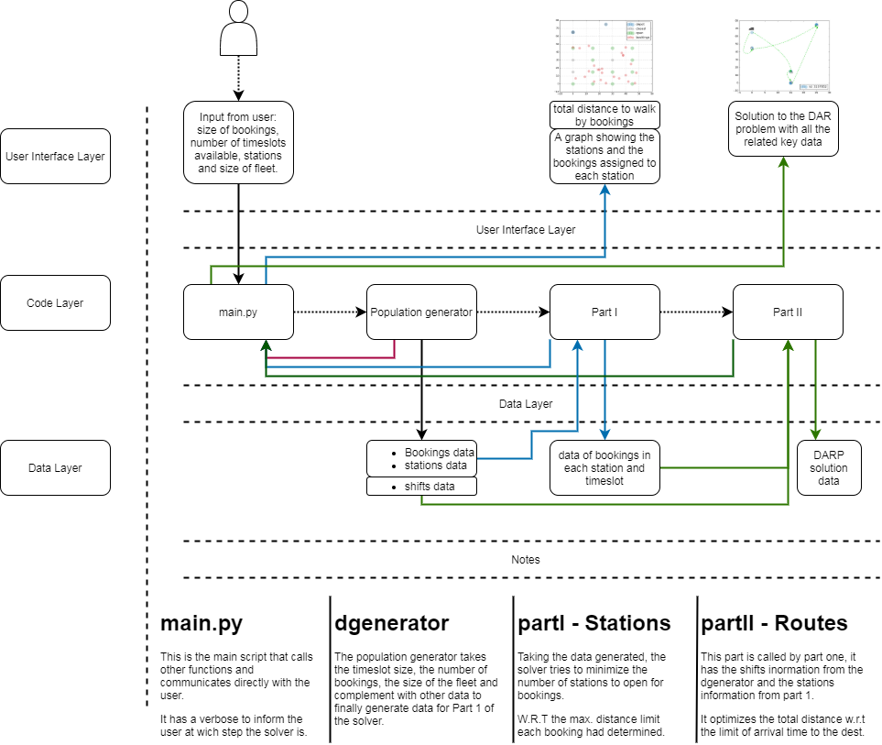
Architecture:

Slide 31
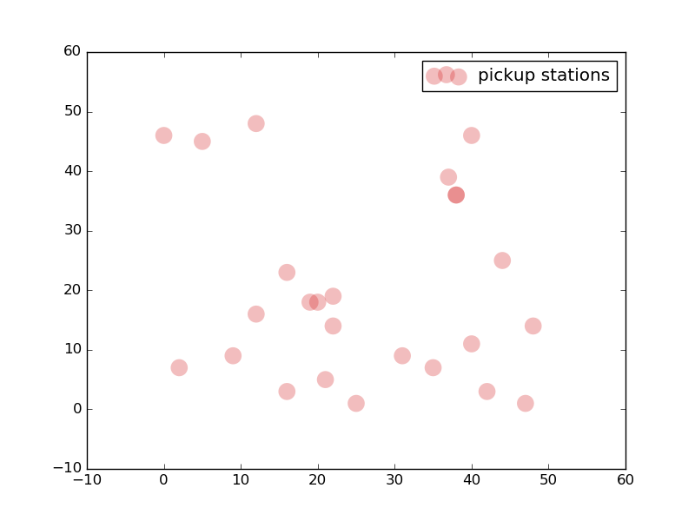
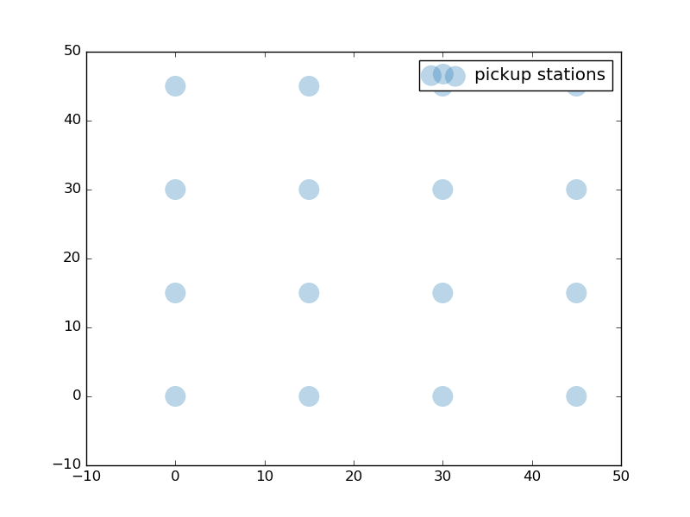

Slide 32
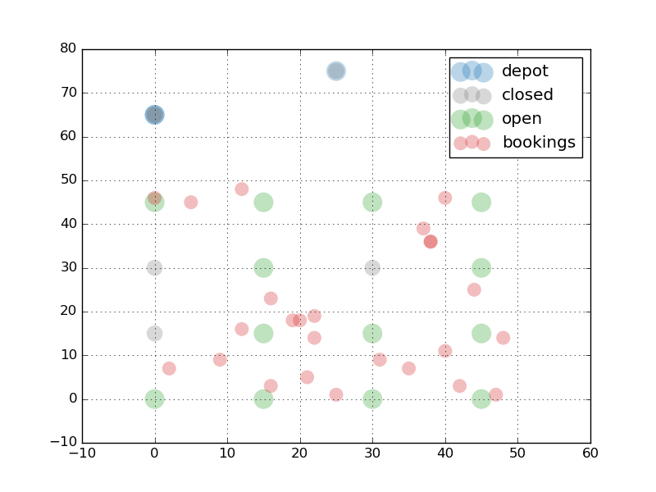

Slide 33
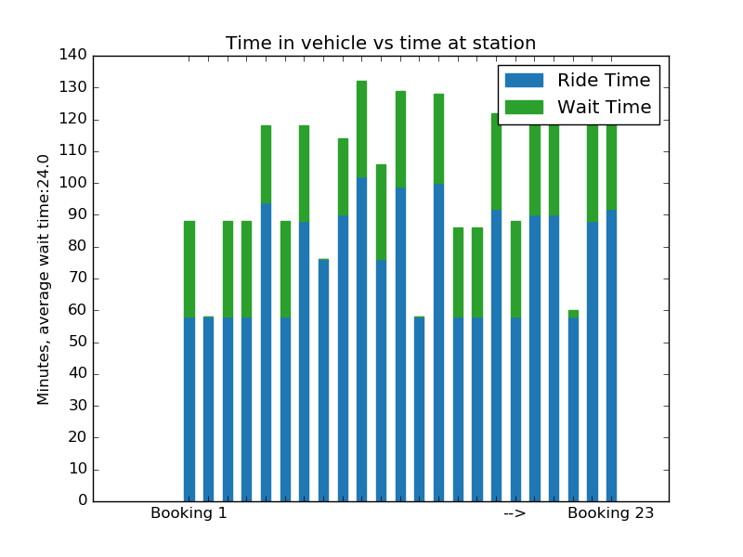
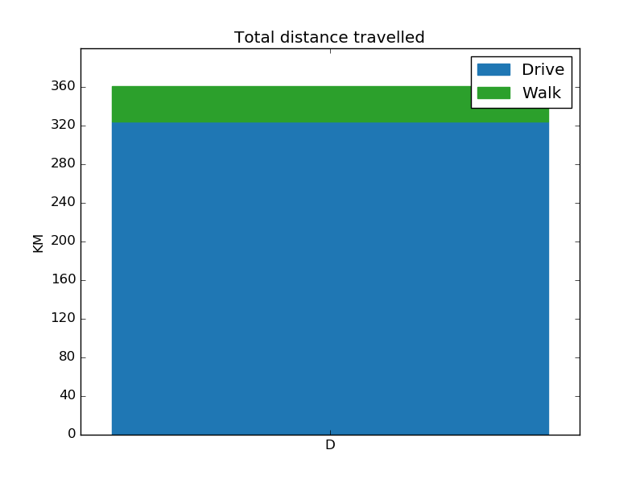
B is the number of shifts available

Slide 35
Results & observations
The data shows that there is a way to make the passengers wait less using darp with time windows in favor of minimizing the wait time.
Highlight the meaning of the results in relation to my studies and this current year
Talk about making actual comparative studies

Slide 36
Conclusion
Here I will restate my research questions The results show that the algorithm becomes more efficient when we have less timeslots, in this example it would relate to a large number of bookings in a peak time.
Show my contribution
State the limitations of the work you have done
Make recommendations and discuss next steps
In this set of data the total distance walke by the bookings is 36:715km, by comparing it to the total distance by vehicles 323:96km, the walking distance covers around 11% of the total travel distance.

Slide 37
The contribution of this project
The state of the art a bibliographic research amazing endeavor
I presented a case studies analyzing shared mobility system performances or studying their potential impacts on people's lives and their daily commutes if we optimized the DARP to feed the public transport system.
Thanks to this rich bibliography I am now able to identify the relevancy of scientic papers on a much higher pace.
Programming Skills
In the state of the art section I showed the connection in literature between public transport and shared mobility
I showed how can the DAR problem be reformulated to answer to the gap that currently exists
I gained confidence & motivation to continue in this research.
In the second part of the process, I learned a lot
With the latest trends to research deploying new autonomous mobility services, inter-modality become more attractive. And there is also a need to introduce new models and algorithms.

Slide 38
Next steps
Factorize and optimize
Create a mathematical formulation for the whole model
Create profiles for trips on repition
Optimize the whole model (instead of dividing it into two part) and compare results
Create user proles for daily commuters to optimize routing
Merge real-time booking with prearranged booking.
A framework of ride-sharing algorithms to build the most efficient public transport feeder.
Put constraints on pickup stations to be open on specific areas where there are no obstacles.

Slide 39






Access to the project:
@aymanmahmoud

Slide 40
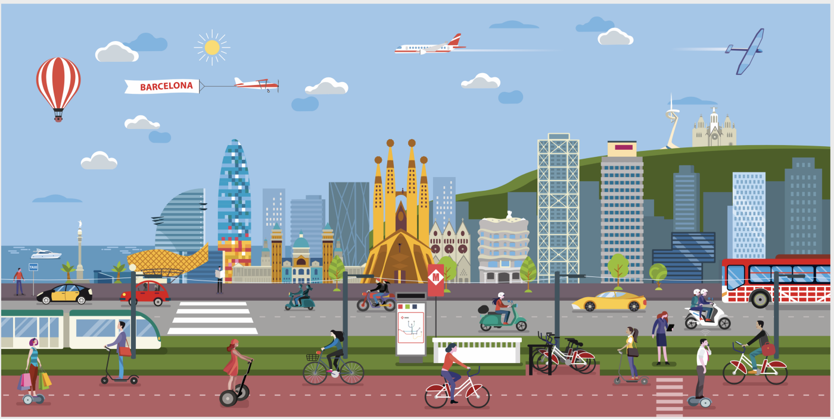
Thank You !

