Slide 1

An optimization algorithm for Dial a Ride problems in the context of intermodal route planning
Research Project Defense
Supervisors:
Prof. Jakob Puchinger
Prof. Asmaa Ghaffari
Presented by Ayman MAHMOUD
Master 1 – Ingénierie des systèmes complexes
CentraleSupélec

Slide 2

Overview:
Introduction
Key Figures & History
Motivation
Hypothesis
Methodology in Research
State of the art
Problem Definition
Results
Observations & Conclusion

Slide 3
Introduction:
Questions raised:
What are the research directions in mobility optimization?
What is the relationship between shared mobility and public transport in research?
Is there really a gap between mobility on demand and public transit systems?
Importance:
The increasing transportation demand in Europe.
The increase of public transport, network to serve a larger population.
Suburban underserved areas
The future of transport for a longer horizon is
There is a clear aim in the EU to make the multimodal passenger transport as seamless as possible.
If successfully implemented intermodal passenger transport will give more options to the traveler.
Objectives:
Understand transportation science and modeling of passenger transport systems.
Establish a framework that connects shared mobility with classical public transport.

Slide 4


Key figures & history:
In the region of Ile de France there's 836km of accessible roads where 25% experience congestion in the peak hour.
15–20% of total GHG in the EU and the US are caused by ground transportation.
Congestion increase 15-20% between 2008 and 2018.
Operating companies with a transport feeder model.
The first ride-sharing as in car-sharing program was established in 1948 in Zurich.
Not an attractive solution during this period.

Slide 5
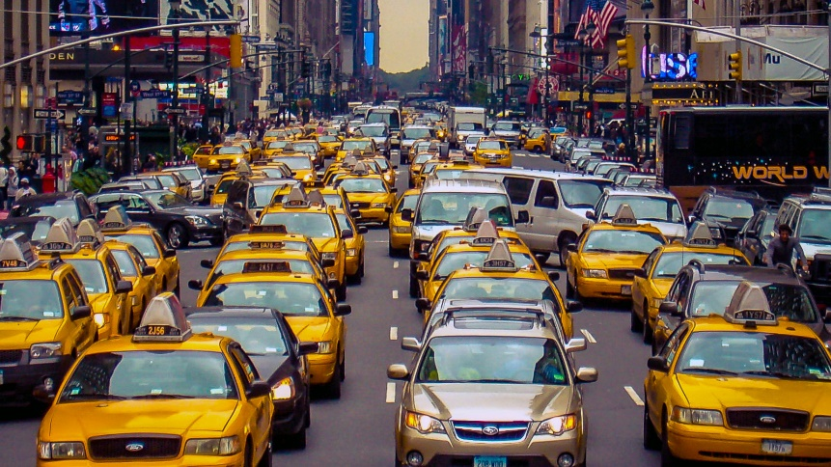
A point of critique:
Ride-sharing solutions exists we still have a rise in the traffic congestion and traffic density is worsening.
There exists no effective method of integrating ride-sharing solutions into transport trip planners.
Shared mobility can be highly criticized:
New York City study:
300,000 Cars
With shared mobility we need 60%
With AMOD…
137,500

Slide 6
Motivation:
The principal trip of passengers in urban zones or in peripheral urban zones.
2.148 million vs 12,278,210 million
Motivation in integrating both modes of transportation and finding a solution.
Current mobility problems require intelligent solutions.
A research gap
Allowing ride sharing to connect routes with public transit increases the demand.

Slide 7


Hypothetis:
There is room to improve intermodality between mobility on demand and public transport.
People find difficulty to manage their time during the trip especially when it consistes of taking more than one mode of transportation.
Example 1
Example 2

Slide 8
Methodology in research:
1. Comprehensive surveys that were published on topics of interest.
2. An overview of application areas of DARPs.
3. A detailed taxonomy of the problem variants.
4. Identification of potential research gaps.

Slide 9
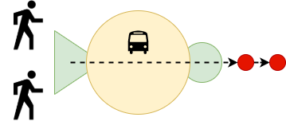
Shared Mobility

Slide 10
A survey on research developments on dial-a-ride problem since 2007.
Proposed solutions:
One of the proposed solutions are hybrid solutions frameworks for solving the DARP this includes two algorithmic components: dynamic programming (DP) and Large Neighborhood Search (LNS).
Branch & Cut algorithm is used to find an exact solution using an LP model.
5000 Taxis and 26,000 bookings.
Insertion Algorithm.
A natural turn into multimodal trip planning and routing problems.

Slide 11
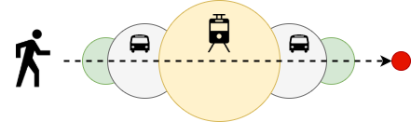
Intermodel passenger mobility

Slide 12
Opportunity for transportation agencies to address the “last mile problem”
The possibility of realizing a seamless integration of ride-sharing and public transit.
Transport feeding challenge but with autonomous mobility on demand in highly dense cities not rural areas.
Connecting between routes

Slide 13
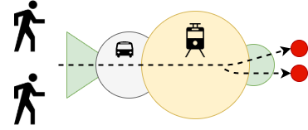
Shared Mobility + Intermodality

Slide 14
Inter-modality and multimodality exist in literature.
A clear lack of research output in DARP optimization problems when it comes to intermodal trip planning.
Same results in autonomous mobility on demand

Slide 15
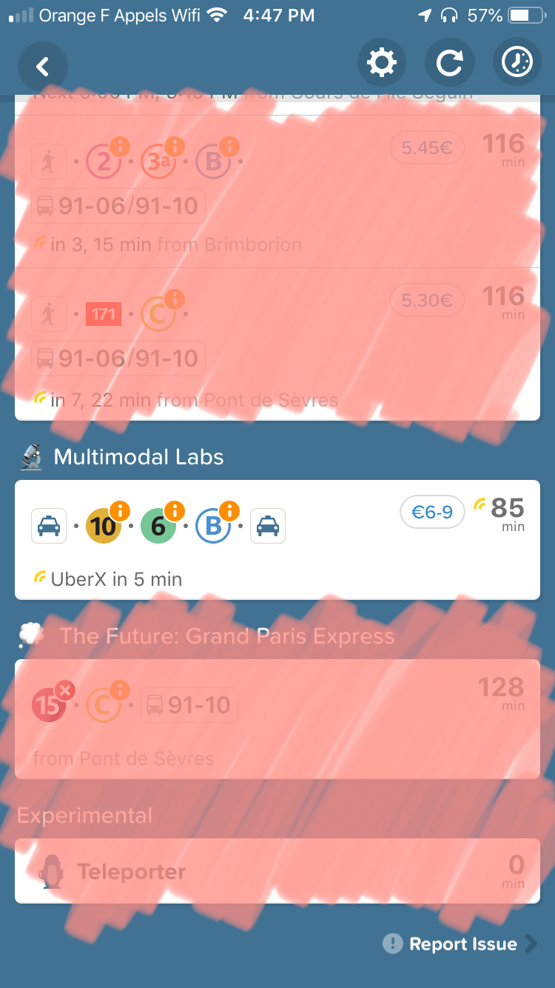
To conclude:
The gap exists.
To date, there exist no optimization frameworks that capture optimal coordination policies for MOD systems.
Research assessment: Stagnant.
A unified method to solve different variants.
No one is responsible if you’re late.

Slide 16
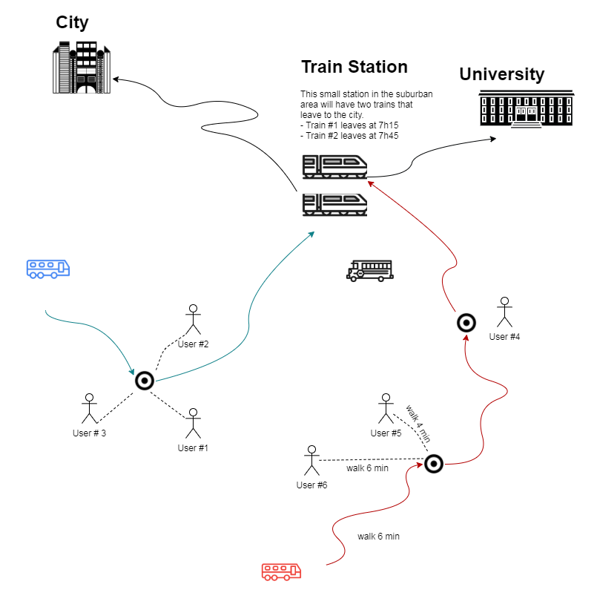
Problem Definition:
A Dial-a-ride problem.
Pickup location.
Timeslots

Slide 17
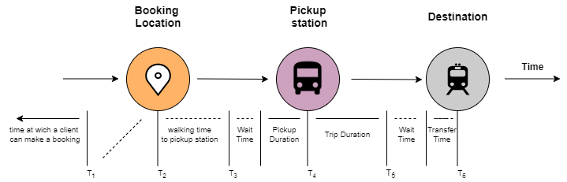
Time Sequence:

Slide 18
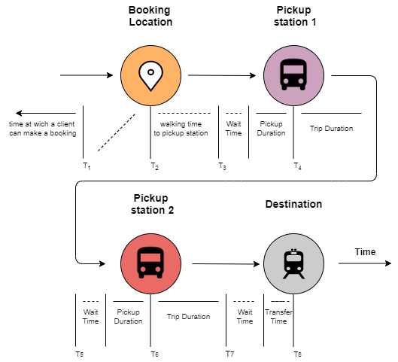

Slide 19
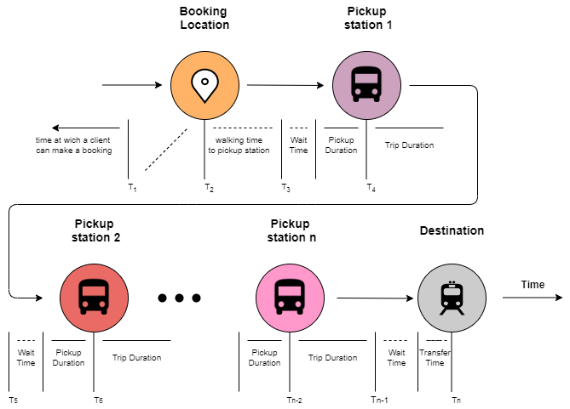

Slide 20
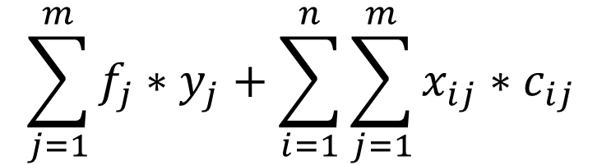
Part I
$$\sum_{j=1}^{m}{f_{j}∗y_{j}}+\sum_{i=1}^{n}{\sum_{j=1}^{m}{x_{ij}∗c_{ij}}}$$
Minimize:
« n » number of bookings
« m » number of stations
« f » opening cost os station j
« c » travel cost from booking i to station j

Slide 21
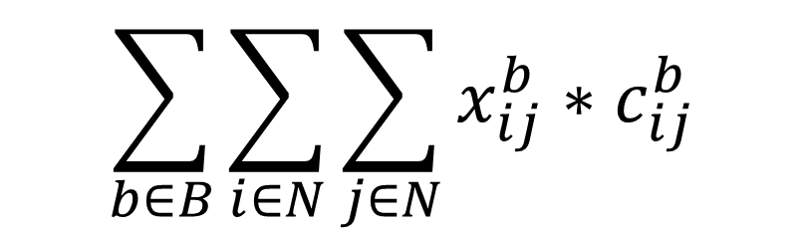
Part II
$$\sum_{b∈B}{\sum_{i∈N}{\sum_{j∈N}{x_{ij}^{b}}}}∗c_{ij}^{b}$$
Minimize:
« B » is the number of shifts available
« N » number of pickups, depots and destinations
« C » cost function w.r.t driver b going from booking i (p/d) to booking j (p/d)

Slide 22
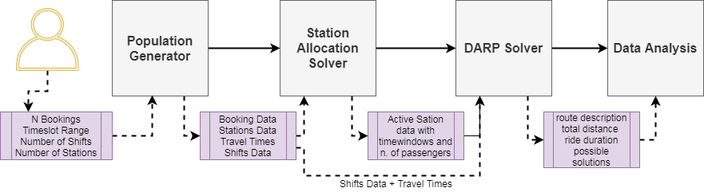
Structure & flow:
Population generator
Station assignment problem
Driver assignment and routing problem
Data analysis

Slide 23
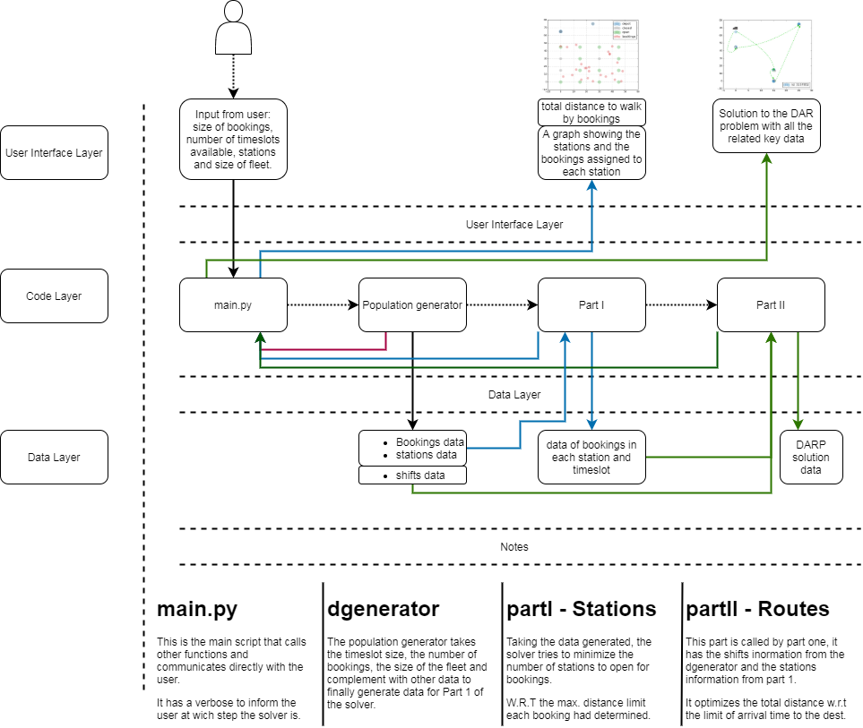
Architecture:

Slide 24
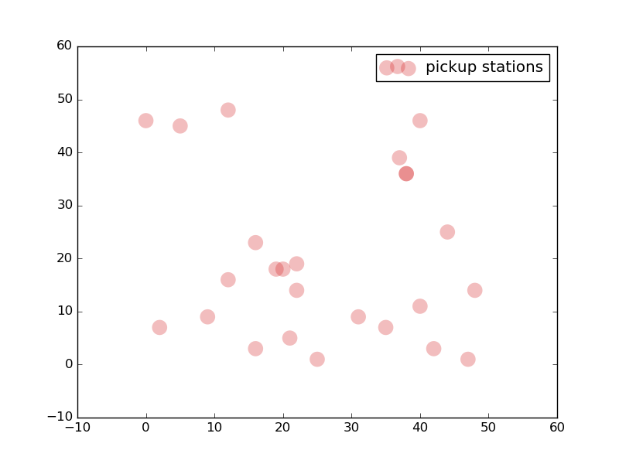
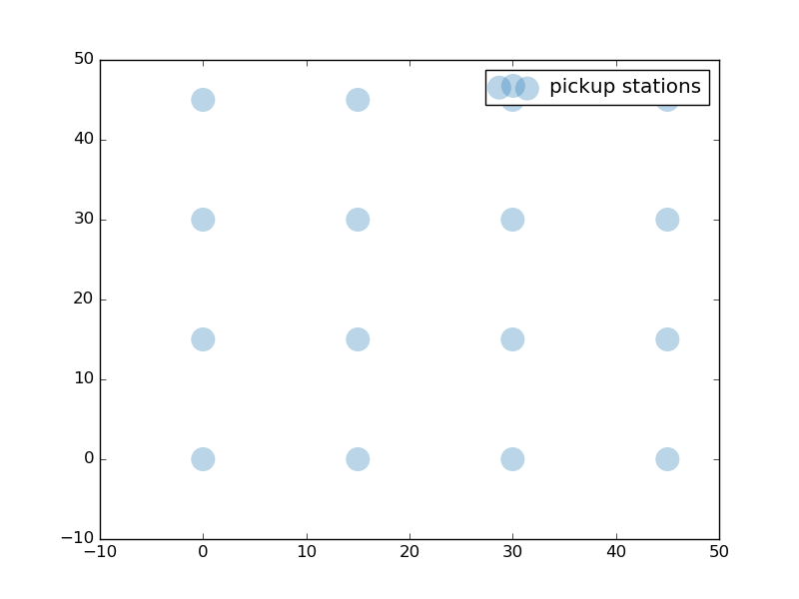

Slide 25
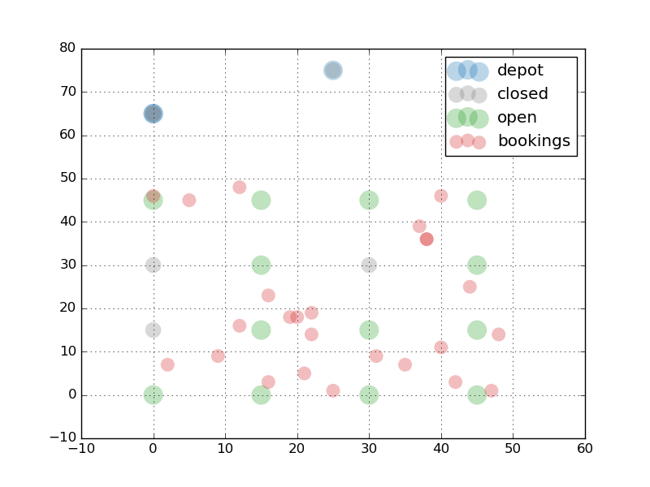

Slide 26
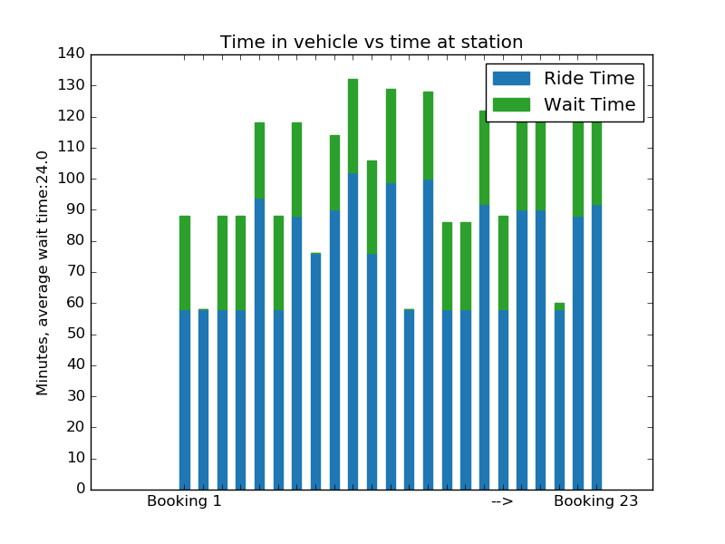
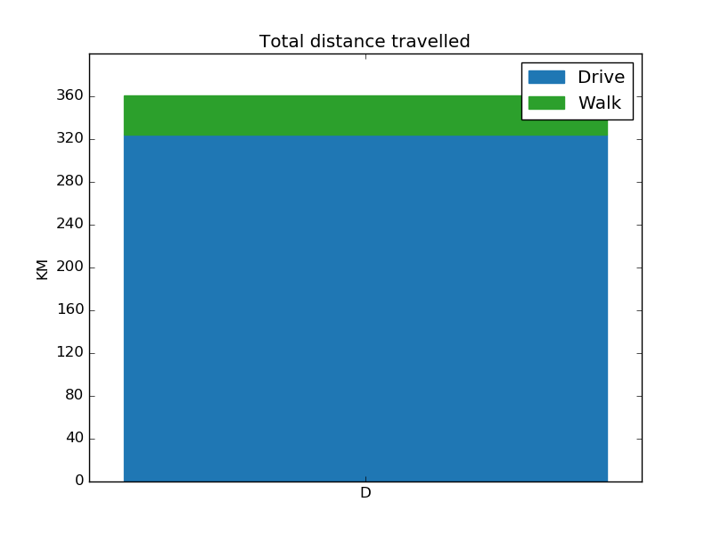
Average wait time: 24min
Total distance walked: 36.750km
Total Distance travelled by vehicles: 323.96km

Slide 28
Results & observations:
The data shows that there is a way to make the passengers wait less using darp with time windows in favor of minimizing the wait time.
Highlight the meaning of the results in relation to my studies and this current year
Talk about making actual comparative studies

Slide 29
Conclusion:
Here I will restate my research questions The results show that the algorithm becomes more efficient when we have less timeslots, in this example it would relate to a large number of bookings in a peak time.
Show my contribution
State the limitations of the work you have done
Make recommendations and discuss next steps
In this set of data the total distance walke by the bookings is 36:715km, by comparing it to the total distance by vehicles 323:96km, the walking distance covers around 11% of the total travel distance.

Slide 30
The contribution of this project
The state of the art a bibliographic research amazing endeavor
I presented a case studies analyzing shared mobility system performances or studying their potential impacts on people's lives and their daily commutes if we optimized the DARP to feed the public transport system.
Thanks to this rich bibliography I am now able to identify the relevancy of scientic papers on a much higher pace.
Programming Skills
In the state of the art section I showed the connection in literature between public transport and shared mobility
I showed how can the DAR problem be reformulated to answer to the gap that currently exists
I gained confidence & motivation to continue in this research.
In the second part of the process, I learned a lot
With the latest trends to research deploying new autonomous mobility services, inter-modality become more attractive. And there is also a need to introduce new models and algorithms.

Slide 31
Next steps:
Factorize and optimize
Create a mathematical formulation for the whole model
Create profiles for trips on repition
Optimize the whole model (instead of dividing it into two part) and compare results
Create user proles for daily commuters to optimize routing
Merge real-time booking with prearranged booking.
A framework of ride-sharing algorithms to build the most efficient public transport feeder.
Put constraints on pickup stations to be open on specific areas where there are no obstacles.

Slide 32






Access to the project:
@aymanmahmoud

Slide 33
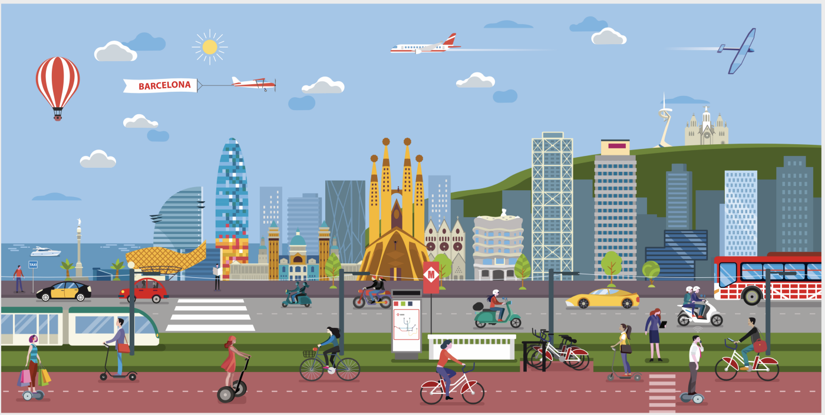
Thank You !

