Slide 1

An optimization algorithm for Dial a Ride problems in the context of intermodal route planning
Research Project Defense
Supervisors:
Prof. Jakob Puchinger
Prof. Asmaa Ghaffari
Presented by Ayman MAHMOUD
Master 1 – Ingénierie des systèmes complexes
CentraleSupélec

Slide 2

Introduction:
Questions raised:
What are the research directions in mobility optimization?
What is the relationship between shared mobility and public transport in research?
Is there really a gap between shared mobility and public transport systems?
Importance:
The increasing transportation demand in Europe. +42%
The increase of public transport, network to serve a larger population.
Suburban underserved areas.
15–20% of total GHG in the EU and the US are caused by ground transportation
Congestion increase 15-20% between 2008 and 2018
Objectives:
Understand transportation science and modeling of passenger transport systems.
Establish a framework that connects shared mobility with classical public transport.

Slide 3
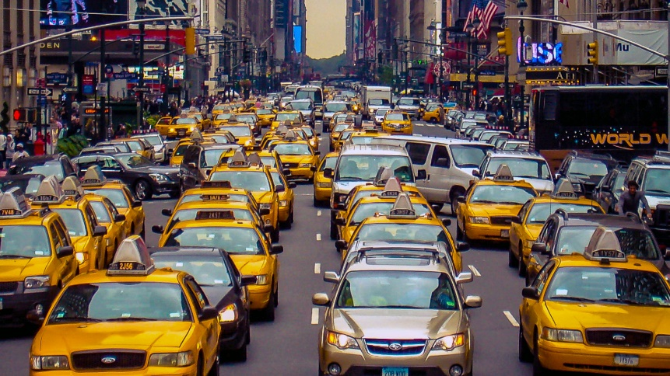
A point of critique:
Ride-sharing solutions exists we still have a rise in the traffic congestion and traffic density is worsening.
There exists no effective method of integrating ride-sharing solutions into transport trip planners.
Shared mobility can be highly criticized:
New York City study:
300,000 Cars
With shared mobility we need 60%
With AMOD…
137,500

Slide 4
Motivation:
The principal trip of passengers in urban zones or in peripheral urban zones.
2.148 million vs 12,278,210 million
Motivation in integrating both modes of transportation and finding a solution.
Current mobility problems require intelligent solutions.
Allowing ride sharing to connect routes with public transit increases the demand.

Slide 5
Methodology in research:
1. Comprehensive surveys that were published on topics of interest.
2. An overview of application areas of DARPs and routing problems in general.
3. A detailed taxonomy of the problem variants.
4. Identification of potential research gaps.

Slide 6
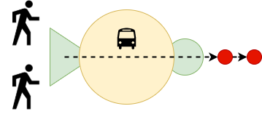
Shared Mobility

Slide 7
A survey on research developments on dial-a-ride problem since 2007.
Proposed solutions:
Hybrid solutions frameworks for solving the DARP.
Branch & Cut algorithm is used to find an exact solution using an LP model.
5000 Taxis and 26,000 bookings.
Insertion Algorithm.
A natural turn into multimodal trip planning and routing problems.

Slide 8
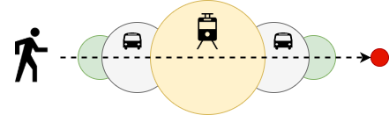
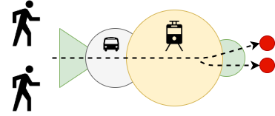
Intermodel passenger mobility

Slide 9
Opportunity for transportation agencies to address the “last mile problem”
The possibility of realizing a seamless integration of ride-sharing and public transit.
Study the transport feeding challenge with autonomous mobility on demand in highly dense cities.
Same results in autonomous mobility on demand.
Connecting between routes

Slide 10
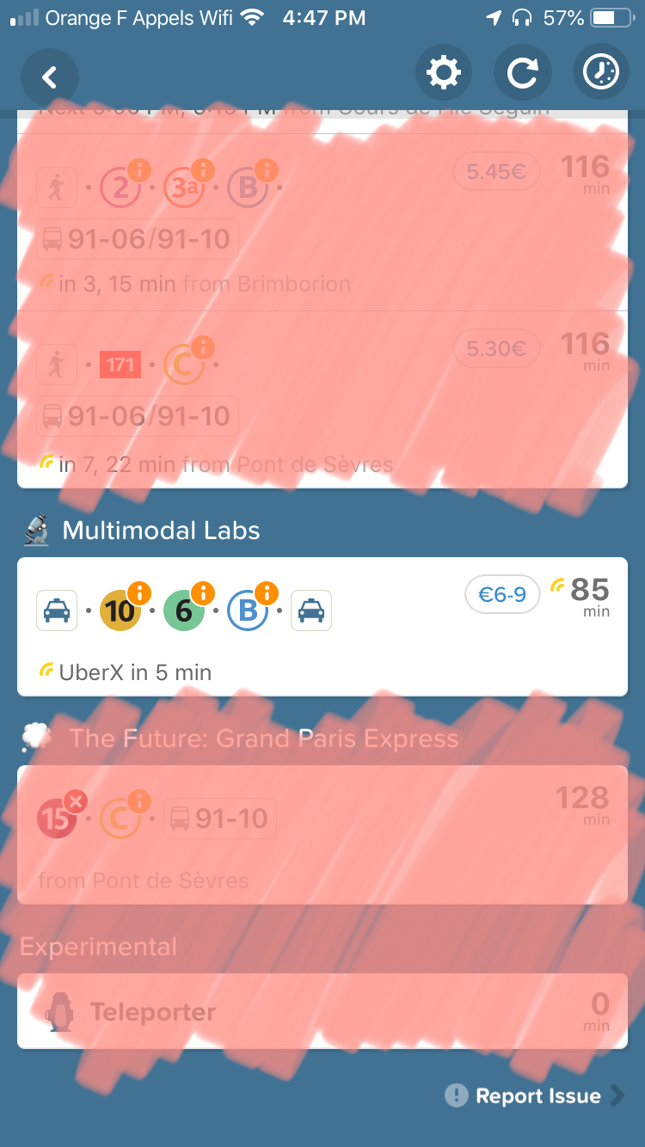
To conclude:
The research gap exists.
To date, there exist no optimization frameworks that capture optimal coordination policies for MOD systems.
Inter-modality and multimodality exists in literature.
Research assessment: Slow.
A clear lack of research output in DARP optimization problems when it comes to intermodal trip planning.
No one is responsible if you’re late.

Slide 11
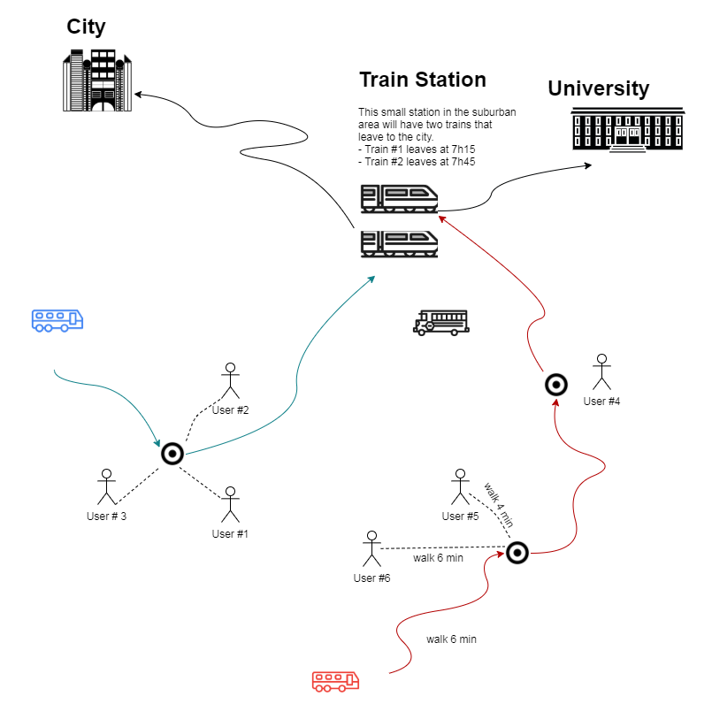
Problem Definition:
A Dial-a-ride problem.
Pickup location.
Timeslots

Slide 12
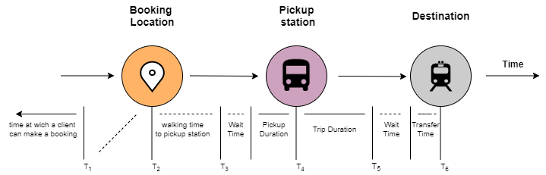
Time Sequence:

Slide 13
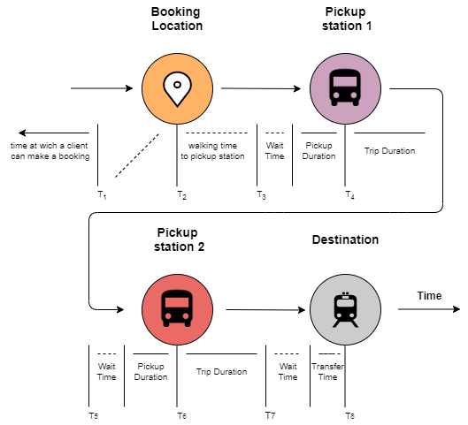

Slide 14
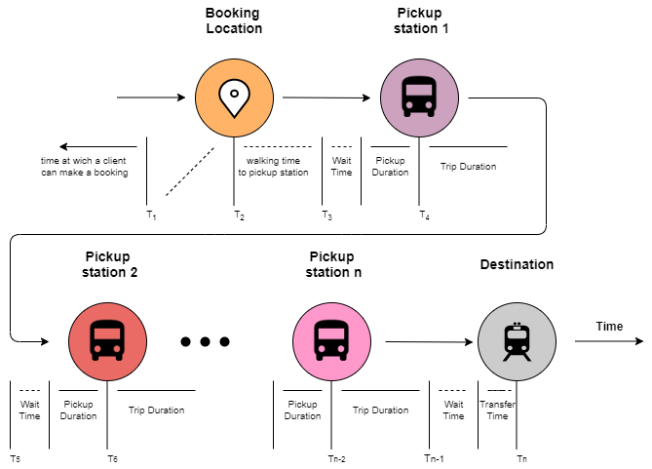

Slide 15
Mathematical Formulation:
Stations Allocation
Driver Allocation
Architecture and flow

Slide 16
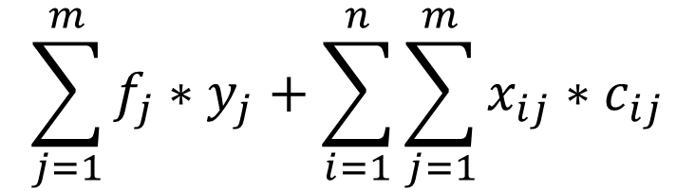
Part I
$$\sum_{j=1}^{m}{f_{j}∗y_{j}}+\sum_{i=1}^{n}{\sum_{j=1}^{m}{x_{ij}∗c_{ij}}}$$
Minimize:
« n » number of bookings
« m » number of stations
« f » opening cost of station j
« c » travel cost from booking i to station j

Slide 17
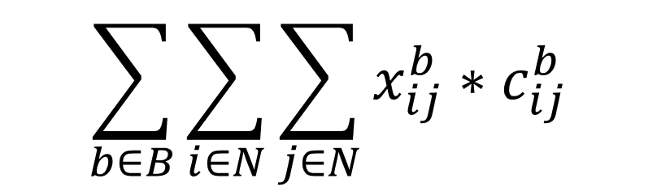
Part II
$$\sum_{b∈B}{\sum_{i∈N}{\sum_{j∈N}{x_{ij}^{b}}}}∗c_{ij}^{b}$$
Minimize:
« B » is the number of shifts available
« N » number of pickups, depots and destinations
« C » cost function w.r.t driver b going from location i (p/d) to location j (p/d)

Slide 18
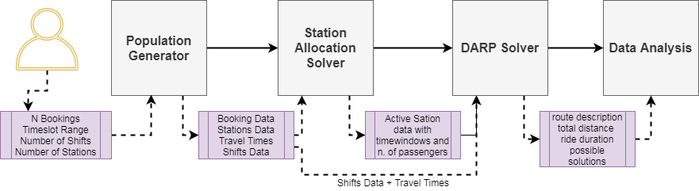
Structure & flow:
Population generator
Station assignment problem
Driver assignment and routing problem
Data analysis

Slide 19
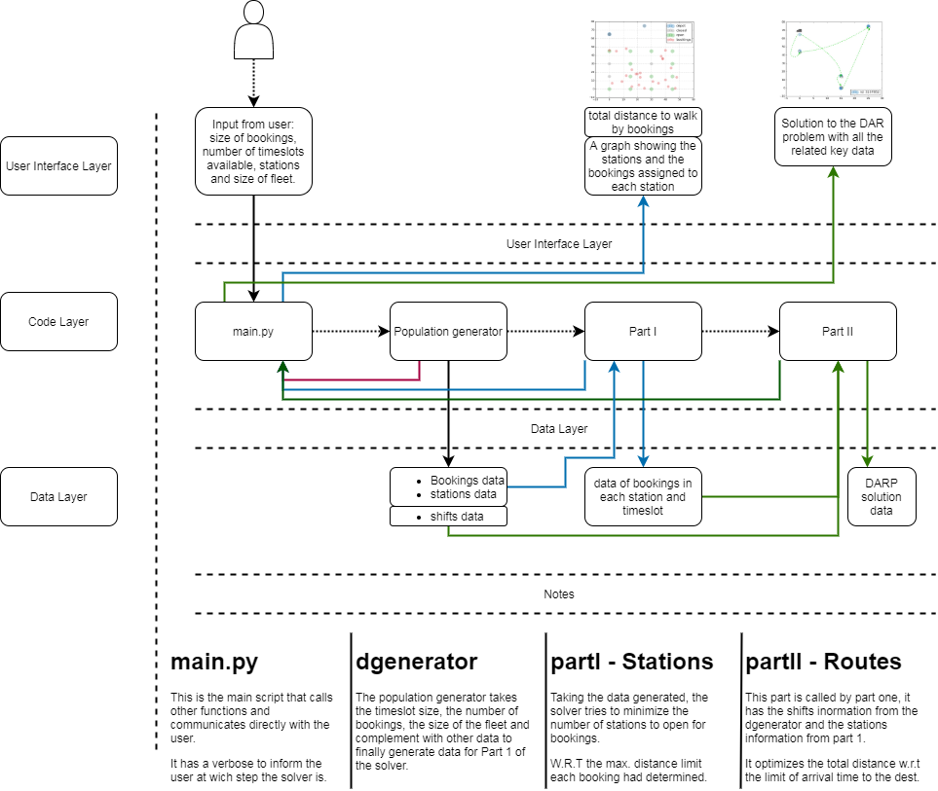
Architecture:

Slide 20
Results:

Slide 21
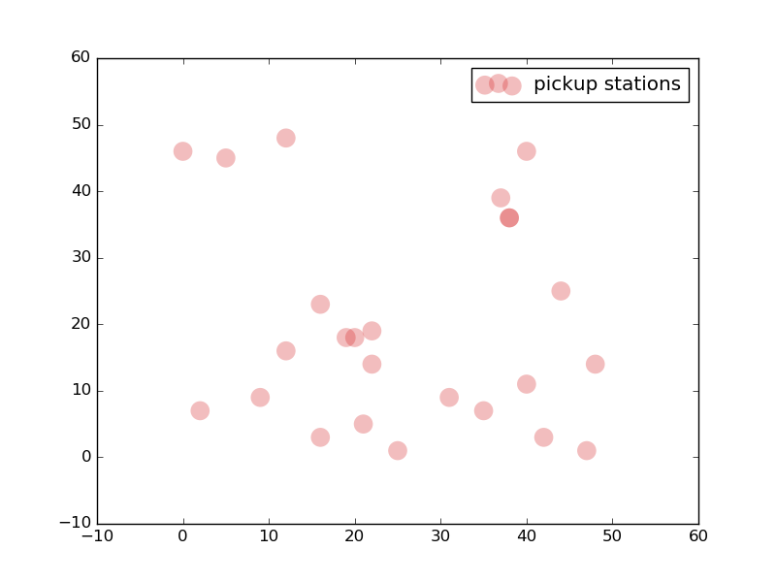
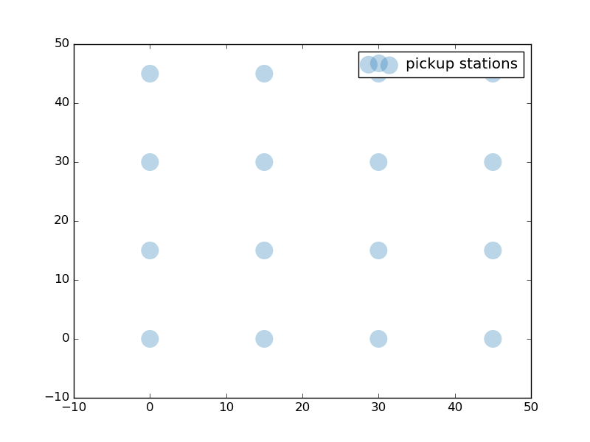
25 Bookings
10 Timeslots
16 Pickup Stations

Slide 22
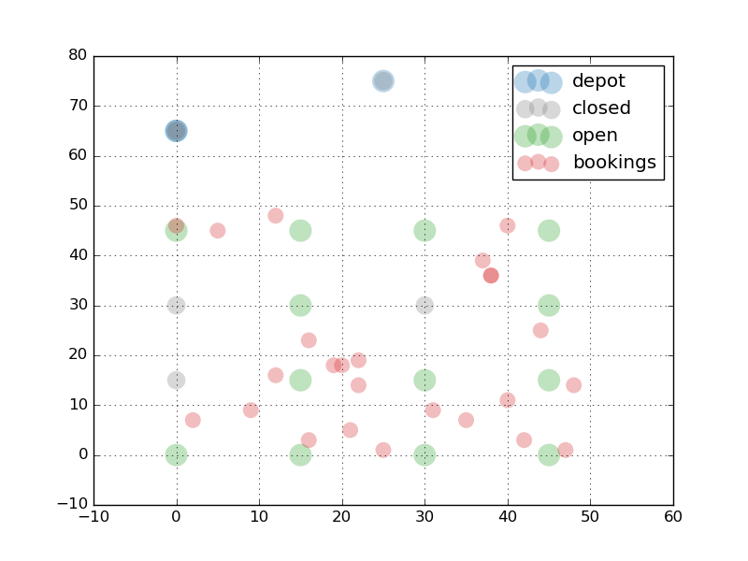
13
3

Slide 23
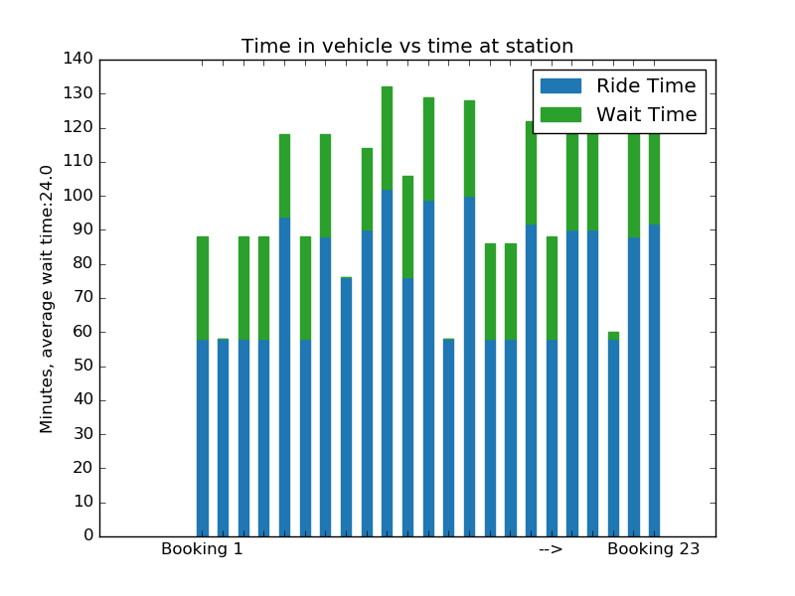
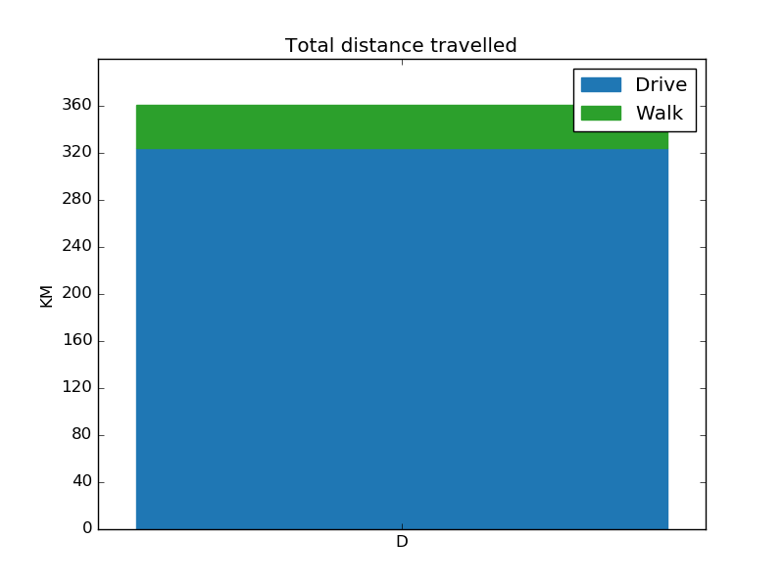
Average wait time: 24min
Total distance walked: 36.750km
Total Distance travelled by vehicles: 323.96km

Slide 25
Results & observations:
Use DARP in favor of minimizing the wait time and feeding P.T.
Shared mobility is a non formal feeder to public transport.
Reduce carbon footprint.
Speed of the solver vs timeslots.
Limitations:
Comparative studies
Data

Slide 26
The contribution of this project:
The state of the art & literature review. Ability to identify relevancy.
In the state of the art section I showed the connection in literature between public transport and shared mobility.
I showed how can the DAR problem be reformulated to answer to the gap that currently exists.
I gained confidence & motivation to continue in this research.
Programming Skills (Julia, Python, Gurobi & CPLEX)

Slide 27
Next steps:
Create a mathematical formulation for the whole model.
Optimize the whole model and compare results.
Integrate timetables.
Include real geographic locations and use real routing data.
Add constraints to the location of pickup stations.

Slide 28






Access to the project:
@aymanmahmoud

Slide 29
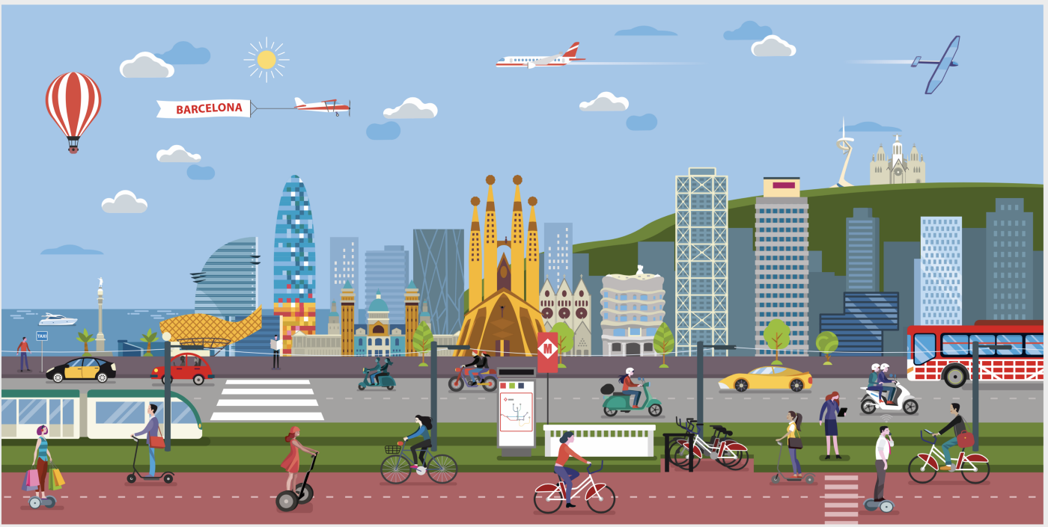
Thank You !

