Slide 1
Wikipedia Data Project: Chemical Elements
Student: Ayman Berri | Course: Web Scraping & Data Analysis
Objective: Scrape, clean, and visualize Wikipedia’s List of Chemical Elements

Slide 2
Project Overview
Scraped live data from Wikipedia’s List of Chemical Element
Cleaned messy numeric and reference formats using regex & Panda
Analyzed 15 KPIs grouped into 5 scientific categories:
  Structure of the Periodic Table
  Atomic & Physical Properties
  Thermal & Energy Behavior
  Natural Abundance & Availability
  Chemical Reactivity & Bonding Behavior
Visualized patterns across 118 elements using Matplotlib & Plotly

Slide 3
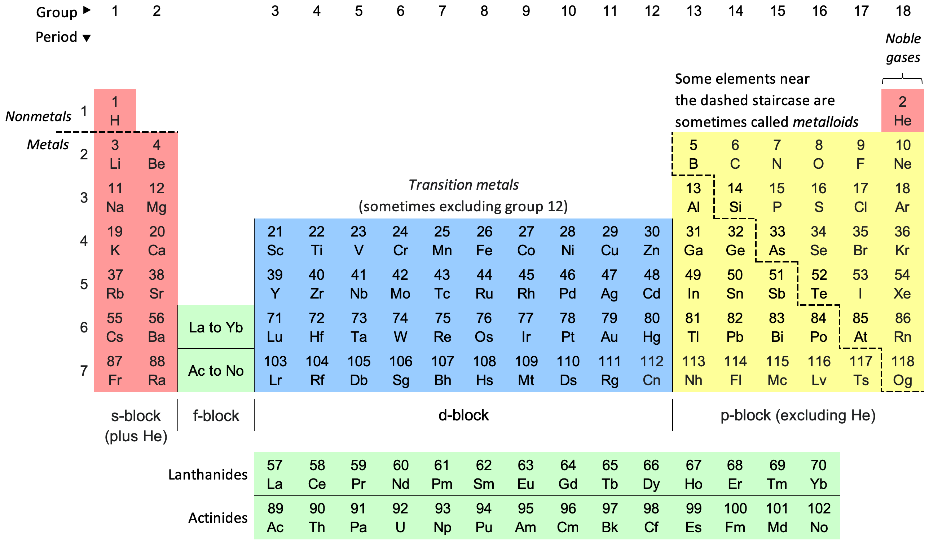
Periodic Table of Elements

Slide 4
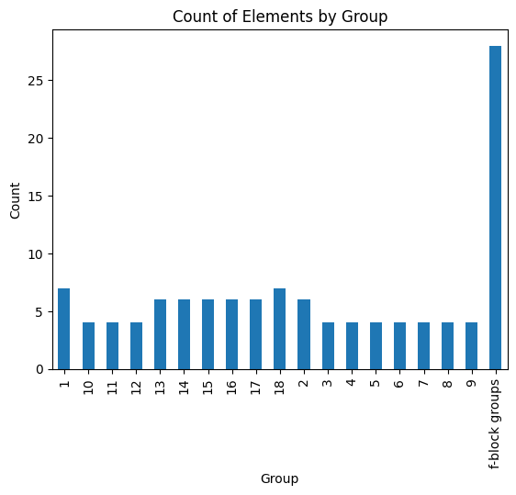
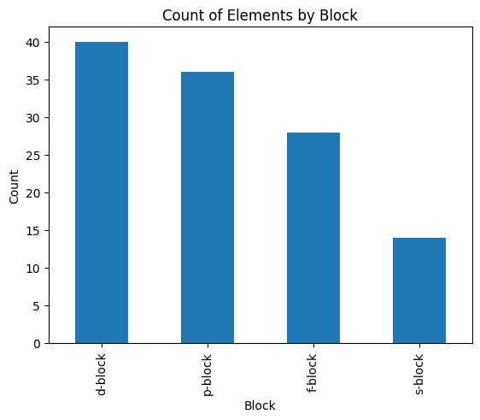
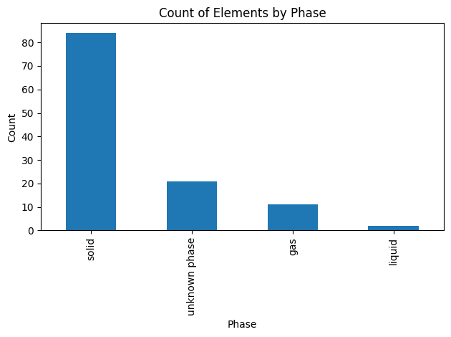
KPI Group 1: Periodic Table Structure
Count of elements in each block and group shows how elements are distributed across the periodic table.
The d-block (transition metals) has the most elements; s- and p-blocks are smaller but contain highly reactive metals and nonmetals.
Real-world relevance:
  Helps chemists predict chemical behavior.
  Industrial chemists can identify which groups are likely sources for metals or semiconductors.

Slide 5
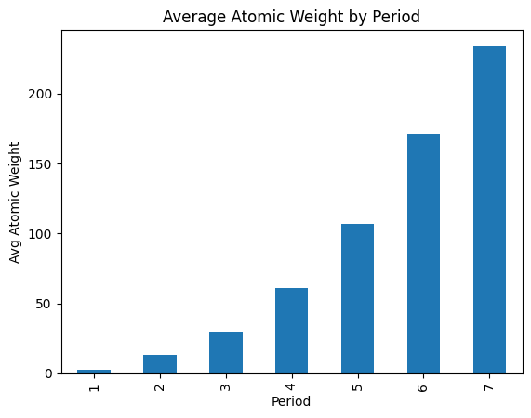
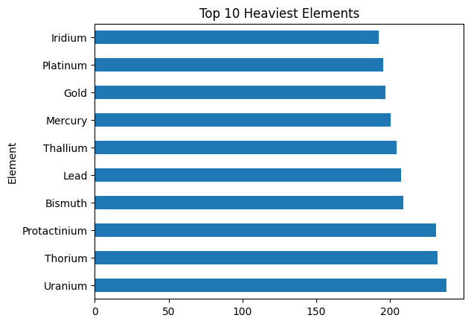
KPI Group 2: Atomic & Physical Properties
Atomic weight increases across periods, showing clear periodic trends.
Osmium and Iridium are extreme density outliers.
Uranium, Thorium, and Neptunium stay liquid across thousands of degrees, great for extreme heat applications.
Real-World Use:
Key for materials science and engineering design.
Helps choose elements for reactors, alloys, and high-temperature processes.

Slide 6
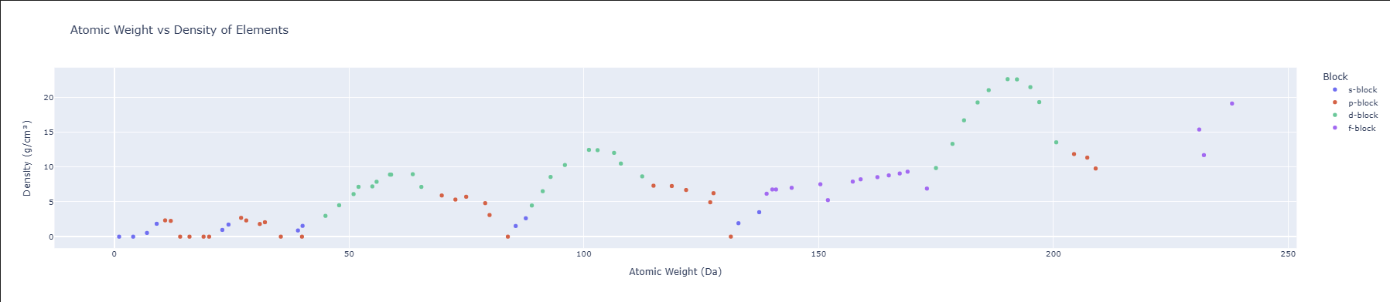
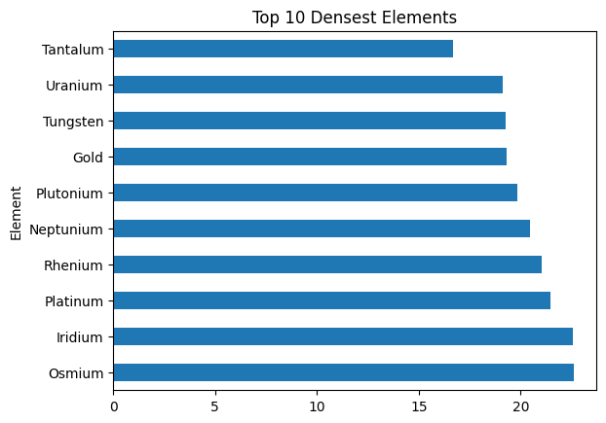
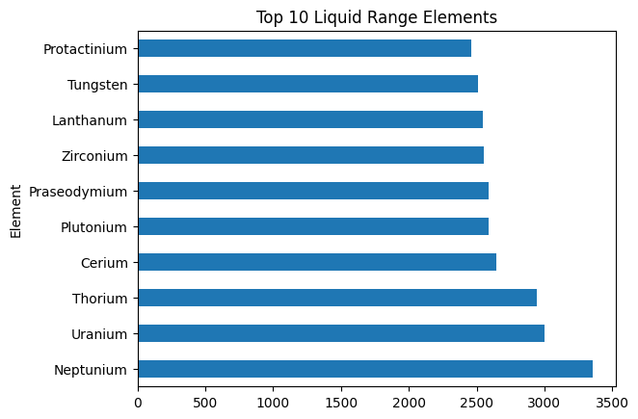

Slide 7
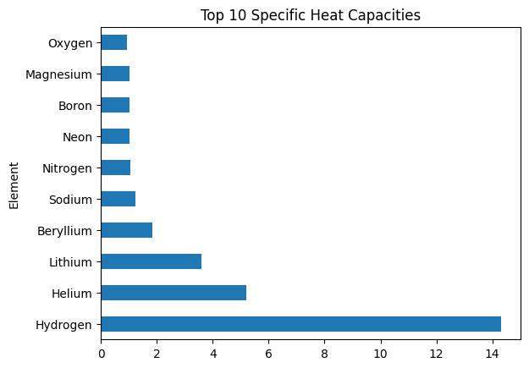
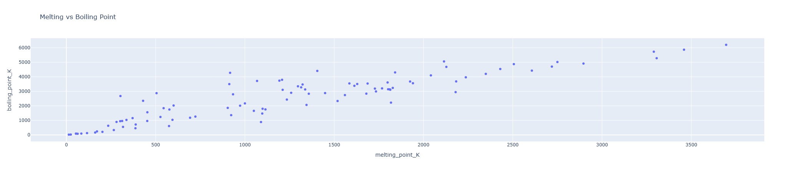
KPI Group 3: Thermal & Energy Behavior
Elements differ in how they handle heat, some melt or boil easily, others stay stable at extreme temperatures.
Specific Heat Capacity shows how well an element stores heat, Hydrogen and Helium top the list, acting like “heat sponges.”
The Melting vs Boiling Point chart reveals elements like Tungsten that remain solid under intense heat.
Real-World Relevance:
Useful for high-temperature materials, energy storage, and cooling system design.
Guides industries from aerospace to everyday cookware in selecting heat-resistant elements.

Slide 8
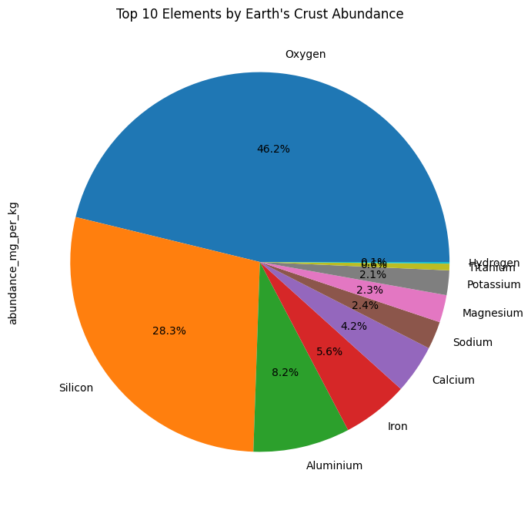
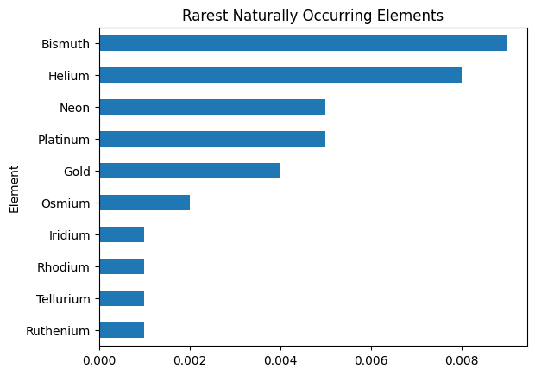
KPI Group 4: Natural Abundance & Availability
The Earth’s crust is mostly Oxygen, Silicon, Aluminum, and Iron, making up over 90% of its mass.
In contrast, rare elements like Gold, Platinum, and Rhodium occur only in trace amounts, explaining their high value.
Real-World Relevance:
Helps identify which elements are economically viable to mine.
Guides resource management and sustainable extraction.
Explains why rare elements are crucial for electronics, clean energy, and high-tech devices despite their scarcity.

Slide 9
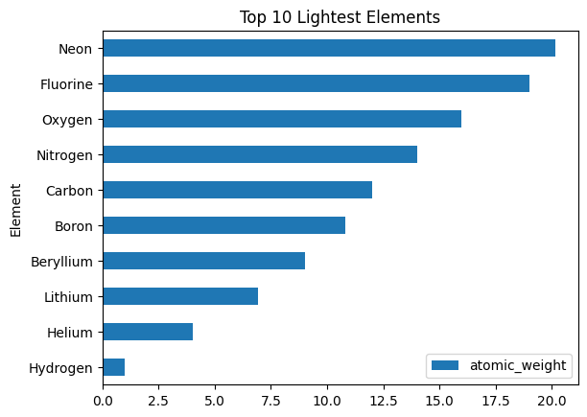
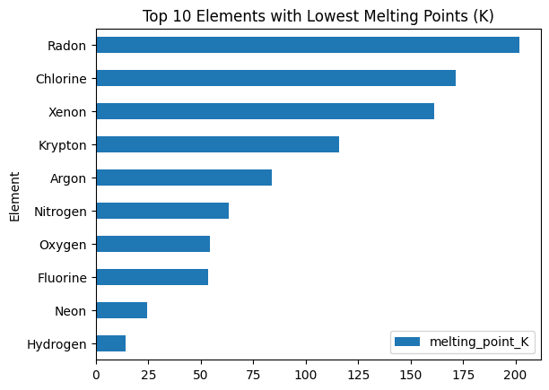
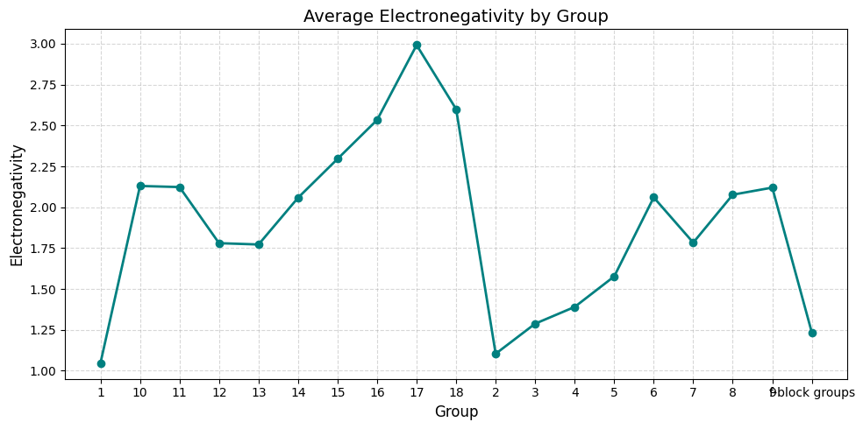
KPI Group 5: Reactivity & Bonding
The lightest elements: Hydrogen, Helium, Carbon, Nitrogen, and Oxygen are the foundation of life and the universe.
They make up water (H₂O), the air we breathe (O₂ and N₂), and organic molecules like proteins and DNA.
Real-World Relevance:
Hydrogen powers rocket fuel and hydrogen fuel cells for clean energy.
Helium is used in MRI machines and cooling superconductors.
Carbon forms the basis of life and modern materials like graphite and carbon fiber.
Together, they show how light elements shape life, technology, and the cosmos.

Slide 10
Methodology
1️⃣ Scraped live HTML tables using Pandas `read_html()`
2️⃣ Cleaned messy numeric fields (e.g., atomic weights, densities, melting points)
3️⃣ Converted and standardized all numeric units for analysis
4️⃣ Created 15 visual KPIs using Matplotlib and Plotly for interactivity
5️⃣ Summarized patterns in element behavior, abundance, and structure

Slide 11
Conclusion
✅ Successfully scraped, cleaned, and analyzed data for all known elements.
✅ Built 15 visual KPIs that show how elements differ in weight, heat, and abundance.
✅ Discovered clear periodic trends in electronegativity, density, and atomic structure.
✅ Final dataset saved as `cleaned_elements.xlsx`, ready for further analysis or ML use.

