Slide 1
Java 8 - Deep Dive Workshop

Slide 2
Topics
New Java tools……………………………….…..114
Nashorn engine: jjs
Class dependency analyzer: jdeps
Java Mission Control (jmc)
Java runtime (JVM) New Features…..131
Java language…………………………3
Lambdas and Functional Interfaces
Method References
Interface Default and Static Methods
Repeating annotations
Extended Annotations Support
Reflection Parameter names
Java APIs………………………………44
Optional
Optimistic Reading – Lock API
Streams
Date/Time API (JSR 310)
Nashorn JavaScript engine
Base64
Parallel Arrays

Slide 3
Java Language
Lambdas and Functional Interfaces
Java 6 came with scripting engine API
Default RI was Rhino Mozilla Java Script Engine
It raised a problem: How should dynamic code get executed in a non-dynamic plug-in like the JVM ?
function main (function, arg1, arg2){ window[function](arg1,arg2);
}
function dynamicFunc(x, y){
alert(x+y);
}
//invoking:
main('dynamicFunc','hello‘,'world');
function getDynamic(x){
var f = doSomething(x){
if(x>y) return true;
else return false;
}
return f;
}

Slide 4
Java Language
Lambdas and Functional Interfaces
Java 7 Dynamic Invocation
JSR 292: Java Platform Support for Dynamically Typed Languages
Engines can use additional runtime instructions in order to compile code
Invokedynamic – new bytecode instruction that allows to translate method invocation without relating to the object holds it
Java.dyn.MethodHandler – bounded to each Invokedynamic instruction
- holds reference to a JVM method
- cached
Both invokedynamic and MethodHandlers are updated during runtime
That’s great…we got this dynamic thing in our plugin but we can’t use it in Java…

Slide 5
Java Language
Lambdas and Functional Interfaces
Java 8 came to the rescue
Provides support for LAMBDA expressions
All LAMBDA calls are done via native invokedynamic
Now we can assign some code as a method
- No need in callbacks (event model)
- Reduces anonymous classes
- More up-to-date way of coding

Slide 6
Java Language
Lambdas and Functional Interfaces
LAMBDA expressions are supported for functional interfaces
Functional interface
- Denoted with @FunctionalInterface
- Some interfaces were updated (Runnable, Comparable, Event….)
- Many new interfaces are provided (later)
- You may create your own

Slide 7
Java Language
Lambdas and Functional Interfaces
Working with Functional Interfaces
Old code
Abuse classes
Uses anonymous classes
public class MyRunnable implements Runnable {
public void run(){
…….
}
}
(new Thread(new MyRunnable())).start();
(new Thread(new Runnable(){
public void run(){
…….
}
})).start();

Slide 8
Java Language
Lambdas and Functional Interfaces
Since Runnable is now:
You may use it like that:
If your method is single lined you may skip { }
Not just simple coding… don’t forget it is also executed dynamically !
@FunctionalInterface
public interface Runnable {
public void run();
}
Runnable r = () -> { ……… };
(new Thread(r)).start();
(new Thread(
() -> { ……… }
)).start();

Slide 9
Java Language
Lambdas and Functional Interfaces
Single-lined & blocks examples:
Runnable r = () -> System.out.println(“Hey!”);
(new Thread(r))).start();
Runnable r = () -> {
for(int i=0;i<100;i++){
System.out.println( i );
}};
(new Thread(r)).start();
(new Thread(() -> System.out.println(“Hey!”))).start();
(new Thread(() -> {
for(int i=0;i<100;i++){
System.out.println( i );
}}
)).start();

Slide 10
Java Language
Lambdas and Functional Interfaces
What about methods that accepts parameters ?
Type safety is determined & enforced during compile time
Example:
here, the compiler assumes you’re about to assign Comparator<String>
Comparator in now @FunctionalInterface
Therefore, the compiler checks any assigned function to have the following signature:
Just like Comparator<T>.compare(T,T) signature
List<String> words = Arrays.asList{“David”,”Adam”,”Eve”,”Moses”};
Collections.sort(words, XXX);
public int XXX (String s1, String s2)

Slide 11
Java Language
Lambdas and Functional Interfaces
So, we may come up with our own implementations
But this time Instead of creating a class & force object instantiation…
Old coding:
public int XXX (String s1, String s2)
public class ReverseNameComparator implements Comparator<String>{
public int compare (String s1, String s2){
return s1.compareTo(s2)*(-1);
}
}

Slide 12
Java Language
Lambdas and Functional Interfaces
We can do it this way:
Or this way:
Or this way:
public int XXX (String s1, String s2)
List<String> words = Arrays.asList{“David”,”Adam”,”Eve”,”Moses”};
Comparator<String> c=(String s1,String s2)->return s1.compareTo(s2)*(-1);
Collections.sort(words, c);
List<String> words = Arrays.asList{“David”,”Adam”,”Eve”,”Moses”};
Collections.sort(words, (String s1,String s2)->return s1.compareTo(s2) *(-1));
List<String> words = Arrays.asList{“David”,”Adam”,”Eve”,”Moses”};
Collections.sort(words, (s1,s2)->return s1.compareTo(s2) *(-1));

Slide 13
Java Language
Lambdas and Functional Interfaces
Polymorphism isn’t checked on dynamic invocation (only method signature)…
This means we don’t even need to implement Comparator (!)
But how exactly can we assign it to Collections.sort() method ?? In a moment…
public int XXX (String s1, String s2)
public class Things {
public int doThings(String s1, String s2){
return s1.compareTo(s2)*(-1);
}
}

Slide 14
Java Language
Lambdas and Functional Interfaces
You may create custom abstractions based on functional interfaces
As we’ll see later, any method with this signature :
can be assigned to RaiseValue.raise()
@FunctionalInterface
public interface IncrementByOne<T> {
public int increment();
}
public class RaiseValues<T> {
public void raise(IncrementByOne<? super T> entity){
System.out.println(entity.increment());
}
}
public int XXX ()

Slide 15
Java Language
Lambdas and Functional Interfaces
Important functional interfaces
Existing & enhanced interfaces
Runnable.run() : void
Comparator<T>.compare(T, T) : int
Java provides several new Functional Interfaces for other purposes:
Predicate<T>.test(T) : boolean
Consumer<T>.accept(T) : void
Supplier<T>.get() : T
Function<T,R>.apply(T) : R

Slide 16
Java Language
Lambdas and Functional Interfaces
Important functional interfaces
Predicate<T>.test(T) : boolean
Accepts T and calculate a boolean result. True = passed the test
Consumer<T>.accept(T) : void
Accept T and perform an operation. No result
Supplier<T>.get() : T
Produces T. Therefore accepts no parameters and returns T
Function<T,R>.apply(T) : R
Maps T value to R. Accepts T and calculate result R

Slide 17
Java Language
Lambdas and Functional Interfaces
Functional interfaces
More concrete interfaces for working with primitives and references
IntPredicate.test(int) : boolean Tests int value and result with boolean
IntConsumer.accept(int) : void Accepts int
IntSupplier.getAsInt() : int Produces int
IntFunction<R>.apply(int) : R Accepts int and produces Result R
Same exists for Double
DoublePredicate, DoubleConsumer, DoubleSupplier, DoubleFunction
And for Long
LongPredicate, LongConsumer, LongSupplier, LongFunction

Slide 18
Java Language
Lambdas and Functional Interfaces
Functional interfaces
Bi – functional interfaces that reduces two inputs, T and U, into one result
BiPredicate<T,U>.test(T,U) : boolean
BiConsumer<T,U>.accept(T, U) : void
BiFunction<T,U,R>.apply(T,U) : R

Slide 19
Java Language
Method reference
If we implement functional interface we use () -> { …. }
But if we got a ready to use implementation that matches with its signature ?
We would like to reference and assign it
We would like to reuse it
Whether static or not, we would like to reference it through its class
Well, this is how you reference methods:
Non-static:
Static :
SomeClass c=new SomeClass();
c :: someMethod
SomeClass :: someMethod

Slide 20
Java Language
Method reference
Back to our examples: Collection.sort(List<String>, )
And we have this code, which doesn’t implements Comparator but got a method with a matching signature to compare() named doThings():
Lets use method referencing to compare with doThings():
public int XXX (String s1, String s2)
public class Things {
public int doThings(String s1, String s2){
return s1.compareTo(s2)*(-1);
}
}
List<String> words = Arrays.asList{“David”,”Adam”,”Eve”,”Moses”};
Things t=new Things();
Collections.sort(words, t::doThings);

Slide 21
Java Language
Method reference
Now, with a static method: Collection.sort(List<String>, )
In this case doThings() is static:
We use method referencing without instantiating an object:
public int XXX (String s1, String s2)
public class Things {
public static int doThings(String s1, String s2){
return s1.compareTo(s2)*(-1);
}
}
List<String> words = Arrays.asList{“David”,”Adam”,”Eve”,”Moses”};
Collections.sort(words, Things::doThings);

Slide 22
Java Language
Method reference
Back to our custom functional interface example:
As mentioned, any method with this signature :
can be assigned to RaiseValue.raise()
@FunctionalInterface
public interface IncrementByOne<T> {
public int increment();
}
public class RaiseValues<T> {
public void raise(IncrementByOne<? super T> entity){
System.out.println(entity.increment());
}
}
public int XXX ()

Slide 23
Java Language
Method reference
So, here is a Person
implementation that
contains such a
method:
public class Person {
private String name;
private int age;
public Person(String name, int age) {
this.name = name;
this.age = age;
}
public String getName() {return name;}
public void setName(String name) {this.name = name;}
public int getAge() {return age;}
public void setAge(int age) {this.age = age;}
//NOTE: method signature matches IncrementByOne.increment() method
public int birthday(){
this.age+=1;
return this.age;
}
}

Slide 24
Java Language
Method reference
Usage:
Person p = new Person("David",20);
RaiseValues<Person> calc=new RaiseValues<Person>();
calc.raise(p::birthday);
Output : (since raise() prints increased value)
21

Slide 25
Java Language
Method reference
What if we would like to assign constructors ?
Java provides a functional interface that may be good choice for default constructors
Java.util.function.Supplier<T> with the method: T get()
Example:
public class Factory<T> {
public T getObject(Supplier<T> s){
return s.get();
}
}
Factory<Person> factory=new Factory<Person>();
factory.getObject(Person::new);

Slide 26
Java Language
Method reference
Method reference performs better than LAMBDAs
But what if we need more complex and extensible calculations on our Person class?
Java Beans should be just value objects….
Solution: use Utility Classes
test(p->p.getAge>18)..
test(Person::isMature)..
test(PersonUtils::isMature)..
public class PersonUtils{
public static boolean isMature (Person p) {..}
…
}

Slide 27
Java Language
Interface Default and Static Methods
Interface can have default implemented methods
Unlike abstract methods – default doesn’t require overriding
Can be overridden in implementation classes
public interface Dimensional {
int getWidth();
int getHeight();
default int getArea(int width, int height){
return width*height;
}
boolean resize() ;

Slide 28
Java Language
Interface Default and Static Methods
Interface can also have implemented static methods
public interface PersonFactory{
static Person getPerson( Supplier<Person> s){
return s.get();
}
}
PersonFactory.gerPerson(Person::new);

Slide 29
Java Language
Interface Default and Static Methods
What about ‘multiple inheritance’ potential collisions ?
Given these 3 interfaces:
public interface Dimensional {
…
default int getArea(int w, int h){
return w*h;
} …
public interface TriangleDimensional {
…
default int getArea(int w, int h){
return (w*h)/2;
} …
public interface AbstractDimensional {
…
int getArea(int w, int h); //abstract
…

Slide 30
Java Language
Interface Default and Static Methods
Which method is taken ?
Answer is that NONE is taken. When you get default collision it fails to compile.
And in this case, does default methods override abstract methods ?
NO. abstract methods NEVER gets overridden by default, so it fails to compile
But – you may override the collided method
public class MyShape1 implements Dimensional, TriangleDimensional{
???
}
public class MyShape2 implements Dimensional, AbstractDimensional{
???
}

Slide 31
Java Language
Interface Default and Static Methods
Means that this code will compile:
When default and abstract methods collide – you must provide your own implementation
Changes to an existing interfaces might break code
public class Rectangle implements Dimensional, AbstractDimensional {
@Override
public int getArea(int w, int h) {
return w*h;
}
….

Slide 32
Java Language
Interface Default and Static Methods
Keep in mind that
Changes to an existing interfaces might break code
At least there is no scenario in which you are running different code than what you think..
This is because
- Multiple default method collision will not compile
- Default & abstract method collision will force you to override

Slide 33
Java Language
Interface Default and Static Methods
What about multiple method Functional Interfaces ?
Functional Interfaces are meant to assign a method
So, only one method can be abstract
Others must be default or static
This is useful in cases where several methods are invoked in some order along with the assigned one
@FunctionalInterface
public interface CalculationFlow{
default void logTx(){…}
default void recordTx(){….}
void calculate(Consumer<T> c)
}

Slide 34
Java Language
Interface Default and Static Methods
Possible multiple method invokers:
When providing CalculatorFlow
implementations both record() &
log() may be overridden
public void nonRecordedCalc(CalculationFlow cf){
cf.calc((v)->{……..});
}
public void recordedCalc(CalculatorFlow cf){
ct.recordTX();
cf.calc((v)->{……..});
cf.logTX();
}

Slide 35
Java Language
Repeating annotations
In previous Java versions we cannot repeat annotations
For example if we have this Authors annotation that holds author names:
We must use String [] in order to hold multiple author names:
@Target(ElementType.TYPE)
@Retention(RetentionPolicy.RUNTIME)
public @interface Authors{
String [] value();
}
@Authors({“authorA”, ”authorB”, ”authorC”})
public @interface ConcreteBook extends Book{
…
}

Slide 36
Java Language
Repeating annotations
In some complex configuration, when annotations contained in others, code is not that readable..
@MessageDriven (
description=“Provides logging services”,
activationConfig={
@ActivationConfigProperty (propertyName=“destinationType”,
propertyValue=“javax.jms.Queue”),
@ActivationConfigProperty (propertyName=“destination”,
propertyValue=“QueuejndiName”)}
)

Slide 37
Java Language
Repeating annotations
In Java 8 we may repeat annotations
So now we’ll change Authors annotation to Author – with a single name
We have to denote the annotation with @repeatable that specifies its container annotation class
Then, we create a container annotation for @Author
@Target(ElementType.TYPE)
@Retention(RetentionPolicy.RUNTIME)
@Repeatable(Authors.class)
public @interface Author{
String value();
}
@Target(ElementType.TYPE)
@Retention(RetentionPolicy.RUNTIME)
public @interface Authors{
Author[] value();
}

Slide 38
Java Language
Repeating annotations
In Java 8 we may repeat annotations
And reuse it:
These annotations are available in their container annotation through reflection
@Author(“authorA”)
@Author(”authorB”)
@Author(”authorC”)
public @interface ConcreteBook extends Book{
….
}

Slide 39
Java Language
Extended annotations
Annotations are placed in code according to its @Target
Java 5 provides target options in ElementType Enum:
Java 8 provides two new powerful options
ANNOTATION_TYPE Annotation type declaration
CONSTRUCTOR Constructor declaration
FIELD Field declaration (includes enum constants)
LOVAL_VARIABLE Local variable declaration
METHOD Method declaration
PACKAGE Package declaration
PARAMETER Formal parameter declaration
TYPE Class, interface (including annotation type), or enum declaration

Slide 40
Java Language
Extended annotations
New ElementType
Examples:
TYPE_PARAMETER Generics declaration
TYPE_USE new(), casting, implements clauses, throws clauses
@Target(ElementType.TYPE_USE)
@Retention(RetentionPolicy.RUNTIME)
public @interface Log{
String value() default “test”;
}
@Target(ElementType.TYPE_PARAMETER)
@Retention(RetentionPolicy.RUNTIME)
public @interface Alert{
String value() default “alert”;
}

Slide 41
Java Language
Extended annotations
Usage :
public void doIt (Object o) throws @Log Exception {
if(o instanceof String){
String data = (@Log String)o;
List <@Alert String> storage = new @Log ArrayList<>();
….
}
}
public class ReverseComparator implements @Log Comparator <@Alert String> {
….
}

Slide 42
Java Language
Reflection – Parameter names
When reflecting a method there is no way of getting real parameter names
We get logical names like ‘arg0’, ‘arg1’ .. instead
In Java 8 we can get the actual parameter names
Use the same reflection code but launch with –parameters flag:
public class Example{
public static void main(String[] args) throws Exception {
Method method = Example.class.getMethod( "main” );
for( final Parameter parameter: method.getParameters() ) {
System.out.println( "Parameter: " + parameter.getName() );
}
}
}
Output without –parameters flag:
arg0
Output with –parameters flag:
args

Slide 43
Java Language
Reflection – Parameter names
This feature is supported only when you set your JVM (-parameter flag)
Reason for that is that it reduces performance and makes reflection a bit heavier
Conclusion – don’t activate it unless it is critical for you to get this information

Slide 44
Java API’s
Optional
Main goal is to clear our code from null checks
java.util.Optional
An object container that provides comfortable behavior regarding nulls & voids
Creating Optional
Empty Optional is a void container
Nullable Optional may contain nulls
Other holds values
Optional<String> eValue=Optional.empty();
Optional<String> nValue=Optional.ofNullable(null);
Optional<String> value=Optional.of("OptionalData");

Slide 45
Java API’s
Optional
Basic behavior
get() – results in T or NoSuchElementException for empty & nullable Optional
orElse(T) – results in wrapped T if present, else return assigned T
orElseGet(Supplier<? extends T>) – results in T or executes Supplier<T>
System.out.println(value.get());
System.out.println(nValue.orElse("else None"));
System.out.println(eValue.orElse("else Empty"));
//Supplier<String>
System.out.println(value.orElseGet(()->"else-get ???"));
System.out.println(nValue.orElseGet(()->"else-get None"));
System.out.println(eValue.orElseGet(()->"else-get Empty"));
Output
OptionalData
else None
else Empty
OptionalData
else-get None
else-get Empty
Supplier<T> functional interface
get() : T

Slide 46
Java API’s
Optional
Basic behavior
isPresent() – results true if Optional wraps an object or false otherwise
ifPresent(Consumer<? super T>) – if object is present, executes Consumer<T>.accept(T) assigning wrapped object T and result with void
System.out.println(value.isPresent());
System.out.println(nValue.isPresent());
System.out.println(eValue.isPresent());
//Consumer
value.ifPresent((String s)->System.out.println(s+" is in the house"));
Output
true
false
false
OptionalData is in the house
Consumer<T> functional interface
accept( T ) : void

Slide 47
Java API’s
Optional
Primitives Optionals
OptionalDouble, OptionalInt, OptionalLong
Let have a look at OptionalDoube, others are just the same idea..
Everything turns to be double oriented:
of(double) – returns OptionalDouble wrapping the given value
get() becomes getAsDouble() and results with the wrapped double value or null
orElse(double) – return wrapped double if present. If not – returns the assigned double
orElseGet (DoubleSupplier) – same but if not present invokes getAsDouble() : double
ifPresent(DoubleConsumer) – if present, assigns value to accept(double) and returns void

Slide 48
Java API’s
Optional
Complex behavior
Filter
Accepts Predicate <? Super T>
If present, performs Predicate<T>.test(T) and result with boolean
If present & test resulted with true – returns Optional<T> with origin value
If not present or test() result with false – returns Empty optional
Map
Mapping means we generate a result or null from an input
Optional wrapped object is the input
If present, Function<T,U>.apply(T) is executed and returns U. The result is Optional<U>
If not present or apply() results with null - returns Empty Optional
Both provides powerful actions on large data collections – we’ll explore it later

Slide 49
Java API’s
Optimistic Reading
When a reader obtains a non-exclusive lock on a resource it receives a stamp
On any writer update to the resource – the stamp gets updated
Readers may use their stamps in order to validate the resource
If the stamp is the same as the one in the source – no writers obtained any lock
Writers always update the resource stamp on completion
Stamps are much like ‘version’ in Hibernate/JPA
StampedLock class
tryOptimisticRead()
used by readers in order to manage optimistic read locks on a resource
results with a non-zero stamp or zero if exclusively locked
validate(stamp)
Returns true if resource has the same stamp (means no other writer flushed data)

Slide 50

Hands On - 1
Create new project
Define search tasks functional interface
Provide a dynamic search platform
Enrich with search utilities referenced methods

Slide 51
Java API’s
Streams
New java.util.stream API
A sequence of elements supporting sequential and parallel aggregate operations
Mostly Relevant for dealing with huge data grids
Therefore obtained mainly from Collections, but not only
Introduces real-world functional-style programming
Since it is functional based - it is much faster

Slide 52
Java API’s
Streams
Streams perform lazily. Means the code is evaluated only if must be executed
All manipulations are put in a stream pipeline that can be consumed, collected or manipulated again
If multiple threads are used – each has its own pipeline which the stream gathers
Spliterators are used behind the scene for breaking huge processing into small parts
When processing completes – we are at the end of the stream. Cannot re-iterated

Slide 53
Java API’s
Streams
Streams vs. Collections
Collections uses External iteration
Means you should handle elements in-between iterations
All operations are eagerly executed
Streams uses Internal iterations
Means that elements are handled by hidden holders in between iterations if & when needed
Operations are executed lazily – when terminal operation is triggered (later)

Slide 54
Java API’s
Streams
Stateless – dynamic code that doesn’t use any external allocations Only local variables.
Stateful – dynamic code that references external allocations
Best is to go stateless
Stateful might be annoying just like when working with Inner Classes
Dynamic invocation is not part of the containing Class reflection and uses its own dedicated stack and lifetime – Just like Inner classes

Slide 55
Java API’s
Streams
Best in this case is to cover features through code
For the next examples we’ll use the following:
Address class – Java Bean with City enum & street attributes
Person class – Java Bean with name, age, Gender enum & Address
List<Person> populated with several thousands Person instances
We’ll do some cool manipulations on List<Person> with stream API

Slide 56
Java API’s
public class Person {
private String name;
private int age;
private Address address;
private Gender gender;
public Person(String name, int age, Gender gender, City city, String street) {
this.name = name;
this.age = age;
this.gender=gender;
address=new Address(city, street);
}
public String getName() {return name;}
public void setName(String name) {this.name = name;}
public int getAge() {return age;}
public void setAge(int age) {this.age = age;}
public Address getAddress() {return address;}
public void setAddress(Address address) {this.address = address;}
public Gender getGender() {return gender;}
public void setGender(Gender gender) {this.gender = gender;}
@Override
public String toString() {return name + "-" + age;}
}
Streams
Example POJOs:

Slide 57
Java API’s
Streams
Example POJOs & Enums:
public class Address {
private City city;
private String street;
public Address(City city, String street) {
this.city = city;
this.street = street;
}
public City getCity() {return city;}
public void setCity(City city) {this.city = city;}
public String getStreet() {return street;}
public void setStreet(String street) {this.street = street;}
@Override
public String toString() {return city.toString();}
}
public enum City {
A,B,C,D,E,F,G,H
}
public enum Gender {
M,F
}

Slide 58
Java API’s
Streams
Loading lots of persons to memory
List<Person> people = new ArrayList<>();
for (int i = 0; i < 10000; i++) {
int cityInx = (int) (Math.random() * 8);
int genderInx = (int) (Math.random() * 2);
int letterInx = (int) (Math.random() * 24);
people.add(new Person("!" + (char) ('a' + letterInx) + "!",
(int) (Math.random() * 121), Gender.values()[genderInx],
City.values()[cityInx], (char) i + ".St"));
}

Slide 59
Java API’s
Streams
Obtaining streams and parallel streams
Arrays utility class provides array based streams
List<Person> people = new ArrayList<>();
….
Stream<Person> stream=people.stream();
Stream<Person> parallel=people.parallelStream();
Stream<Person>.of(new Person(..),new Person(..),…);
int [] nums =new int[100000];
….
IntStream= Arrays.stream(nums)

Slide 60
Java API’s
Streams
Basic collective operations with streams
count() – counts elements in the stream
distinct() – returns stream of unique values (uses Object.equals())
empty() – returns an empty stream
findAny() – peeks (randomly) a value from the stream and returns it wrapped in Optional
findFirst() – does the same but always with the first element in the stream
limit(long maxSize) – returns a sub-stream from first element to maxSize
skip(long n) – returns a sub-stream starting from n to last element
sorted() – returns a stream of sorted element – sorts according to naturally ordering
sorted(Comparator<? super T> comparator) – does the same but sorts with compare(T t1,T t2)
iterator()

Slide 61
Java API’s
Streams
Basic collective operations with streams
Simple example with array stream:
int [] nums =new int[100000];
for(int i=0;i<nums.length;i++){
nums[i]=(int)(Math.random()*100000);
}
System.out.println(Arrays.toString(nums));
int[] sorted=Arrays.stream(nums).sorted().toArray();
System.out.println(Arrays.toString(sorted));
System.out.println(Arrays.stream(nums).average().getAsDouble());

Slide 62
Java API’s
Streams
Basic collective operations with IntStreams, LongStreams & DoubleStreams
Can save the headache when handling index loops with ints, longs and doubles
range(long s, long e) – returns a sub-stream from s to e (e is excluded)
rangeClosed(long s, long e) – returns a sub-stream from s to e (e is included)
iterate() – dynamically streams value based on previous value
Accepts initial value and applyAsInt(int):int dynamic method
Comes from IntUnaryOperator functional interface
Also available for long & double
Iterates infinitely - use limit()
generate() – dynamically generates a stream with a given Supplier
Generates infinitely – use limit()
limit(long maxSize) – provides a stream with the given maxSize

Slide 63
Java API’s
Streams
Basic collective operations with streams
Simple example with int stream:
Stream contains: 1,2,3
IntStream.range(1,4);
IntStream.rangeClosed(1,4);
IntStream ist= IntStream.of(1,2,3,4,5,6);
ist.limit(3);
IntStream.iterate(0, (i) -> i+2).limit(10); //start with zero, increment index in 2
IntStream.generate(()->(int)(Math.random()*10).limit(100));
Stream contains: 1,2,3,4
Stream contains: 1,2,3
Stream contains: 0,2,4,6,8,10,12,14,16,18

Slide 64
Hands On - 2
Use streams collective operations
Examine streams & parallel streams performance

Slide 65
Java API’s
Streams
Match operations with streams
allMatch(Predicate <? super T>) - returns true is all elements in the stream passes the test
anyMatch(Predicate <? super T>) – return true is one element in the stream passes the test
noneMatch(Predicate <? super T>) – return true is no element in the stream passes the test
Predicate <T> functional interface
public boolean test (T)
List<Person> people = new ArrayList<>();
//fill with 10,000 person instances
….
System.out.println(people.stream().allMatch(p->p.getName().startsWith("!")));
System.out.println(people.stream().allMatch(p->p.getName().startsWith("!h")));
System.out.println(people.stream().anyMatch(p->p.getName().startsWith("!h")));
System.out.println(people.stream().anyMatch(p->p.getName().startsWith("!hx")));
Output
true
false
true
false

Slide 66
Java API’s
Streams
Match operations with streams
Using predefined tests :
public class MaturePredicate{
//could be a Person method as well…
public static boolean isMature(Person t) {
if(t.getAge()>=18)return true;
return false;
}
}
List<Person> people = new ArrayList<>();
//fill with 10,000 person instances
….
System.out.println(people.stream().anyMatch(MaturePredicate::isMature));
System.out.println(people.stream().allMatch(MaturePredicate::isMature));
Output
true
false

Slide 67
Java API’s
Streams
Lazily executed stream operations:
filter(…)
map(…)
peek(…)
flatMap(…)
empty()
distinct()
limit(…)
skip(…)
sorted(), sorted(…)

Slide 68
Java API’s
Streams
Lazily executed stream operations
Think of that every time an intermediate operation is added to a stream it is actually being added to the stream pipeline
The stream pipeline is executed when terminal operation is invoked
Each element in the stream source is passed through the pipeline
- Result contains only those who passed all the way
- Element that fails is not evaluated along the rest of the pipeline
- Single iteration over the stream source
Pipelines iterate over stream sources and therefore cannot be reused

Slide 69
Java API’s
Streams
Lazily executed stream operations
Interfering
Basically, stream sources (Lists, arrays, IO streams…) shouldn’t change during streaming.
Non-concurrent sources will throw ConcurrentModificationException
It is possible to change concurrent sources (like ConcurrentLinkedList) during streaming
- Concurrent collections uses Lock API in order to perform effective atomic locks when serving multiple threads

Slide 70
Java API’s
Streams
Lazily executed operations:
Lazy execution means that when using these methods nothing really gets iterated…
Like creating a ‘view’ – which is basically a sub-stream
Since each method results with a sub-stream – many operations can be chained without actually being evaluated:
Iteration starts when finalizing the stream via
Some basic operations like count(), findAny()…
Collectors (later)
stream.map(…).filter(…).limit(100)….

Slide 71
Java API’s
Streams
Filtering streams
Filters uses Predicate<T> as well but result with an updated stream
The updated stream contains all the elements that passed the test
filter(Predicate <? super T>) : Stream<T>
List<Person> people = new ArrayList<>();
//fill with 10,000 person instances
….
System.out.println("Females: "+people.stream().filter(p->p.getGender()==Gender.F).count());
System.out.println("Males: "+people.stream().filter(p->p.getGender()==Gender.M).count());
Output
Females: 5059
Males: 4941

Slide 72
Java API’s
Streams
Mapping streams
Mapping means to take an input and generate a related result out of it
map() uses Function<T,R> with the apply method:
Function.apply(T) - returns R
Example – in order to calculate average age we need to
map each person in the stream to its age collected in a new stream.
than, having an integers stream, we may calculate average

Slide 73
Java API’s
Streams
Mapping streams
So, Function.apply(T) - returns R
Means that a Stream<T> can be mapped to Stream<R>
Results are in the same order as T
Steams API provides the following Mappers:
mapToDouble – apply(T) : double, produces DoubleStream
mapToInt – apply(T) : int, produces IntStream
mapToLong – apply(T) : long, produces LongStream
map – apply(T) : R produces Stream<R>
Double, Int & Long Streams got additional collective methods:
average() – results in OptionalDouble/Int/Long
min(), max() – returns Optional<Double>/<Integer>/<Long>
boxed() – auto-box all primitives with their wrapper class
sum()
MAP

Slide 74
Java API’s
Streams
Mapping streams
Let’s calculate average age
Now, let’s print the highest age value among the males in the list:
System.out.println(people.stream().mapToDouble(p -> p.getAge()).average().getAsDouble());
System.out.println(people.stream().filter(p->p.getGender()==Gender.M)
.mapToInt(p -> p.getAge()).max().getAsInt());

Slide 75
Java API’s
Streams
Mapping streams
flatMap() uses Function<T,Stream<R>> with the apply method:
Function.apply(T) - returns Stream<R>
Each element result is flattened into one big Stream<R>
Steams API provides the following Mappers:
FlatMapToDouble – apply(T) : double, produces DoubleStream
FlatMapToInt – apply(T) : int, produces IntStream
FlatMapToLong – apply(T) : long, produces LongStream
FlatMap – apply(T) : R produces Stream<R>
Double, Int & Long Flat Streams got same additional collective methods
MAP
Flat MAP

Slide 76
Java API’s
Streams
Mapping streams
Here we gather people phone numbers
We assume each person holds a String array of phones available via getPhones() method
We end up with a phone (String) stream holding all phone numbers from all people
…people.stream().flatMap(p -> Stream<String>.of(p.getPhones())...

Slide 77
Java API’s
Streams
For Each with streams
For each means to perform operation for each element in the stream
forEach() takes a Consumer<T> and returns void
This means forEach() is EAGERLY executed
forEachOrdered() executes on each element in its original order in the stream
Here, we let all the babies (age < 2) introduce themselves:
people.stream().filter(p->p.getAge()<2).forEach(p->System.out.println("Hi I'm "+p.getName()));

Slide 78
Java API’s
Streams
Peek with streams
Peek acts just like forEach(..) – but with one major difference:
peek() takes a Consumer<T> and returns a stream with the SAME elements
Consumer code is executed on each element on its way to the new stream
This is a big difference since peek() performs LAZILY
Here, we call a method on each person just before filtering…
people.stream().peek(p->System.out.println(p.sayHello())…filter(…

Slide 79
Hands On - 3
Use streams matching operations
Use filter, map and for-each

Slide 80
Java API’s
Streams
Streams Collectors
Collector generates a concrete result out of a stream
Collectors utility class factors Collector of various types:
Simple collection collectors
‘Single Result’ collectors
Manipulated collection collectors

Slide 81
Java API’s
Streams
Streams Collectors
Simple collection collectors simply returns stream elements in a new Collection
toList() – returns a List collector
toSet() – returns a Set collector
List<Person> babies= people.stream().filter(p->p.getAge()<2).collect(Collectors.toList());
System.out.println(babies.size());

Slide 82
Java API’s
Streams
Streams Collectors
Simple collection collectors simply returns stream elements in a new Collection
toMap() – returns a Map collector
In this case each element is split to its logical key and value.
Keys must be unique !
Therefore, two mapping Function<T> must be provided - for both Key and Value
toMap(Function<? Super T, ? extends K >, Function<? Super T, ? extends V >)
Here, we generate a Map collection which holds baby ID as a key and its address as value:
Map<String,Address> babyAddresses=people.stream().filter(p->p.getAge()<2)
.collect(Collectors.toMap(p->p.getID(), p->p.getAddress()));

Slide 83
Java API’s
Streams
Streams Collectors
Creating ‘Single Result’ Collectors
‘Single Result’ collectors
Actually reduces the stream
Executes Function on each element and than fuses the outcome into single result
Counting collector is the simplest – simply counts elements

Slide 84
Java API’s
Streams
Streams Collectors
Creating ‘Single Result’ Collectors – occurs when resulting in Collector sum value
All these methods return Collector.sum() which is the calculated result wrapped in:
averagingDouble (ToDoubleFunction< ? super T >) – results in Double value
averagingInt (ToIntFunction< ? super T >) – results in Integer value
averagingLong (ToLongFunction< ? super T >) – results in Long value
summingInt(), summingLong(), summingDouble()…
In order to simply count elements:
counting() – results in long value which is the element count
In this example we calculate the average age of all young persons ( age<18 )
System.out.println(people.stream().filter(p->p.getAge()<18).
collect(Collectors.averagingDouble(p->p.getAge())).doubleValue());

Slide 85
Java API’s
Streams
Streams Collectors
Creating ‘Single Result’ Collectors – occurs when resulting in Collector sum value
When summarizing we get much more detailed information
Result is not Collator.sum() simple value – but SummaryStatistics instread
summarizingDouble (…) – returns DoubleSummaryStatistics
summarizingInt (…) - returns DoubleSummaryStatistics
summarizingLong (…) - returns DoubleSummaryStatistics
SummaryStatistics methods:
accept(T) – records new value to the statistics
getAverage()
getCount()
getMax()
getMin()
getSum()

Slide 86
Java API’s
Streams
Streams Collectors
Creating Manipulated Collection Collectors
These collectors performs aggressive operation while collecting elements into collections:
Grouping by
Grouping by concurrent – works with ConcurrentMaps
Partitioning by
Joining

Slide 87
Java API’s
Streams
Streams Collectors
Grouping by means generating a Map out of a Stream<T>
A Function<T,K> calculates the key from each element
Elements with identical keys are grouped into List / Set / Map Collectors
Eventually, each Key is paired with a list of grouped elements - List<T>
In this example we filter all persons which are 120 years old and group them by city:
Map<City, List<Person>> groups = people.stream().filter(p->p.getAge()==120)
.collect(Collectors.groupingBy(p->p.getAddress().getCity(),Collectors.toList()));
System.out.println(groups);

Slide 88
Java API’s
Streams
Streams Collectors
As mentioned, grouping by generates a Map in which a key is paired with a list of grouped elements - List<T>
We may group by assigning ‘single result’ collectors as well:
In this example we filter all persons which are 120 years old and count how many are living in each city:
Map<City, Long> groups = people.stream().filter(p->p.getAge()==120)
.collect(Collectors.groupingBy(p->p.getAddress().getCity(),Collectors.counting()));
System.out.println(groups);
Output:
{F=12, H=15, E=9, A=14, D=16, B=8, G=10, C=8}

Slide 89
Java API’s
Streams
Streams Collectors
More group by examples:
Showing how many persons live in each city:
Here we show average ages by gender:
Map<City, Long> groups = people.stream().collect(
Collectors.groupingBy(p->p.getAddress().getCity(), Collectors.counting()));
System.out.println(groups);
Output:
{A=1321, B=1272, C=1193, D=1257, E=1249, F=1204, G=1275, H=1229}
Map<Gender, Double> groups = people.parallelStream().collect(
Collectors.groupingBy(Person::getGender,
Collectors.averagingInt(Person::getAge))));
System.out.println(groups);
Output:
{F=60.81089743589744, M=55.755711775043935}

Slide 90
Java API’s
Streams
Streams Collectors
Partitioning means creating a true/false key Map from a given stream
partitioningBy(Predicate<? super T>) results with a Map<Boolean,List<T>>
False key – holds a List<T> with elements that failed to pass the test
True key – holds a List<T> with elements that passes the test
Here we divide persons from city ‘A’ into 2 groups:
false - younger than 60
true – all the rest:
Map<Boolean,List<Person>> part=people.stream().filter(p -> p.getAddress().getCity().equals(City.A))
.collect(Collectors.partitioningBy(p->p.getAge()>60));

Slide 91
Java API’s
Streams
Streams Collectors
Concatenates the input elements
Elements must be of type String
Collectors.joining()
A delimiter can be placed between each element: Collection.joining(String delimiter)
Example of creating a long String with all person names :
System.out.println(people.stream().map(Person::getName).collect(Collectors.joining()));
Output:
!s!!o!!g!!e!!t!!n!!b!!g!!g!!j!!d!!r!!j!!i!!n!!b!!t!!b!!o!!b!!t!!e!!j!....

Slide 92
Java API’s
Streams
Reducing Streams
Reducing means to fuse stream elements into single result
reduce() accepts reduced value U, and current element T
Reduce results is in fact an updated U value
Updated U value is delegated to next element in the stream and so on..
When reducing is started with initial value, result is U
When reducing is started without it – result is Optional<U> - for null value outcome
Mapping all person names and reducing into collection made of 2nd letter in each:
a is current reduced value
b is current element in the stream
b.name 2nd letter is added to a
if not present already
System.out.println(people.stream().map(p -> p.getName())
.reduce("", (a, b) -> {
if(a.indexOf(b.charAt(1))==-1)
a += b.charAt(1);
return a;
}));
Output:
{ajtbwhildxnrcspmuekgvfoq}

Slide 93
Hands On - 4
Use streams collectors
Use groupingBy and partitionBy
Use reduce on streams

Slide 94
Java API’s
Parallel Streams
Fork-Join
All parallel stream share the same ForkJoinPool by default
The default ForkJoinPool uses a number of threads equals to the number of available processors -1
Fork-Join on stream includes:
Create a thread pool
Splitting the stream
Assigning each part to a thread consumed from the pool
Computing
Gathering results

Slide 95
Java API’s
Parallel Streams
Pros & Cons
Parallelism is effective when:
There are limited number of threads &
Tasks are blocking for a long time
When processing intensive requests
We usually count on JVM to do the parallelism
Adding another business logic parallelism will cause slower execution
Parallel execution performance might vary dramatically due to other processing on the hosting machine

Slide 96
Java API’s
Parallel Streams
When collecting parallel streams – use concurrent collections when possible
people.parallelStream().filter(p->p.getAge()>18).collect(Collectors.groupingByConcurrent(Person::getAge));

Slide 97
Java API’s
Parallel Streams
Assigning dedicated pools to streams
Good for not sharing the default pool if too occupied
List<String> list = ……// A list of Strings
Stream<Integer> stream = list.parallelStream().map(String::length);
//we pause here and turn the stream into a Callable task.
//collect() eagerly starts the iteration and map Strings to their lengths:
Callable<List<Integer>> c = () -> stream.collect(toList());
ForkJoinTask task=ForkJoinTask.adapt(c);
//now, we create a NEW thread pool and assign the task to it
ForkJoinPool forkJoinPool = new ForkJoinPool(4);
List<Integer> lengths = forkJoinPool.submit(task).get();

Slide 98
Java API’s
Date/Time API
JSR – 310
Java can do much better that Date & Calendar
Meet the new fellows in town:
Clock
ZoneID
ZonedDateTime
LocalDate
LocalTime
LocalDateTime
Duration & Period
ChronoLocalDate
ChronoUnit
java.time is the parent package

Slide 99
Java API’s
Date/Time API
Clock
Clock provides access to the current instant, date and time
Can be used instead of System.currentTimeMillis() and TimeZone.getDefault()
Clock shows you the time according to your time zone
ZonedDateTime also provides zone-id based timestamp – but with different features
Clock clock=Clock.systemUTC();
System.out.println(clock.millis());
System.out.println(clock.instant());
Output:
1434478395137
2015-06-16T18:13:15.137Z

Slide 100
Java API’s
Date/Time API
ZoneID
A container of all supported time zones in Java
Israel is also included: “Israel”
Regions with more specific time zones uses this format: “America/Los_Angeles”
System.out.println(ZoneId.getAvailableZoneIds());
System.out.println(ZoneId.systemDefault());
Output:
[Asia/Aden, America/Cuiaba, Etc/GMT+9, Etc/GMT+8, Africa/Nairobi, America/Marigot….
Europe/Athens

Slide 101
Java API’s
Date/Time API
LocalDate, LocalTime, LocalDateTime
Holds local date, time & timestamp respectively
Can be created with clock and by that use time-zone timestamp as local
LocalDate ld=LocalDate.now();
System.out.println(ld);
LocalTime lt=LocalTime.now();
System.out.println(lt);
LocalTime ltc=LocalTime.now(clock);
System.out.println(ltc);
LocalDateTime ldt=LocalDateTime.now();
System.out.println(ldt);
Output:
2015-06-17
12:40:40.143
09:40:40.143
2015-06-17T12:40:40.143

Slide 102
Java API’s
Date/Time API
Duration and Period
Both implement TemporalAmount
Period is for these time units: days, weeks, months, years
Duration is for nanos, millis, seconds, minutes, hours, days
LocalTime, LocalDate and ZonedDateTime can be changed by TemporalAmount
Got plus() & minus() methods
Note: Periods are too big for LocalTime (UnsupportedTemporalTypeException)
Period fiveDays=Period.ofDays(5);
Duration fewNanos=Duration.ofNanos(29999911);
System.out.println(ltc.plus(fewNanos));
System.out.println(ld.plus(fiveDays));
Output:
18:31:12.795999911
2015-06-21

Slide 103
Java API’s
Date/Time API
Duration and Period
Duration can be converted into other units via dedicated methods
Duration supported converts:
toDays(), toHours(), toMinutes(), toMillis(), toNanos()
Duration fewNanos=Duration.ofNanos(29999911);
System.out.println(fewNanos.toMillis());
System.out.println(fewNanos.toMinutes());
Output:
29
0

Slide 104
Java API’s
Date/Time API
Duration and Period
Use methods plus(TemporalAmount) , minus(TemporalAmmount) to roll date & time
LocalDate got specific plus/minusXXX(int) for day, week, month & year
LocalTime got specific plus/minusXXX(long) for nano, milli, sec, min, hour & day
ZonedDateTime and LocalDateTime got all combinations
LocalDate yesteday=LocalDate.now().minusDays(1);
LocalDate tomorrow=LocalDate.now().plusDays(1);
System.out.println("yesterday: "+yesteday);
System.out.println("tomorrow: "+tomorrow);
Output:
yesterday: 2015-06-16
tomorrow: 2015-06-18

Slide 105
Java API’s
Date/Time API
ChronoLocalDate
A date without time-of-day or time-zone in an arbitrary chronology
Intended for advanced globalization use cases – like gaming
Prefer LocalDate
Abstracting local calendar system is usually the wrong approach
Resulting in logic errors and hard to find bugs
As such, it should be considered an application-wide architectural decision to choose to use this interface as opposed to LocalDate.
ChronoLocalDate chronoNow=ChronoLocalDate.from(LocalDate.now());
System.out.println(chronoNow);
LocalDate yesteday=LocalDate.now().minusDays(1);
LocalDate tomorrow=LocalDate.now().plusDays(1);
System.out.println(yesteday.isAfter(chronoNow));
System.out.println(tomorrow.isAfter(chronoNow));
System.out.println(yesteday.isBefore(chronoNow));
System.out.println(tomorrow.isBefore(chronoNow));
Output:
2015-06-17
false
true
true
false

Slide 106
Java API’s
Date/Time API
ChronoUnit
A handy Enum that provides unit based operations
Defines the units used to measure time
CENTURIES, DECADES, MILLENNIA, ERAS, FOREVER
HALF_DAYS, DAYS, WEEKS, MONTHS, YEARS
SECONDS, MINUTES, HOURS
MILLIS , MICROS, NONOS
Main operations:
getDuration() – each unit has a different duration
between() – returns the number of units between to Dates/Times (may be from different time zones)

Slide 107
Java API’s
Date/Time API
ChronoUnit
getDuration() Example:
System.out.println(ChronoUnit.DAYS.getDuration()); //enum’s default duration unit
System.out.println(ChronoUnit.DAYS.getDuration().toDays());
System.out.println(ChronoUnit.HOURS.getDuration()); //enum’s default duration unit
System.out.println(ChronoUnit.HOURS.getDuration().toMinutes());
System.out.println(ChronoUnit.SECONDS.getDuration().toMillis());
System.out.println(ChronoUnit.SECONDS.getDuration().toNanos());
System.out.println(ChronoUnit.MILLENNIA.getDuration().toHours());
System.out.println(ChronoUnit.MILLENNIA.getDuration().toDays());
Output:
PT24H //default form
1
PT1H //default form
60
1000
1000000000
8765820
365242

Slide 108
Java API’s
Date/Time API
ChronoUnit
between() Example:
LocalDateTime now=LocalDateTime.now();
LocalDateTime future=now.plus(Period.ofDays(328));
future.plus(Duration.ofHours(56));
System.out.println(ChronoUnit.DAYS.between(now,future));
System.out.println(ChronoUnit.HOURS.between(now,future));
System.out.println(ChronoUnit.SECONDS.between(now,future));
System.out.println(ChronoUnit.MILLENNIA.between(now,future));
Output:
328
7872
28339200
0

Slide 109
Java API’s
Nashorn JavaScript engine
Java 8 comes with a new implementation of javax.script.ScriptEngine
Nashorn engine
Developed by Oracle
Capable of running standalone Java Script
Is default
Accepts *.js

Slide 110
Java API’s
Nashorn JavaScript engine
Example:
public static void main(String[] args) {
ScriptEngineManager manager = new ScriptEngineManager();
ScriptEngine engine = manager.getEngineByName( "JavaScript" );
System.out.println( engine.getClass().getName() );
try {
System.out.println( "Result:" + engine.eval(
"function f(name) {
return 'hello '+name;
};
f('david‘);"
));
} catch (ScriptException e) {
e.printStackTrace();
}
}
Output:
jdk.nashorn.api.scripting.NashornScriptEngine
Result:hello david

Slide 111
Java API’s
Nashorn JavaScript engine
Nashorn engine can be populated with a given JS files or streams as well
Accepts *.js
public static void main(String[] args) {
ScriptEngineManager manager = new ScriptEngineManager();
ScriptEngine engine = manager.getEngineByName( "JavaScript" );
System.out.println( engine.getClass().getName() );
try {
System.out.println( "Result:" + engine.eval(
new FileReader(“myScript.js”)
));
} catch (ScriptException e) {
e.printStackTrace();
}
}

Slide 112
Java API’s
Base64
Java 8 support Base64 encoding and decoding
Base64
Binary to text encoding standard
Useful when passing binary data over textual protocols like HTTP
Uses ASCII format text representation
public static void main(String[] args) {
String text = "This test is Base64 encoded and decoded !";
System.out.println(text);
byte[] bin=text.getBytes(StandardCharsets.UTF_8);
//encode
String encoded = Base64.getEncoder().encodeToString(bin);
System.out.println( encoded );
//decode
String decoded = new String(Base64.getDecoder().decode( encoded ),
StandardCharsets.UTF_8 );
System.out.println( decoded );
}
Output:
This test is Base64 encoded and decoded !
VGhpcyB0ZXN0IGlzIEJhc2U2NCBlbmNvZGVkIGFuZCBkZWNvZGVkICE=
This test is Base64 encoded and decoded !

Slide 113
Java API’s
Parallel Arrays
- We already covered Arrays utility class stream support
- Arrays also offers powerful parallel operations that can be performed on arrays
- Both uses Fork-Join API – splits the array into smaller parallel processed tasks
parallelSetAll
fills an array with a calculated number
parallelSetAll( XXX[] , IntToXXXFunction)
Function accepts index and results with value
parallelSort
Sorts the given array according to naturally ordering
int[] nums=new int[100000];
Arrays.parallelSetAll(nums, index->ThreadLocalRandom.current().nextInt(100000));
System.out.println(Arrays.toString(nums));
Arrays.parallelSort(nums);
System.out.println(Arrays.toString(nums));

Slide 114
New Java Tools
Nashorn JavaScript engine utility
Class dependency analyzer

Slide 115
New Java Tools
Nashorn JavaScript engine utility
Java based engine which can also be activated as a utility
jjs.exe found in your jdk/bin directory is used to run scripts
Assume we have this test.js file:
In order to launch it do this in your prompt:
function f(name) {
return 'hello '+name;
};
f('david‘);
jjs test.js

Slide 116
New Java Tools
Class dependency analyzer
Java 8 comes with a great utility that check jar dependencies
jdeps.exe found in your JDK/bin directory
Accepts a given jar
Prints out its dependencies
If some dependencies are missing in your classpath – you’ll see ‘not fount’ next to it

Slide 117
New Java Tools
Class dependency analyzer
Lets examine the following scenario:
In projectA we have this A.class:
In projectB we got B.class that uses A type:
Classpath dependencies were set by linking the 2 projects in our IDE
so B can get compiled
package aaa;
public class A {
public void print(){
System.out.println("A");
}
}
package aaa;
public class B {
public static String main(String [] args){
A obj=new A();
obj.print();
}
}

Slide 118
New Java Tools
Class dependency analyzer
Now, we export the two projects into 2 separated jars:
projectA
projectB
Note : aProject.jar is an independent jar that uses JSE libraries
bProject is broken since it needs aProject.jar in its classpath

Slide 119
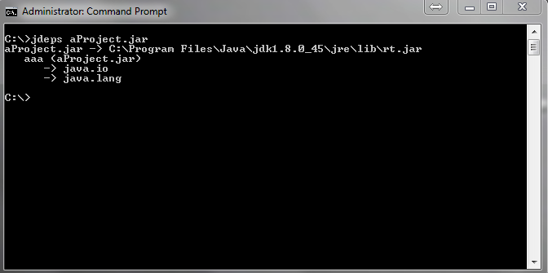
New Java Tools
Class dependency analyzer
When a client receives aProject.jar and check its dependencies – everything is fine:

Slide 120
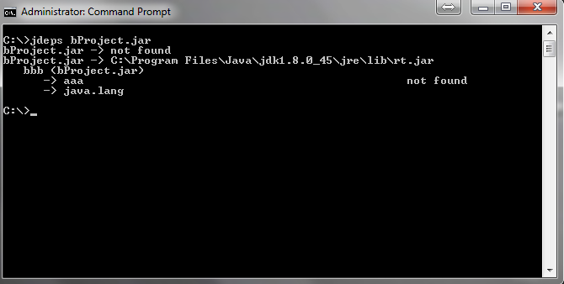
New Java Tools
Class dependency analyzer
But when doing the same thing with bProject.jar we can clearly see the broken dependency:
Jdeps may
use –cp
to include
classpath
in the
check

Slide 121

New Java Tools
Java Mission Control
Available in the Oracle JDK since Java 7u40
Originates from JRockit JVM
Used for 2 main purposes:
Monitoring the state of multiple running Oracle JVMs
Java Flight Recorder dump file analysis
Built on JVM JMX Server
JAVA_HOME\bin\jmc.exe

Slide 122
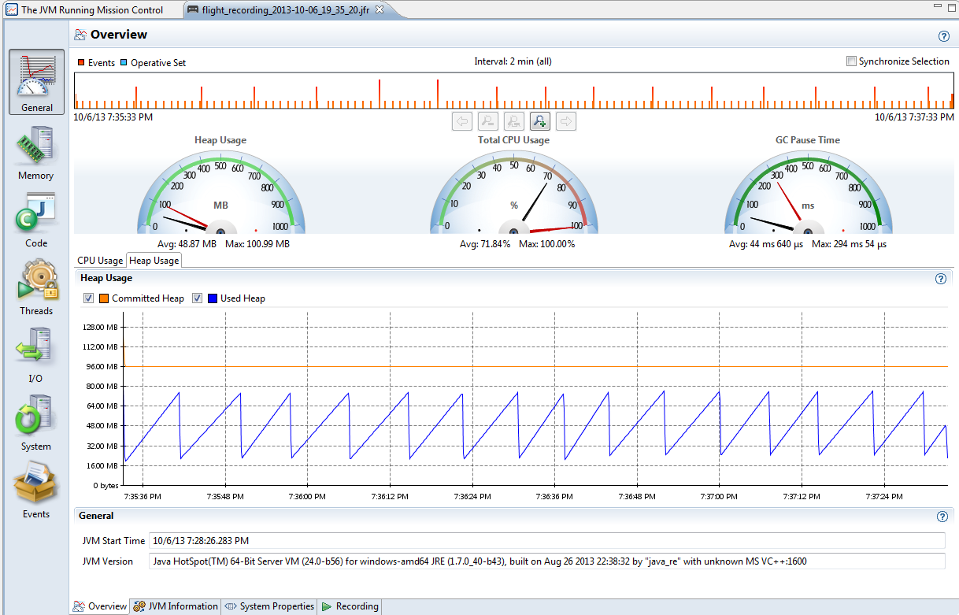
New Java Tools
Java Mission Control
Real time processing
Heap
CPU
GC Pause time

Slide 123
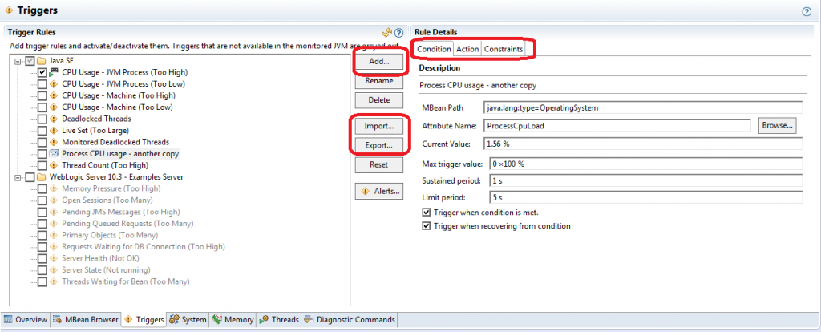
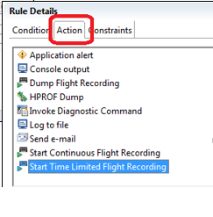
New Java Tools
Java Mission Control
Event triggers
Act when JMX counter exceeds any pre-set limit in any given time

Slide 124
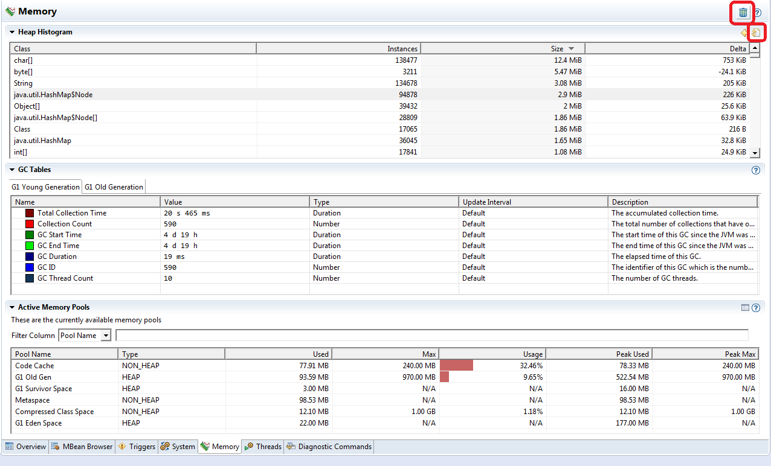
New Java Tools
Java Mission Control
Memory tab
Heap generation
Minor & full GC Info

Slide 125
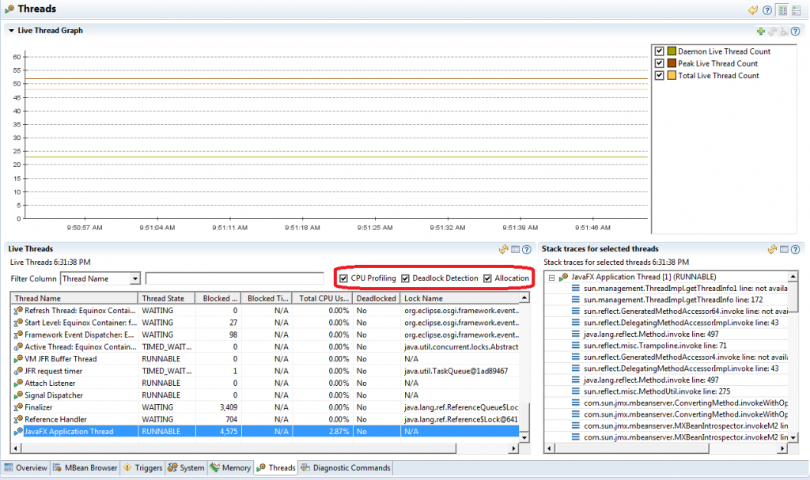
New Java Tools
Java Mission Control
Threads tab
Thread state
Lock name
Deadlock
Blocked count
Per thread CPU usage
Amount of memory allocated by a given thread since it was started

Slide 126
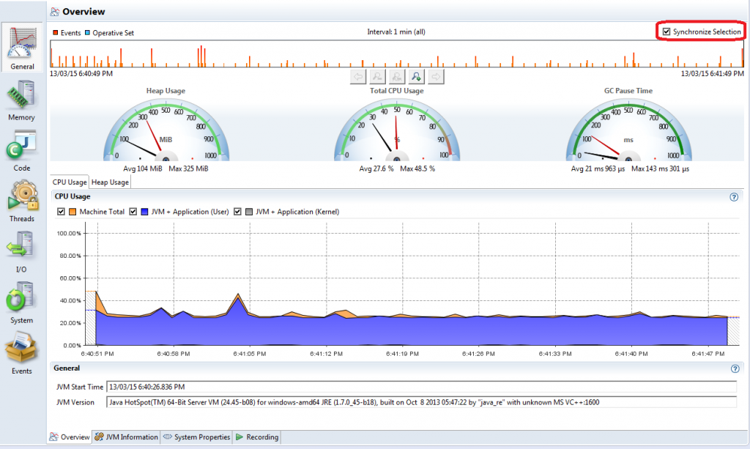
New Java Tools
Java Mission Control
Flight recorder - Initial screen
View JVM args
You may set
time range for
analyzing

Slide 127
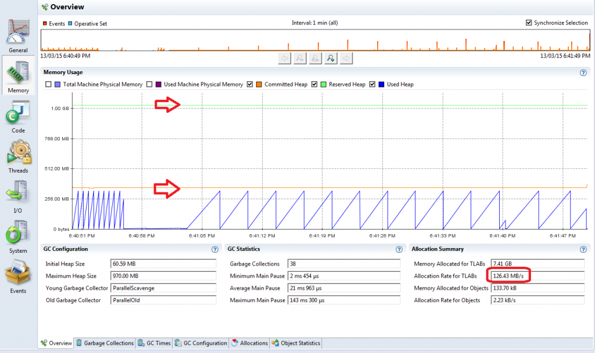
New Java Tools
Java Mission Control
Flight recorder
– memory tab
Machine RAM
Java heap usage
Garbage collections – when, why, for how long and how much space was cleaned up.
Memory allocation – inside / outside TLAB, by class/thread/stack trace.
Heap snapshot – number / amount of memory occupied by class name

Slide 128
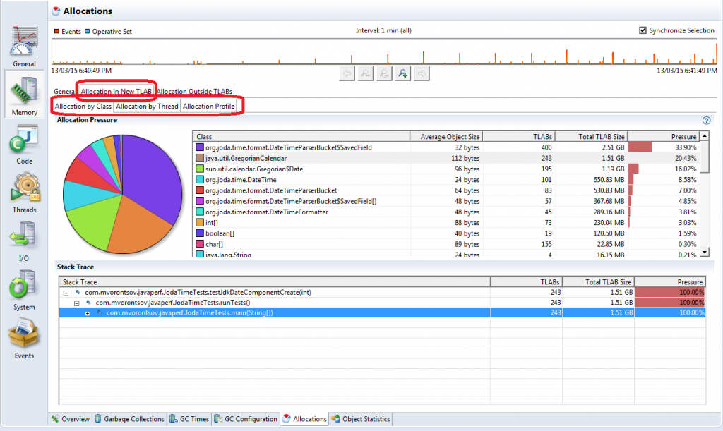
New Java Tools
Java Mission Control
Flight recorder
– allocation tab
Object allocations
By class
By thread

Slide 129
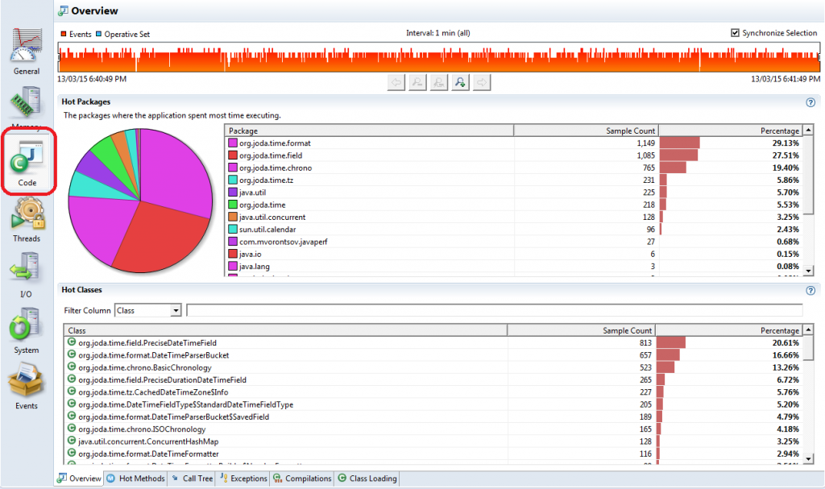
New Java Tools
Java Mission Control
Flight recorder
– code tab
Method hotspots
Packages hotspots
Useful for CPU optimization

Slide 130
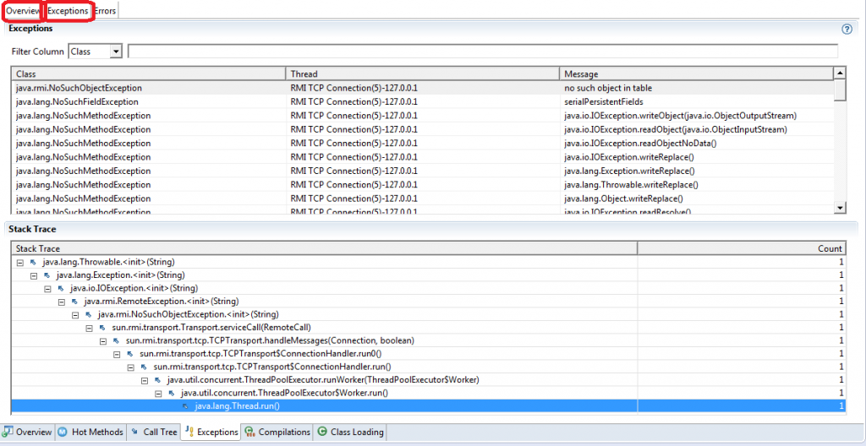
New Java Tools
Java Mission Control
Other tabs
Exceptions
I/O
Threads

Slide 131
New Features In Java Runtime
Java provides two changes in its runtime but both are very important
Main goals are:
Reducing JVM footprint
Make JVM a faster plugin
Java wants to be everywhere…
We can see by now that
Stream API allows effective manipulations on huge data grids
This is great for cloud parallel computing and big data processing
But what about the emerging IoT ?
Java also gets ready to be ‘embedded’ in the tiny future internet clients

Slide 132
New Features In Java Runtime
Feature 1 - Smaller VM
Up to Java 7 footprints averages are
6Mb for –client
9Mb for –server
In Java 8 JVM shouldn’t use more than 3Mb on startup
Smaller plugins are better for small clients….
How what it achieved?
By getting rid of large components from Java Kernel
Kernel makefiles now differentiate between required and optional components

Slide 133
New Features In Java Runtime
Feature 2 - No more PermGen
Java 6
Classes and interned strings were allocated in the PermGen which was part of the heap
Java 7
Puts interned strings in a new place – Metaspace
Java 8 doesn’t come with a PermGen at all. Only Metaspace.
Classes are also allocated on Metaspace
Metapsace
Native space used for holding classes and interned strings
Faster than PermGen
By default – has no max size –
Allocates memory according to needs (unlike PermGen which was part of the heap)
Native memory reduces footprint and executes faster

Slide 134
New Features In Java Runtime
Feature 2 - No more PermGen
No more:
PermSize & MaxPermSize
OutOfMemoryError: PermGen Error
klasses that were used to describe class metadata
From now on:
MaxMetaspaceSize
OutOfMemoryError: Metaspace Error
Use –verbosegc to view Metaspace GC activity

Slide 135
New Features In Java Runtime
Feature 3 – Tiered Compilation by Default
Client mode – compiles instant used code
Assuming that code will be reused frequently
Compilation starts sooner than in server mode
Fast launching – available JIT compilations for immediate execution
Server mode – compiles after more runtime analysis
Assuming there is much going on so better sit and analyze…
Optimizations are much more sophisticated
Slow launching – analyzing….. Code is re-interpreted until JIT kicks in…

Slide 136
New Features In Java Runtime
Feature 3 – Tiered Compilation by Default
Tiered Compilation
Starts in client mode for fast launching and then shifts into server mode
Was experimental in Java 7 (XX:+TieredCompilation)
Default in Java 8 (for –server supported environments)

Slide 137
Last Words
Java 8 addresses today & future major concerns
Rapid development
Parallel based APIs
Big data processing
Java Script support
Performance improvements
IoT relevance

Slide 138
Java 9 – Most Important New Features
jshell – utility for Java REPL scripting
JMH – micro-benchmarking framework
G1 as default for OLD region (?)
HTTP2 compliant URLConnection & WebSocket
Process API – more info on JVM process
Project Jigsaw – Modular Java

Slide 139

Thank You!

