Slide 1


JAVA 9 – NEW FEATURES

Slide 2
Topics
API & code
Reactive programming with flow
Collection Factories
Stream API new features
Private interface methods
HTTP/2 API
Stack walking
Environmental
Modular Java & Jlink
Jshell
Multi version jars
G1 made default

Slide 3
API & CODE

Slide 4
Reactive programming with Flow
Reactive programming enhancements made in latest versions

Slide 5
Reactive Programming
“Reactive programming is an asynchronous programming paradigm concerned with data streams and the propagation of change” Wiki
Why do we need this?
Relevant for asynchronous messaging only
When facing unknown amounts of requests we usually go asynchronous
When lots of requests are published we might face back-pressure
need lots of processing threads….
need unbounded Queues….
But in most cases we are forced to restrict both Threads & Queues

Slide 6

Reactive Programming
Goal is to:
Reduce blocking back pressure
Done by splitting requests into small phases
Each phase can be forked separately in the execution path
Use a strong mechanism that simplifies all this
Good reactive API should encapsulate thread management & communication complexity

Slide 7
Reactive Programming
So, we need: Stream API, dynamic invoker, thread pools & reactive infrastructure
Java 8 provides
Stream API & Parallel streams backed by Fork-Join
Static and dynamic programming support
Java 9 adds the core infrastructure for reactive programming
Flow – unit that processes events and encapsulates concurrency
Subscriber – event endpoint
Publisher – generates events and publishes to registered subscribers
Processors – subscribing interceptors (for creating subscription chain)

Slide 8
Reactive Programming
How do we do it?
Create a Flow.Publisher
Register Flow.Subscribers via Publisher.subscribe()
Implement Subscriber to handle events:
onSubscribe()
onNext()
onError()
onComplete()
Use Publisher to generate events
Flow acts like a Pipe here – passing events from publisher to the ‘Sink’ side – the Consumer
BUT –unlike pipes - it uses Executor, the daemon common pool (ForkJoin)

Slide 9
Reactive Programming
When creating Publisher
Default constructor uses common pool (Fork-Join daemon pool)
Alternative executors may be used instead
This is how all thread complexity remains hidden
Multiple subscribers may be registered to a single Publisher
Use publisher.subscribe()
//Create Publisher (works with common-pool)
SubmissionPublisher<String> publisher = new SubmissionPublisher<>();
// Create Publisher with dedicated pool
Executor e=Executors.newFixedThreadPool(3);
SubmissionPublisher<String> publisher = new SubmissionPublisher<>(e);

Slide 10
Reactive Programming
Subscriber
public class MySubscriber<T> implements Subscriber<T> {
private Subscription subscription;
@Override
public void onSubscribe(Subscription subscription) {
this.subscription = subscription;
{
@Override
public void onNext(T item) {
subscription.request(1); //Long.MAX_VALUE may be considered as unbounded
{
@Override
public void onError(Throwable t) {
t.printStackTrace();
{
@Override
public void onComplete() {
System.out.println("Done");
{
{

Slide 11
Reactive Programming
Publishing messages
Use publisher.submit(T)
Each registered Subscriber get its own instance of Subscription
//Create Publisher
SubmissionPublisher<String> publisher = new SubmissionPublisher<>();
//Register Subscriber
MySubscriber<String> subscriber = new MySubscriber<>();
publisher.subscribe(subscriber);
//Publish messages
String[] items = {"msg1", "msg2", "msg3"};
Arrays.asList(items).stream().forEach(publisher::submit);

Slide 12
Reactive Programming
Processors
Enhanced subscribers
While subscribers acts as endpoints, processors delegates messages
Processor uses Function<T,R> to process messages
Incoming message is T
Outgoing message is R (which might be T as well..)

Slide 13
Reactive Programming
Processors example
public class Processor1<T,R> extends SubmissionPublisher<R> implements Processor<T, R> {
private Function<? super T, ? extends R> function;
private Subscription subscription;
public MyTransformProcessor(Function<? super T, ? extends R> function) {
super();
this.function = function;
{
@Override
public void onSubscribe(Subscription subscription) {
this.subscription = subscription;
}
@Override
public void onNext(T item) {
submit((R) function.apply(item));
subscription.request(1);
{ …

Slide 14
Reactive Programming
Processors
Now we can define a subscription chain
This is haw we split asynchronous tasks while using thread pools
SubmissionPublisher<String> publisher = new SubmissionPublisher<>();
MySubscriber<Integer> subscriber = new MySubscriber<>();
//Creating Midpoints Processors
Processor1<String, String> p1 =
new Processor1<>(s -> {if(s.equals("msg1"))return “100"; return “200";});
Processor1<String, Integer> p2 =
new Processor1<>(s -> Integer.parseInt(s));
//Configuring subscription chain
publisher.subscribe(p1);
p1.subscribe(p2);
p2.subscribe(subscriber);

Slide 15
Collection Factories
Easy to use and remember – new factories for creating unmodifiable collections

Slide 16
Collection Factories
There are many different ways to create collections:
Java 9 provides a much straight forward methods
List<Integer> numbers = new ArrayList<>();
for(int i=0;i<100;i++){
numbers.add(i);
}
List<Integer> numbers = Arrays.asList(1,2,3…)
List<Integer> n=Collections.unmodifiableList(new ArrayList() {
{add(1);add(2);add(3);}
});
List<Integer> numbers = Stream.of(1,2,3…).collect(Collectors.toList());

Slide 17
Collection Factories
Java 9 collection factory methods:
List.of()
Set.of()
Map.of()
Generates unmodifiable collections
Updates causes UnsupportedOperationException
List.of() & Set.of() of methods takes var-args for 10 elements or more
BUT - in order to save array allocations, all got 10 different ‘of()’ methods:
Set/List: of(T t1), of(T t1, T t2), of(T t1, T t2, T t3), ……
Map: of(K k, V v), of(K k1, V v1, K k2, V v2) ….
Means that from 0 to 9 elements – no arrays are allocated
Java 9 provides a much straight forward methods

Slide 18
Collection Factories
Example
List<String> wordsList = List.of("a","b","c","d","a");
Set<String> wordsSet = Set.of("a","b","c","d");
Map<Integer,String> wordsMap = Map.of(1,"a",2,"b",3,"c",4,"d",5,"a");

Slide 19
Streams new features
Cool APIs can be even cooler..

Slide 20
Streams new features
Method improvements
Java 8 iterate() method cannot have any stop condition but limit()
Iterate(T seed, UnaryOperator<T>)
If we don’t call limit() - iterate() never returns…
Java 9 provides another version for iterate() for saving this unwanted pause:
Iterate(T seed, Predicate<T>, UnaryOperator<T>)
Iteration continues as long as test returns ‘true’
//Generates a Stream<Integer> with values: 1, 2, 4, 8
Stream.iterate(1, n -> n*2).limit(4);
//Generates a Stream<Integer> with values: 1, 2, 4, 8
Stream.iterate(1, n -> n<=8 ,n -> n*2);

Slide 21
Streams new features
New methods:
takeWhile(Predicate<T>) – passes elements as long as test returns ‘true’
dropWhile(Predicate<T>) – drops elements as long as test returns ‘true’
//Generates a Stream<Integer> with values: 1, 2, 3, 4, 5, 6, 7, 8, 9, 10
Stream<Integer> nums=Stream.iterate(1, n -> n<=10, n -> n+1);
List<Integer> low =nums.takeWhile(n -> n<=5).collect(Collectors.toList());
System.out.println(low);
//Output:
[1, 2, 3, 4, 5]
//Generates a Stream<Integer> with values: 1, 2, 3, 4, 5, 6, 7, 8, 9, 10
Stream<Integer> nums=Stream.iterate(1, n -> n<=10, n -> n+1);
List<Integer> high=nums.dropWhile(n -> n<=5).collect(Collectors.toList());
System.out.println(high);
//Output:
[6, 7, 8, 9, 10]

Slide 22
Streams new features
ofNullable(T)
If T is null – returns an empty stream
If T is an object – returns a Stream<T> with a single object in it
Mostly relevant when getting flat-maps from an object that might be null
//lib might be null
Library lib = loadLibrary(id);
Stream<Book> books= Stream.ofNullable(lib).flatMap(l-> Stream.of(l.getBooks()));
//we end up with a Book stream of an empty stream (in case lib was null)

Slide 23
Interface Private Methods
What happens when two or more default methods share code?

Slide 24

Interface Private Methods
Java 8 provides interface default & static method support
But what if 2 or more default / static method share code ?
Java 9 provides interface private methods
These methods are available to other private / default / static methods
Are not inherited or visible for implementing classes
NOTE
Private methods are counted.
So, @FunctionalInterface cannot have both abstract & private methods…

Slide 25
Interface Private Methods
Example
public interface Recorder<T> {
default void startRecord() {
System.out.println("recording started at: ");//+timestamp());
}
void record(T data);
default void endRecord() {
System.out.println("recording stopped at: ");//+timestamp());
}
private String timestamp() {
return DateFormat.getTimeInstance().format(new Date());
}
}
RecorderImpl<String> r=new RecorderImpl<>();
r.startRecord();
r.record("Hello World!");
r.endRecord();

Slide 26
HTTP/2 Support
Simple Http client API with HTTP/2 support

Slide 27
HTTP/2 Support
HTTP/2
Uses multiplexing
Can send multiple parallel requests over single TCP connection
HTTP/1 is limited to only 6 at a time
Headers are packed and compressed
Saves bandwidth
Push support
After first request – server can push data asynchronously
Binary protocol

Slide 28
HTTP/2 Support
Java 9 provides a simple, standalone HTTP/2 based API
Package: jdk.incubator.http.*;
HttpClient
Responsible for connection configuration (SSL support)
Configuring client for handling requests and web-sockets
HttpRequest
Encapsulates all Http-Request information
Uses builders to configure request headers and content
HttpResponse
Encapsulates all Http-Response information
Uses handlers to parse response body

Slide 29
HTTP/2 Support
HttpClient
authenticator() : Optional< Authenticator>
cookieManager() : Optional<CookieManager>
followRedirects() : Redirect
Redirect ENUM stands for
ALWAYS – Always redirect
NEVER – Never redirect
SAME_PROTOCOL – redirect only to the same protocol
http to http
https to https
http to https and vice versa are not redirected
executor() - Returns the default executor for this client
Each client uses a new dedicated executor

Slide 30
HTTP/2 Support
HttpClient
newHttpClient() – static method to instantiate default client
newWebSocketBuilder(URI uri, Listener listener)
WebSocket.Listener
onOpen()
onText(), onBinary(), onPing(), onPong()
onClose(), onError()
In order to send HttpRequests:
send(…) – blocking operation
sendAsynchronously – non-blocking – using executor
Results with CompletableFuture
//creating new Http Client
HttpClient httpClient=HttpClient.newHttpClient();

Slide 31
HTTP/2 Support
HttpRequest
Uses HttpRequest.Builder inner class to construct and define requests
newBuilder()
HttpRequest.Builder
Provides pipelined methods for generating HttpRequest
uri( URI)
GET(), POST(), PUT(), DELETE()
setHeader(…), setHeaders(…)
//creating new Http Request
HttpRequest httpReq=HttpRequest.newBuilder()
.uri(new URI("http://google.com"))
.GET().build();

Slide 32
HTTP/2 Support
HttpResponse
Wraps the HTTP result sent by the server
Main operations:
body() : T – body content is handled by BodyHandler (later)
headers()
request() – each result holds a reference to the origin request
statusCode() : int – return HTTP result status

Slide 33
HTTP/2 Support
HttpResponse
HttpResponse.BodyHandler
Parses HTTP response body into T body of HttpResponse
Is attached to a request on HttpClient submit
Main methods:
asByteArray(), asByteArrayConsumer(Consumer<byte[]>)
asFile(Path path)
asString(), asString(Charset charset)

Slide 34
HTTP/2 Support
Example
HttpClient httpClient=HttpClient.newHttpClient();
HttpRequest httpReq=HttpRequest.newBuilder().uri(new URI("http://google.com"))
.GET().build();
// Request Data:
System.out.println(httpClient.version());
System.out.println(httpReq.uri());
System.out.println(httpReq.method());
// Response Data:
HttpResponse<String> httpRes=httpClient.send(httpReq, HttpResponse.BodyHandler.asString());
System.out.println(httpClient.version());
System.out.println(httpRes.statusCode());
System.out.println(httpRes.headers());
System.out.println(httpRes.body());

Slide 35
HTTP/2 Support
Launching
Strange thing here is that while everything compiles, when you launch you end up with:
Java 9 is modular…we’ll discuss it later
It happens since httpclient module is not part of java_base modules
In order to launch correctly we must add httpclient module:
Done via –add-modules
Httpclient module name is: jdk.incubator
Exception in thread "main" java.lang.NoClassDefFoundError: jdk/incubator/http/HttpClient
at web.http2.Test.main(Test.java:14)
Caused by: java.lang.ClassNotFoundException: jdk.incubator.http.HttpClient
at java.base/jdk.internal.loader.BuiltinClassLoader.loadClass(BuiltinClassLoader.java:582)
at java.base/jdk.internal.loader.ClassLoaders$AppClassLoader.loadClass(ClassLoaders.java:185)
at java.base/java.lang.ClassLoader.loadClass(ClassLoader.java:496)
... 1 more

Slide 36
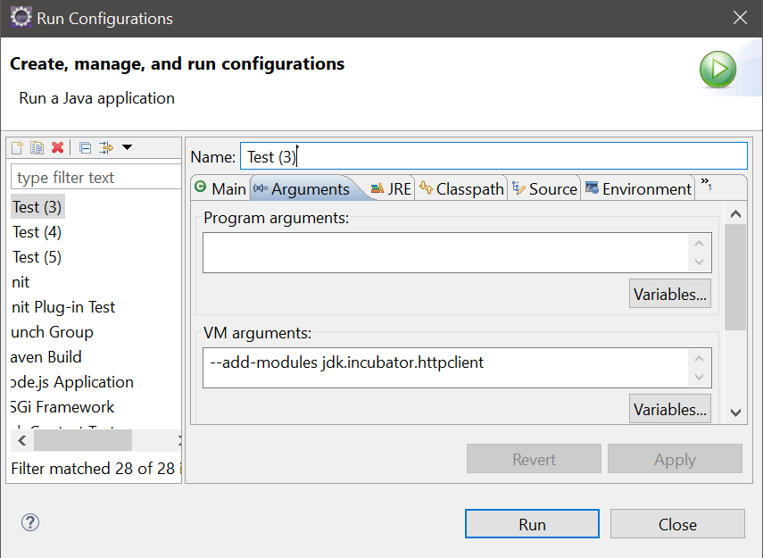
HTTP/2 Support
launching
Doing it right:
WARNING: Using incubator modules: jdk.incubator.httpclient
Request Data:
HTTP_2
http://google.com
GET
Response Data:
HTTP_2
302
jdk.incubator.http.ResponseHeaders@4d339552
<HTML><HEAD><meta http-equiv="content-type" content="text/html;charset=utf-8">
<TITLE>302 Moved</TITLE></HEAD><BODY>
<H1>302 Moved</H1>
The document has moved
<A HREF="http://www.google.co.il/?gfe_rd=cr&amp;dcr=0&amp;ei=n8nlWev9AdDb8Afl46v4BQ">here</A>.
</BODY></HTML>

Slide 37
Stack Walking
Easy way to walk through stack trace and enjoy streams while doing it!

Slide 38
Stack Walking
What’s wrong with StackTrace & StackTraceElements?
Not easily accessible
Eagerly generates full stack trace
Not efficient when you are looking for recent invocations in the stack..
Heavy
StackWalker
Easy to use
Thread-safe (threads may share same stack trace information)
Generates StackFrame stream
Streams are lazily executed by nature

Slide 39
Stack Walking
StackWalker main operations:
getInstance() methods for static allocations
Options can be assigned as a Set
StackWalker.Option.RETAIN_CLASS_REFERENCE
StackWalker.Option.SHOW_HIDDEN_FRAMES,
StackWalker.Option.SHOW_REFLECT_FRAMES
forEach(Consumer<StackFrame> consumer)
Allows to eagerly iterate and manipulate StackFrames
walk(Function<Stream<StackFrame>,?> function)
Returns a stream of StackFrames
Since stream are lazily executed – partial stack info can be loaded via limit()
Can be invoked multiple times to obtain new streams

Slide 40
Stack Walking
Example
public class Example {
public void a() {
b();
}
public void b() {
c();
}
public void c() {
StackWalker sw=StackWalker.getInstance();
sw.forEach(System.out::println);
}
}
Output:
stackwalking.Example.c(Example.java:15)
stackwalking.Example.b(Example.java:10)
stackwalking.Example.a(Example.java:6)
stackwalking.Test.main(Test.java:8)

Slide 41
Stack Walking
Example
StackWalker sw=StackWalker.getInstance();
//count elements
long size=sw.walk(frames->frames.count());
//obtain full stack trace
List<StackFrame> all = sw.walk(frames->frames.collect(Collectors.toList()));
//obtain 3 last stack trace elements
List<StackFrame> last3 = sw.walk(frames->frames.limit(3)
.collect(Collectors.toList()));

Slide 42
ENVIRONMENTAL

Slide 43
Modular Java & Jlink
Eliminate JAR hell by creating modules & defining dependencies

Slide 44
Modular Java & Jlink
Jar & Classpath Hell
We usually add jars to the classpath and hope for the best…
Worst scenario is using unwanted classes
Common problem is ClassDefNotFoundException
We have no runtime information regarding jars containing which class
The JRE handles all jars just as a single collection of classes
No further meta-data to
Create more focused images (with only classes we need)
Reuse code without risking in classpath collisions

Slide 45
Modular Java & Jlink
Modules
Provides this meta-data layer
Specifies exactly what is exposed to other modules
Specifies module dependencies – so it can be checked along development
Improves maintainability of large systems
Allows creating focused, standalone images (via Jlink - later)

Slide 46
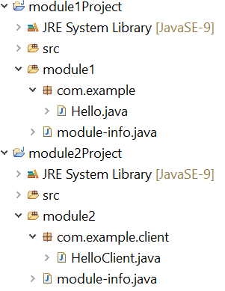
Modular Java & Jlink
Defining modules:
Project structure:
package com.example;
public class Hello {
public void sayHello() {
System.out.println("Hello!");
}
}
package com.example.client;
import com.example.Hello;
public class HelloClient {
public static void main(String[] args) {
Hello h=new Hello();
h.sayHello();
}
}

Slide 47
Modular Java & Jlink
Defining modules:
Project structure:
module module1{
exports com.example;
}
module module2{
requires module1;
}

Slide 48
Modular Java & Jlink
Compiling modules:
Basically done by IDE, but let’s see javac & java module support:
For this example
we’ll use C:/temp directory as base directory
Sources are copies to base directory:
C:/temp/module1/com/example/Hello.java
C:/temp/module1/module-info.java
C:/temp/module2/com/example/client/HelloClient.java
C:/temp/module2/module-info.java

Slide 49
Modular Java & Jlink
Compiling modules:
Compiling module1 - C:/temp/mods/module1:
Compiling module2 - C:/temp/mods/module2:
--module-path – specifies modules location
Modules can be packed as .mod files or remain expanded
Here we must specify module1 location since module2 depends on it
javac -d mods/module1 module1/module-info.java module1/com/example/Hello.java
javac --module-path mods/module1 -d mods/module2 module2/module-info.java module2/com/example/client/HelloClient.java

Slide 50
Modular Java & Jlink
Running main class with modules:
Running module2/com.example.client.HelloClient
--module-path – specifies modules root location – C:/temp/mods
-m specifies extended fully qualified class name to launch
java --module-path mods -m mods/module2/com.example.client.HelloClient
Output:
Hello!

Slide 51
Modular Java & Jlink
Jlink
New utility that links different modules and creates a run-time image
Run-time images
Includes java-base module
Contains only relevant modules and their dependencies
Highly relevant for
DevOps
Microservices

Slide 52
Modular Java & Jlink
Jlink
Parameters
--module-path – points to both java-base (jmods) & mods root directories
default JAVA_HOME is: C:/Program Files/Java/jdk-9
--add-modules – included modules list
dependencies are resolved automatically
--output – generated image destination directory
jlink --module-path JAVA_HOME/jmods;mods --add-modules module2
--output helloApp

Slide 53
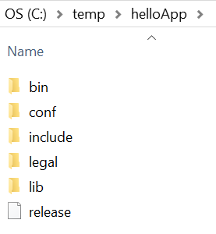
Modular Java & Jlink
Jlink
Generated image
Running main class with image:
C:\temp\helloApp\bin>java -m module2/com.example.client.HelloClient
Output:
Hello!

Slide 54
Java REPL - Jshell
Use command line utility for rapid usage of Java code snippets

Slide 55
Java REPL - Jshell
Jshell utility
Useful tool for prototyping and testing Java code snippets
Each statement is evaluated and executed immediately
Good for starting with Java
Simplifies testing
Is the first official Java REPL
Read – Eval – Print Loop
Read – accept expression from user
Eval – evaluating the expression as a var/method or read/invoke
Print – show the result of eval phase
Loop – wait for next user expression
A.K.A Interactive toplevel or Language shell

Slide 56
Java REPL - Jshell
Starting Jshell:
Jshell is part of JDK9 installation and found under JAVA_HOME/bin directory
To use it simply run the utility from the command:
You may use –verbose in order to get more detailed prints
C:\Program Files\Java\jdk-9\bin>jshell
| Welcome to JShell -- Version 9
| For an introduction type: /help intro
jshell>
C:\Program Files\Java\jdk-9\bin>jshell -v
| Welcome to JShell -- Version 9
| For an introduction type: /help intro
jshell>

Slide 57
Java REPL - Jshell
Define and show vars:
List vars:
jshell> 3+3
$1 ==> 6
jshell> int x=5
x ==> 5
jshell> x
x ==> 5
jshell> /vars
| int $1 = 6
| int x = 5

Slide 58
Java REPL - Jshell
Define and show vars:
Call method:
List methods:
jshell> public void showAllVars(){System.out.println(x+","+$1);}
| created method showAllVars()
jshell> showAllVars()
5,6
jshell> /methods
| void showAllVars()

Slide 59
Java REPL - Jshell
Show history :
Includes
Expressions & invocations
Variable declaration
Methods declaration
jshell> /list
1 : 3+3
2 : int x=5;
3 : public void showAllVars(){System.out.println(x+","+$1);}
4 : showAllVars()

Slide 60
Java REPL - Jshell
Using modules:
Jshell must be started with --add-modules
May need to pre-set --module-path
Jshell can use only what module exports!
C:\Program Files\Java\jdk-9\bin>jshell --module-path c:/temp/mods
--add-modules module1
| Welcome to JShell -- Version 9
| For an introduction type: /help intro
jshell> import com.example.Hello
jshell> Hello h=new Hello()
h ==> com.example.Hello@6ee52dcd
jshell> h.sayHello()
Hello!

Slide 61
Java REPL - Jshell
Executing files
Predefined files:
DEFAULT – loads commonly used imports
JAVASE – imports all JavaSE packages
PRINTING – adds print, println & printf as Jshell methods
Using pre-defined files in Jshell – example:
C:\Program Files\Java\jdk-9\bin>jshell –startup file
C:\Program Files\Java\jdk-9\bin>jshell --startup PRINTING
| Welcome to JShell -- Version 9
| For an introduction type: /help intro
jshell> printf("There are %d melons on the %s",2,“ shelf")
There are 2 melons on the shelf

Slide 62
Java REPL - Jshell
Closing Jshell session
jshell> /exit
| Goodbye

Slide 63
Multi-version JARS
Generate JARs that can detect JSE version and choose the correct class accordingly

Slide 64
Multi-version JARS
Multi-versioning in Java
Goal here is to be able to generate JARS that
Contains duplicated classes
Each class has it own version-sensitive implementation
Java runtime will choose the correct class according to the current hosting runtime

Slide 65
Multi-version JARS
Example:
public class VersionDependant {
public List<String> getList(){
System.out.println("Using List.of() - Java 9");
return List.of("Hello","To","Multiversion","Jars");
}
}
public class VersionDependant {
public List<String> getList(){
System.out.println("Using Arrays.asList() - Java 8");
return Arrays.asList("Hello","To","Multiversion","Jars"); }
}
public class Main {
public static void main(String[] args) {
VersionDependant v=new VersionDependant();
System.out.println(v.getList());
}
}

Slide 66
Multi-version JARS
Example:
First, we have to compile the project for each supported version:
Compile with JDK8 compiler into lib\jdk8 directory
Assume we have placed source files in jdk8 directory
Compile with JDK9 compiler into lib\jdk9 directory
Assume we have placed source files in jdk9 directory
java -version
java version "1.8.0_71"
javac -d lib\jdk8 jdk8\*.java
java -version
java version "9"
javac -d lib\jdk9 jdk9\*.java

Slide 67
Multi-version JARS
Example:
Now, we use jar (JDK9) utility in order to create a multi-versioned JAR
--create – generates a file
--file – specifies generated jar location
-C – points to classes location
--release – specifies alternative version followed by –C
Now we got multiversion.jar located at our working directory
java -version
java version "9"
jar --create --file multiversion.jar -C lib\jdk8 . --release 9 -C lib\jdk9 .
Warning: entry META-INF/versions/9/com/example/Main.class contains a class that is identical to an entry already in the jar

Slide 68
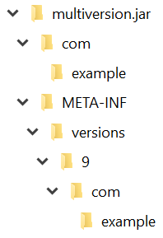

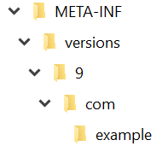
Multi-version JARS
Example:
Multi-version JAR infrastructure:

Slide 69
Multi-version JARS
Example:
Launching with JRE8:
Launching with JRE9:
java -version
java version "1.8.0_71"
SET classpath=.\multiversion.jar
java com.example.Main
Using Arrays.asList() - Java 8
[Hello, To, Multiversion, Jars]
java -version
java version "9"
SET classpath=.\multiversion.jar
java com.example.Main
Using List.of() - Java 9
[Hello, To, Multiversion, Jars]

Slide 70
G1 Made Default GC
Not in 7…
Not in 8…
It’s about time….

Slide 71
G1 Made Default GC
What are the defaults in earlier Hotspots ?
New region
minor GC
name : Scavenge GC
parallel capable
Old region
Full GC
name : CMS – Concurrent Mark Sweep
Parallel capable
Recent minor versions of Java8 comes with G1 as default

Slide 72
G1 Made Default GC
What is G1?
According to Oracle:
Targeted for multiprocessor machines with a large amount of memory
Aims to provide the best balance between latency and throughput
Main application related assumptions:
Heap sizes up to 10 GBs or larger
Rates of object allocation and promotion that can vary dramatically
pause-time target goals that aren’t longer than a few hundred millis
How does it work in general?
Uses compaction
Maintains areas with most phantom objects
Collects in these areas first while leaving less to compact

Slide 73
G1 Made Default GC
More on G1
Instead of sweeping – compacts and defragments
Also generational (acts on NEW & OLD regions)
Based on concurrent / parallel behavior
Like CMS, a low-pause GC – but better
Usage: --XX: +UseG1GC
In Java 6 activate feature first with: -XX:+UnlockExperimentalVMOptions
Note: G1 increases JVM process footprint due to area collections and management
Note: No need to switch to G1 if CMS works fine (low pauses and good throughput)

Slide 74
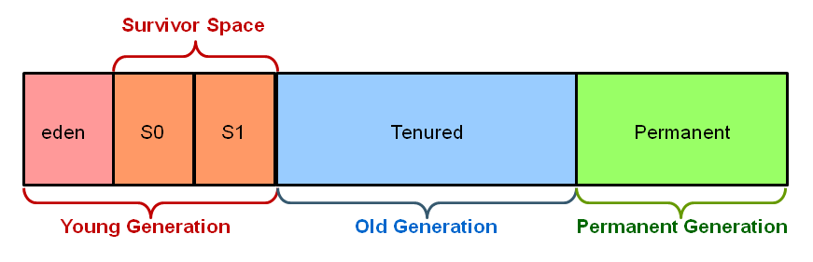
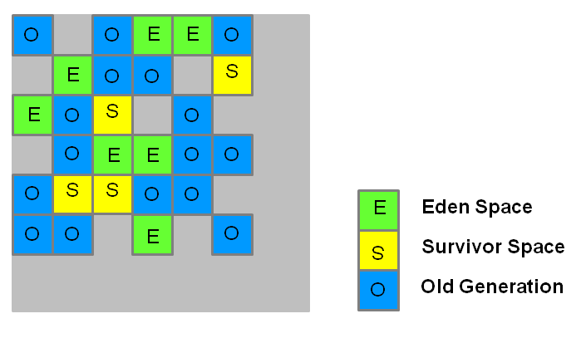
G1 Made Default GC
G1 – How does it work ?
Previous GCs (serial, parallel, CMS) manages objects in predefined memory regions:
G1 manages objects like this:
Reserved Area

Slide 75
G1 Made Default GC
G1 – How does it work ?
heap is partitioned into a set of equal-sized heap regions
Each partition has a role (Eden / Survivor Space / Old)
Step1: G1 performs a concurrent global marking of unreachable objects
Step 2: G1 tracks areas where most phantom objects exist
Step 3: G1 collects in these areas FIRST(!)
Step 4: G1 compacts the remaining object in these areas (not much left….)
Reserved Area
for old region
helpful in cases of huge allocations
Size may be set as heap percent
Reserved Area

Slide 76
Last words
Java 9 efforts to remain relevant for:
Microservices
Modular java
Images for DevOps
Jlink
Reactive programming
Flow
Scripting
Jshell
Parallel handling for in memory data grids
Streams

Slide 77

Thank You!

