Slide 1
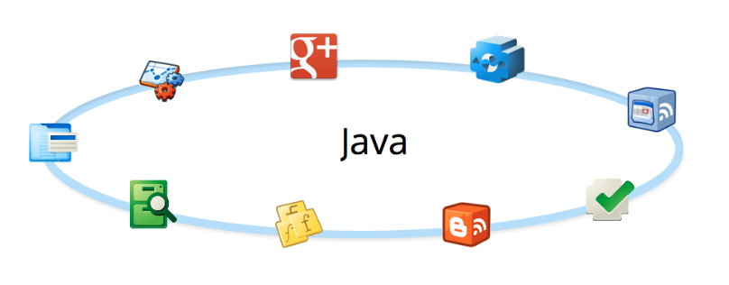
Advanced Java
Collections

Slide 2
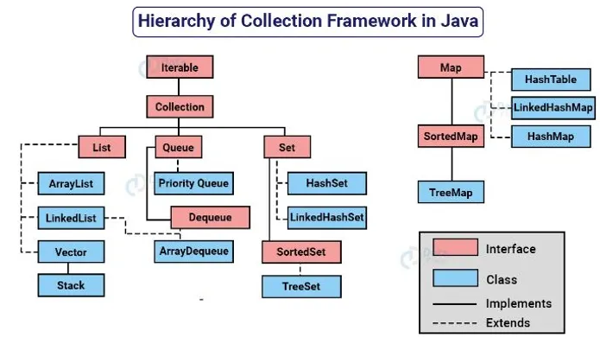
Collections
Java provides a rich set of collection classes and interfaces
Under java.util package all collections classes and interfaces are exists

Slide 3
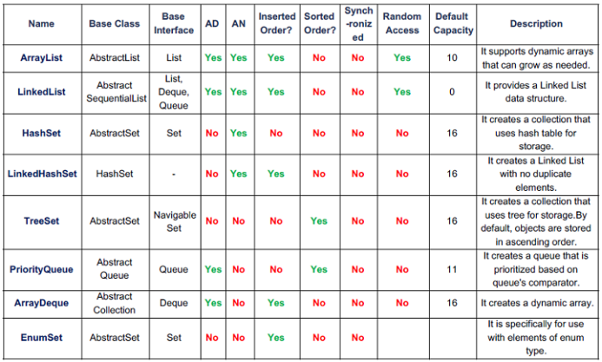
Collections
Collection Classes
Specialized Interfaces

Slide 4
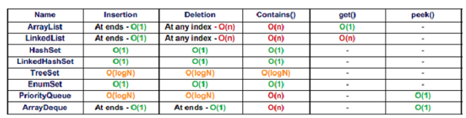
Collections
Collection Classes
Specialized Interfaces

Slide 5
Collections
Collection Interfaces:
List Interface
Set Interface
Queue Interface
Map Interface
Collection Interfaces

Slide 6
Collections
Collection Classes:
Legacy Classes
Vector
Specialized Interfaces:
Deque Interface
Map.Entry Interface
Collection Classes
Specialized Interfaces

Slide 7
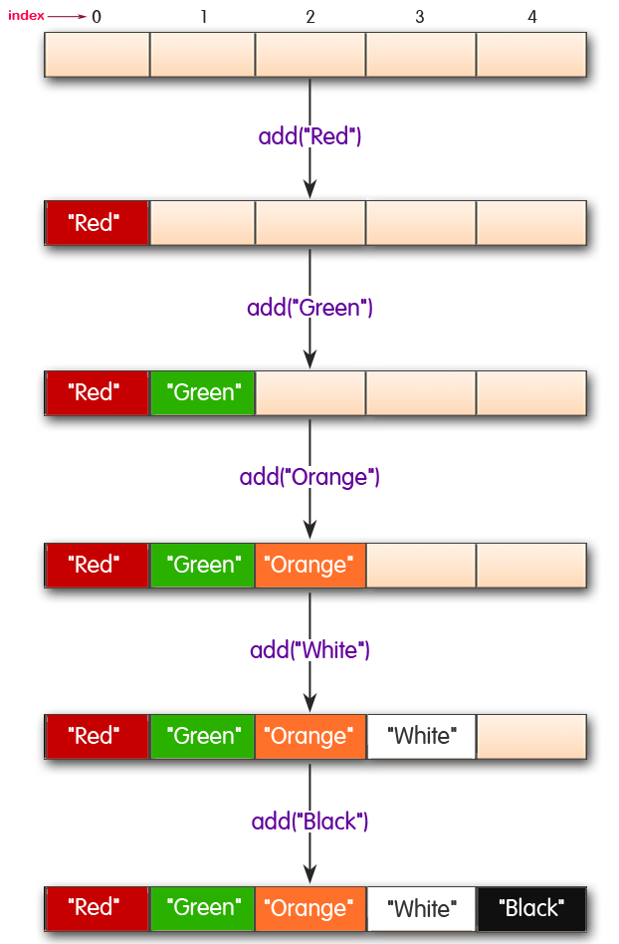
Collections
List
Insertion Order

Slide 8
Collections
Being a Collection subtype all methods in the Collection interface are also available in the List interface.
Since List is an interface, you need to instantiate a concrete implementation of the interface in order to use it. You can choose between the following List implementations in the Java Collections API:
java.util.ArrayList
java.util.LinkedList
java.util.Vector
java.util.Stack
Lists are an Ordered Collections , they are allowing duplicates , precise control over the positioning of individual elements within the data .
List
List is an interface.
A list is an ordered collection.
Lists allow structure.

Slide 9
List
Arraylist class implements List interface and it is based on an Array data structure.
ArrayList is widely used because of the functionality and flexibility it offers.
Most of the developers choose Arraylist over Array as it’s a very good alternative of traditional java arrays.
ArrayList is a resizable-array implementation of the List interface.
ArrayList implements all optional list operations, and permits all elements, including null.
ArrayList

Slide 10
List
Why ArrayList is better than Array?
The limitation with array is that it has a fixed length so if it is full you cannot add any more elements to it, likewise if there are number of elements gets removed from it the memory consumption would be the same as it doesn’t shrink.
On the other ArrayList can dynamically grow and shrink after addition and removal of elements (See the images below). Apart from these benefits ArrayList class enables us to use predefined methods of it which makes our task easy. Let’s see the diagrams to understand the addition and removal of elements from ArrayList and then we will see the programs.
ArrayList

Slide 11
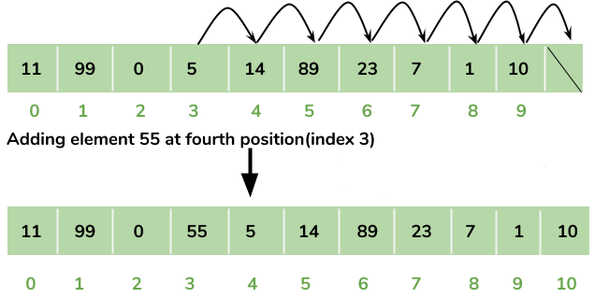
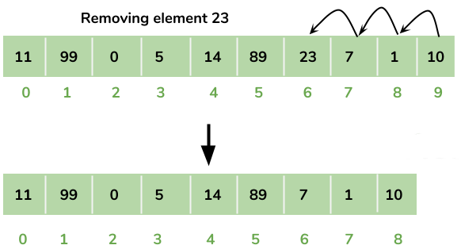
List
Why ArrayList is better than Array?
Adding Element in ArrayList at specified position:
ArrayList
Removing Element from ArrayList:

Slide 12
List
Operations on the ArrayList Elements
How to initialize an ArrayList
Method 1: Initialization using Arrays.asList
ArrayList<Type> obj = new ArrayList<Type>(
Arrays.asList(
Object o1, Object o2, Object o3, ....so on));
ArrayList
Method 2: Anonymous inner class method to initialize ArrayList
ArrayList<T> obj = new ArrayList<T>(){
{
add(Object o1);
add(Object o2);
add(Object o3);
}
};

Slide 13
List
Operations on the ArrayList Elements
How to initialize an ArrayList
Method3: Normal way of ArrayList initialization
ArrayList<T> obj = new ArrayList<T>();
obj.add("Object o1");
obj.add("Object o2");
obj.add("Object o3");
ArrayList
Method 4: Use Collections.ncopies
ArrayList<T> obj = new ArrayList<T>(Collections.nCopies(count, element));

Slide 14
List
Operations on the ArrayList Elements
Insert :
You insert elements (objects) into a Java List using its add() method. Here is an example of adding elements to a Java List using the add() method:
List<String> listA = new ArrayList<>();
listA.add("element 1");
listA.add("element 2");
listA.add("element 3");
ArrayList
The first three add() calls add a String instance to the end of the list.
Insert null Values
Object element = null;
List<Object> list = new ArrayList<>();
list.add(element);
Insert Elements at Specific Index
list.add(0, "element 4");

Slide 15
List
Operations on the ArrayList Elements
Insert All Elements From One List Into Another
List<String> listSource = new ArrayList<>();
listSource.add("123");
listSource.add("456");
List<String> listDest = new ArrayList<>();
listDest.addAll(listSource);
ArrayList
Get Elements From a Java List
List<String> listA = new ArrayList<>();
listA.add("element 0");
listA.add("element 1");
listA.add("element 2");
//access via index
String element0 = listA.get(0);
String element1 = listA.get(1);
String element3 = listA.get(2);

Slide 16
List
Operations on the ArrayList Elements
Find Elements in a List
You can find elements in a Java List using one of these two methods:
indexOf()
lastIndexOf()
The indexOf() method finds the index of the first occurrence in the List of the given element. Here is an example finding the index of two elements in a Java List:
ArrayList
List<String> list = new ArrayList<>();
String element1 = "element 1";
String element2 = "element 2";
list.add(element1);
list.add(element2);
int index1 = list.indexOf(element1);
int index2 = list.indexOf(element2);
System.out.println("index1 = " + index1);
System.out.println("index2 = " + index2);

Slide 17
List
Sort ArrayList
We have a sort() method in the Collections class.
This class is is a part of java.util package.
This method can be used to sort an ArrayList.
public class JavaExample {
public static void main(String[] args) {
ArrayList<String> fruits = new ArrayList<String>();
fruits.add("Orange"); fruits.add("Apple");
fruits.add("Banana"); fruits.add("Pineapple");
Collections.sort(fruits);
for (String str : fruits)
{
System.out.println(str);
}
}
ArrayList

Slide 18
List
ArrayList Vs Vector:
Synchronization: ArrayList is non-synchronized which means multiple threads can work on ArrayList at the same time.
while Vector is synchronized. This means if one thread is working on Vector, no other thread can get a hold of it. Unlike ArrayList, only one thread can perform an operation on vector at a time.
Resize: Both ArrayList and Vector can grow and shrink dynamically to maintain the optimal use of storage, however the way they resized is different. ArrayList grow by half of its size when resized while Vector doubles the size of itself by default when grows.
Performance: ArrayList gives better performance as it is non-synchronized. Vector operations gives poor performance as they are thread-safe, the thread which works on Vector gets a lock on it which makes other thread wait till the lock is released.
Vector

Slide 19
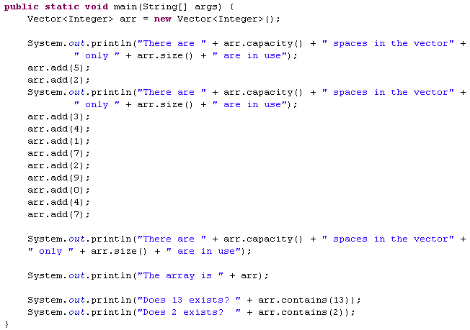
List
טיפוס איברי המערך הוא מחלקה
10
הגודל הפיזי ההתחלתי של המערך הוא 10
0
10
Vector
Vector is a class.
Vector implements a dynamic array.
Vector is synchronized and have some legacy method which collection framework does not contain.
2
ניתן לראות כי ברגע שהמקום במערך נגמר המחלקה מגדילה אותו פי 2
11
[5, 2, 3, 4, 1, 7, 2, 9, 0, 4, 7]
F
T

Slide 20
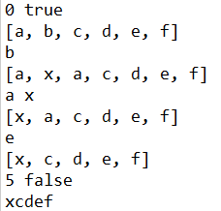
List
public static void main(String[] args) {
LinkedList<String> l = new LinkedList<String>();
System.out.println(l.size() + " " + l.isEmpty());
l.add("a");
l.add("b");
l.add("c");
l.add("d");
l.add("e");
l.add("f");
System.out.println(l);
System.out.println(l.set(1, "x"));
l.add(2, "a");
System.out.println(l);
System.out.println(l.pollFirst() + " " + l.peekFirst());
System.out.println(l);
System.out.println(l.get(4));
l.remove("a");
System.out.println(l);
System.out.println(l.size() + " " + l.isEmpty());
for (String s : l) {
System.out.print(s);
}
}
LinkedList

Slide 21
Set
Set is a type of collection that does not allow duplicate elements. That means an element can only exist once in a Set. It models the set abstraction in mathematics.
Characteristics of a Set collection:
Duplicate elements are not allowed.
Elements are not stored in order. That means you cannot expect elements sorted in any order when iterating over elements of a Set.
Why and When Use Sets?
Based on the characteristics, consider using a Set collection when:
You want to store elements distinctly without duplication, or unique elements.
You don’t care about the order of elements.
For example, you can use a Set to store unique integer numbers; you can use a Set to store cards randomly in a card game; you can use a Set to store numbers in random order, etc.
Set
Sets implementations include
HashSet - an unordered and hash-based implementation.
LinkedHashSet -provide predictable iteration order (insertion order), extends HashSet.
HashTree - provides predictable iteration order (CompareTo)

Slide 22
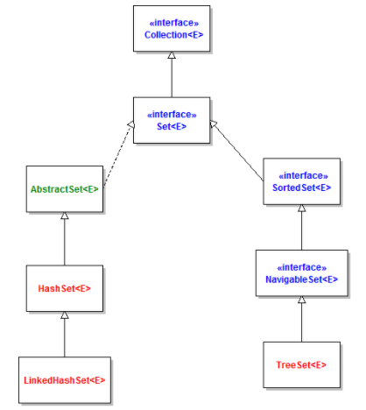
Set
Set Implementations
The Java Collections Framework provides three major implementations of the Set interface: HashSet, LinkedHashSet and TreeSet. The Set API is described in the following diagram:
Set

Slide 23
Set
Set Implementations
The Java Collections Framework provides three major implementations of the Set interface: HashSet, LinkedHashSet and TreeSet. The Set API is described in the following diagram:
Let’s look at the characteristics of each implementation in details:
HashSet:
is the best-performing implementation and is a widely-used Set implementation. It represents the core characteristics of sets: no duplication and unordered.
LinkedHashSet:
This implementation orders its elements based on insertion order. So consider using a LinkedHashSet when you want to store unique elements in order.
TreeSet:
This implementation orders its elements based on their values, either by their natural ordering, or by a Comparator provided at creation time.
Set

Slide 24
Set
Creating a new Set
Set<Integer> numbers = new HashSet<>();
List<Integer> listNumbers =
Arrays.asList(3, 9, 1, 4, 7, 2, 5, 3, 8, 9, 1, 3, 8, 6);
System.out.println(listNumbers);
Set<Integer> uniqueNumbers = new HashSet<>(listNumbers);
System.out.println(uniqueNumbers);
Set
Output:
[3, 9, 1, 4, 7, 2, 5, 3, 8, 9, 1, 3, 8, 6]
[1, 2, 3, 4, 5, 6, 7, 8, 9]
You see, the list listNumbers contains duplicate numbers, and the set uniqueNumbers removes the duplicate ones.
with Java 8, we can use stream with filter and collection functions to return a Set from a collection.
Set<Integer> uniqueOddNumbers = listNumbers.stream()
.filter(number -> number % 2 != 0).collect(Collectors.toSet());
System.out.println(uniqueOddNumbers);

Slide 25
Set
Operation On Set
Adding elements to a Set:
The add()method returns true if the set does not contain the specified element, and returns false if the set already contains the specified element:
Set<String> names = new HashSet<>();
names.add("Tom");
names.add("Mary");
if (names.add("Peter")) {
System.out.println("Peter is added to the set");
}
if (!names.add("Tom")) {
System.out.println("Tom is already added to the set");
}
Set
Peter is added to the set
Tom is already added to the set

Slide 26
Set
Operation On Set
Removing elements from a Set:
The remove() method removes the specified element from the set if it is present (the method returns true, or false otherwise):
if (names.remove("Mary")) {
System.out.println("Marry is removed");
}
Set
Note that the objects in the Set should implement the equals() and hashCode() methods correctly so the Set can find and remove the objects.
Check if a Set is empty:
The isEmpty() method returns true if the set contains no elements, otherwise returns false:
if (names.isEmpty()) {
System.out.println("The set is empty");
} else {
System.out.println("The set is not empty");
}

Slide 27
Set
Operation On Set
Removing elements from a Set:
The clear() method removes all elements from the set. The set will be empty afterward:
names.clear();
if (names.isEmpty()) {
System.out.println("The set is empty");
}
Set
Get total number of elements in a Set:
The size() method returns the number of elements contained in the set:
Set<String> names = new HashSet<>();
names.add("Tom");
names.add("Mary");
names.add("Peter");
names.add("Alice");
System.out.printf("The set has %d elements", names.size());

Slide 28
Set
Operation On Set
Iterating over elements in a Set
Set<String> names = new HashSet<>();
names.add("Tom");
names.add("Mary");
names.add("Peter");
names.add("Alice");
Iterator<String> iterator = names.iterator();
while (iterator.hasNext()) {
String name = iterator.next();
System.out.println(name);
}
Set
Output:
Tom
Alice
Peter
Mary

Slide 29
Set
Operation On Set
Using the enhanced for loop:
for (String name : names) {
System.out.println(name);
}
Set
Using the forEach() method with Lambda expression in Java 8:
names.forEach(System.out::println);

Slide 30
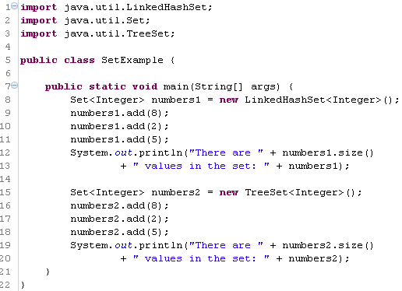

Collections
השיטה add מחזירה true במידה והערך הוכנס לאוסף, false אחרת
LinkedHashSet הינה מחלקה המממשת את הממשק set והיא שומרת את האיברים לפי סדר הכנסתם
LinkedHashSet
TreeSet הינה מחלקה המממשת את הממשק set והיא שומרת את האיברים ממוינים

Slide 31
Collections
unsorted map is not thread-safe | HashMap
is thread-safe null values are not permitted | Hashtable like HashMap but:
a sorted map is not thread-safe | HashTree
Map
Map is an interface.
Maps map keys to values.
A map cannot contain duplicate keys
Implementations of Map include:
HashMap - an unordered and hash-based implementation.
LinkedHashMap - extends HashMap to provide predictable iteration order. (Order)
TreeMap - a NavigableMap that provides predictable iteration order. (Sorting)

Slide 32
Collections
public static void main(String[] args) {
Map<Integer, String> map = new HashMap<Integer, String>();
map.put(new Integer(1), "One");
map.put(new Integer(2), "Two");
map.put(new Integer(3), "Three");
map.put(new Integer(4), "Four");
map.put(new Integer(5), "Five");
map.put(new Integer(1), "Six");
System.out.println(map);
}
HashMap
Existing key – value is replaced
{1=Six, 2=Two, 3=Three, 4=Four, 5=Five}

Slide 33
Collections
public static void main(String[] args) {
String[] a = new String[]{"apple", "orange", "banana", "kiwi", "banana", "grape"};
List<String> l = new ArrayList<String>();
Collections.addAll(l, a);
System.out.println(l);
System.out.println(Collections.frequency(l, "banana"));
System.out.println(Collections.min(l));
System.out.println(Collections.max(l));
Collections.swap(l,0,2);
System.out.println(l);
Collections.reverse(l);
System.out.println(l);
Collections.sort(l);
System.out.println(l);
List<String> unmodifiable = Collections.unmodifiableList(l);
for (String v : unmodifiable) {
System.out.print(v);
}
System.out.println();
try {
unmodifiable.add("pear");
} catch (UnsupportedOperationException e) {
e.printStackTrace();
}
}
Collections
collections is a class.
Collections contains static factory and helper methods for working with collections.
min
max
swap
reverse
sort
unmodifiableList
Using the methods provided by Collections avoids developers having to spend time writing their own, possibly inefficient or incorrect, algorithms to perform common operations such as populating, sorting and searching of collections.

Slide 34
Collections
Some points to consider:
When single thread is involved – no need in thread-safe collections
Use List only when the collection must be ordered
For object pool implementation use Set or HashTable/Map
Use the initial-size and increment-size parameters of the collection’s constructor.
When there’s key-value pairs – prefer HashTable [for quicker search]
List: Vector is synchronized & ArrayList is not
To synchronize the work done on a non thread-safe collection use:
Set s = Collections.synchronizedSet(new HashSet(...));
Collections

Slide 35

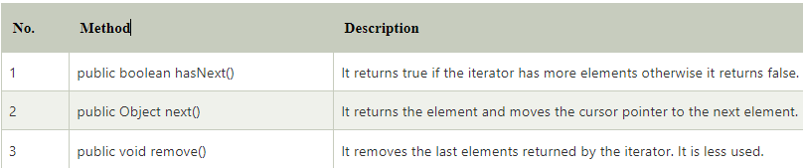
Collections
Iterator:
Iterator interface
Iterator interface provides the facility of iterating the elements in a forward direction only.
Iterator Types
Enumeration
Iterator
ListIterator

Slide 36
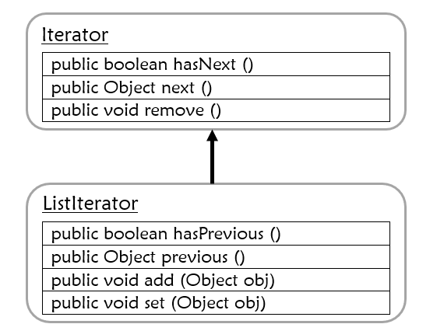
Collections
Iterators
Iterator retrieves all elements in a Collection one by one.
Collection & Set Iterators are unordered.
List Iterator is ordered – therefore it has more options.

Slide 37
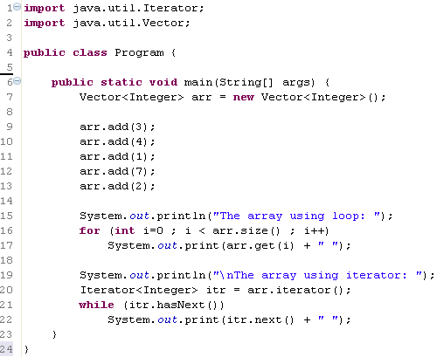
Collections
Iterators
Iterator retrieves all elements in a Collection one by one.
Collection & Set Iterators are unordered.
List Iterator is ordered – therefore it has more options.
הגדרת איטרטור מטיפוס איברי האוסף
קבלת איטרטור לאיבר הראשון באוסף
כל עוד יש איברים באוסף
קבלת האיבר הבא

Slide 38
Collections
public static void main(String[] args) {
Collection<String> col = new ArrayList<String>();
col.add("apple");
col.add("Orange");
col.add("Banana");
Iterator<String> elements = col.iterator(); // an iterator is retrieved from the collection
while (elements.hasNext()){
System.out.println(elements.next());
}
}
Iterators
Iterator retrieves all elements in a Collection one by one.
Collection & Set Iterators are unordered.
List Iterator is ordered – therefore it has more options.
apple
Orange
Banana

Slide 39
Collections
public static void main(String[] args) {
Collection<String> col = new ArrayList<String>();
col.add("apple");
col.add("Orange");
col.add("Banana");
for (Iterator<String> iterator = col.iterator(); iterator.hasNext();) {
System.out.println((String) iterator.next());
}
Iterators
Iterator retrieves all elements in a Collection one by one.
Collection & Set Iterators are unordered.
List Iterator is ordered – therefore it has more options.
apple
Orange
Banana

Slide 40
Collections
public class Runner {
public static void main(String[] args) {
Collection<String> col = new ArrayList<String>();
col.add("apple");
col.add("Orange");
col.add("Banana");
for (String colElm : col) {
System.out.println(colElm);
}
}
}
ForEach
Another way to iterate over collections
It is based on for loop
The index of the looping is a reference from the same type of the collection elements.
apple
Orange
Banana

Slide 41
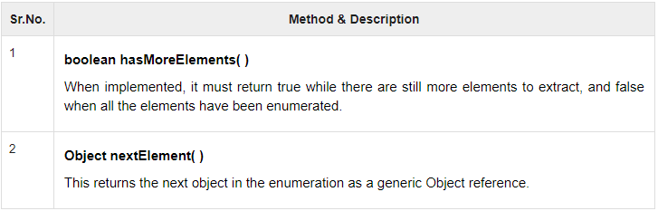
Collections
Enumeration:
A primitive version of Iterator.
Can be used for any purpose – like in StringTokenizer
public static void main(String args[]) {
Enumeration<String> days;
Vector<String> dayNames = new Vector<String>();
dayNames.add("Sunday");
dayNames.add("Monday");
dayNames.add("Tuesday");
dayNames.add("Wednesday");
dayNames.add("Thursday");
dayNames.add("Friday");
dayNames.add("Saturday");
days = dayNames.elements();
while (days.hasMoreElements()) {
System.out.println(days.nextElement());
}
}

Slide 42


Thank You

