Slide 1
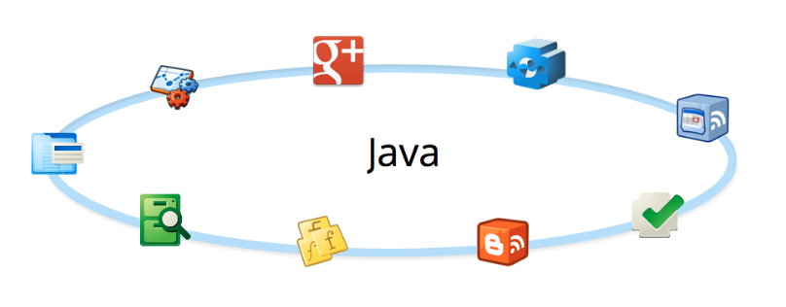
Advanced JAVA
Exceptions
Collections
Serialization & Deserliazation
iostream
Java8 Features
Threads
Concurrency

Slide 2
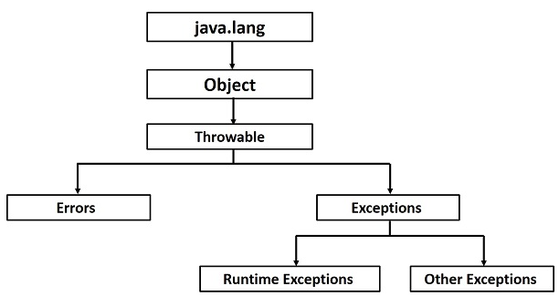
Exceptions
Exceptions Types

Slide 3
Exceptions
RuntimeException (unchecked)
- any exception that extends RuntimeException
- counted as bugs and must be fixed to complete app
- unchecked by the compiler – developer responsibility
Compilation Exceptions (checked)
- any exception that doesn’t extend RuntimeException
- user defined exceptions
- are NOT bugs !! And therefore checked by the compiler
Errors : Serious problems that user /programmer is not responsible about it and they shouldn’t handle it.
Exceptions Types
RuntimeExceptions (unchecked)
Application Exceptions (checked/compilation)
Error

Slide 4
Exceptions
Any error raised due to the application logic or miscalculation
Programmer does not have to handle it – but…
The consequences will be stopping the program
Since we don’t want to provide applications with bugs,
developers will eliminate these exceptions from occurring
RuntimeException
ArithmeticException
NullPointerException
NegativeArraySizeException
ArrayIndexOutOfBoundsException
SecurityException
NumberFormatException
ClassCastException

Slide 5
Exceptions
Usually thrown when any external implementation is involved – such as:
File System
JDBC Drivers
XML Parsers
Programmer must handle it (compilation error)
CompilationException
IOException
[EOFException, FileNotFoundException…]
SQLException
DOMException, SAXException
ClassNotFoundException
RemoteException
AWTException

Slide 6
Errors
Used to indicated problems that mostly cannot be fixed in runtime
AWTError
VirtualMachineError
StackOverflowError
OutOfMemoryError
InternalError (unexpected problem in the VM)
An Error is a subclass of Throwable that
indicates serious problems that a
reasonable application should not try to catch
Assertation Error
IncompatibleClassChangeError
ExceptionInitializerError
OutOfMemoryError
StackOverFlowError

Slide 7
Exceptions
Keyword | Description
try | Used to specify a block where we should place exception code. must be followed by either catch or finally.
catch | Used to handle the exception. It must be preceded by try block which means we can't use catch block alone.
finally | Used to execute the important code of the program. It is executed whether an exception is handled or not.
throw | used to throw an exception.
throws | used to declare exceptions. It doesn't throw an exception. It specifies that there may occur an exception in the method. It is always used with method signature.
Exception keywords

Slide 8
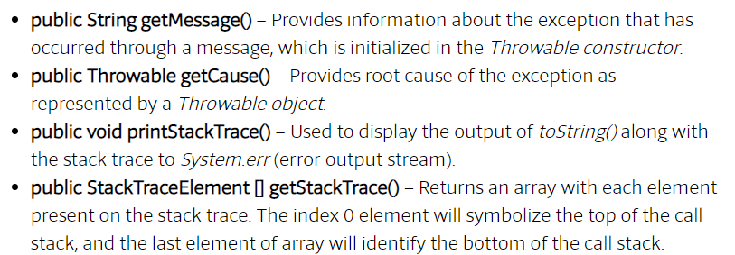
Exceptions
Exception Methods

Slide 9
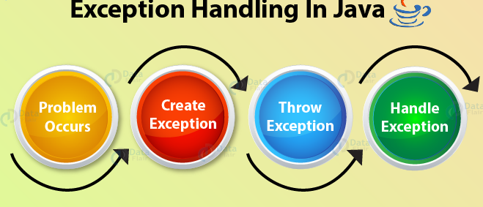
Exceptions
Handling Exceptions
Done in two ways:
Catching exceptions
Throwing Exceptions

Slide 10
Exceptions
Catching exceptions - providing a solution to the situation
Throwing Exceptions – hand on the situation so clients can decide upon their wanted solution
Rethrow exception if catch cannot handle it
Handling Exceptions
Compilation Exception must be handled (caught or thrown)
Runtime Exception may be handled (caught or thrown)

Slide 11
Exceptions
- opens a block to ‘try’ and execute | try
- catches the exception if thrown - written for each Exception [& its subclasses] - closes the try block and opens a new one to be executed when exception is caught - catching order should be considered | catch
- a “do it anyway” block - is optional | finally
Handling Exceptions
Catching exceptions

Slide 12
Exceptions
public class Test {
public static void main(String args[]) {
try {
int a[] = new int[2];
System.out.println("Access element three :" +a[3]);
} catch (ArrayIndexOutOfBoundsException e) {
System.out.println("Exception thrown :" + e);
}
System.out.println("Out of the block");
}
}
Handling Exceptions
1- Catching exceptions

Slide 13
Exceptions
public void check(String fileName, String value) {
try {
FileInputStream in = new FileInputStream(fileName);
if (Integer.parseInt(value) >= 100) {
return;
}
} catch (IOException e) {
// handle I/O problem…
return;
} catch (NumberFormatException e) {
// handle runtime exception…
} finally {
System.out.println("This is printed in any case...");
}
System.out.println("Done!");
}
Multiple catch blocks

Slide 14
Exceptions
Should be written as close to the origin throwing point as possible.
Catching java.lang.Exception will catch all types of exceptions.
Use java.lang.Exception methods to get information:
Catching exceptions
}catch(Exception e){
System.out.println(e.getMessage());
e.printStackTrace(System.out);
}
getMessage()
Returns a message describes this exception
printStackTrace (out)
Prints the stack trace – good for debugging

Slide 15
Exceptions
Any method can delegate exceptions to the caller.
A method must declare any thrown checked Exception as part of its signature.
Throwing Runtime Exceptions (unchecked) is allowed but not always necessary.
throws – used in a method or constructor signatures to declare all their thrown exceptions.
throw – is used inside a method body when actually throwing a created exception object.
Handling Exceptions
Throwing exceptions

Slide 16
Exceptions
public class Checking {
public static int check(String s) throws NumberFormatException {
return Integer.parseInt(s);
}
public static void main(String[] args) {
int num = check(args[0]);
System.out.println(num + 1);
}
}
Handling Exceptions
2- Throwing exceptions

Slide 17
Exceptions
public static int check(String s) throws NumberFormatException {
int x = Integer.parseInt(s);
if (x > 100)
throw new NumberFormatException("Number is too big");
return x;
}
public static void main(String[] args) {
int num = check(args[0]);
System.out.println(num + 1);
}
Handling Exceptions
Throwing exceptions

Slide 18
Exceptions
Method overriding in Subclass with Checked Exception
Checked exception is the exception which is expected or known to occur at compile time hence they must be handled at compile time.
class Super {
void show() {
System.out.println("parent class");
}
}
public class Sub extends Super {
void show() throws IOException //Compile time error {
System.out.println("parent class");
}
public static void main(String[] args) {
Super s=new Sub();
s.show(); }
}
Method Overriding and Exceptions
In the example above, the method show() doesn't throw any exception when its declared/defined in the Super class, hence its overridden version in the class Sub also cannot throw any checked exception.

Slide 19
Exceptions
Method overriding in Subclass with UnChecked Exception
class Super {
void show() {
System.out.println("parent class");
}
}
class Sub extends Super {
void show() throws ArrayIndexOutOfBoundsException {
System.out.println("child class");
}
public static void main(String[] args) {
Super s = new Sub(); s.show();
}
}
Method Overriding and Exceptions
Output
child class
Because ArrayIndexOutOfBoundsException is an unchecked exception hence,
overrided show() method can throw it.

Slide 20
Exceptions
Subclass overriden method with same Exception
Method of a sub class can declare same exception as declared in the super class.
class Super {
void show() throws Exception {
System.out.println("parent class");
}
}
public class Sub extends Super {
void show() throws Exception //Correct {
System.out.println("child class");
}
public static void main(String[] args) {
try {
Super s=new Sub();
s.show();
} catch(Exception e){}
}
}
Method Overriding and Exceptions
Output
child class

Slide 21
Exceptions
Subclass overriden method with no Exception
It is optional to declare the exception in sub class during overriding.
If method of super class declared an exception, then it is up to the subclass to declare exception or not. See the below example.
class Super {
void show() throws Exception {
System.out.println("parent class");
}
}
public class Sub extends Super {
void show() //Correct {
System.out.println("child class");
}
public static void main(String[] args) {
try {
Super s=new Sub();
s.show();
} catch(Exception e){}
}
}
Method Overriding and Exceptions
child class

Slide 22
Exceptions
Subclass overriden method with parent Exception
It is not allowed to declare parent class exception in the subclass method, we get compile time error if we try to compile that program.
class Super {
void show() throws ArithmeticException {
System.out.println("parent class");
}
}
public class Sub extends Super {
void show() throws Exception //Compile time Error {
System.out.println("child class");
}
public static void main(String[] args) {
try {
Super s=new Sub();
s.show();
} catch(Exception e){}
}
}
Method Overriding and Exceptions

Slide 23
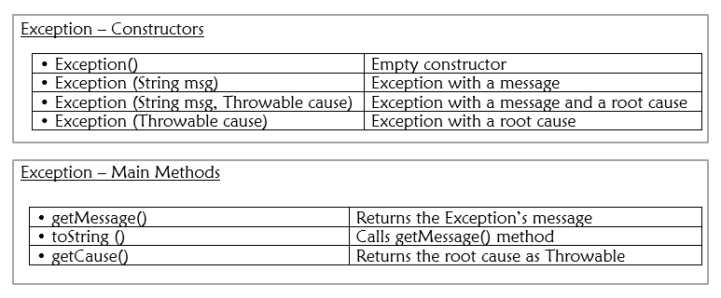
Exceptions
Class must be a subclass of Exception (directly or indirectly)
May hold more methods and fields
Creating Your Own Exceptions

Slide 24
Exceptions
public class NumberOutOfLimitsException extends Exception {
// added field
private int num = 0;
public NumberOutOfLimitsException(String msg, int num) {
super(msg);
this.num = num;
}
// added method
public int getNum() {
return num;
}
}
Creating Your Own Exceptions

Slide 25
Exceptions
public class NumChecker {
public void check(int num) throws NumberOutOfLimitsException {
if (num < 0 || num > 100)
throw new NumberOutOfLimitsException("Wrong value", num);
}
}
public class TestChecker {
public static void main(String[] args) {
NumChecker nc = new NumChecker();
try {
nc.check(Integer.parseInt(args[0]));
System.out.println(args[0] + " is OK");
} catch (NumberOutOfLimitsException e) {
System.out.println(e.getMessage() + " " + e.getNum());
}
}
}
Creating Your Own Exceptions

Slide 26


Thank You

