Slide 1

Java Advanced
Generic

Slide 2
Java Advanced
Generics provide a way to create classes, interfaces, and methods with placeholder types.
The placeholder types are specified when using the generic class or method.
Generics offer several benefits, and they primarily serve two main purposes:
  type safety.
  code reusability.
Generics does not work with primitive types (int, float, char, …).
Generics

Slide 3
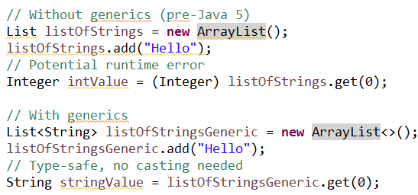
Java Advanced
Type safety:
Generics

Slide 4
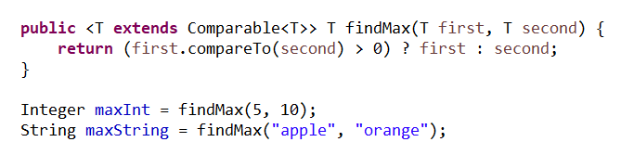
Java Advanced
code reusability:
Generics

Slide 5
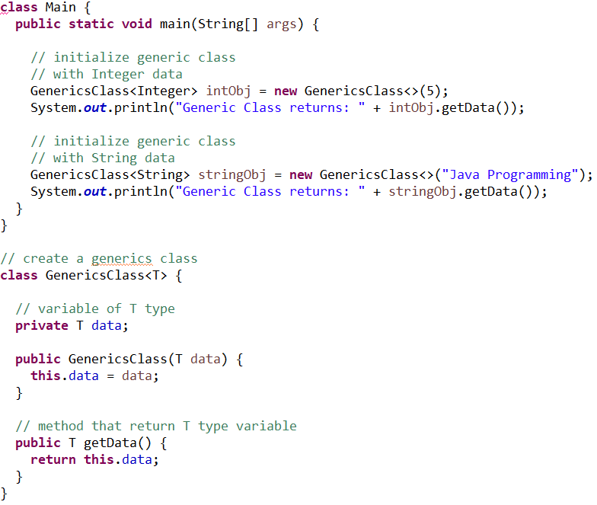
Java Advanced
Java Generics Class
Generics

Slide 6
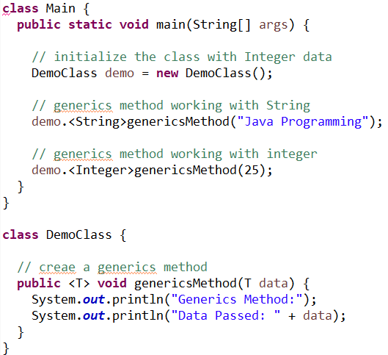
Java Advanced
Java Generics Method
Generics

Slide 7
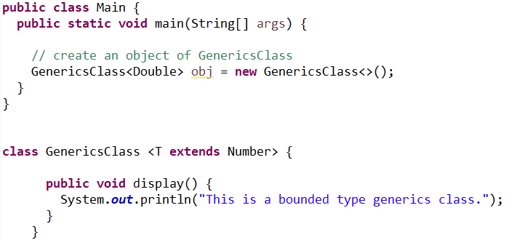
Java Advanced
Java Generics Bounded Class
Generics

