Slide 1
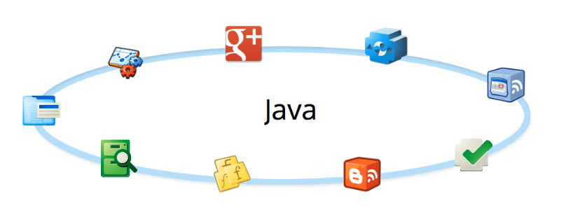
Advanced Java
Iostream

Slide 2
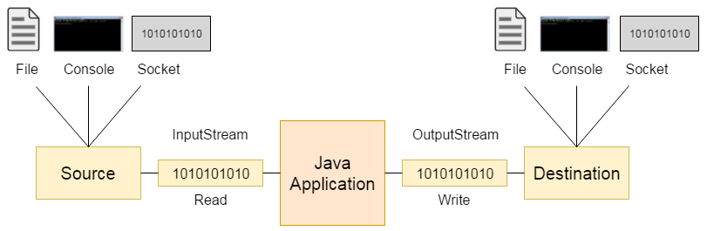
Iostream
Input / Output
Streaming data

Slide 3
Iostream
Streaming data – a stream is a sequence of data read or written, one item at a time
  Blocking: java.io package
  Non-blocking: java.nio package
Random access – reading and writing data can be done in a non sequential order
  java.io.RandomAccessFile
Streaming Data
Random access

Slide 4
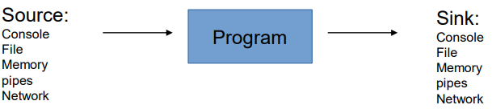
Iostream
A stream can come to the program from a source or can be generated by the program to a sink. Sources and sinks are both node streams:
Streaming Data
Random access

Slide 5
Iostream
The basic abstract classes for the different types of streams are:
Byte streams:
InputStream
OutputStream
Character streams:
Reader
Writer
Streaming Data
Random access

Slide 6
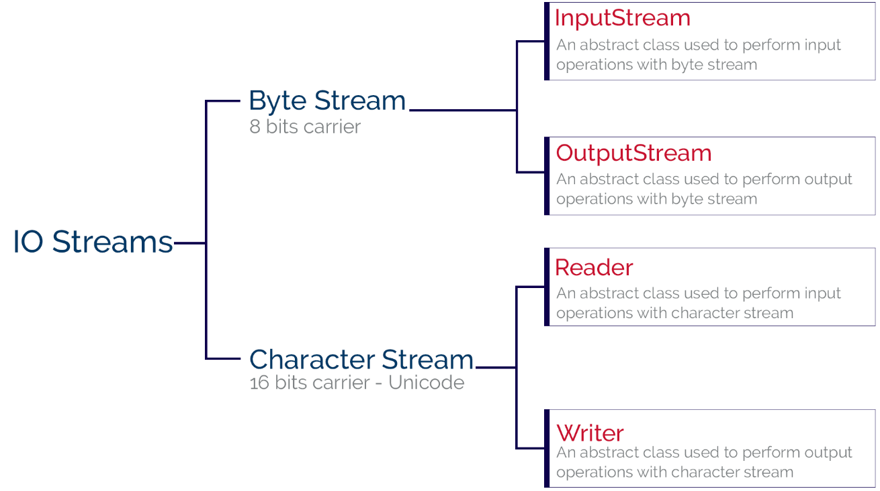
Iostream
Streaming Data
Random access

Slide 7
Iostream
Character Stream
Use :
When dealing with text-based data, such as plain text files, configuration files, or any file that contains human-readable characters.
Advantages:
Character streams automatically handle character encoding and decoding, making them suitable for dealing with text in different character sets.
They provide higher-level abstractions like Reader and Writer, which work with characters rather than bytes.
Example:
      FileReader reader = new FileReader("textFile.txt");
      FileWriter writer = new FileWriter("output.txt");
Streaming Data
Random access

Slide 8
Iostream
Byte Stream
Use :
When working with binary data, such as image files, audio files, or any non-text data.
Advantages:
Byte streams are low-level and handle data in its raw form, making them suitable for binary data or when you need to work with the actual bytes of a file.
They are more suitable for network operations where data is transmitted in binary form.
Example:
FileInputStream inputStream = new FileInputStream("binaryFile.bin");
FileOutputStream outputStream = new FileOutputStream("output.bin");
Streaming Data
Random access

Slide 9
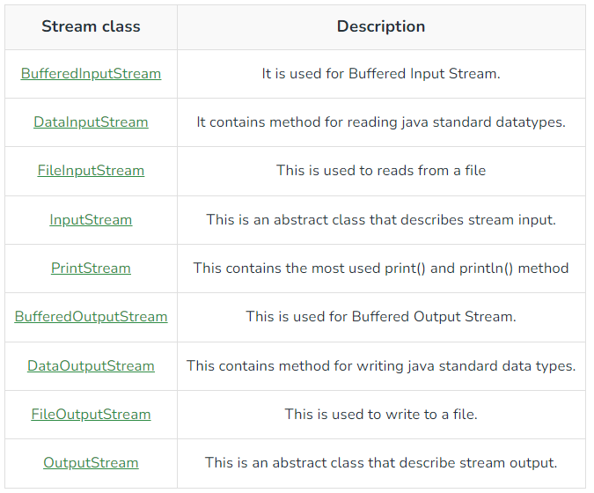
Iostream
Byte Stream methods
Streaming Data
Random access

Slide 10
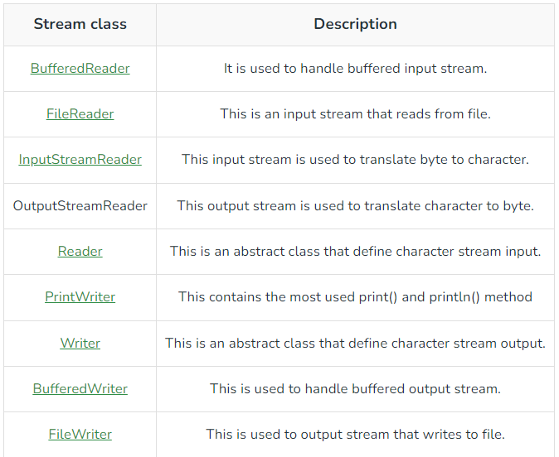
Iostream
Character Stream methods
Streaming Data
Random access

Slide 11
Iostream
Main IO endpoints (sources and sinks):
File System:
• FileReader / FileWriter / FileInputStream / FileOutputStream
Networking:
• Socket / ServerSocket
Threads communication (pipes):
• PipedInputStream / PipedOutputStream
Streaming Data
Random access

Slide 12
Iostream
Streams:
Three default accessed streams
System.in – InputStream
System.out - PrintStream (OutputStream)
System.err - PrintStream
Streaming Data
Random access

Slide 13
Iostream
OutputStream methods
void write(byte[] b)
void write(byte[] b, int off, int len)
void write(int b)
void flush()
void close()
Streaming Data
Random access

Slide 14
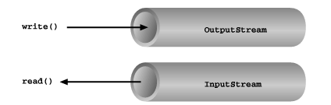
Iostream
Basic input and output stream functionality
Streaming Data
Random access

Slide 15
Iostream
InputStream methods
int available()
int read()
int read(byte[] b)
int read(byte[] b, int off, int len)
long skip(long n)
void close()
void mark(int readlimit)
boolean markSupported()
void reset()
Streaming Data
Random access

Slide 16
Iostream
OutputStream methods
void write(byte[] b)
void write(byte[] b, int off, int len)
void write(int b)
void flush()
void close()
Streaming Data
Random access

Slide 17
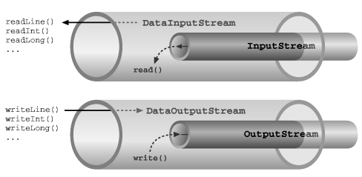
Iostream
Basic input and output stream functionality
Streaming Data
Random access

Slide 18
Iostream
Filter Streams – Decorators
Stream created over another stream
Subclasses of:
  FilterInputStream
  FilterOutputStream
  FilterReader
  FilterWriter
used frequently to decorate IO into:
  Text
  Primitives
  Objects
Streaming Data
Random access

Slide 19
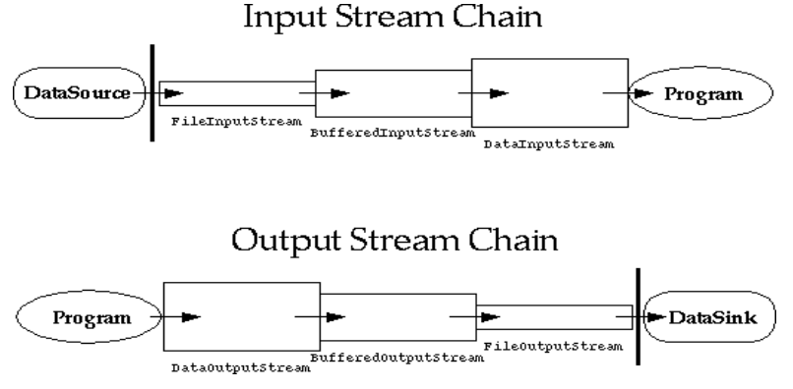
Iostream
Chaining Decoration
Streaming Data
Random access

Slide 20
Iostream
Switch between binary <-> text IO
Converts the bytes read from the underlying InputStreamReader to characters according to the specified
OutputStreamReader Converts characters to bytes according to the character coding before writing
Streaming Data
Random access

Slide 21
Iostream
Text Decorators
BufferedReader / BufferedWriter
Provides Line based reading and writing:
  Reading:
  BufferedReader.readLine() returns String (or null on end of file).
  Writing:
  BufferedWriter.write(String line) & BufferedWriter.newline()
Streaming Data
Random access

Slide 22
Iostream
Primitives Decorators
DataInputStream / DataOutputStream
Provides primitive based reading and writing:
Reading:
• readUTF() : String
• readInt() : int
• readBoolean() : boolean ….
Writing:
• writeUTF(String)
• writeInt(int)
• writeBoolean(boolean)
Streaming Data
Random access

Slide 23
Iostream
Objects Decorators
ObjectInputStream / ObjectOutputStream
All objects must implement Serializable
Provides Objects based reading and writing:
Reading:
• readObject() : Object
Writing:
• writeObject(Object)
Streaming Data
Random access

Slide 24
Iostream
Serialization
Only the object's data are serialized
Data marked with the transient keyword are not serialized.
Serialization stores the state of an object to a file
Serializable objects can be stored and loaded from object streams:
  ObjectInputStream
  ObjectOutputStream
Streaming Data
Random access

Slide 25
Iostream
Random AccessFile
Constructors:
RandomAccessFile(File file, String mode)
RandomAccessFile(String name, String mode)
Mode is usually ”r” or ”rw” .
file pointer can be read and positioned:
int skipBytes(int)
void seek(long)
long getFilePointer()
Streaming Data
Random access

Slide 26
Iostream
Stream Tokenizer
A class reads the stream character by character.
Each of them can have zero or more of the following attributes:
white space, alphabetic, numeric, string quote or comment character.
types of characters:
  Word characters: ranges like ‘a’ to ‘z’ and ‘A’ to ‘Z
  Numeric characters: 0,1,…,9
  Whitespace characters: ASCII values from 0 to 32
  Comment character: /
  String quote characters: ‘ and “
Streaming Data
Random access

