Slide 1
Threads and Concurrency
Running at the same time (concurrently) and performing different tasks
For example, a Web browser can do several things at the same time:
scroll a page
download a file
play animation, sound
print page
load a new page
Multitasking

Slide 2
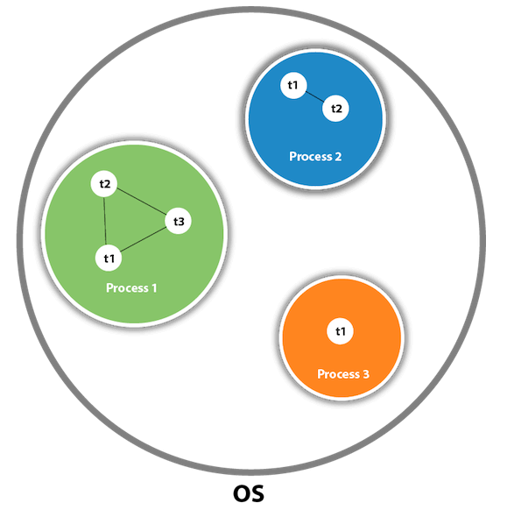
Threads
What is Thread?
A Thread is an independent path of execution within a program
Many threads can run concurrently within a program.
Every thread in Java is created and controlled by the java.lang.Thread class.
A Java program can have many threads, and these threads can run concurrently, either asynchronously or synchronously.
Every thread has a priority. Threads with higher priority are executed in preference to threads with lower priority.

Slide 3
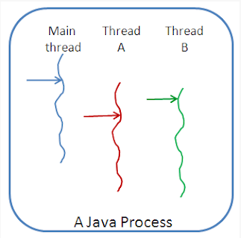
Threads
Thread and Process
A process has a self-contained execution environment.
A process generally has a complete, private set of basic run-time resources
Threads are sometimes called lightweight processes
Both processes and threads provide an execution environment, but creating a new thread requires fewer resources than creating a new process.

Slide 4
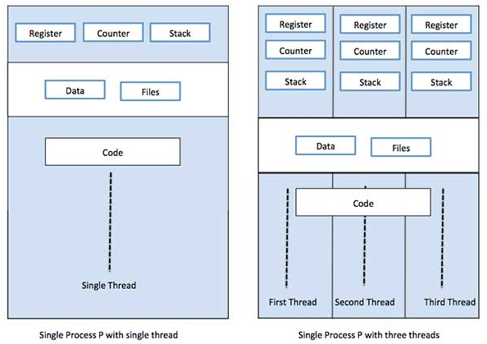
Threads
What is Thread?
Multi Threading

Slide 5
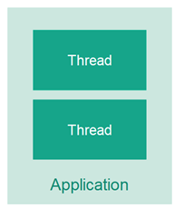
Threads
What is Multithreading?
Multiple Threads in a Single Program
Multithreading means that you have multiple threads of execution inside the same application.
A thread is like a separate CPU executing your application.
a multithreaded application is like an application that has multiple CPUs executing different parts of the code at the same time.

Slide 6
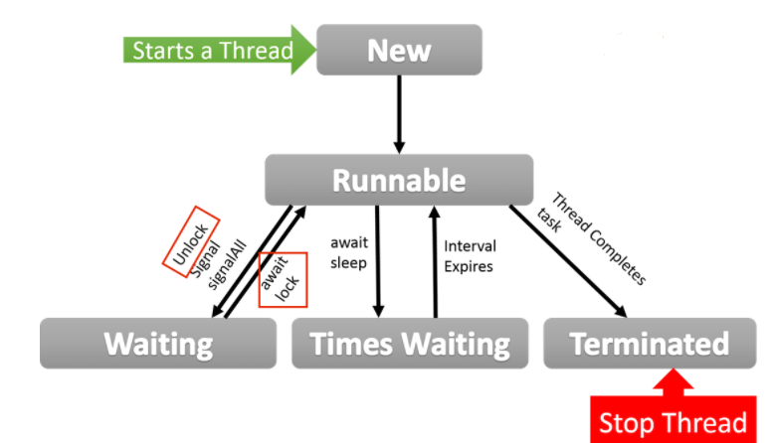
Threads
Thread Lifecycle

Slide 7
Threads
There are 2 ways for defining and creating threads
Subclassing Thread and Overriding run
Implementing the Runnable interface
Techniques for Using of Threads

Slide 8
Threads
public class SimpleThread extends Thread {
//override run and extends thread
public SimpleThread(String str) {
super(str);
}
@Override
public void run() {
for (int i = 0; i < 10; i++) {
System.out.println(i + " " + getName());
System.out.println(Thread.currentThread().getPriority());
try {
sleep((long)(Math.random() * 1000));
} catch (InterruptedException e) {
e.getStackTrace();
}
}
System.out.println("DONE! " + getName());
}
public static void main (String[] args) {
new SimpleThread("thread1").start();
new SimpleThread("thread2").start();
System.out.println("Hi Assaf" +Thread.currentThread().getPriority());
}
}
Techniques for Using of Threads
Subclassing Thread and Overriding run

Slide 9
Threads
public class SimpleRunnable implements Runnable {
public void run() {
for (int i = 0; i < 10; i++) {
System.out.println(i + " " + Thread.currentThread().getName());
System.out.println(Thread.currentThread().getPriority());
try {
Thread.sleep((long)(Math.random() * 3000));
}
catch (InterruptedException e) {}
}
System.out.println("DONE! " + Thread.currentThread(). getName());
}
public static void main (String[] args)
{
SimpleRunnable runner=new SimpleRunnable ();
Thread t1=new Thread(runner,“Mark thread");
Thread t2=new Thread(runner,“Adir thread");
t1.start();
t2.start();
}
}
Techniques for Using of Threads
Implementing the Runnable interface

Slide 10
Threads
Implementing Runnable
Allows your class to extend some other class
Is good if you want light-weight runnable objects
That’s what interfaces are for
Problems – might be less convenient for coding
Sub classing Thread
Allows direct access to Thread attributes and methods
Less coding
Problems – single inheritance in Java – your class cannot extend another class
Which Way is Better ?

Slide 11
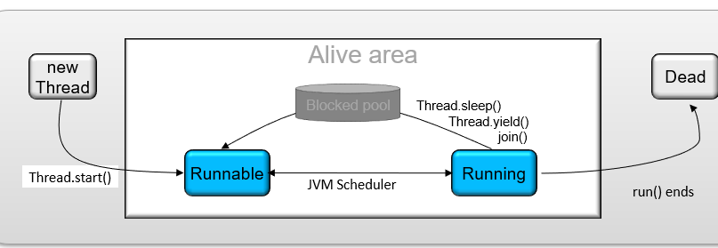
Threads
Basic states of the Thread:
New Thread
Running
Not Runnable
Dead
The Life Cycle of a Thread

Slide 12
Threads
Life cycle of Threads
New Thread
No system resource have been allocated for it yet
Can only be started
Calling any method besides causes an IllegalThreadStateException
Born state
Thread was just created
Ready state
Thread’s start method invoked
Thread can now execute
Running state
Thread is assigned a processor and running
Dead state
Thread has completed or exited
Eventually disposed of by system
Running
Creates the system resources necessary to run the thread
Schedules the thread to run
Calls the thread's run method
Not Runnable
A thread becomes Not Runnable when one of these events occurs:
-- Its sleep(), yield() method is invoked
One thread uses join() on another and becomes blocked
The thread calls the wait() method to wait for a specific condition to be satisfied.
The thread is blocked on I/O

Slide 13
Threads
Life cycle of Threads
Move the thread to a non-Runnable state for a period of time (ms) Usually the simplest way to delay threads or main Note: blocks the thread at least to the specified time – not exactly | Sleep
Move the Running thread to the Rannable pool (Equals to sleep(0)) Usually for giving other low priority thread a chance to run | Yield
Move the running thread to a non-Runnable state until a specific thread ends Delays the caller until the referenced thread ends Is absolute – not like priority | Join
Thread states
Born state
Thread was just created
Ready state
Thread’s start method invoked
Thread can now execute
Running state
Thread is assigned a processor and running
Dead state
Thread has completed or exited
Eventually disposed of by system
try {
Thread.sleep(3000)
} catch (InterruptedException e) {}
All methods throws InterruptedException
When thread are out of the blocking state before time
Might happen due to OS activity
Blocked threads returns to runnable state
never to running (!)
try {
Thread.yield()
} catch (InterruptedException e) {}
…
Thread t=new Thread(runner);
t.start();
try {
t.join()
} catch (InterruptedException e) {}
// all the work here happens after t ends
…

Slide 14
Threads
Life cycle of Threads
The following list describes the escape route for every entrance into the Not Runnable state:
If a thread has been put to sleep, then the specified number of milliseconds must elapse
If a thread is waiting for a condition, then another object must notify the waiting thread of a change in condition by calling notify() or notifyAll() - later
If a thread is blocked on I/O, then the I/O must complete
Born state
Thread was just created
Ready state
Thread’s start method invoked
Thread can now execute
Running state
Thread is assigned a processor and running
Dead state
Thread has completed or exited
Eventually disposed of by system

Slide 15
Threads
Life cycle of Threads
Dead
The run method must terminate naturally
Stop method – deprecated!!!
This method is inherently unsafe. Stopping a thread with Thread.stop causes it to unlock all of the monitors that it has locked (as a natural consequence of the unchecked ThreadDeath exception propagating up the stack)
Born state
Thread was just created
Ready state
Thread’s start method invoked
Thread can now execute
Running state
Thread is assigned a processor and running
Dead state
Thread has completed or exited
Eventually disposed of by system

Slide 16
Threads
public class ThreadController {
private Ruuner r = new Ruuner();
private Thread t = new Thread(r);
public void startThread() {
t.start();
}
public void stopThread() {
// use specific instance of Runner
r.stopRunning();
}
}
Thread Control
public class Ruuner implements Runnable {
private boolean timeToQuit=false;
@Override
public void run() {
while ( ! timeToQuit ) {
}
}
public void stopRunning() {
timeToQuit=true;
}
}

Slide 17
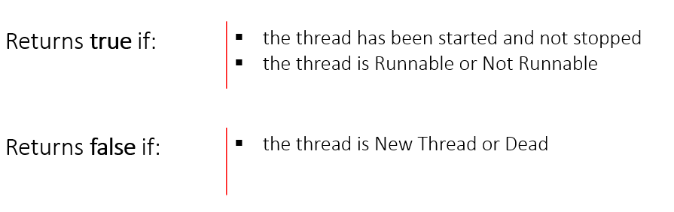
Threads
IsLive

Slide 18
Threads
public class Car{
...
//It’s not synchronized now
public void drive(){…}
}
public class Person{
public void use(Car c){
synchronized(c){
…
c.drive();
…
}
}
}
Object Lock
More than one Driver can drive the Car at a time

Slide 19
Threads
public class Car{
...
public synchronized void drive(){
//this Car is locked by a Driver
…
//this Car is unlocked by a Driver
}
}
public class Person{
public void use(Car c){
synchronized(c){
…
c.drive();
…
}
}
}
Object Lock
Only one Driver can drive the Car at a time
Only one thread at a time can own an object’s monitor

Slide 20
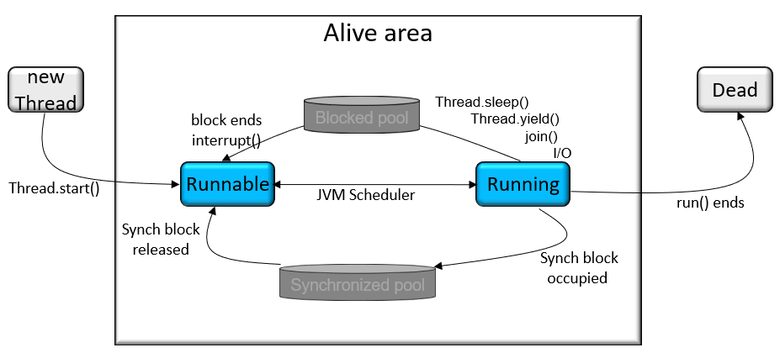
Threads
Synchronization

Slide 21
Threads
Separate, concurrently running threads do share data and must consider the state and activities of other threads
One such set of programming situations are known as producer/consumer scenarios where the producer generates a stream of data which then is consumed by a consumer
The code segments within a program that access the same object from separate, concurrent threads are called critical sections
Synch Threads

Slide 22
Threads
public class Table {
synchronized void printTable(int n){//method not synchronized
for(int i=1;i<=5;i++){
System.out.println(n*i);
try{
Thread.sleep(400);
}catch(Exception e){System.out.println(e);}
}
}
}
class MyThread1 extends Thread{
Table t;
MyThread1(Table t){
this.t=t;
}
public void run(){
t.printTable(5);
}
}
class MyThread2 extends Thread{
Table t;
MyThread2(Table t){
this.t=t;
}
public void run(){
t.printTable(100);
}
}
Synch Threads

Slide 23
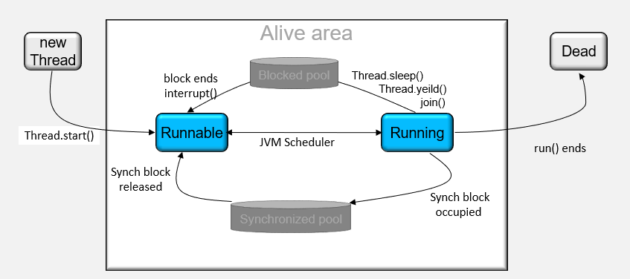
Threads
Wait and Notify

Slide 24
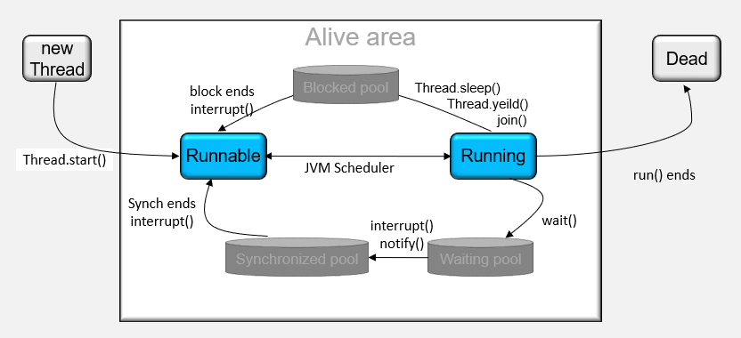
Threads
wait(), wait(long timeout)
Causes current thread to wait until another thread invokes the notify() method or the notifyAll() method for this object, or a specified amount of time has elapsed.
notify()
Wakes up a single thread that is waiting on this object's monitor
notifyAll()
Wakes up all threads that are waiting on this object's monitor
Wait

Slide 25
Threads
The current thread must own this object’s monitor
A thread becomes the owner of the object’s monitor in one of three ways:
By executing a synchronized instance method
By executing the body of a synchronized
For objects of type Class, by executing a synchronized static method
Only one thread at a time can own an object’s monitor
Notify

Slide 26
Threads
The current thread must own this object’s monitor
A thread becomes the owner of the object’s monitor in one of three ways:
By executing a synchronized instance method
By executing the body of a synchronized
For objects of type Class, by executing a synchronized static method
Only one thread at a time can own an object’s monitor
Notify

Slide 27
Threads
Is two threads, each waiting for a lock from the other
Is not detected or avoided
Can be avoided by:
Deciding on the order to obtain locks
Adhering to this order throughout
Releasing locks in reverse order
Deadlock

Slide 28
Threads
Threads keep on running even after main thread ends
Means that the VM still ‘on the air’ until the last thread dies
In order to kill a thread when system exits it has to be a daemon
Thread can be set to behave as daemon via setDaemon(boolean)
Thread can be checked via isDaemon()
Garbage collection is a daemon thread
therefore, doesn’t last after system exit
That’s why sometimes object may never get the finalize() call
Daemon Threads

Slide 29


Thank You

