Slide 1

GIT
Git is a free and open-source distributed version control system designed to handle everything from small to very large projects with speed and efficiency.
Git is easy to learn and has a tiny footprint with lightning-fast performance.
Git outclasses SCM tools like Subversion, CVS, Perforce, and ClearCase with features like cheap local branching, convenient staging areas, and multiple workflows.
GIT

Slide 2
GIT
Site:
https://git-scm.com/book/en/v2/Getting-Started-Installing-Git
Download the server package :
https://git-scm.com/download/win
Download a client package :
https://git-scm.com/download/gui/windows
Install GIT

Slide 3
GIT
Site:
https://git-scm.com/book/en/v2/Getting-Started-Installing-Git
Download the server package :
https://git-scm.com/download/win
Download a client package :
https://git-scm.com/download/gui/windows
Local and Origin

Slide 4
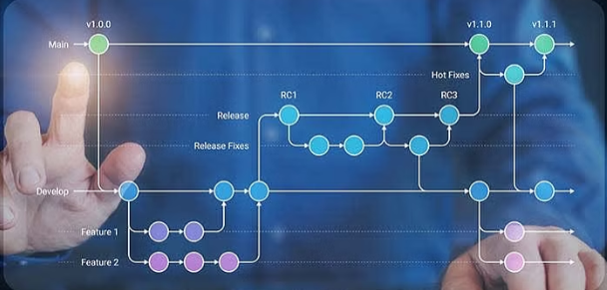
GIT
A repository, often abbreviated as "repo," is a data structure that stores metadata and a set of files or directories, usually representing a project or a codebase.
A repository contains the entire history of the project, including all versions of files and information about changes made over time.
There are two phases per repository :
  Local repository :
    The copy of the repository that exists on local machine.
    Created by cloning action.
    Contains the full history and allows to work on the project, make changes, and commit them locally.
  Remote repository:
    The version of the repository that is hosted on a server.
    Separate from your local machine.
    Servers as a centralized location where developers can collaborate, share changes, and synchronize their work.
    Remote is used for sharing code and for backup purposes.
Repositories

Slide 5
GIT
Cloning:
  By cloning we create a copy of the entire project, including its history, on the local machine.
  The original repository becomes the origin remote by default.
  Cloning establishes a link between local and remote repository.
Commit:
  A commit in Git represents a snapshot of the project at a specific point in time.
  Commits contain changes made to files, a commit message describing the changes, and a reference to the previous commit.
Push and Pull:
  Push sends your local commits to the remote.
  pull retrieves changes from the remote and merges them into your local branch.
Branches:
  Branches in Git provide a way to work on different features or changes independently.
  Developers can create, switch, merge, and delete branches in their local repositories.
Repository Actions

Slide 6
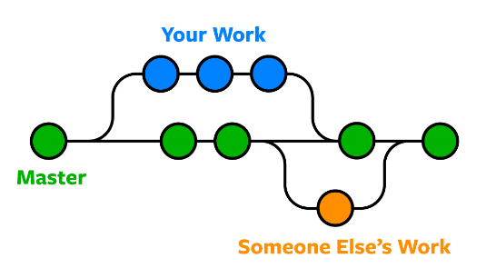
GIT
Branch

Slide 7
GIT
Branch is a lightweight movable pointer to a commit.
The default branch created in a Git repository is typically named "master".
Each branch represents an independent line of development, allowing you to work on different features, bug fixes, or experiments simultaneously without affecting the main codebase.
A branch is essentially a pointer to a specific commit in the Git history.
When new commit is made in branch , the branch pointer moves forward to the latest commit.
The main branch, often named "master" or "main," typically represents the stable version of the project. It serves as the default branch when you create a new repository.
Branch

Slide 8
GIT
Create a new branch: git branch branch_name
Switch to existing branch: git checkout branch_name
Create a new branch and switch to it : git checkout -b branch_name
List local branches : git branch
Delete the specified branch : git branch -d branch_name
Delete in force the specified branch : git branch -D branch_name
Rename the branch name : git branch -m new_name
Merge the specified branch into the current branch:
  git merge specified_name
Rebases the current branch onto the specified branch:
  git rebase specified_name
Pulls changes from the remote repository for the specified branch : git pull origin main
Branch Actions

Slide 9
GIT
Initialize a new Git repository
  If you are starting a new project, you can initialize a Git repository in your local working directory using the following
  git init
Clone an existing repository
  If you want to work on an existing project, you can clone the repository into your local working directory
        git clone repository_url
Check the working directory status
  To see which files have been modified, added, or deleted in your working directory, you can use
  git status
Create new branch
  git checkout –b branch_name
      git branch branch_name , git checkout branch_name
Local Area

Slide 10
GIT
View commit history
  to view the commits history, you can use the following command
  git log
Update your local repository
  If others have pushed changes to the remote repository, you can fetch those changes and update your local branches:
git pull origin <branch_name>
Merge branches
  After you've made changes in a branch and want to incorporate those changes into another branch (typically the main branch), you can use:
  git checkout <target_branch> , git merge <source_branch>
Rebase branch
  Rebasing a branch in Git involves moving or combining a sequence of commits to a new base commit
  Next Slide ….
Local Area

Slide 11
GIT
Rebase branch
  rebasing allows you to integrate changes from one branch into another by applying the commits individually.
  Ensure you are on the branch to be rebased
      git checkout feature-branch
  Fetch the latest changes from the remote repository
      git fetch origin
  Rebase the branch onto the target branch
      git rebase main
  Resolve any conflicts
git rebase –continue
Local Area

Slide 12

GIT
The staging area is an intermediate area between your working directory and the repository.
The staging area is where you prepare changes before committing them to the Git repository.
The staging area acts as a place to collect and review changes before making a commit
To move code changes from local work directory to the staging
  git add . Or git add “file_name”
To move code changes from staging area to a commit into the repository (origin)
  git commit –m “message”
Staging Area

Slide 13
GIT
The staging area is an intermediate area between your working directory and the repository.
The staging area is where you prepare changes before committing them to the Git repository.
The staging area acts as a place to collect and review changes before making a commit
To move code changes from local work directory to the staging
  git add . Or git add “file_name”
To move code changes from staging area to a commit into the repository (origin)
  git commit –m “message”
Staging Area

Slide 14
GIT
To upload the changes, you made locally to a remote repository
git push <remote> <branch>
Example :
git push origin master
Origin Area

Slide 15

GIT
Git Entities

Slide 16
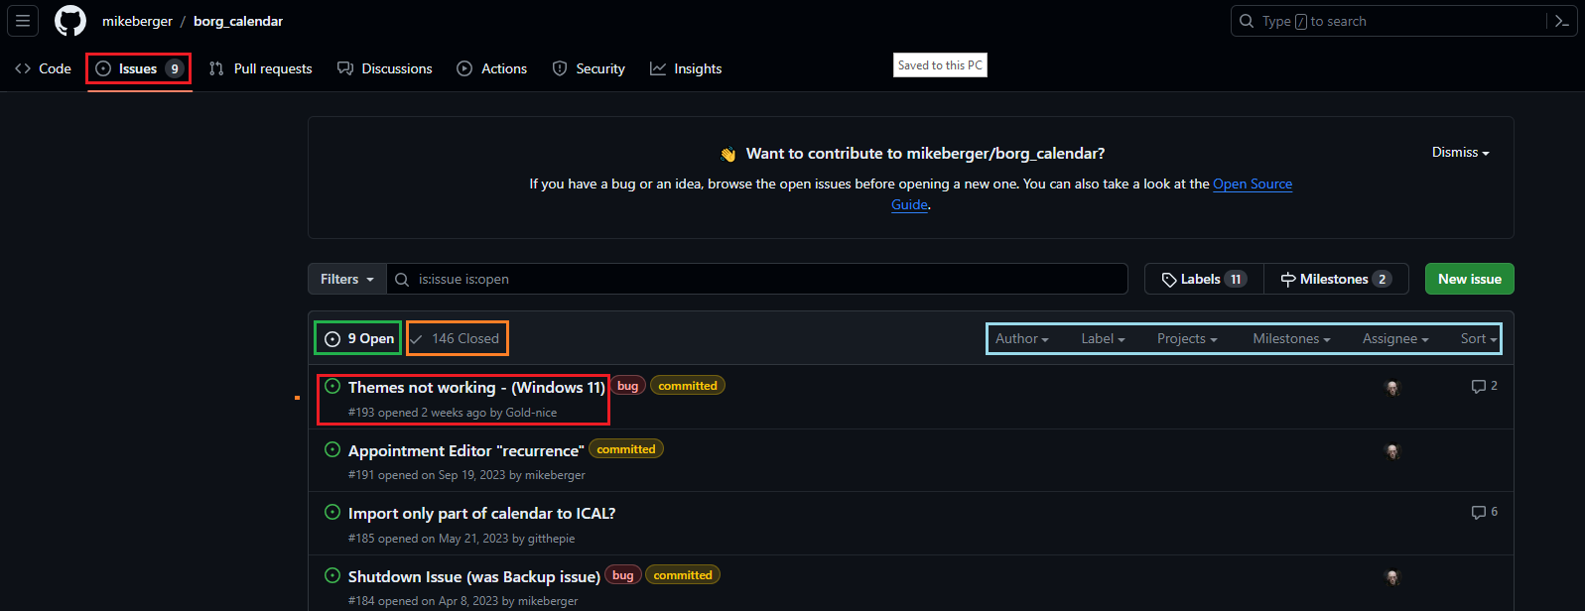
GIT
Issues

Slide 17
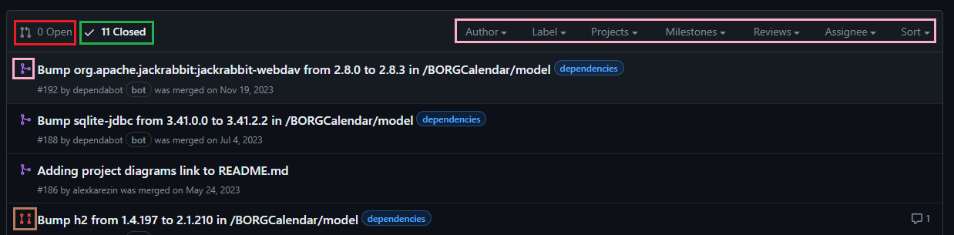
GIT
PRs

