Slide 1
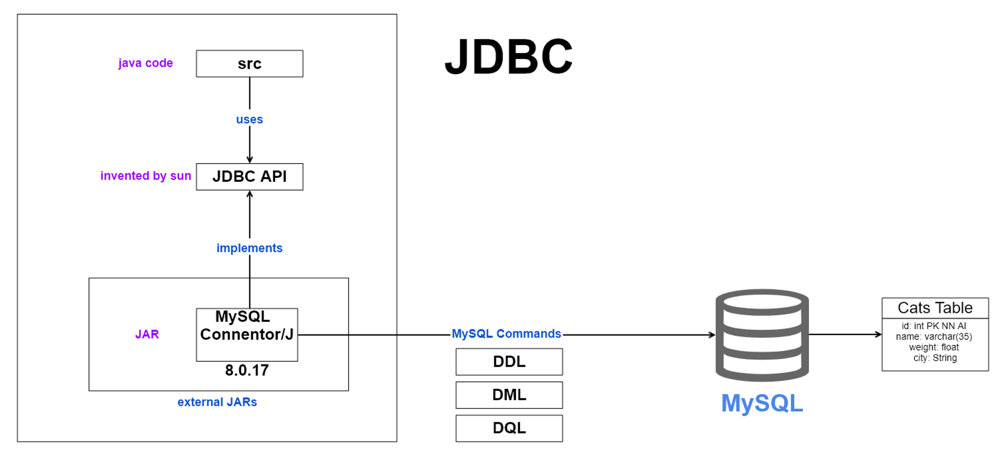

Slide 2
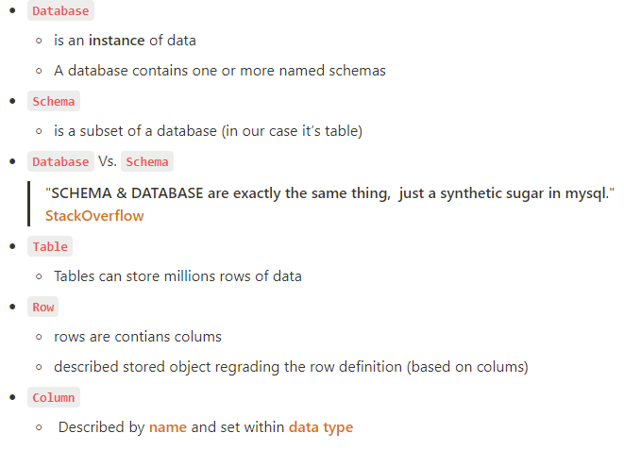
JDBC
Data Base

Slide 3
JDBC
What is RDBMS
Relational Databases Management System.
It uses a structure that allows us to identify and access data in relation to another piece of data in the database.
Often, data in a relational database are organized into tables.
Support SQL Language.
What is NoSQL
non-SQL or non-relational.
provides a mechanism for storage and retrieval of data.
The data is not modeled (orginized) in relational desiged (Tables) .
That data is organed as JSON Collections Documents.
The name "NoSQL" is associating as Big Data databases.
SQL VS NOSQL

Slide 4
JDBC
The Java API for database handling.
JDBC stands for Java Database Connectivity.
JDBC is a collection of interfaces serving as an integration protocol with various existing databases (DBs).
For the vendor, JDBC is a standard that must be supported.
Each vendor may implement the interfaces in his own way (either by using a driver or by using an extra layer called a JDBC bridge).
The developer will use Interfaces to work transparently with vendor supplied objects.
There are 4 different drivers, each suitable for a different purpose.
JDBC

Slide 5
JDBC
ODBC Drivers (DBC & ODBC)
  ODBC is supported in Microsoft environments.
  DBC is a JDBC bridge that allows, among other things, integration of Java code with a variety of DBs it supports .
  Using it requires a special class that knows how to connect to ODBC services
Native Drivers
  written in languages such as C or C++ and allow fast integration with the various DB they are written for.
Network drivers :
  appropriate for clients that want to connect to a DB through a network.
Java drivers ( via Maven Repository )
JDBC DRIVER

Slide 6
JDBC
Database Details
JDBC
private static final String url = "jdbc:mysql://localhost:3306?createDatabaseIfNotExist=TRUE&useTimezone=TRUE&serverTimezone=UTC";
private static final String username = "root";
private static final String password = "1234";

Slide 7
JDBC
JDBC In 5 Steps
Step 1 - Loading JDBC Driver
public class Test {
public static void main(String[] args) throws ClassNotFoundException, SQLException {
System.out.println("START");
//STEP 1 - Setup Driver - MySQL
Class.forName("com.mysql.cj.jdbc.Driver");
}
JDBC

Slide 8
JDBC
JDBC In 5 Steps
Step 2 -Establishing Connection
try {
Connection conn = DriverManager.getConnection(Database.getUrl(),
Database.getUsername(),Database.getPassword());
}
JDBC

Slide 9
JDBC
JDBC In 5 Steps
Step 3 - Creating a Statement (execute & update queries)
List<User> users = new ArrayList<User>(); ... ...
// STEP 3
String sql = "SELECT * from .customers ";
PreparedStatement statement connection.createStatement();
ResultSet resultSet = statement.executeQuery(sql);
JDBC

Slide 10
JDBC
JDBC In 5 Steps
Step 4 - Process the results (ResultSet)
// STEP 4
while (resultSet.next()) {
int id = resultSet.getInt(1);
String last = resultSet.getString(2);
String first = resultSet.getString(3);
users.add(new User(id, last, first));
}
return users;
JDBC

Slide 11
JDBC
JDBC In 5 Steps
Step 5 - Closing Resources
finally { conn.close(); }
JDBC

