Slide 1

Maven
Maven is a project management and comprehension tool that provides developers a complete build lifecycle framework.
Development team can automate the project's build infrastructure in almost no time as Maven uses a standard directory layout and a default build lifecycle.
Maven provides developers ways to manage the following:
  Builds
  Documentation
  Reporting
  Dependencies
  SCMs
  Releases
  Distribution
  Mailing list
Maven

Slide 2
Maven
POM stands for Project Object Model.
POM is fundamental unit of work in Maven.
POM is an XML file that resides in the base directory of the project as pom.xml.
The POM contains information about the project and various configuration detail used by Maven to build the project(s).
POM has the following configuration:
  Project dependencies
  plugins
  goals
  build profiles
  project version
  developers
  mailing list
POM

Slide 3
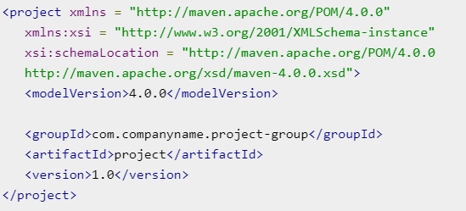
Maven
POM

Slide 4
Maven
All POM files require the project element and three mandatory fields: groupId, artifactId, version.
Projects notation in repository is groupId:artifactId:version.
Minimal requirements for a POM −
  Project root
  Model version
  groupId
  artifactId
  version
POM

Slide 5
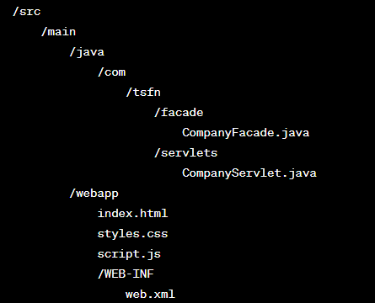
Maven
MVC Model 2 :
Model
Example of Maven App
Controller
View

Slide 6
Maven
<dependency>
<groupId>javax.servlet</groupId> <artifactId>javax.servlet-api</artifactId> <version>4.0.1</version>
<scope>provided</scope>
</dependency>
Dependencies
<dependency> <groupId>com.fasterxml.jackson.core</groupId> <artifactId>jackson-databind</artifactId> <version>2.13.0</version>
</dependency>
<dependency>
<groupId>com.mysql</groupId>
<artifactId>mysql-connector-j</artifactId>
<version>8.3.0</version>
</dependency>

Slide 7
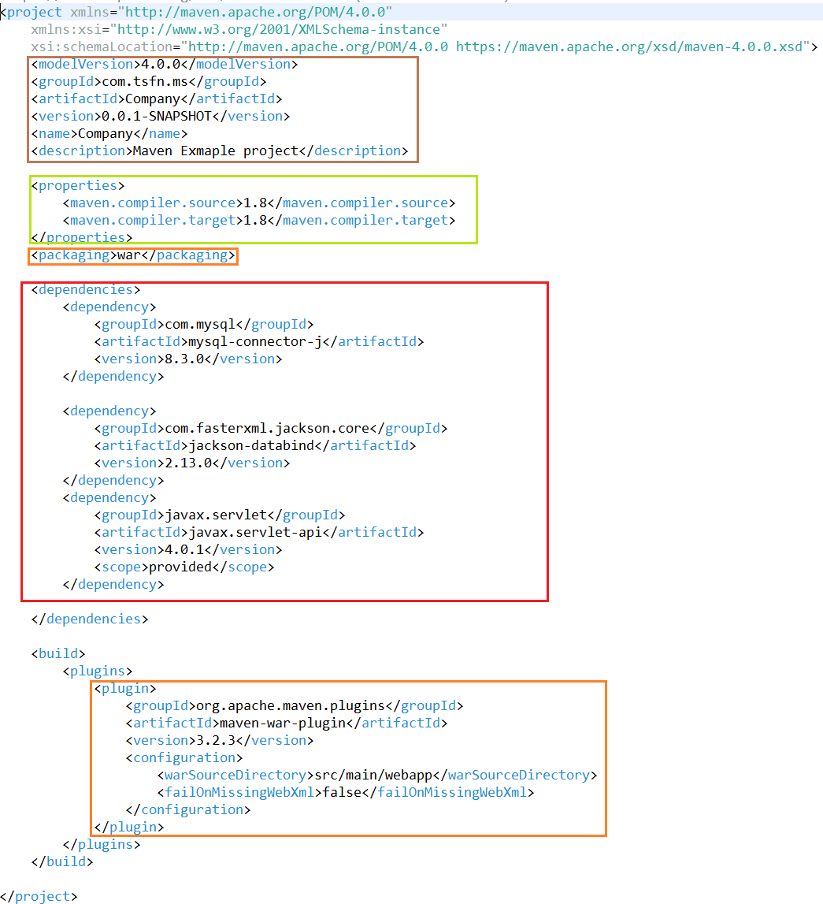
Maven
POM.xml

