Slide 1
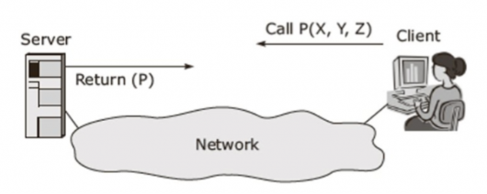
RPC
Remote Procedure Call or RPC is a powerful technique for constructing distributed, client-server-based applications.
RPC is a form of client-server interaction implemented via a request-response message-passing system.
RPC abstracts the procedure or method call, allowing a program to invoke a function on another address space or machine as if it were a local call.
RPC relies on communication protocols like HTTP, XML-RPC, beside to more low-level protocols CORBA and gRPC .
RPC can be synchronous or asynchronous.
Remote Procedure Call

Slide 2
RPC
  For server development Team
    Map services to generate a contract
    Expose the contract
    Instantiate & publish the resource (or resource pool)
    Create skeleton when requested
  For client development Team
    Generate stub according to a given contract
RPC Framework Requirements

Slide 3
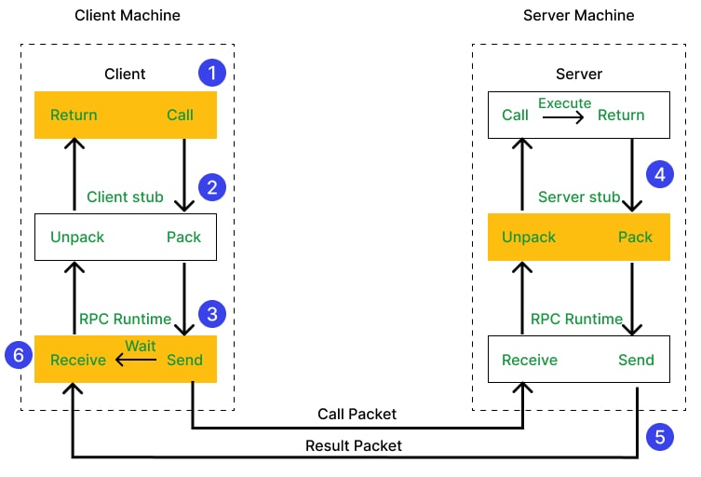
RPC

Slide 4
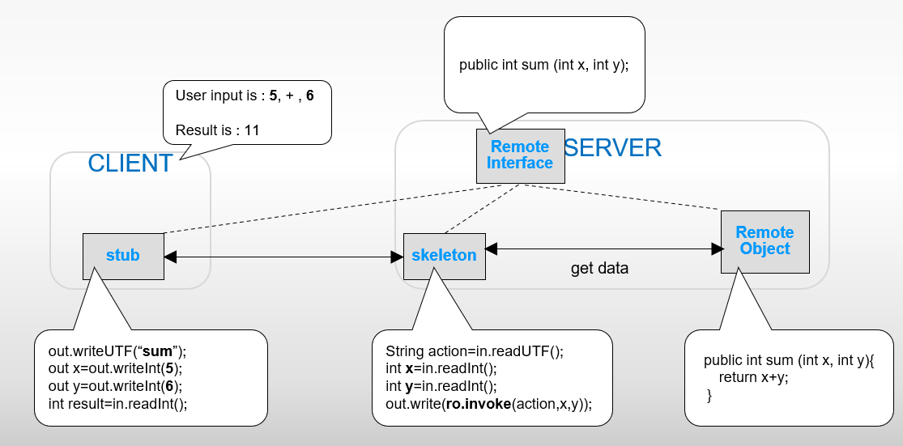
RPC

Slide 5
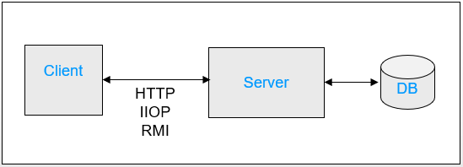
RPC
2 Tier Architecture
App Architecture

Slide 6
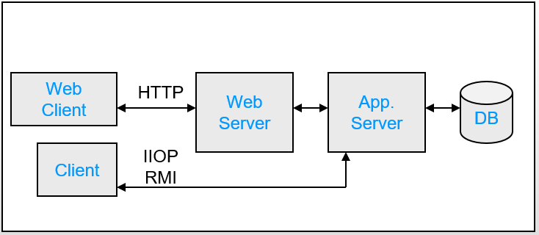
RPC
3 Tier Architecture
App Architecture

Slide 7
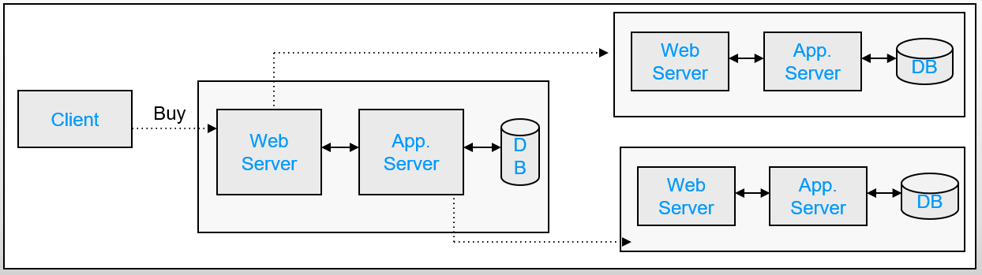
RPC
N Tier Architecture

Slide 8
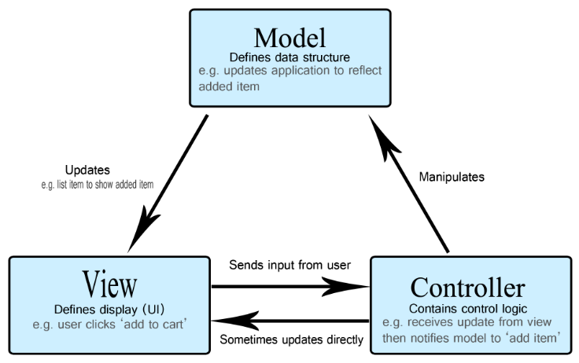
RPC
MVC (Model-View-Controller) is a pattern in software design commonly used to implement user interfaces, data, and controlling logic.
MVC emphasizes a separation between the software's business logic and display.
The three parts of the MVC software-design pattern can be described as follows:
  Model: Manages data and business logic.
  View: Handles layout and display.
  Controller: Routes commands to the model and view parts.
MVC

Slide 9
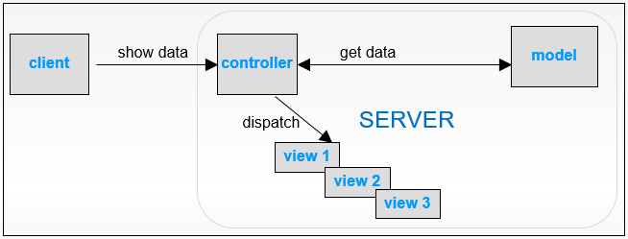
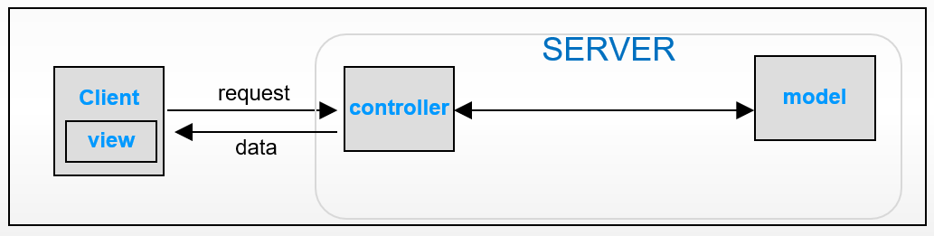
RPC
Old VS New Model MVC

Slide 10
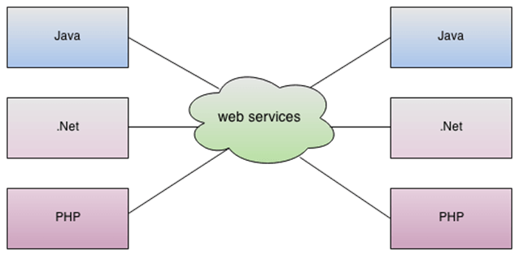
RPC
WS is a client-server application or application component for communication.
The method of communication between two devices over the network.
WS is a software system for the interoperable machine to machine communication.
WS is a collection of standards or protocols for exchanging information between two devices or application.
Web Services

Slide 11
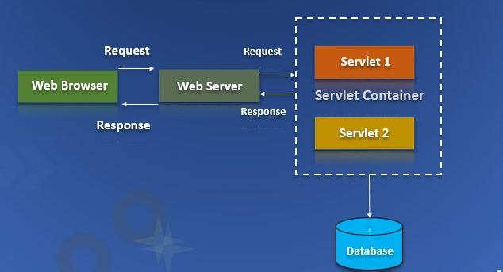
RPC
Servlet
Servlet is a technology which is used to create a web application.
Servlet is an API that provides many interfaces and classes including documentation.
Servlet is an interface that must be implemented for creating any Servlet.
Servlet is a class that extends the capabilities of the servers and responds to the incoming requests.
Servlet is a web component that is deployed on the server to create a dynamic web page.
Web Services Types

Slide 12
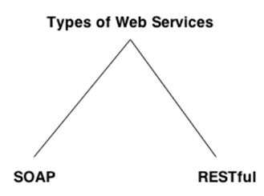
RPC
SOAP
SOAP is an acronym for Simple Object Access Protocol.
SOAP is a XML-based protocol for accessing web services.
SOAP is a W3C recommendation for communication between applications.
Web Services Types
WSDL
WSDL is an acronym for Web Services Description Language.
WSDL is a xml document containing information about web services
WSDL is a part of UDDI. It acts as a interface between web service applications.
WSDL is pronounced as wiz-dull.

Slide 13
RPC
REST
  REST is an HTTP ‘enrichment’ that provides advanced RPC
  REST passing data in any format including XML, JSON and binary data
  REST can be counted as part of HTTP unlike SOAP which is a separate protocol
Web Services Types

Slide 14
RPC
Client may use the following HTTP features to invoke a service:
  URI – path can determine the endpoint class and even method
  ACCEPT header – used by the client to specify response MIME type
    service methods may result in different MIME types.
    client call can be delegated to method that produces the MIME type it expects.
  METHOD – GET, POST, DELETE, PUT, HEAD
    each method can be mapped to several HTTP-methods.
    client call is delegated to the method matches client HTTP request method.
HTTP and Webservices

Slide 15
RPC
Collection | Single element | HTTP Method
Fetch the whole collection | Fetch an element from a collection | GET
Override one collection with a new one | Replace or create new element in a collection | PUT
Add new value to a collection | Assign a value to an object | POST
Delete the entire collection | Delete a specific element from a collection | DELETE
HTTP and Webservices

Slide 16
RPC
  For simple types (texts and primitives)
  Path parameters
  Request parameters
  For Objects
  Request body (JSON or XML)
REST PARAMETERS

