Slide 1
Spring
Swagger

Slide 2
Spring
Swagger
Swagger is an open-source software framework backed by a large ecosystem of tools that helps developers design, build, document, test and consume RESTful web services.
Swagger framework is constructed from Open API Specification , Open-Source Tools and a Swagger Hub .
https://swagger.io/ is the URL of Online Swagger Framework
Swagger

Slide 3
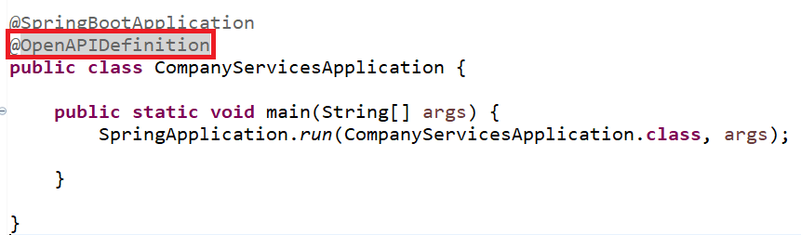
Spring
Swagger UI
<dependency>
<groupId>org.springdoc</groupId>
<artifactId>springdoc-openapi-starter-webmvc-ui</artifactId>
<version>2.0.3</version>
</dependency>
Swagger

Slide 4
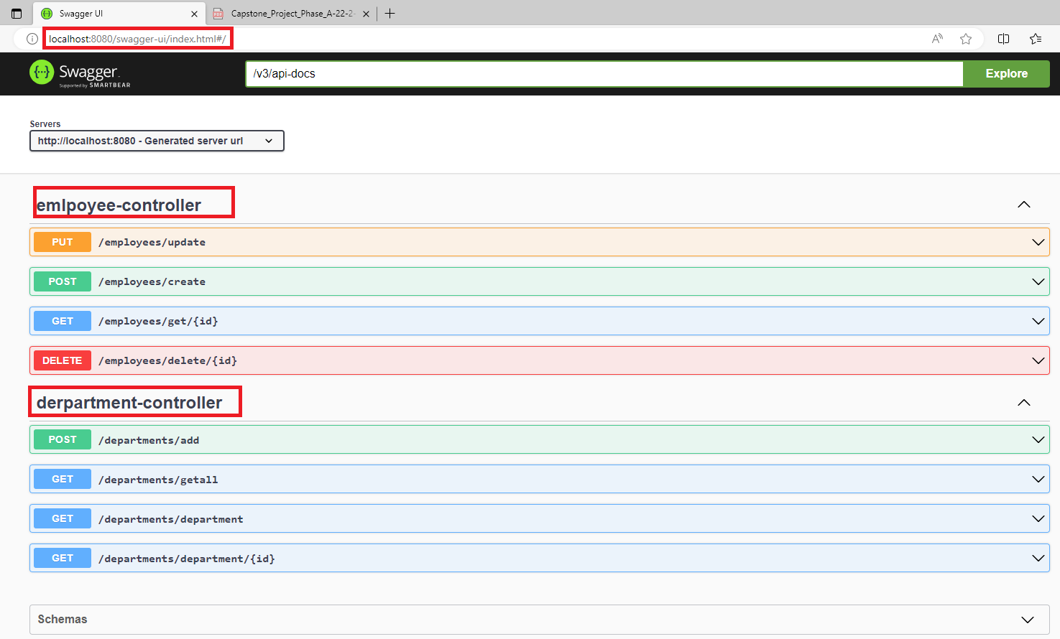
Spring
Swagger UI
Swagger
Swagger UI

Slide 5
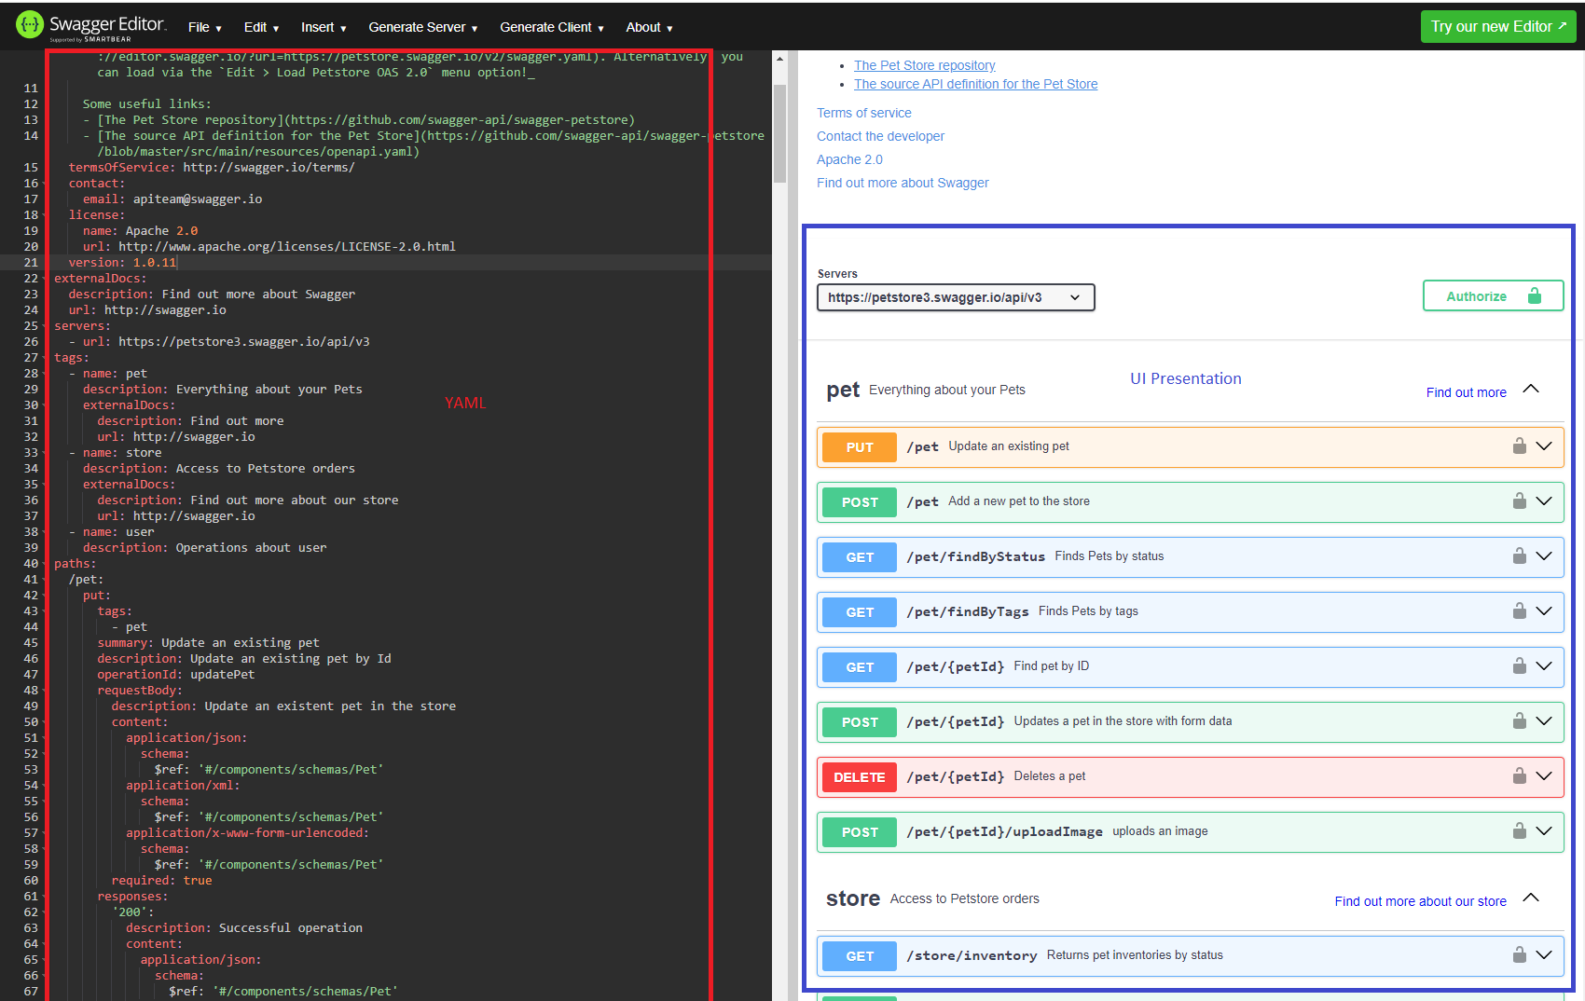
Spring
Swagger Editor
Swagger
Swagger Editor : https://editor.swagger.io/

Slide 6
Spring
YAML
“YAML Ain't Markup Language” is a human-readable data serialization language commonly used for configuration files and structured data exchange in various applications.
YAML files use a simple and intuitive syntax designed to be easy for both humans and machines to read and write.
YAML files are designed to be easy for humans to read and write. It uses indentation to represent hierarchy and structure, making it visually intuitive.
YAML uses indentation (typically spaces) to denote structure and nesting, rather than relying on explicit symbols or tags.
Swagger

Slide 7
Spring
YAML
YAML supports various data types including scalar (strings, numbers, booleans), sequences (arrays/lists), and mappings (key-value pairs).
YAML allows comments using the # symbol, making it easy to add explanatory notes within the file.
YAML is not tied to any specific programming language, making it suitable for configuration files and data interchange between different systems and applications.
YAML supports the inclusion of other YAML files (known as anchors and references), allowing for reuse and modularity in larger configurations.
Swagger

Slide 8
Spring
YAML Example
server:
port: 8080
spring:
datasource:
url: jdbc:mysql://localhost:3306/mydatabase
username: root
password: password
driver-class-name: com.mysql.cj.jdbc.Driver
jpa:
hibernate:
ddl-auto: update
properties:
hibernate:
dialect: org.hibernate.dialect.MySQLDialect
logging:
level:
root: info
org.springframework.web: debug
Swagger

Slide 9
Spring
YAML Example
/store/inventory:
get:
tags:
- store
summary: Returns pet inventories by status
description: Returns a map of status codes to quantities
operationId: getInventory
responses:
'200':
description: successful operation
content:
application/json:
schema:
type: object
additionalProperties:
type: integer
format: int32
security:
- api_key: []
Swagger

Slide 10
Spring
Customize Swagger GUI
public interface BookControllerIFC {
@Operation(summary= "Create New Book" ,tags = {"Books", "POST"})
@ApiResponses({
@ApiResponse(responseCode = "201", content = {
@Content(schema = @Schema(implementation = Book.class), mediaType = "application/json") }),
@ApiResponse(responseCode = "500", content = { @Content(schema = @Schema()) }) })
@PostMapping("/create")
public ResponseEntity<Book> createBook(@RequestBody Book book) ;
}

Slide 11
Generate YAML from Code
@Configuration
public class OpenAPIConfig {
@Value("${Kabhad82.openapi.dev-url}")
private String devUrl;
@Bean
public OpenAPI myOpenAPI() {
Server devServer = new Server();
devServer.setUrl(devUrl);
devServer.setDescription("Server URL in Development environment");
Info info = new Info()
.title("Tutorial Management API")
.version("1.0")
.contact(contact)
.description("This API exposes endpoints to manage tutorials.").termsOfService(“”);
.license(null);
return new OpenAPI().info(info).servers(List.of(devServer));
}}

Slide 12
Spring
YAML Example
springdoc.api-docs.path=/Kabhad82-api-docs
springdoc.swagger-ui.tryItOutEnabled=true
springdoc.swagger-ui.filter=true
Kabhad82.openapi.dev-url=http://localhost:8080
Swagger

Slide 13
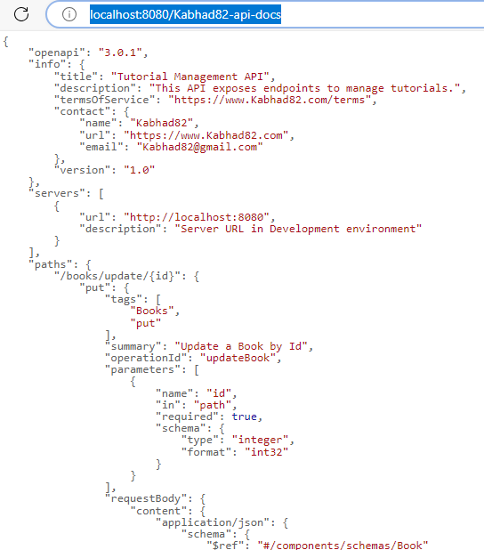
Spring
YAML Example
Swagger

