Slide 1
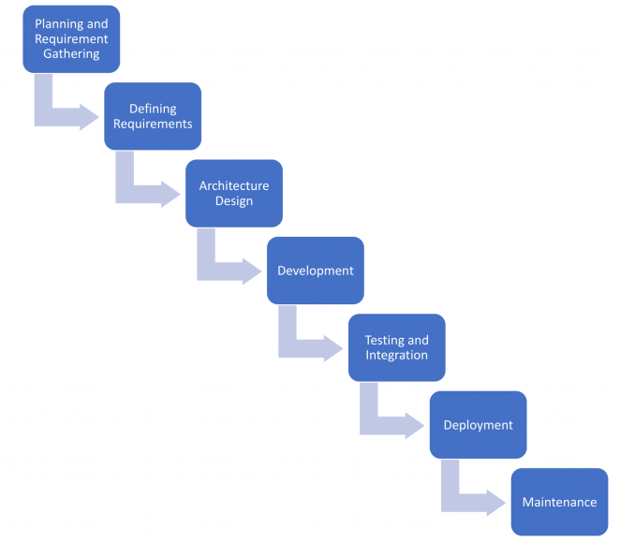
MS Deployment
Software Development Lifecycle

Slide 2
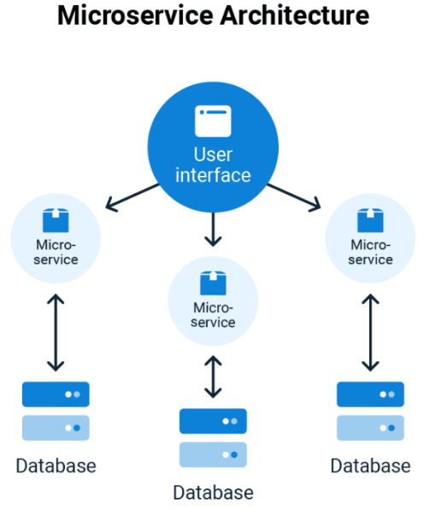
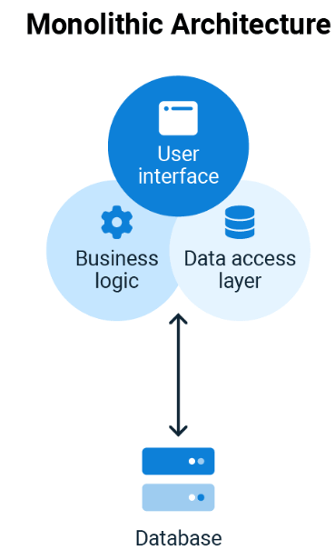
MS Deployment
Microservices Architecture

Slide 3
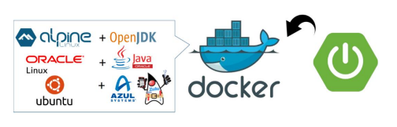
MS Deployment
DOCKERIZING SPRINGBOOT

Slide 4
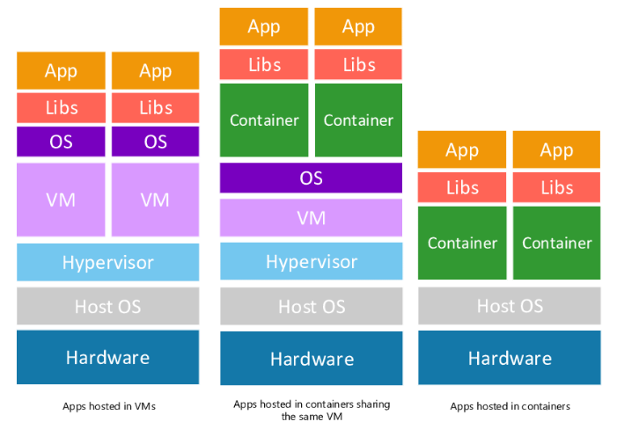
MS Deployment
Containers and VMs
DOCKERIZING SPRINGBOOT

Slide 5
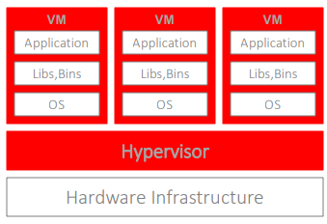
MS Deployment
VMs
Hardware is virtualized - we run multiple OS on a specific infrastructure.
On top of hardware and infrastructure there is a Hypervisor .
Hypervisor (software/hardware) is responsible for creating and running VMs.
Pros:
  All OS resources available to application
  Better security control
DOCKERIZING SPRINGBOOT

Slide 6
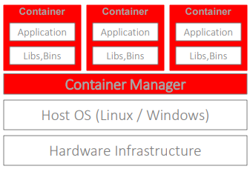
MS Deployment
Containers
Only OS is virtualized – each container instance hosts a virtual OS of your choice.
Container runs on a specific OS (usually Linux or Windows).
Containers shared resources are read-only.
Pros
  Containers share OS libraries resources
  Much lighter
  Launch faster
  Single OS installation is required
  Portable
DOCKERIZING SPRINGBOOT

Slide 7
MS Deployment
Basic Terms
Image – a configuration of an application
  Working directory
  Sources to copy
  Properties and runtime configuration
  Entry point to execute.
Container – an instance of an application based on an image
  Multiple containers can be initiated from the same image
  As a copy, no permanent changes to the application when container goes down
Dockerfile – specifies image build
  Docker Engine uses it to build an image
  Uses hierarchical (layered) configuration and defines dependencies
  Java applications are based on images with a
DOCKERIZING SPRINGBOOT

Slide 8
MS Deployment
Basic Terms
Docker Engine – Local Docker agent application
  creates images [stored in Docker Registry]
  runs containers
  monitor & maintain instances
  can export/import images
    save / load from local FS
    push/pull from DockerHub
Node – a machine that runs Docker Engine agent
Docker Daemon – is the process of Docker Engine running on a Node
DOCKERIZING SPRINGBOOT

Slide 9
MS SLDC
Basic Terms
Repository – is where Docker keeps its images
  Images can be saved and loaded from local repositories.
Docker Hub – public image repository
  Images can be pushed and pulled from repositories
  You can create your own images and use others
DOCKERIZING SPRINGBOOT

Slide 10
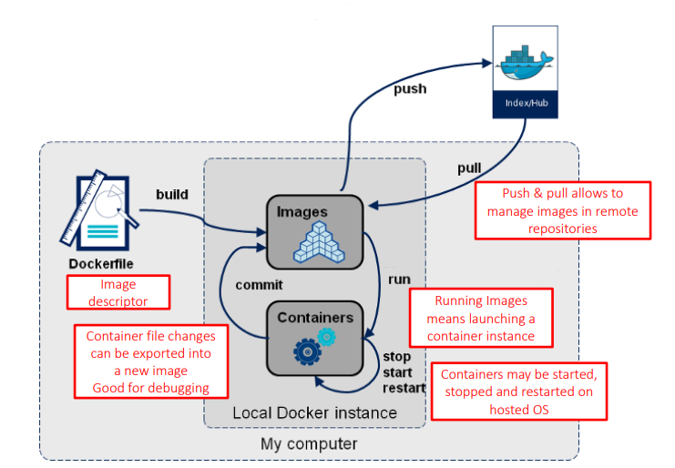
MS Deployment
Docker Engine
DOCKERIZING SPRINGBOOT

Slide 11
MS Deployment
How Docker works
Once we have an image we can run it in Docker container.
Docker may host multiple different images.
Docker may launch multiple instances of a specific image.
  Each container instance may use different settings like ports.
Kubernetes (K8S) communicates with Docker containers in order to automatically configure & orchestrate instance.
DOCKERIZING SPRINGBOOT

Slide 12
MS Deployment
Create Docker Image
Install & run Docker Desktop
Create Dockerfile
Generate executable jar (Maven install)
Build Docker image
Run image
Manage using Docker Dashboard
DOCKERIZING SPRINGBOOT

Slide 13
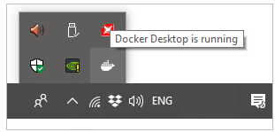
MS Deployment
Create Docker Image
Install & run Docker Desktop
Download from https://docs.docker.com/docker-for-windows/install
Installation uses Linux virtualization by default
During installation – don’t switch to Windows containers
  If you do, you can change it later
Restart your PC/Laptop
Run Docker Desktop
  Make sure it is in ‘running’ mode
DOCKERIZING SPRINGBOOT

Slide 14
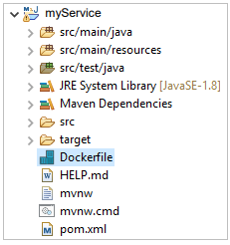
MS Deployment
Create Docker Image
Create a Docker File
Add Dockerfile to the root directory of your project (microservice)
FROM java:8-jdk-alpine
COPY ./target/myService-0.0.1-SNAPSHOT.jar /usr/app/
WORKDIR /usr/app
RUN sh -c 'touch myService-0.0.1-SNAPSHOT.jar’
ENTRYPOINT ["java","-jar",“myService-0.0.1-SNAPSHOT.jar"]
DOCKERIZING SPRINGBOOT

Slide 15
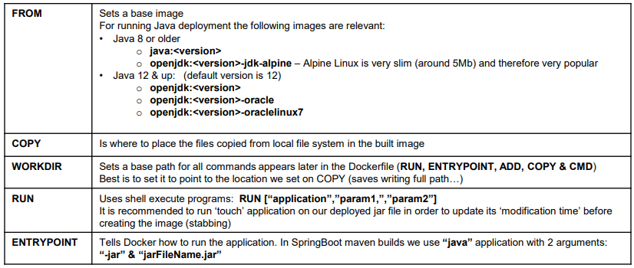
MS Deployment
Create Docker Image
Dockerfile major commands
DOCKERIZING SPRINGBOOT

Slide 16
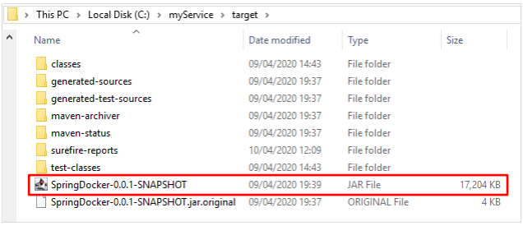
MS Deployment
Create Docker Image
Generate executable jar
Run Maven install to generate jar in ./target
Make sure the name of the jar matches the one in your Dockerfile major commands
DOCKERIZING SPRINGBOOT

Slide 17
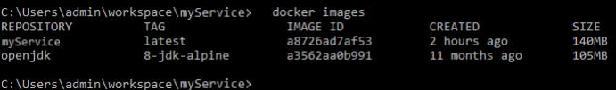
MS Deployment
Create Docker Image
Build Docker image
Use Docker ‘build’ command and specify build name & tag (-t)
  docker build –t <name><location-of-Dockerfile>
  image name cannot contain upper-case letters
Check images:
  docker images
Image default location: C:\ProgramData\DockerDesktop\vm-data
DOCKERIZING SPRINGBOOT

Slide 18
MS Deployment
Create Docker Image
Run image
• Use Docker ‘run’ command to launch image • docker run -p: • random port: -p • --ip – sets container IP (default is set sequentially) • -e – overrides SpringBoot properties • must be passed in uppercase and ‘_’ delimiter
DOCKERIZING SPRINGBOOT

