Slide 1
Boosting
"Some figures in this presentation are taken from ”The Elements of Statistical Learning" (Springer, 2009) with permission from the authors: Hastie, T; Tibshirani, R. & Friedman, J. "

Slide 2
Overview
Review of Decision Tree – Regression
What is boosting?
Gradient Boosted Regression Trees
How to tune
____________________________________
Discrete AdaBoost

Slide 3
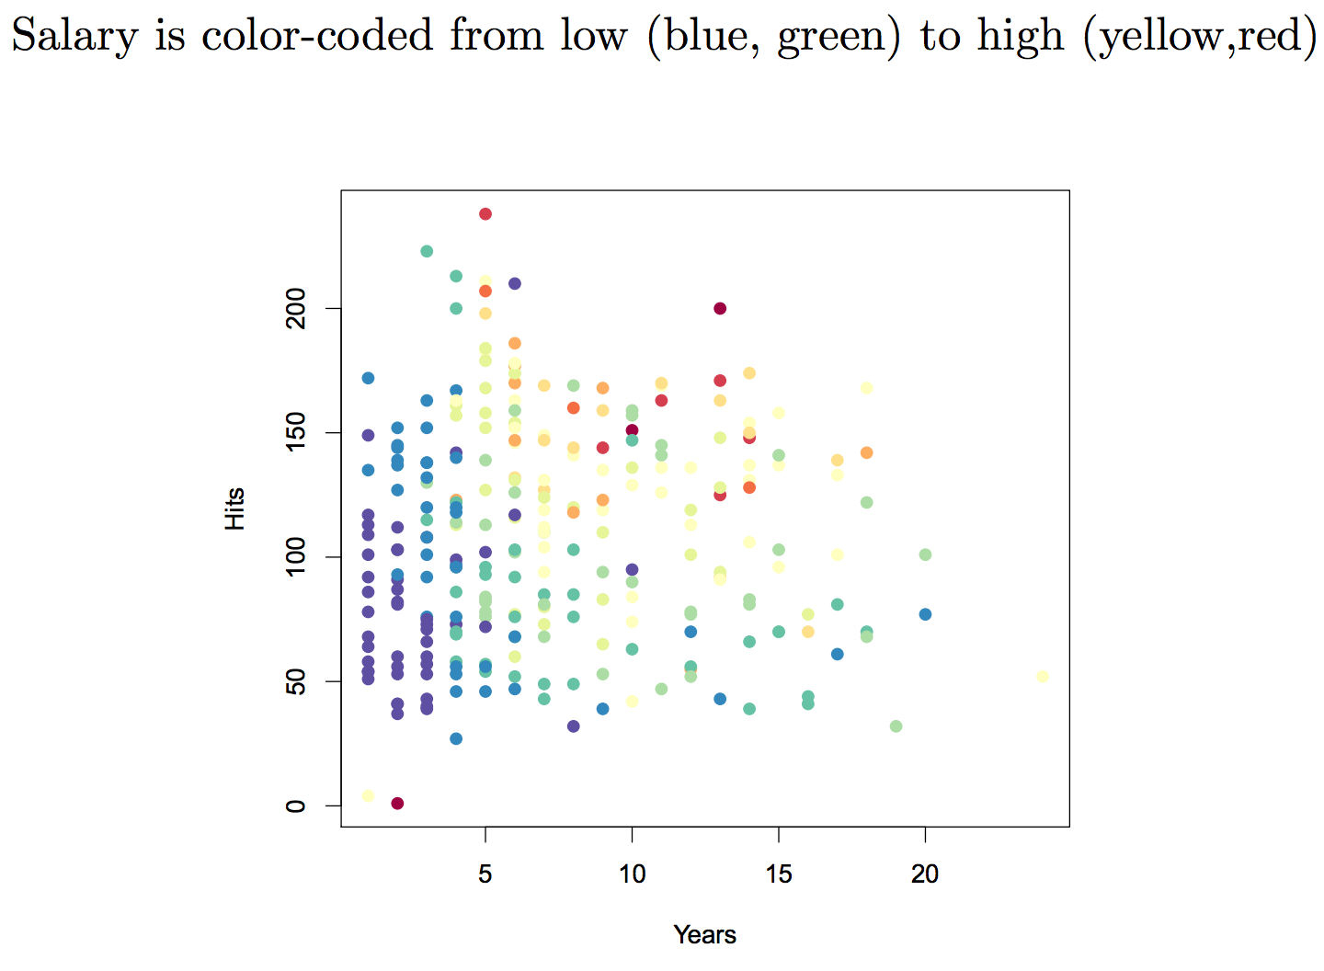
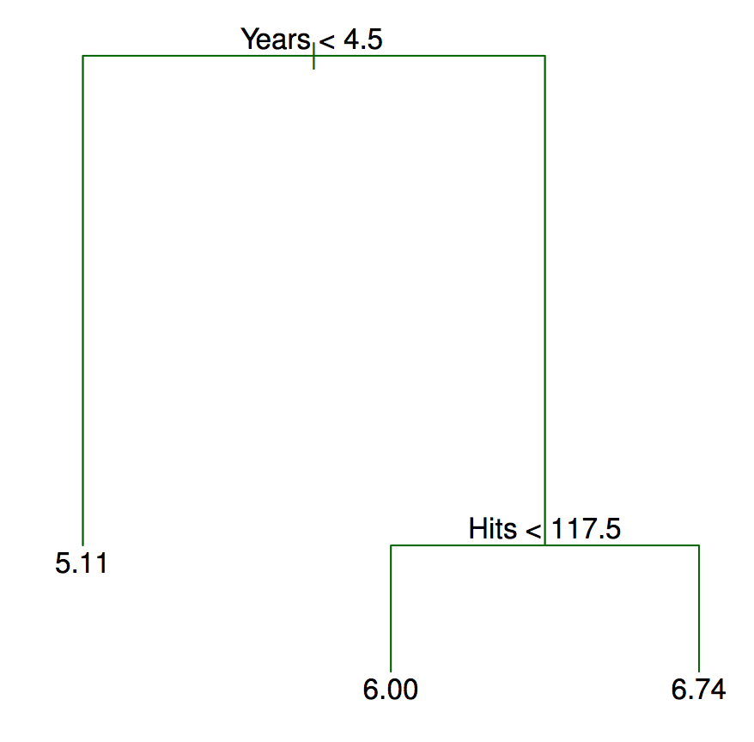
Decision Trees - Regression

Slide 4
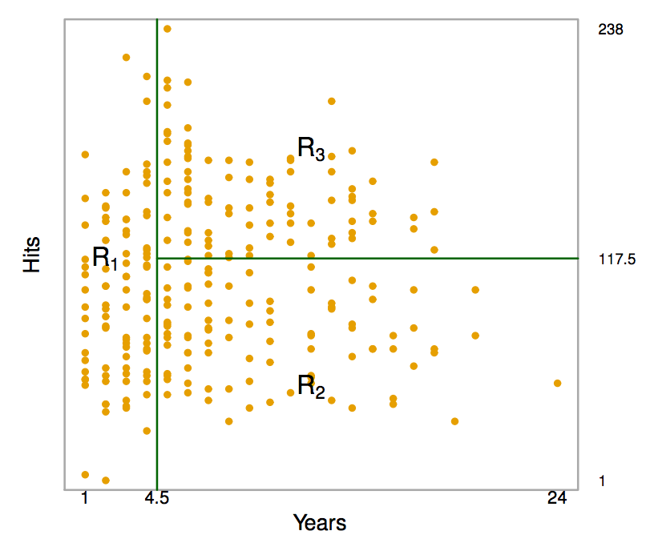
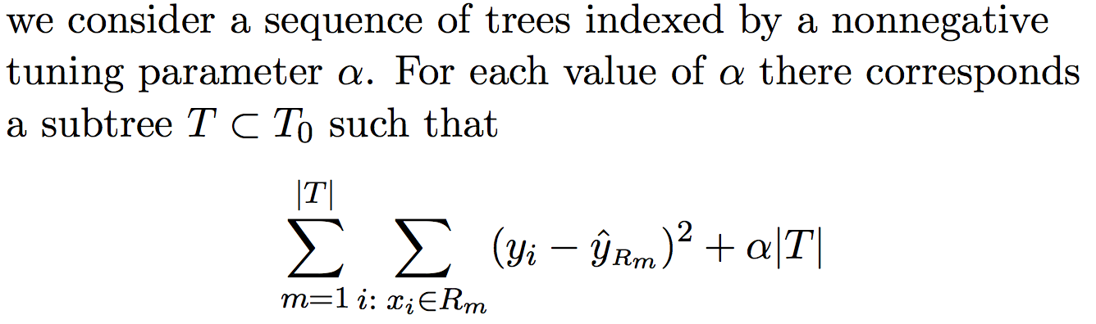
Decision Trees – Regression

Slide 5
What is Boosting?
Bagging – Bootstrap many trees, each tree independently grown, in an effort to decrease variance through averaging
Random Forest – Similar idea, but take random subset of possible features at each split to “decorrelate the trees”.
What is Boosting? Not at all like Bagging or Random Forest!
Idea: Combine set of “weak” learners to form strong learner
“weak” in that error rate only slightly better than random guessing
How: Sequentially apply weak classification algorithm to modified versions of the data → sequence of weak classifiers
Each tree is grown using information from last tree

Slide 6
Boosting – the heart of it
Learns slowly
As opposed to fitting the data hard (like in Bagging and RF)
Each tree might be rather small, with just a few terminal nodes
As opposed to growing the trees really large and averaging away variance
Focuses on areas of weakness
By fitting small trees to residuals bit by bit, different shaped trees can be used to attack residuals
Lots of tuning
Number of trees - can overfit if too large
Learning rate
Depth of tree
What is Boosting? Not at all like Bagging or Random Forest!
Idea: Combine set of “weak” learners to form strong learner
“weak” in that error rate only slightly better than random guessing
How: Sequentially apply weak classification algorithm to modified versions of the data → sequence of weak classifiers
Each tree is grown using information from last tree

Slide 7
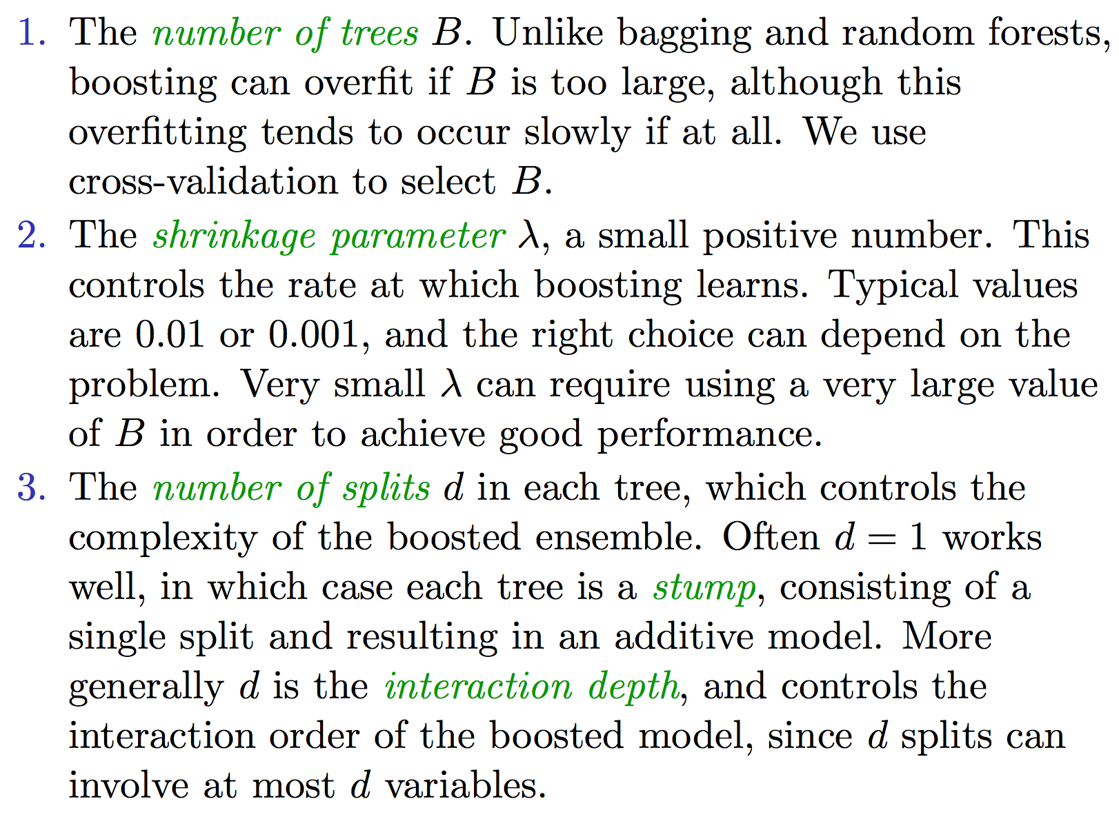
Boosting – way more tuning
Notes:
0.494

Slide 8
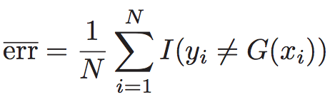
Discrete AdaBoost
One of the most popular boosting algorithms
also known as AdaBoost.M1,Freund & Schapire (1997)
Y: {-1, 1}
G(X): classifier producing predictions taking two values {-1, 1}
Error rate on the training set:

Slide 9
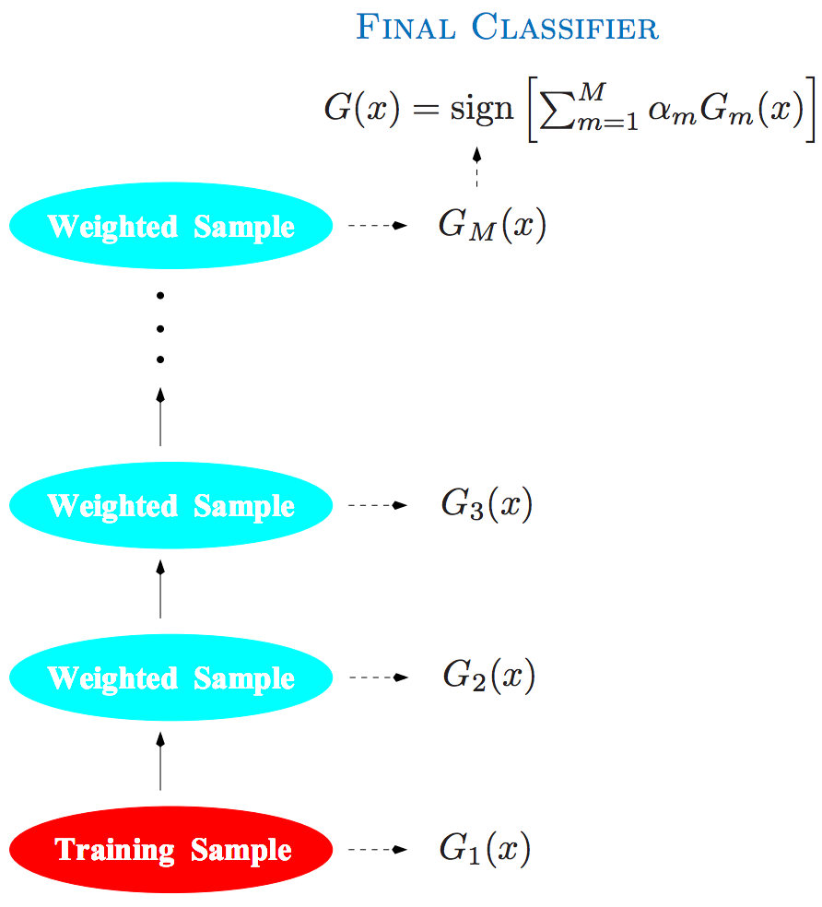
Discrete AdaBoost
Gi(x) weak classifiers
G(x) strong learner
Note only G1(x) fit on training

Slide 10
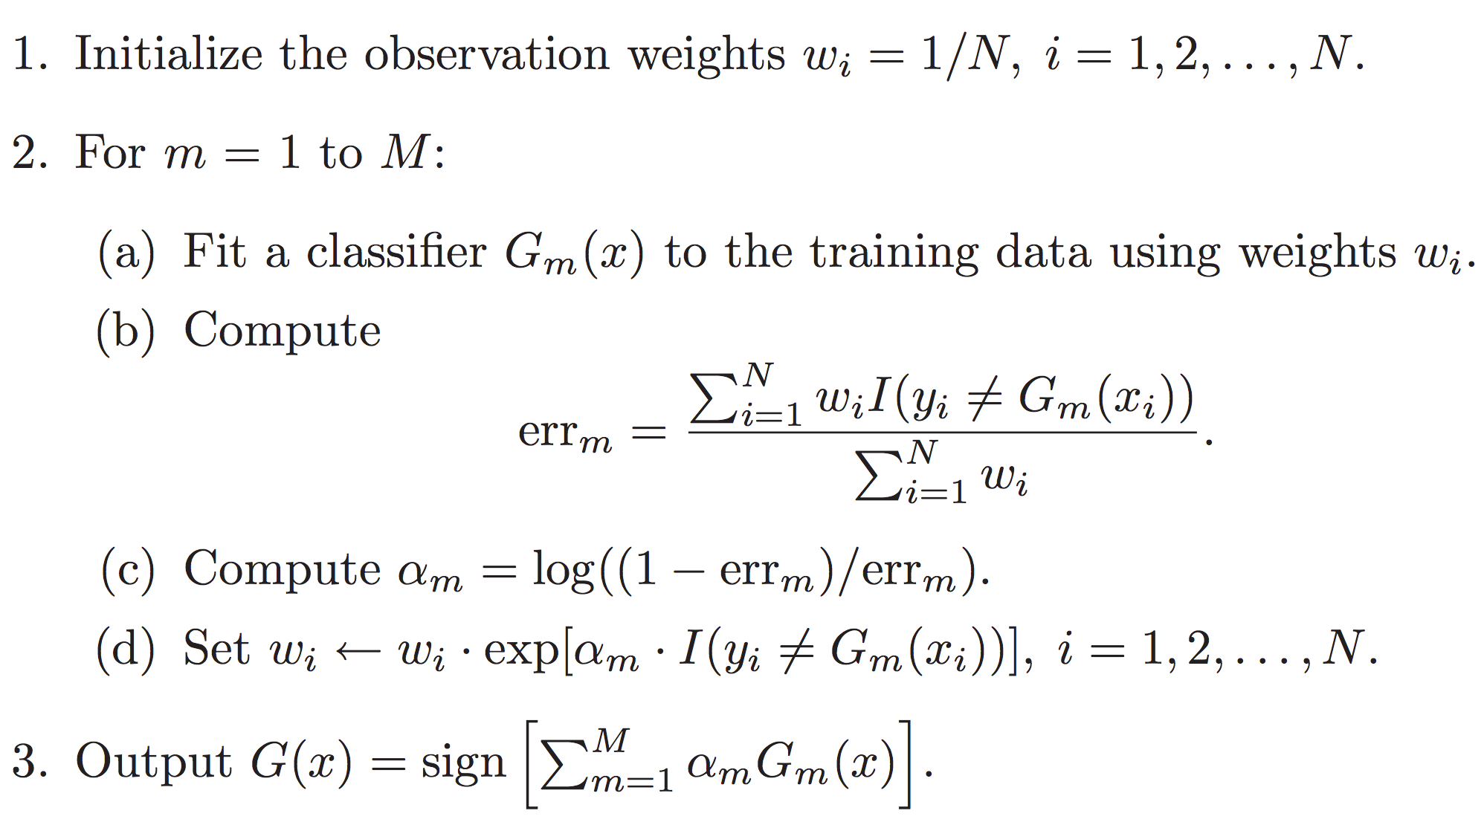
Discrete AdaBoost

Slide 11
For first weak classifier, G1(x), just use training data
For subsequent weak classifier, same classification algorithm but modify weights
If previously misclassified, scale by e^(αm)
else, wi same
Final strong classifier G(x) determined by weighted majority votes
α1, … αM as weight of votes
The smaller the error of the weak classifier, the greater the weight

Slide 12
Observe that…
α1, …, αM give higher influence to more accurate classifiers
At each step m, observations previously misclassified by Gm-1(x) have their weights increased
→ Each successive classifier forced to concentrate on training observations previously missed

Slide 13
Appendix

Slide 14
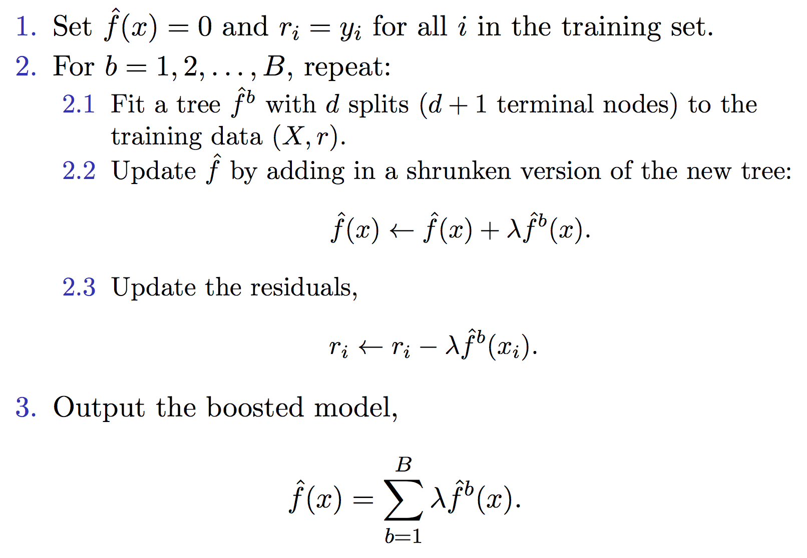
Boosting Algorithm for Regression Trees
Notes:
0.494

Slide 15


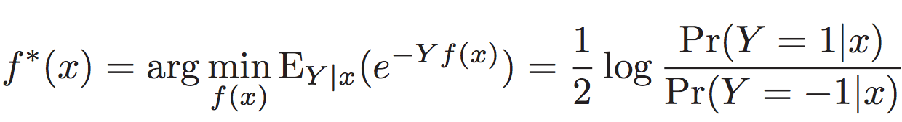
Adaboost is not black magic
But there is quite a bit of math and underpinning concepts to go through to really understand it. http://web.stanford.edu/~hastie/local.ftp/Springer/OLD/ESLII_print4.pdf - Page 341-346
Very very very roughly,
It is a version of Forward Stagewise Additive Modeling, which adds new basis functions without adjusting previous parameters and coefficients.
In the squared loss regime, forward stagewise additive modeling fits to the current residual at each step.
Similar idea, but AdaBoost uses Exponential Loss instead.
It can be shown that to minimize loss, at each iteration, we can reweight our observations
Use exponential loss principally because of computational advantage; could consider others.
Can be shown that the additive expansion in Adaboost is estimating
which justifies taking the sign as classification rule.

Slide 16
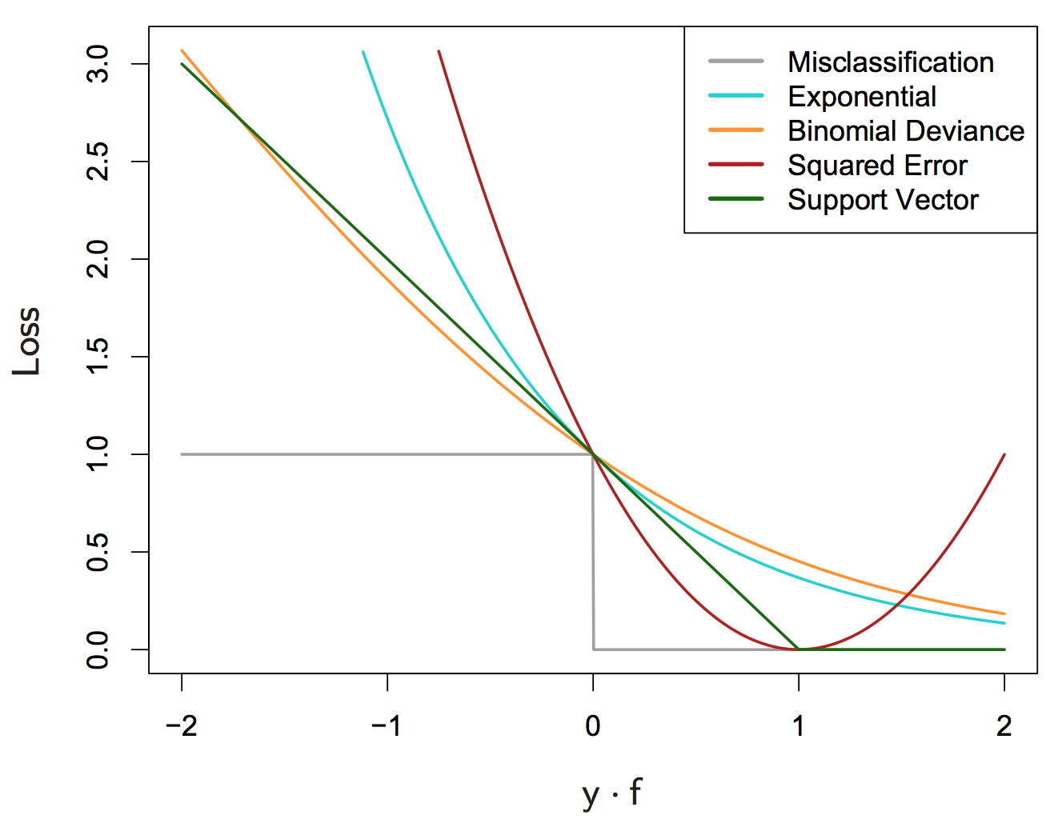
Comparison of Loss Functions

