Slide 1
Updating XML
Igor Tatarinov, Zachary G. Ives, Alon Y. Halevy, Daniel S. Weld
{igor, zives, alon, weld}@cs.washington.edu Department of Computer Science and Engineering University of Washington, Seattle, WA 98195ub

Slide 2
Experimental Results
The Objectif : Determine which update methods work best and under what conditions
The Architecture : JDBC over IBM DB2, local memory fitting data
The Workloads : bulk (input – {root} ) and random (10 random subtrees of input)
The Data : Fixed Synthetic Data, Randomized Synthetic Data, Real-Life Data
The Experiments : Performance of Delete Methods, Inserts, Hybrids
Ayman
1

Slide 3
Performance of Delete Methods
The running methods :
Per-tuple trigger
Per-statement trigger Performed best
Cascading delete Similar performance to 5 % (Cascading mimics PPT)
ASR-based delete
Ayman
1

Slide 4
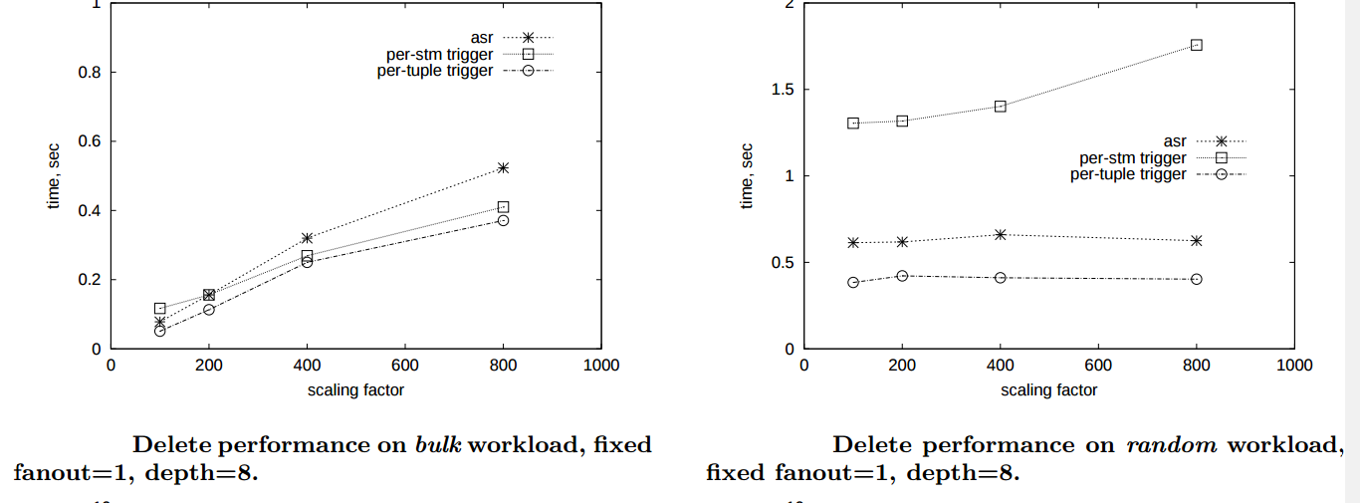
Performance of Delete Methods
Ayman
1

Slide 5
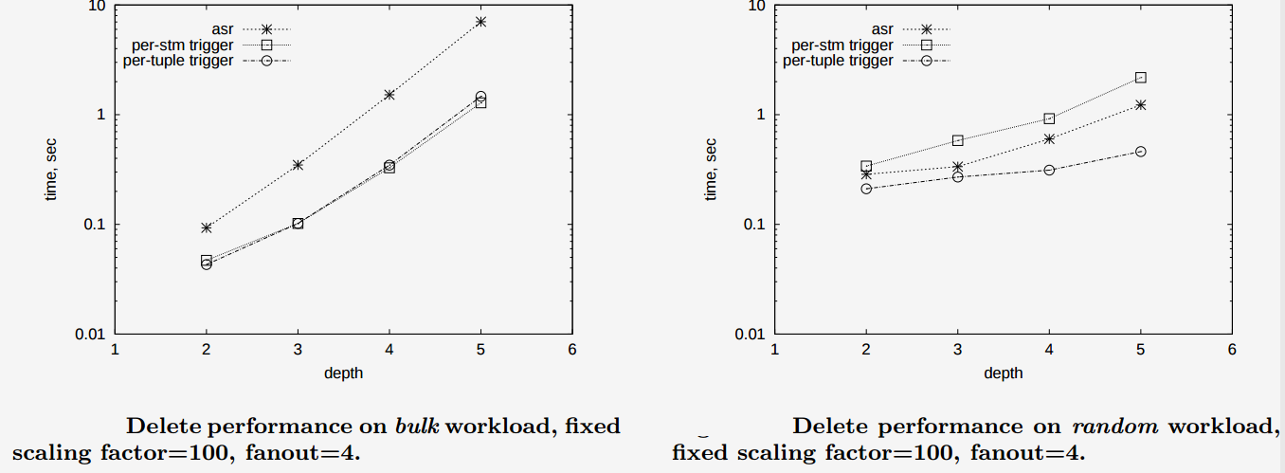
Performance of Delete Methods
Ayman
1

Slide 6
Performance of Insert Methods
The query : copy of complex XML elements from within a single document
The running methods :
Table-method Fastest for bulk inserts
Tuple-method Faster for small random (less overhead)
ASR
Ayman
1

Slide 7
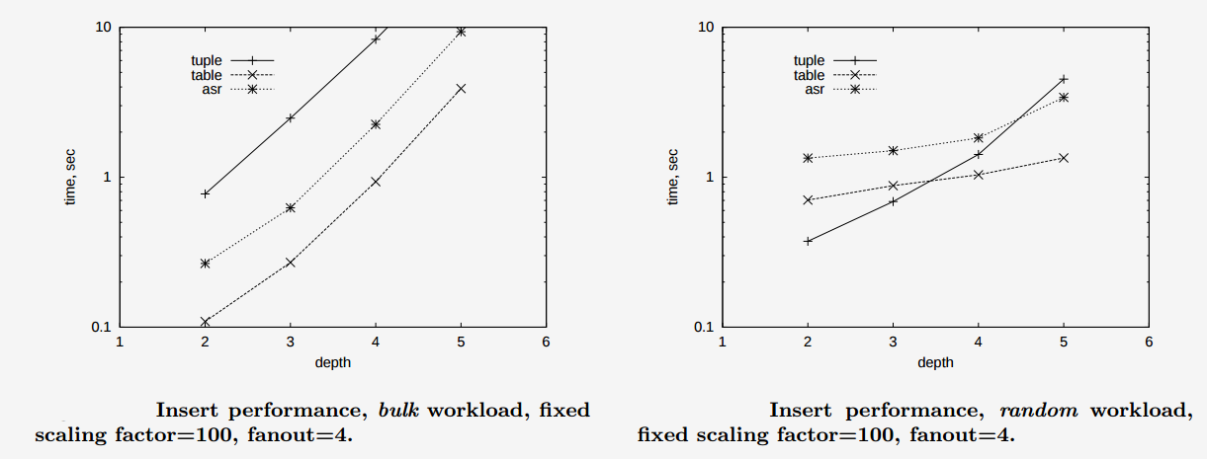
Performance of Insert Methods
Ayman
1

Slide 8
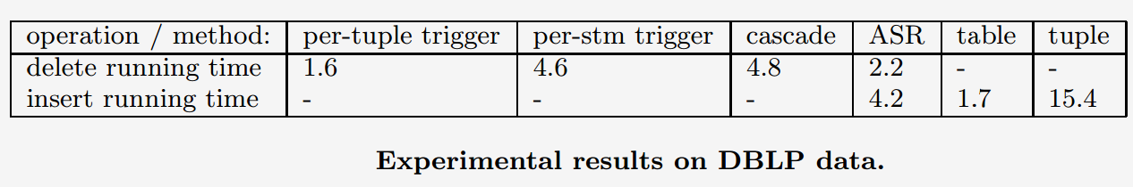
Performance of Hybrid Methods
Other UPDATE = sequence(UPDATE,DELETE)
No benchmark, Performace = best DELETE ( per-tuple trigger-based )
+ best INSERT ( table-based )
Final review : Global performances on Real-life data :
Ayman
1

Slide 9
Conclusions and future work
The article proposed a set of primitive XML update operations that can be composed to express modifications at multiple levels within an XML document
These primitives were incorporated as a set of language extensions to Xquery
Implemented and tested on the most common use-case : Relational Dbs
Future :
Typechecking updates
To be able to efficiently provide a deterministic result if a particular XML update target is reachable more than once in a path expression
Extend the relational techniques to support the preservation of order within the XML document
Ayman
1

