Slide 1


ADVANCED PYTHON — FORMATION PROGRAM , PILLAR 1
Advanced Python
From Scripts to Structured Code
Animated by :
AYMANE GALIBOU
Data Cell

Slide 2
SESSION 4 / 4
Object-Oriented Programming & Design Basics
Duration: 2h

Slide 3
THEORY
Why OOP for Data Pipelines?
A script with 15 loose functions and global variables becomes unmanageable past a certain size.
OOP groups data (attributes) and behavior (methods) that belong together into one unit: a class.
Goal today: turn a messy data-cleaning script into a clean, testable Data Pipeline class hierarchy.

Slide 4
THEORY
Classes vs. Objects
A class is a blueprint/template used to build objects , consists of attributes and methods .
An object (instance of the class) is a combination of a state and behavior .
State is the data associated with an object, assigned through attributes .
Behavior is the object's functionality, defined through methods .
class Dog:
def __init__(self, name):
self.name = name
def bark(self):
return f"{self.name} says Woof!"
rex = Dog("Rex") # rex is an instance of Dog
print(rex.bark())

Slide 5
THEORY
Instance-level attributes
name and salary values are specific to each instance.
Without instance we can’t access those attributes .
class Employee:
def __init__(self, name, salary):
self.name = name
self.salary = salary
emp1 = Employee("Teo Mille", 50000)
emp2 = Employee("Marta Popov", 65000)
print(Employee.name) # class has no attribute

Slide 6
THEORY
Class-level attributes
class Employee:
MIN_SALARY = 3000
def __init__(self, name, salary):
self.name = name
# Use class name
if salary >= Employee.MIN_SALARY:
self.salary = salary
else:
self.salary = Employee.MIN_SALARY
print(Employee.MIN_SALARY)
emp1 = Employee("Reda reda", 5000)
print(emp1.MIN_SALARY) # -> 3000
emp2 = Employee("Yousef ait", 5000)
print(emp2.MIN_SALARY) # -> 3000
Data shared among all instances of a class .
Define class attributes in the body of class .
"Global variable" within the class .

Slide 7
THEORY
Modifying class-level attributes
emp1 = Employee("John", 40000)
emp2 = Employee("Jane", 60000)
print(emp1.MIN_SALARY) # 3000
print(emp2.MIN_SALARY) # 3000
# Update MIN_SALARY of the entire class
Employee.MIN_SALARY = 50000
print(emp1.MIN_SALARY) # 50000
print(emp2.MIN_SALARY) # 50000
Updating a class attribute by referencing to the class itself updates the value across all instances .
emp1 = Employee("John", 40000)
emp2 = Employee("Jane", 60000)
print(emp1.MIN_SALARY) # 3000
print(emp2.MIN_SALARY) # 3000
# Update MIN_SALARY of the emp1
emp1.MIN_SALARY = 50000
print(emp1.MIN_SALARY) # 50000
print(emp2.MIN_SALARY) # 3000
print(Employee.MIN_SALARY) # 3000
Updating a class attribute by referencing to the instance doesn’t update the value across all instances or the class itself .

Slide 8
THEORY
Instance methods
The method here isn’t accessible through class reference , mean the method is accessible only through instance.
class Employee:
def __init__(self, name, salary):
self.name = name
self.salary = salary
def give_raise(self, amount):
self.salary += amount
emp1 = Employee("Ahmed youari",50000)
emp1.give_raise(5000)
print(f"The new Salary is {emp1.salary}") # 55000

Slide 9
THEORY
Class methods
Class methods are accessible without instancing the class means it’s accessible through the class itself .
As with self , cls is a convention but any word will work the essential is that referencing to the class .
class MyClass:
# Use a decorator to declare a class method
@classmethod
# cls argument refers to the class
def my_awesome_method(cls, args...):
# Do stuff here
# Can't use any instance attributes
# Call the class, not the object
MyClass.my_awesome_method(args...)

Slide 10
THEORY
Alternative constructor using class methods
class Employee:
def __init__(self,name,salary):
self.name= name
self.salary= salary
@classmethod
def creating_employee(cls,path):
with open(path) as f:
first_line = next(f)
info_list = first_line.split(',')
return cls(info_list[0].strip(),info_list[1].strip())
emp1= Employee.creating_employee('info.txt')
print(f'The employee {emp1.name} and he makes {emp1.salary} per month')
We can use the class method to create an instance (like reading from a file txt,csv ...)
Write a class method that creates a list of instances based on the information within a file , then try to use the generator approach .

Slide 11
THEORY
The Four Pillars of OOP
1
Encapsulation bundling data + behavior, hiding internal details
Inheritance a class reusing/extending another class's behavior
2
3
Polymorphism different classes responding to the same method call in their own way
4
Abstraction exposing only what's necessary, hiding implementation

Slide 12
CODE
Encapsulation & Naming Conventions
class BankAccount:
def __init__(self, balance):
self.balance = balance # public
self._pin = "1234" # protected (convention only)
self.__secret_key = "xyz" # "private" (name-mangled)
acc = BankAccount(100)
print(acc.balance) # OK
print(acc._pin) # works, but "please don't touch" by convention
print(acc.__secret_key) # AttributeError — stored as _BankAccount__secret_key

Slide 13
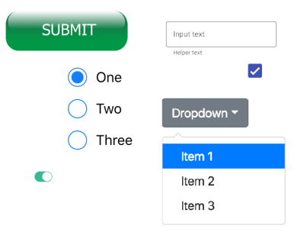

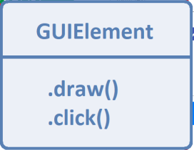
THEORY
Inheritance
inheritance is a mechanism that allows a new class (child or subclass) to adopt the attributes and methods of an existing class (parent or superclass) .
New class functionality = Old class functionality + extra .
Inheritance is a best approach to apply the DRY concepts

Slide 14
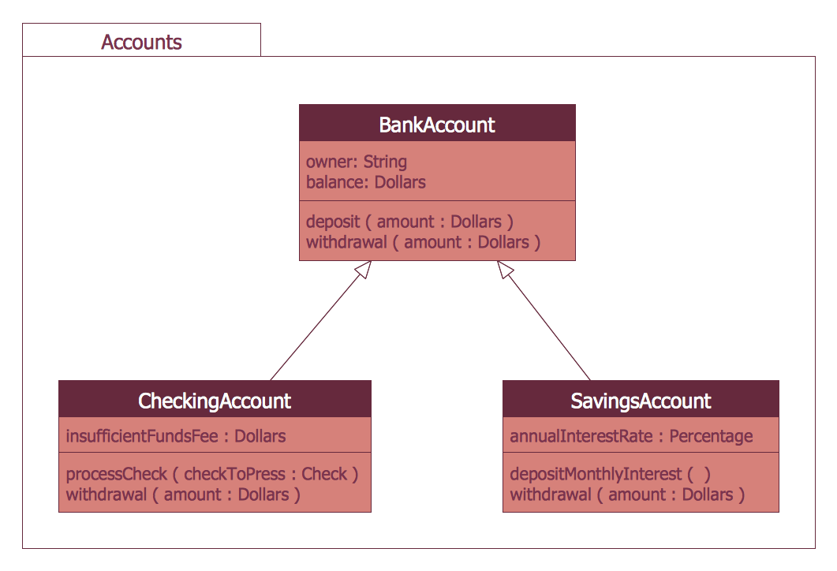
THEORY
Inheritance
Inheritance allows subclasses like CheckingAccount and SavingsAccount to reuse shared logic from BankAccount while adding their own specialized features.

Slide 15
CODE
Inheritance
class DataSource:
def __init__(self, name):
self.name = name
def load(self):
raise NotImplementedError("Subclasses must implement load()")
class CSVSource(DataSource):
def __init__(self, name, path):
super().__init__(name) # reuse the parent's __init__ i.e DataSource.__init__(self, balance)
self.path = path
def load(self):
print(f"Loading CSV from {self.path}")
class APISource(DataSource):
def __init__(self, name, url):
super().__init__(name) # reuse the parent's __init__ i.e DataSource.__init__(self, balance)
self.url = url
def load(self):
print(f"Fetching data from {self.url}")

Slide 16
THEORY
Polymorphism (many forms)
Polymorphism Allows different subclasses to implement the same method interface in their own unique way.
Instead of writing separate, conditional code for every type of object (e.g., if type == 'Checking': ... elif type == 'Savings': ...), you call the exact same method name on any object, and Python automatically executes the correct implementation.
sources = [
CSVSource("sales", "sales.csv"),
APISource("weather", "https://api.weather.com/data"),
]
for source in sources:
source.load() # each object calls its OWN load() method

Slide 17
CODE
Polymorphism in Action
class BankAccount:
def __init__(self,balance):
self.balance = balance
def calculate_interest(self):
return 0.0 # Base default behavior
class SavingsAccount(BankAccount):
def __init__(self,balance):
super().__init__(balance)
def calculate_interest(self):
return self.balance * 0.05 # 5% annual interest
class HighYieldAccount(BankAccount):
def __init__(self,balance):
super().__init__(balance)
def calculate_interest(self):
return self.balance * 0.08 # 8% high-yield interest
# Polymorphism in action: uniform loop over different account types
accounts = [SavingsAccount(1000), HighYieldAccount(1000), BankAccount(1000)]
for account in accounts:
# Same method call, different calculated output!
print(account.calculate_interest())

Slide 18
THEORY
Abstract Base Classes — Enforcing a Contract
Abstraction Hides underlying operational complexity while exposing a clean, standardized interface.
Uses Python's ABC module and @abstractmethod to enforce required behaviors across all subclasses.
Benefit: Reduces code complexity and prevents incomplete or broken subclasses from being instantiated.
from abc import ABC, abstractmethod
# Define an Abstract Base Class (inherits from ABC)
class PaymentProcessor(ABC):
# Decorate mandatory methods with @abstractmethod
@abstractmethod
def process_payment(self, amount):
"""Abstract method: Subclasses MUST implement this."""
pass

Slide 19
CODE
Using abc
from abc import ABC, abstractmethod
class PaymentProcessor(ABC):
@abstractmethod
def process_payment(self, amount):
"""Abstract method: Every payment method MUST define this."""
pass
class CreditCardPayment(PaymentProcessor):
def process_payment(self, amount):
# Specific API integration logic for Credit Card
return f"Processing ${amount} via Credit Card Gateway."
class CryptoPayment(PaymentProcessor):
def process_payment(self, amount):
# Specific blockchain transaction logic
return f"Processing ${amount} via Blockchain Ledger."
# Instantiating PaymentProcessor directly raises a TypeError!
processor = PaymentProcessor() # -> ERROR

Slide 20
THEORY
Dunder (Magic) Methods
Special methods prefixed and suffixed with double underscores (__) that customize how custom objects behave with built-in Python operators and functions.
Category | Dunder Method | Triggered By | Example Use Case
String Representation | __str__, __repr__ | print(obj), str(obj) and repr(obj) , print([obj]) | Readable string representation for users vs. debugging info for developers
Length & Indexing | __len__, __getitem__ | len(obj), obj[idx] | Enables list-like indexing and length checks on custom collections
Operator Overloading | __add__, __eq__ | a + b, a == b | Defines custom addition and equality logic between instances
Context Management | __enter__, __exit__ | with obj as x: | Manages setup and teardown resources (files, database connections)

Slide 21
CODE
__str__ vs. __repr__
class Point:
def __init__(self, x, y):
self.x, self.y = x, y
def __repr__(self):
return f"Point(x={self.x}, y={self.y})" # unambiguous, for devs
def __str__(self):
return f"({self.x}, {self.y})" # readable, for humans
p = Point(1, 2)
print(p) # uses __str__ -> (1, 2)
print(str(p)) # uses __str__ -> (1, 2)
print([p]) # uses __repr__ -> [Point(x=1, y=2)]
Bonus : handle the equal and add for the Point class

Slide 22
CODE
__getitem__ — Making an Object Indexable
class Portfolio:
def __init__(self, assets):
# assets is a list of stock tickers
self.assets = assets
def __getitem__(self, index):
# Enables indexing (portfolio[0]) and slicing (portfolio[0:2])
return self.assets[index]
def __len__(self):
return len(self.assets)
# instantiating the object
tech_portfolio = Portfolio(['AAPL', 'NVDA', 'GOOGL', 'MSFT', 'AMZN'])
# single Indexing
print(tech_portfolio[0]) # Output: AAPL
# slicing
print(tech_portfolio[1:3]) # Output: ['NVDA', 'GOOGL']
# iteration (Python automatically uses __getitem__ for loops!)
for stock in tech_portfolio:
print(f"Holding: {stock}")

Slide 23
CODE
@property — Computed & Validated Attributes
class Rectangle:
def __init__(self, width, height):
self.width = width
self.height = height
@property
def get_width(self):
return self.width
@get_width.setter
def get_width(self, value):
if value <= 0:
raise ValueError("width must be positive")
self.width = value
r = Rectangle(4, 5)
print(r.get_width)
r.get_width = 2
print(r.get_width)

Slide 24
EXERCISE
Real-World Pipeline Scenario: CSV Data Cleaning & Normalization
Step-by-Step Pipeline Description
DropNulls: Remove any row that contains missing (None) or blank ("") values in any column.
StandardizeText: Strip leading/trailing whitespace and uppercase specified string columns (city, status).
ClipOutliers: Cap numerical values within min/max thresholds (e.g., limit salary to a max of $50,000).
AddDerivedFeature: Calculate a new field dynamically (e.g., tax = salary * 0.20).
Pipeline Orchestrator: Store and execute an ordered list of PipelineStep instances sequentially.

Slide 25
SESSION 4 RECAP
Object-Oriented Programming & Design Basics
✓
Classes bundle data + behavior; inheritance and polymorphism let you write flexible, extensible code.
✓
abc.ABC + @abstractmethod enforces a contract at instantiation time, not just at runtime.
✓
Dunder methods (__str__, __repr__, __getitem__, __len__) let your objects work naturally with Python's built-in syntax.
✓
@property gives you computed and validated attributes without breaking the "looks like an attribute" API.

