Slide 1


ADVANCED PYTHON — FORMATION PROGRAM , PILLAR 1
Advanced Python
From Scripts to Structured Code
Animated by :
AYMANE GALIBOU
Data Cell

Slide 2
INTRO
Why This Pillar Exists
Most students write Python as a sequence of instructions in one file.
Real codebases (pandas, FastAPI, scikit-learn) are built on 4 ideas: scope & closures, iteration, resource management, and object design.
By the end of this pillar, you'll read library source code and no longer be confused by @decorator, yield, with, or self.
1
2
3
4
Scope & Closures
Structure
Resource Lifecycles
Iteration
→ decorators
→ OOP
→ context managers
→ generators -
comprehensions

Slide 3
SESSION 1 / 4
Scope,Functions & Decorators
Duration: 2h

Slide 4
THEORY
What "Scope" Means
Scope = the region of your code where a variable name is visible/accessible.
Python doesn't use curly-brace block scope like C/Java — it uses function scope.
Every time you call a function, Python creates a new local namespace (a dictionary under the hood).

Slide 5
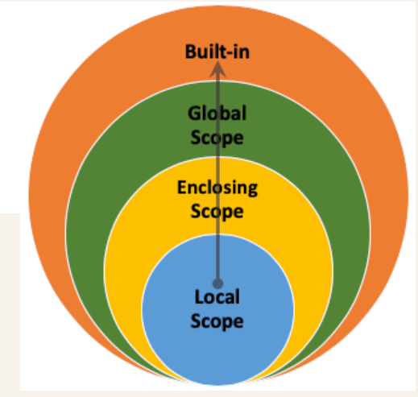
THEORY
The LEGB Rule
Python resolves a variable name by checking these 4 scopes in this order:
L
Local inside the current function
E
Enclosing inside any enclosing function (for nested functions)
G
Global at the top level of the module
B
Built-in Python's built-in names (len, print, range...)
The first scope where the name is found wins. If none match → NameError.

Slide 6
CODE
LEGB in Action
x = "global"
def outer():
x = "enclosing"
def inner():
x = "local"
print(x) # -> "local"
inner()
print(x) # -> "enclosing"
print(x) # -> "global"

Slide 7
Reading vs. Assigning to Global Variables
✓ Fix
counter = 0
def increment():
counter += 1 # UnboundLocalError!
return counter
def increment():
global counter
counter += 1
return counter
Assigning to a name anywhere in a function makes Python treat it as local for the entire function.
Fix: use the global keyword (or, better, avoid mutable globals entirely).
✓ no problem with reading variable outside the current scope
counter = 0
def increment():
# instructions ...
print(counter)
return counter

Slide 8
Reading vs. Assigning to non local variables
✓ Fix
def handler():
counter = 0
def increment():
counter += 1 # UnboundLocalError!
return counter
increment()
def handler():
counter = 0
def increment():
nonlocal counter
counter += 1
return counter
increment()
Fix: use the nonlocal keyword .
✓ no problem with reading variable outside the current scope
def handler():
counter = 0
def increment():
print(counter) # no reading problem
return counter
increment()

Slide 9
THEORY
Functions Are First-Class Objects
In Python, functions can be: assigned to variables, passed as arguments, returned from other functions, stored in lists/dicts.
This is what makes higher-order functions (and decorators) possible.
def x():
pass
x = [1, 2, 3]
x = {'foo': 42}
x = pandas.DataFrame()
x = 'This is a sentence.'
x = 3
def my_function():
print('Hello')
x = my_function
print(type(x))
# -> <type 'function'>
list_of_functions = [my_function, open, print]
list_of_functions[2]('I am printing a list')
dict_of_functions = {
'func1': my_function,
'func2': open,
'func3': print }
dict_of_functions['func3']('I am printing a dict')

Slide 10
CODE
Higher-Order Functions
def uppercase_decorator(text):
return text.upper()
def greet(func): # This is the higher-order function
greeting = func("Hello, World!")
print(greeting)
# Passing 'uppercase_decorator' as an argument
greet(uppercase_decorator) # Output: HELLO, WORLD!
def greeting_generator():
# This inner function captures the 'greeting_word' variable
def person_greeter(name):
return f"hello Mr, {name}!"
return person_greeter
# Generate customized functions
say_hello = greeting_generator()
print(say_hello("Alice"))

Slide 11
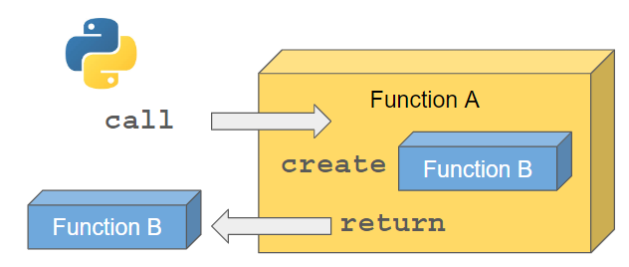
THEORY
Closures — Functions That Remember
A closure is a function that "remembers" variables from its enclosing scope, even after that scope has finished executing.
This is possible because Python functions carry a reference to their enclosing scope (__closure__).
The variables saved by the closure are called captured variables or free variables .

Slide 12
CODE
Building a Closure
def make_multiplier(factor):
def multiply(x):
return x * factor # "factor" is remembered
return multiply
double = make_multiplier(2)
triple = make_multiplier(3)
print(double(5)) # -> 10
print(triple(5)) # -> 15
Accessing the closure
print(type(double.__closure__)) # -> <class 'tuple'>
print(len(double.__closure__)) # -> 1
print(double.__closure__[0].cell_contents) # -> 2

Slide 13
Late Binding Closures in Loops
✓ Fix
funcs = []
for i in range(3):
funcs.append(lambda: i)
print([f() for f in funcs])
# -> [2, 2, 2] NOT [0, 1, 2] !
## second solution
funcs = []
for i in range(3):
funcs.append(lambda v=i: v)
print([f() for f in funcs])
All three lambdas share the same i variable, evaluated at call time, not creation time.
Fix: capture the value as a default argument.
Exercise : make the previous function suffer from the late binding.

Slide 14
Question ?
Why Does all that matter ?
Decorator use :
    Functions as objects
    Nested function
    Nonlocal Scope
    Closures

Slide 15
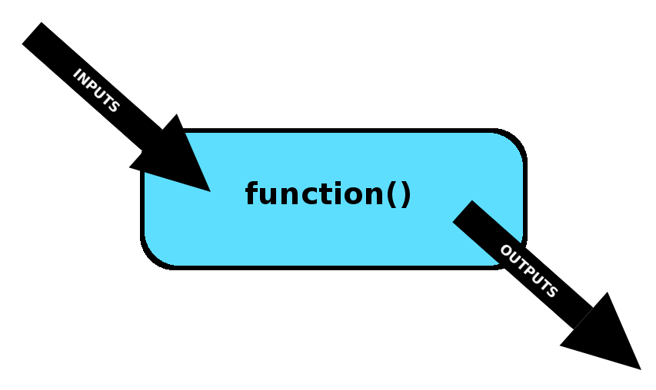
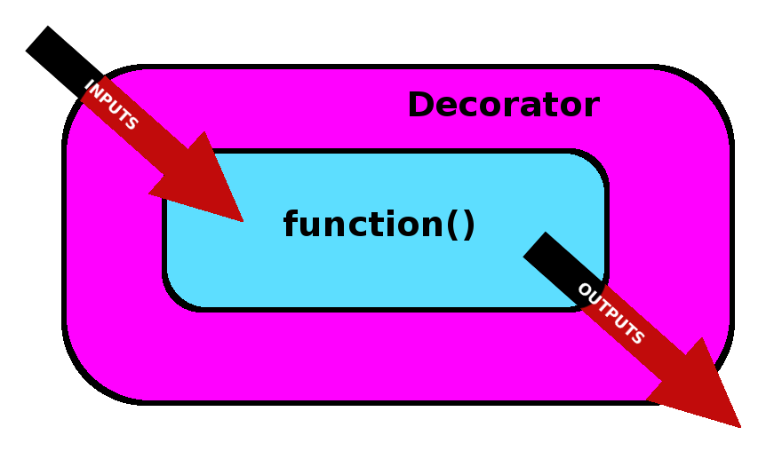
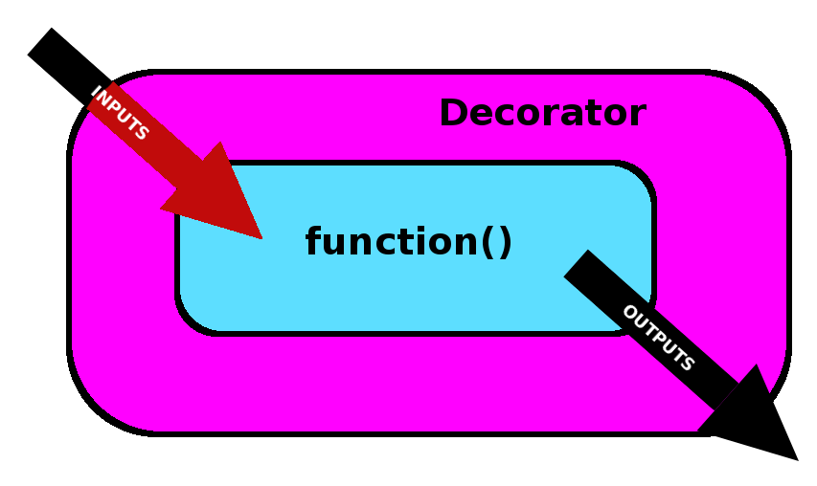
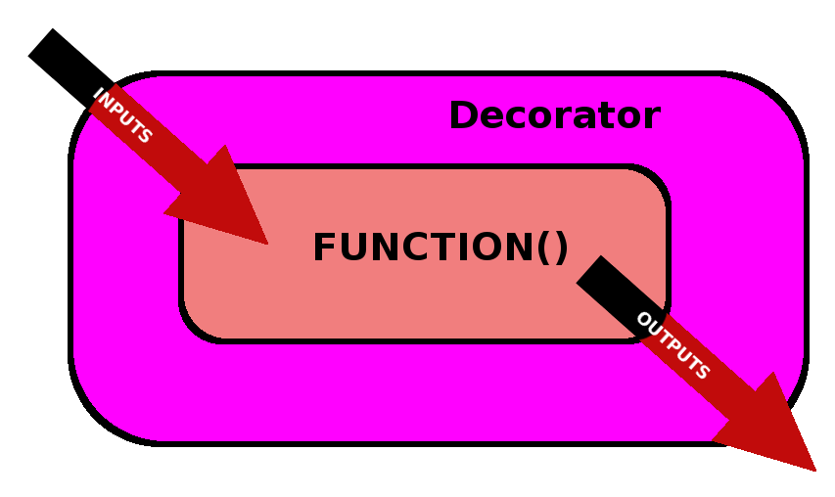
THEORY
What a Decorator Really Is
@my_decorator
def say_hi():
...
# is exactly equivalent to:
say_hi = my_decorator(say_hi)
A decorator is just a higher-order function: it takes a function, wraps it in another function, and returns the wrapper.
The @decorator syntax is pure syntactic sugar:

Slide 16
CODE
Decorator Syntax
def our_decorator(func):
def wrapper():
# instructions
return func()
return wrapper
@our_decorator
def our_function():
# instructions
return "This our function"
print(our_function()) #-> This our function
def our_decorator(func):
def wrapper():
# instructions
return func()
return wrapper
def our_function():
# instructions
return "This our function"
our_function1 = our_decorator(our_function)
print(our_function1()) #-> This our function

Slide 17
CODE
Your First Decorator
def my_decorator(func):
def wrapper(*args, **kwargs):
""" This is doc string of the wrapper function """
print(f"Calling {func.__name__}")
result = func(*args, **kwargs)
print(f"{func.__name__} finished")
return result
return wrapper
@my_decorator
def say_hi():
print("Hi!")
say_hi()
# Calling say_hi
# Hi!
# say_hi finished

Slide 18
Losing Function Identity
✓ Fix
print(say_hi.__name__)
# "wrapper" (wrong! should be "say_hi")
print(say_hi.__doc__)
# This is doc string of the wrapper function
from functools import wraps
def my_decorator(func):
@wraps(func)
def wrapper(*args, **kwargs):
return func(*args, **kwargs)
return wrapper
Without care, decorators overwrite __name__, __doc__, and other metadata of the original function.
Fix: functools.wraps.

Slide 19
CODE
Decorators That Take Arguments
from functools import wraps
def repeat(times):
def decorator(func):
@wraps(func)
def wrapper(*args, **kwargs):
for _ in range(times):
func(*args, **kwargs)
return wrapper
return decorator
@repeat(times=3)
def say_hi():
print("Hi!")
say_hi() # prints "Hi!" three times
Three levels of nesting: repeat(times) returns decorator, which returns wrapper.

Slide 20
CODE
Class-Based Decorators
from functools import wraps
class CountCalls:
def __init__(self, func):
wraps(func)(self)
self.func = func
self.calls = 0
def __call__(self, *args, **kwargs):
self.calls += 1
print(f"Call #{self.calls} to {self.func.__name__}")
return self.func(*args, **kwargs)
@CountCalls
def say_hi():
print("Hi!")
say_hi()
say_hi()
Try to rewrite it as a decorator with arguments

Slide 21
CODE
Real-World Decorator — @timeit
import time
from functools import wraps
def timeit(func):
@wraps(func)
def wrapper(*args, **kwargs):
start = time.perf_counter()
result = func(*args, **kwargs)
elapsed = time.perf_counter() - start
print(f"{func.__name__} took {elapsed:.4f}s")
return result
return wrapper
@timeit
def slow_square(n):
return [i**2 for i in range(n)]
slow_square(1000)

Slide 22
CODE
Real-World Decorator — @retry
import time
from functools import wraps
def retry(max_attempts=3, delay=1):
def decorator(func):
@wraps(func)
def wrapper(*args, **kwargs):
for attempt in range(1, max_attempts + 1):
try:
return func(*args, **kwargs)
except Exception as e:
print(f"Attempt {attempt} failed: {e}")
if attempt == max_attempts:
raise
time.sleep(delay)
return wrapper
return decorator
@retry(max_attempts=3, delay=2)
def unstable_api_call():
...

Slide 23
CODE
Real-World Decorator — @validate_input
from functools import wraps
def validate_positive(func):
@wraps(func)
def wrapper(x, *args, **kwargs):
if x < 0:
raise ValueError(f"{func.__name__} expects a positive number, got {x}")
return func(x, *args, **kwargs)
return wrapper
@validate_positive
def square_root(x):
return x ** 0.5

Slide 24
CODE
Built-in Decorators You Already Use
class Circle:
def __init__(self, radius):
self._radius = radius
@property
def area(self):
return 3.14159 * self._radius ** 2
@staticmethod
def unit_circle():
return Circle(1)
@classmethod
def from_diameter(cls, diameter):
return cls(diameter / 2)
@property, @staticmethod, @classmethod are decorators from the standard library — now you know how they work under the hood.

Slide 25
EXERCISE
Build a Mini Decorator Toolkit
In pairs, in 15 minutes:
1. Write @timeit from scratch (no peeking!).
2. Write @log_calls that prints the function name and its arguments every time it's called.
3. Combine both decorators on the same function — does order matter?

Slide 26
SESSION 1 RECAP
Functions, Scope & Decorators
Scope resolution follows LEGB.
✓
Closures let inner functions "remember" enclosing variables.
✓
Decorators = higher-order functions that wrap other functions.
✓
Always use functools.wraps to preserve metadata.
✓
Real decorators you'll actually use: @timeit, @retry, @validate_input, @lru_cache.
✓

