Slide 1
CLOUDSYS / GROUP G2
Anomalies in
Wheat Trade
From UN Comtrade data to anomaly reports on AWS
Aymen Belkacem, Luca Di Cosola and Zekria Sormasor
Notes:
The project compares export and import declarations for wheat (HS 1001). The AWS pipeline loads the data, flags discrepancies and lets users request an analysis from the dashboard.
Repository sources
docs/main.pdf
README.md
data/Bilateral_data.csv

Slide 2
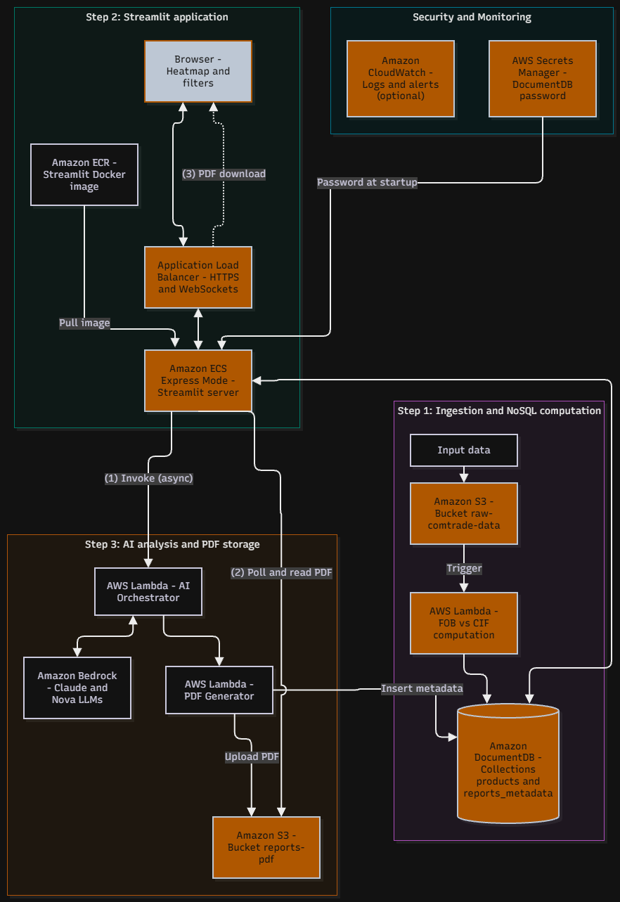
Architecture
The data pipeline
01
Ingestion
S3 triggers a Lambda function. DocumentDB stores the processed trade records.
02
Dashboard
Streamlit runs on ECS and reads DocumentDB to display anomalies.
03
On-demand analysis
Bedrock suggests an explanation. A separate Lambda function creates the PDF and saves it to S3.
02
Notes:
The Lambda functions connect to DocumentDB inside a VPC. An Application Load Balancer (ALB) exposes the dashboard. IAM restricts access between services and CloudWatch collects logs.
The diagram comes from the project report. The code and configuration files use products as the default collection.
Repository sources
docs/main.pdf
docs/archi_cloudsys.drawio.png
README.md

Slide 3
Step 1 / Ingestion
Ingestion service setup
01
Create the S3 bucket and DocumentDB cluster
Boto3 scripts create the CSV bucket, then the cluster and its instance.
02
Create the VPC and subnets
Link an S3 gateway endpoint to the subnet route tables so Lambda can reach S3.
03
Deploy the ingestion Lambda
Create the IAM role, then deploy the function in the VPC.
04
Configure the S3 event notification
Upload the CSV to trigger processing and write the results to DocumentDB.
03
Notes:
Set up AWS credentials, the VPC, security groups and the S3 gateway endpoint. DocumentDB must accept TLS connections from Lambda on port 27017.
In etape-1-ingestion, run s3/create-s3.py, then documentdb/create_cluster.py. Set DOCDB_HOST in the Lambda configuration to the cluster endpoint.
For Lambda, run create_iam.py and then create_lambda.py with the pandas and PyMongo layers. Use configure_s3_event.py to enable notifications, then upload the data with s3/put-data-s3.py.
The function calculates unit prices and matches declarations by month, exporter, importer and HS4 code.
Repository sources
etape-1-ingestion/readme.md
etape-1-ingestion/lambda/readme.md
etape-1-ingestion/lambda/lambda_function.py

Slide 4
Step 2 / Dashboard
Streamlit deployment
Local setup
FRANCE TO EGYPT / WHEAT / FEBRUARY 2022
Docker Compose starts Streamlit and seeds a MongoDB instance from the CSV.
+38.2%
AWS deployment
infra/deploy.sh pushes the image to ECR and deploys the service to ECS Express Mode.
FOB $330.41/t / CIF $456.67/t
A cell turns red when the gap exceeds 35% or FOB is higher than CIF.
The heatmap shows the selected exporter’s top 10 trading partners.
Example calculated from the project CSV
04
Notes:
For local development, run docker compose up --build from etape-2-ui and open localhost:8501. To deploy to AWS, run infra/deploy.sh from WSL. The script creates the ECR repository, IAM roles, log group and ECS service. The ALB serves the application over HTTPS and forwards WebSocket traffic.
In Streamlit, choose the exporter, product and reporting frequency. The FOB price comes from the export declaration. The CIF price comes from the import declaration and includes cost, insurance and freight.
For France’s exports to Egypt in February 2022, divide the declared value by the declared quantity on each side. The gap is (CIF − FOB) / FOB, or approximately +38.21%.
Repository sources
etape-2-ui/README.md
etape-2-ui/app/matrix.py
data/Bilateral_data.csv

Slide 5
Step 3 / AI and PDF
On-demand anomaly analysis
01
AI Lambda and Bedrock
Streamlit sends the selected cell’s data to the AI Lambda, which calls Bedrock.
02
PDF Lambda
This function runs from an ECR image and creates the PDF with WeasyPrint.
03
Storage and download
Streamlit retrieves the PDF from S3. DocumentDB stores the metadata.
The report suggests possible causes for the analyst to verify.
05
Notes:
The dashboard invokes the AI Lambda asynchronously. The AI Lambda passes the explanation and anomaly data to the PDF Lambda. Build the PDF image with Dockerfile.lambda_pdf, push it to ECR and deploy it to the Lambda function.
The page polls S3 until the report is available and reuses a PDF if one already exists. The PDF Lambda attempts to save metadata in reports_metadata and logs any write failure.
Repository sources
etape-3-ia/README.md
etape-3-ia/lambda_ai.py
etape-3-ia/lambda_pdf.py
etape-2-ui/app/reports.py

Slide 6
Configuration
.env files and secrets management
Ingestion
Copy each .env.example to .env and enter the AWS resource settings. Set DOCDB_HOST for Lambda once the cluster is ready.
s3/, documentdb/ and lambda/
Dashboard
Set the ECS and network options, DocumentDB access, and the names of the AI Lambda and report bucket.
etape-2-ui/infra/config.env
AI and PDF
The example file lists the Bedrock model, the PDF Lambda name and the report bucket.
etape-3-ia/.env.example
Git ignores local .env files. On ECS, the password comes from Secrets Manager.
06
Notes:
Each ingestion .env.example belongs in the directory from which you run its scripts. The infra/config.env file configures the ECS deployment. On the first run, the script prompts for the DocumentDB password and injects it into the container via Secrets Manager.
Use the .env.example file in step 3 as a reference for Lambda environment variables, including BEDROCK_CHAT_MODEL_ID, PDF_LAMBDA_NAME and S3_BUCKET_REPORTS.
Repository sources
etape-1-ingestion/readme.md
etape-2-ui/infra/config.env
etape-2-ui/infra/deploy.sh
etape-3-ia/.env.example
.gitignore

Slide 7
Report and demo
Project report
Demo video
AWS service choices, deployment and team responsibilities.
Suggested Streamlit walkthrough. Open a red cell, then view the PDF.
docs/main.pdf
docs/demo_projet.mov
Group G2
07
Notes:
The project report (docs/main.pdf) describes the group’s architecture. The PDF Lambda produces a separate report for each anomaly analyzed in Streamlit.
The Typst source is in docs/main.typ. For the demo, select an exporter and wheat, open a red cell, then start the analysis or open an existing PDF.
Repository sources
docs/main.pdf
docs/main.typ
docs/demo_projet.mov
etape-2-ui/README.md

