Slide 1
Perceptron
By Aymen Tariq

Slide 2
Topics to Cover:
Single layer perceptron
Multi-layer perceptron
Activation Function in Perceptron
Back Propagation in Perceptron
Learning Logical Gates

Slide 3
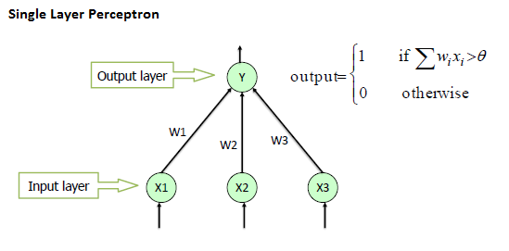
Single-Layer Perceptron
Simplest type of feed forward network
Linear classifier, not for non-linear cases
Doesn’t contain a hidden layer
Produces output based on a threshold function

Slide 4
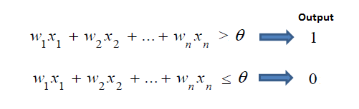
Working of Single Layer Perceptron
Input is provided at input layer
Weights are randomly assigned
Sum of all weighted input

Slide 5
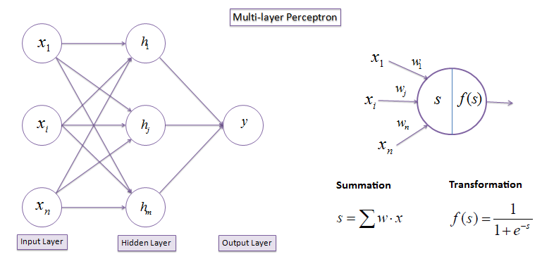
Multi-Layer Perceptron
It has one or more hidden layer
Also deals with non-linear classification
Has activation function that imposes threshold

Slide 6
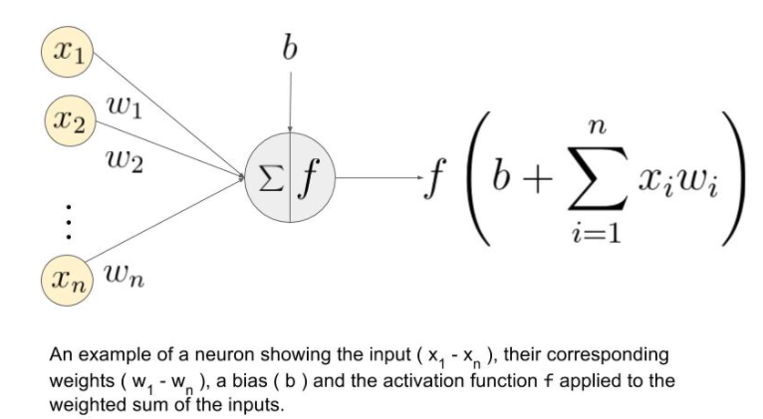
Activation Functions in Perceptrons
Used to decide whether a neuron should be activated or not
done by calculating the weighted sum and providing it to the activation function
Activation function maps the resulting values in between a specific range e.g. 0-1, etc.

Slide 7
Types of Activation Functions:
There are 3 types of activation functions in artificial neural networks
Linear Activation Function: activation is directly proportional to the input
Non-Linear activation function: works with variety of data and can differentiate between the outcomes e.g. sigmoid, softmax, etc.
Binary Step Function: threshold based, we decide on the basis of threshold that whether the neuron should be activated or not

Slide 8
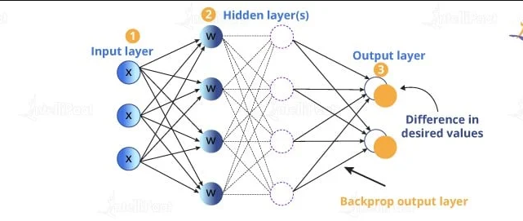
Backpropagation in Perceptron
Is a mathematical tool for enhancing the prediction accuracy in machine learning or deep learning
It is used for computing derivatives.
After each forward pass, a backward pass is performed by backpropagation in which the model’s parameters (coefficients) are adjusted or updated
Done using chain rule
Helps in computing gradient of a loss function in terms of the weights/coefficients/parameters in the network

Slide 9
Logic Gates
AND Gate
OR Gate
NOT Gate
NOR Gate
NAND Gate
XOR Gate
XNOR Gate

Slide 10
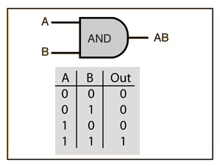
AND Gate
Output is 1 if both inputs are 1. Else 0
According to perceptron algorithm,

Slide 11
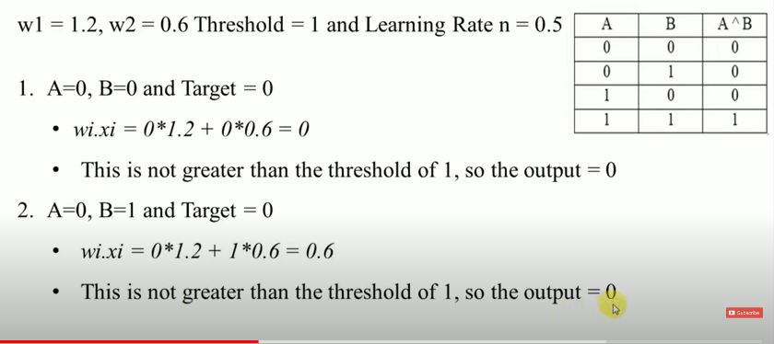
AND Gate

Slide 12
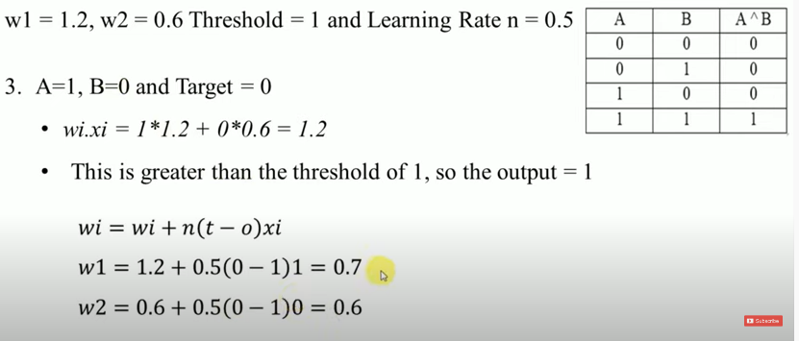
AND Gate

Slide 13
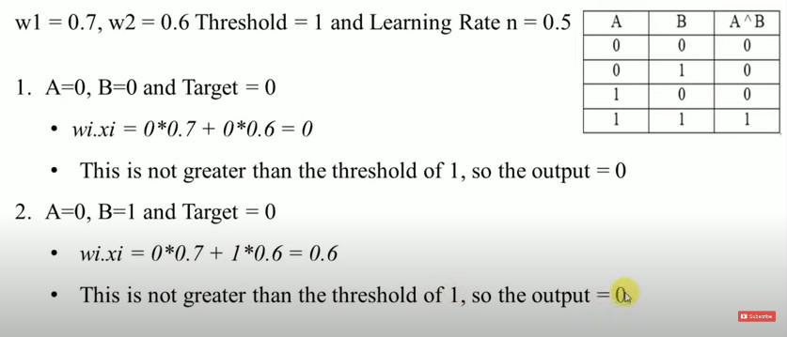
AND Gate

Slide 14
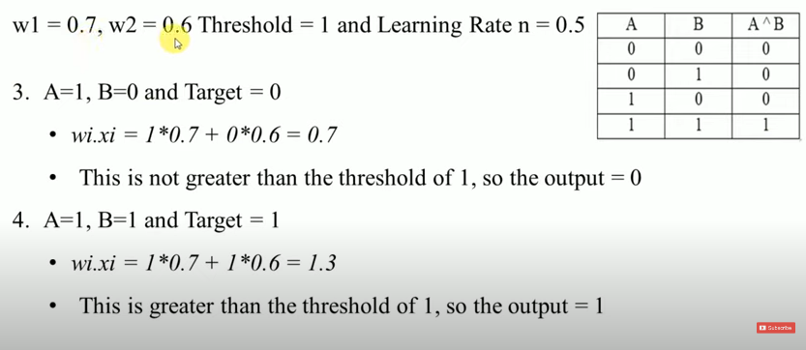
AND Gate

Slide 15
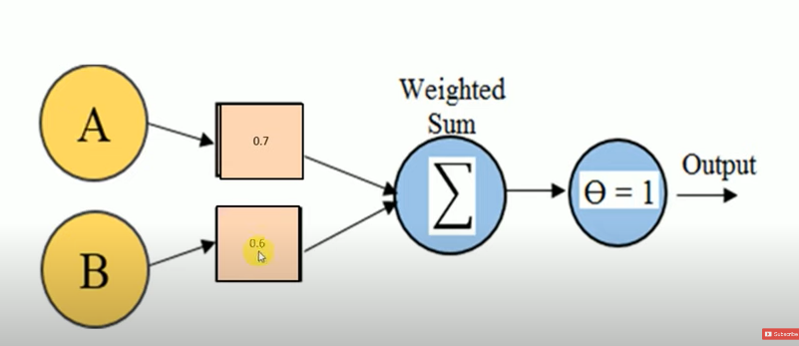
AND Gate

