Slide 1
Data Science 1 - Programming Task Topic 5: Link Analytics
Aymen Hachicha
Institut für Informatik
Database Technologies and Data Analytics Goethe-Universität Frankfurt

Slide 2
Presentation Outline
The PageRank Problem
The PageRank Algorithm
How does the Algorithm work?
The Chosen Dataset
The Chosen Public Implementation of the Algorithm
Implemented Frontend to visualize Results
Resources and Links

Slide 3
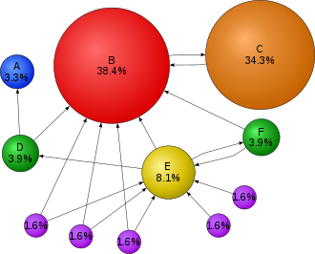
The PageRank Problem
When performing a Google search, how does Google order the result pages?
PageRank is a search ranking engine used to estimate the importance of a webpage.
The underlying assumption is that more important websites are likely to receive more links from other websites.
The PageRank theory holds that an imaginary surfer who is randomly clicking on links will eventually stop clicking.
Currently, PageRank is not the only algorithm used by Google to order search results, but it is the first algorithm that was used by the company.
Notes:
Importance of a webpage: The degree to which typical searchers would like that page returned as an answer to their search query.

Slide 4
The PageRank Algorithm
Condition:
Links from a page to itself, or multiple outbound links from one single page to another single page, are ignored.
Input:
A set of pages having links to other pages in that set. This is represented as a directed graph. Output:
A probability distribution that represents the likelihood that a person randomly clicking on links will arrive at any particular page.
Notes:
The algorithm may be applied to any collection of entities with reciprocal quotations and references. The numerical weight that it assigns to any given element E is referred to as the PageRank of E and denoted by PR(E).
The rank value indicates an importance of a particular page. A hyperlink to a page counts as a vote of support. The PageRank of a page is defined recursively and depends on the number and PageRank metric of all pages that link to it ("incoming links"). A page that is linked to by many pages with high PageRank receives a high rank itself.
The PageRank algorithm outputs a probability distribution used to represent the likelihood that a person randomly clicking on links will arrive at any particular page. PageRank can be calculated for collections of documents of any size. It is assumed in several research papers that the distribution is evenly divided among all documents in the collection at the beginning of the computational process. The PageRank computations require several passes, called "iterations", through the collection to adjust approximate PageRank values to more closely reflect the theoretical true value.
A probability is expressed as a numeric value between 0 and 1. A 0.5 probability is commonly expressed as a "50% chance" of something happening. Hence, a document with a PageRank of 0.5 means there is a 50% chance that a person clicking on a random link will be directed to said document.
Source: https://en.wikipedia.org/wiki/PageRank

Slide 5
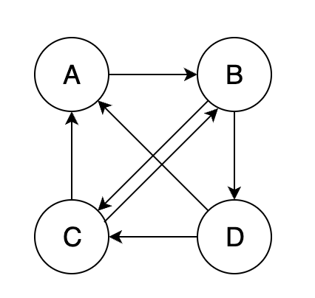
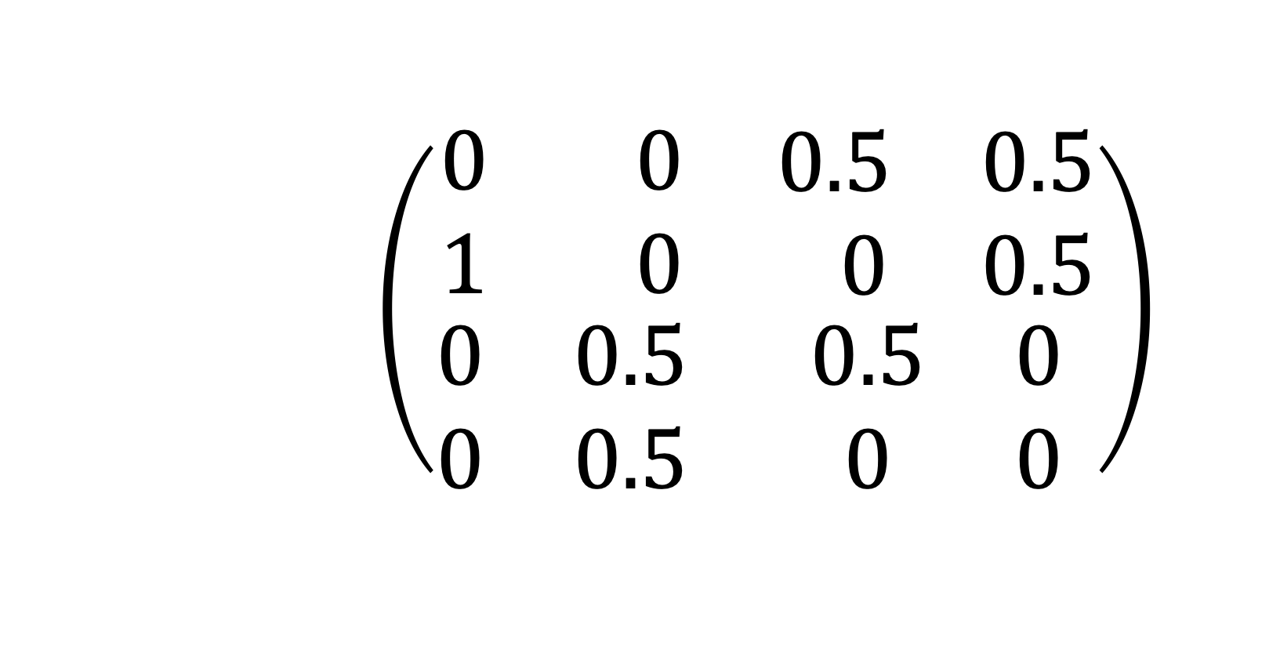
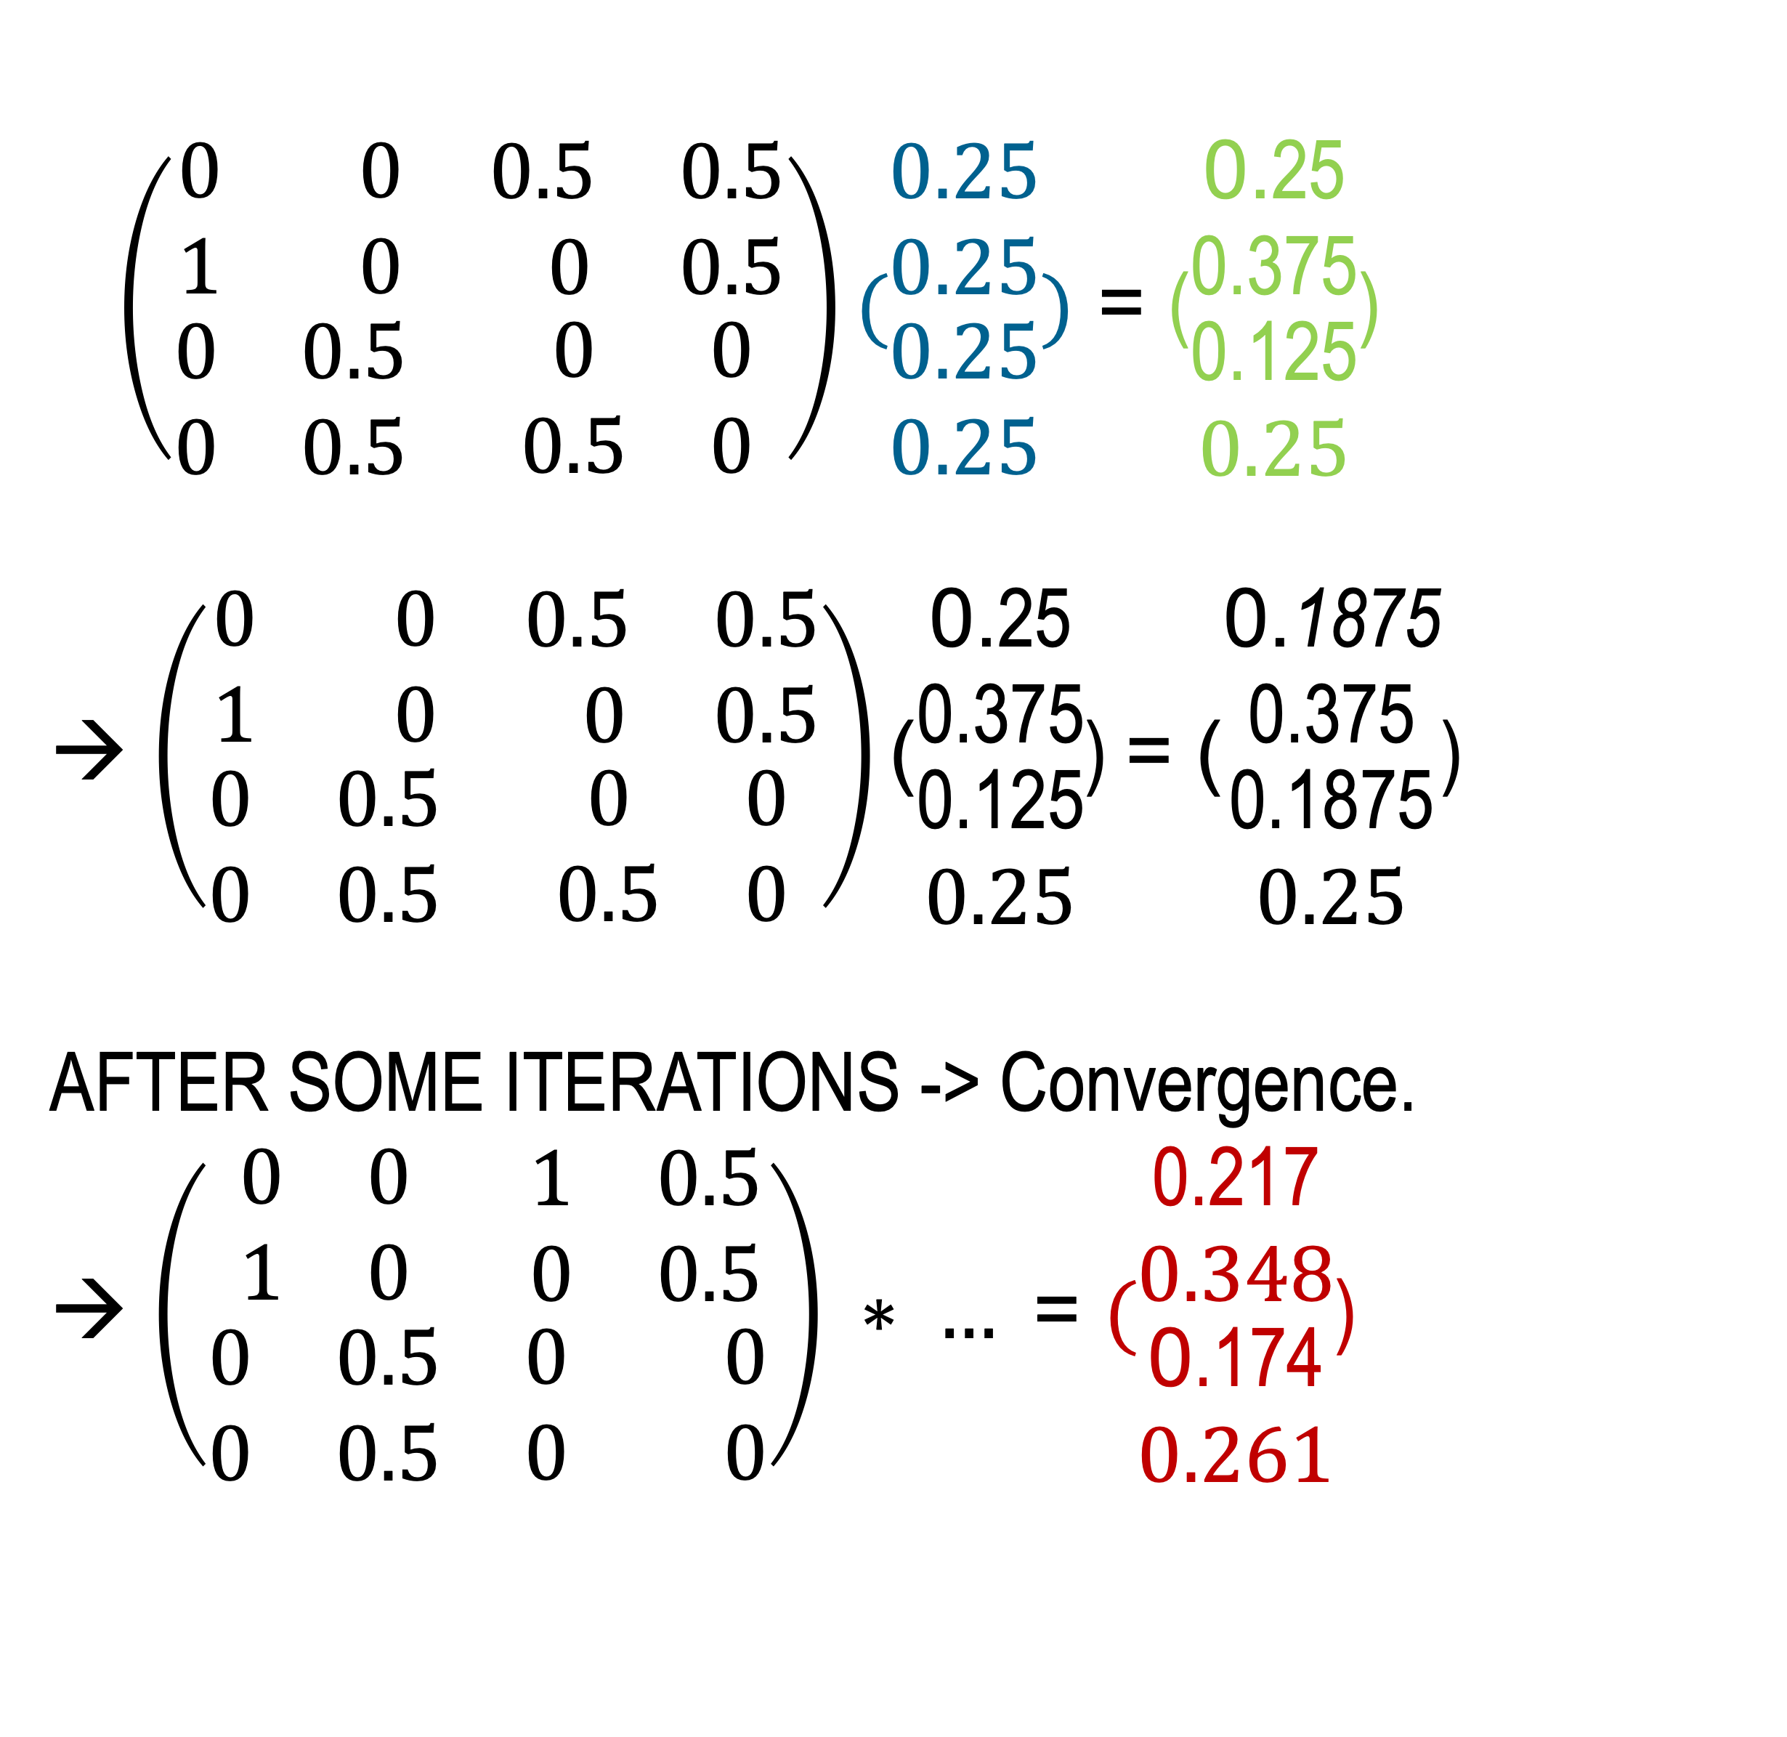
Algorithm - Example
$\left(\begin{matrix}\begin{matrix}0 & 0 \\ 1 & 0\end{matrix} & \begin{matrix}0.5 & 0.5 \\ 0 & 0.5\end{matrix} \\ \begin{matrix}0 & 0.5 \\ 0 & 0.5\end{matrix} & \begin{matrix}0 & 0 \\ 0.5 & 0\end{matrix}\end{matrix}\right)(\begin{matrix}\begin{matrix}0.25 \\ 0.25\end{matrix} \\ \begin{matrix}0.25 \\ 0.25\end{matrix}\end{matrix})$ = ($\begin{matrix}\begin{matrix}\text{0.}\text{25} \\ \text{0.375}\end{matrix} \\ \begin{matrix}\text{0.125} \\ 0.25\end{matrix}\end{matrix}$) → $\left(\begin{matrix}\begin{matrix}0 & 0 \\ 1 & 0\end{matrix} & \begin{matrix}0.5 & 0.5 \\ 0 & 0.5\end{matrix} \\ \begin{matrix}0 & 0.5 \\ 0 & 0.5\end{matrix} & \begin{matrix}0 & 0 \\ 0.5 & 0\end{matrix}\end{matrix}\right)\text{(}\begin{matrix}\begin{matrix}\text{0.}\text{25} \\ \text{0.375}\end{matrix} \\ \begin{matrix}\text{0.125} \\ 0.25\end{matrix}\end{matrix}\text{)}$ = $\text{(}\begin{matrix}\begin{matrix}\text{0.}\text{1875} \\ \text{0.375}\end{matrix} \\ \begin{matrix}\text{0.}\text{187}\text{5} \\ 0.25\end{matrix}\end{matrix}\text{)}$
AFTER SOME ITERATIONS -> Convergence.
→ $\left(\begin{matrix}\begin{matrix}0 & 0 \\ 1 & 0\end{matrix} & \begin{matrix}1 & 0.5 \\ 0 & 0.5\end{matrix} \\ \begin{matrix}0 & 0.5 \\ 0 & 0.5\end{matrix} & \begin{matrix}0 & 0 \\ 0 & 0\end{matrix}\end{matrix}\right) ∗ …$= $(\begin{matrix}\begin{matrix}\text{0.217} \\ 0.348\end{matrix} \\ \begin{matrix}\text{0}\text{.174} \\ 0.261\end{matrix}\end{matrix}$)
A
B
C
D
$\left(\begin{matrix}\begin{matrix}0 & 0 \\ 1 & 0\end{matrix} & \begin{matrix}0.5 & 0.5 \\ 0 & 0.5\end{matrix} \\ \begin{matrix}0 & 0.5 \\ 0 & 0.5\end{matrix} & \begin{matrix}0.5 & 0 \\ 0 & 0\end{matrix}\end{matrix}\right)$
A
B
C
D

Slide 6
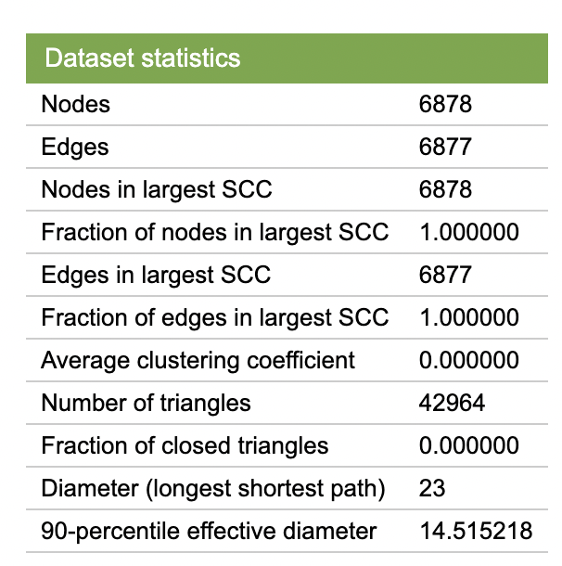
Dataset
Disease-disease Network representing relationships between diseases.
Reduced Dataset to 630 Nodes and 733 Edges
Analog to webpages, we can get a value for each disease describing its “importance” based on the number/importance of other diseases it is related to.

Slide 7
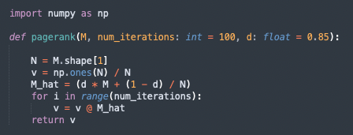
Public Implementation used in this Project
- Code in Python
- PageRank Algorithm with explicit number of iterations.
- Returns ranking of nodes (pages) in the adjacency matrix
- Damping Factor -> typical values: 0.7, 0.85 - Input: Adjacency Matrix of the graph at hand
Notes:
Assume a small universe of four web pages: A, B, C, and D.
Links from a page to itself are ignored. Multiple outbound links from one page to another page are treated as a single link.
PageRank is initialized to the same value for all pages. We assume a probability distribution between 0 and 1. Hence the initial value for each page in this example is 0.25.
The PageRank transferred from a given page to the targets of its outbound links upon the next iteration is divided equally among all outbound links.
Source: https://en.wikipedia.org/wiki/PageRank

Slide 8
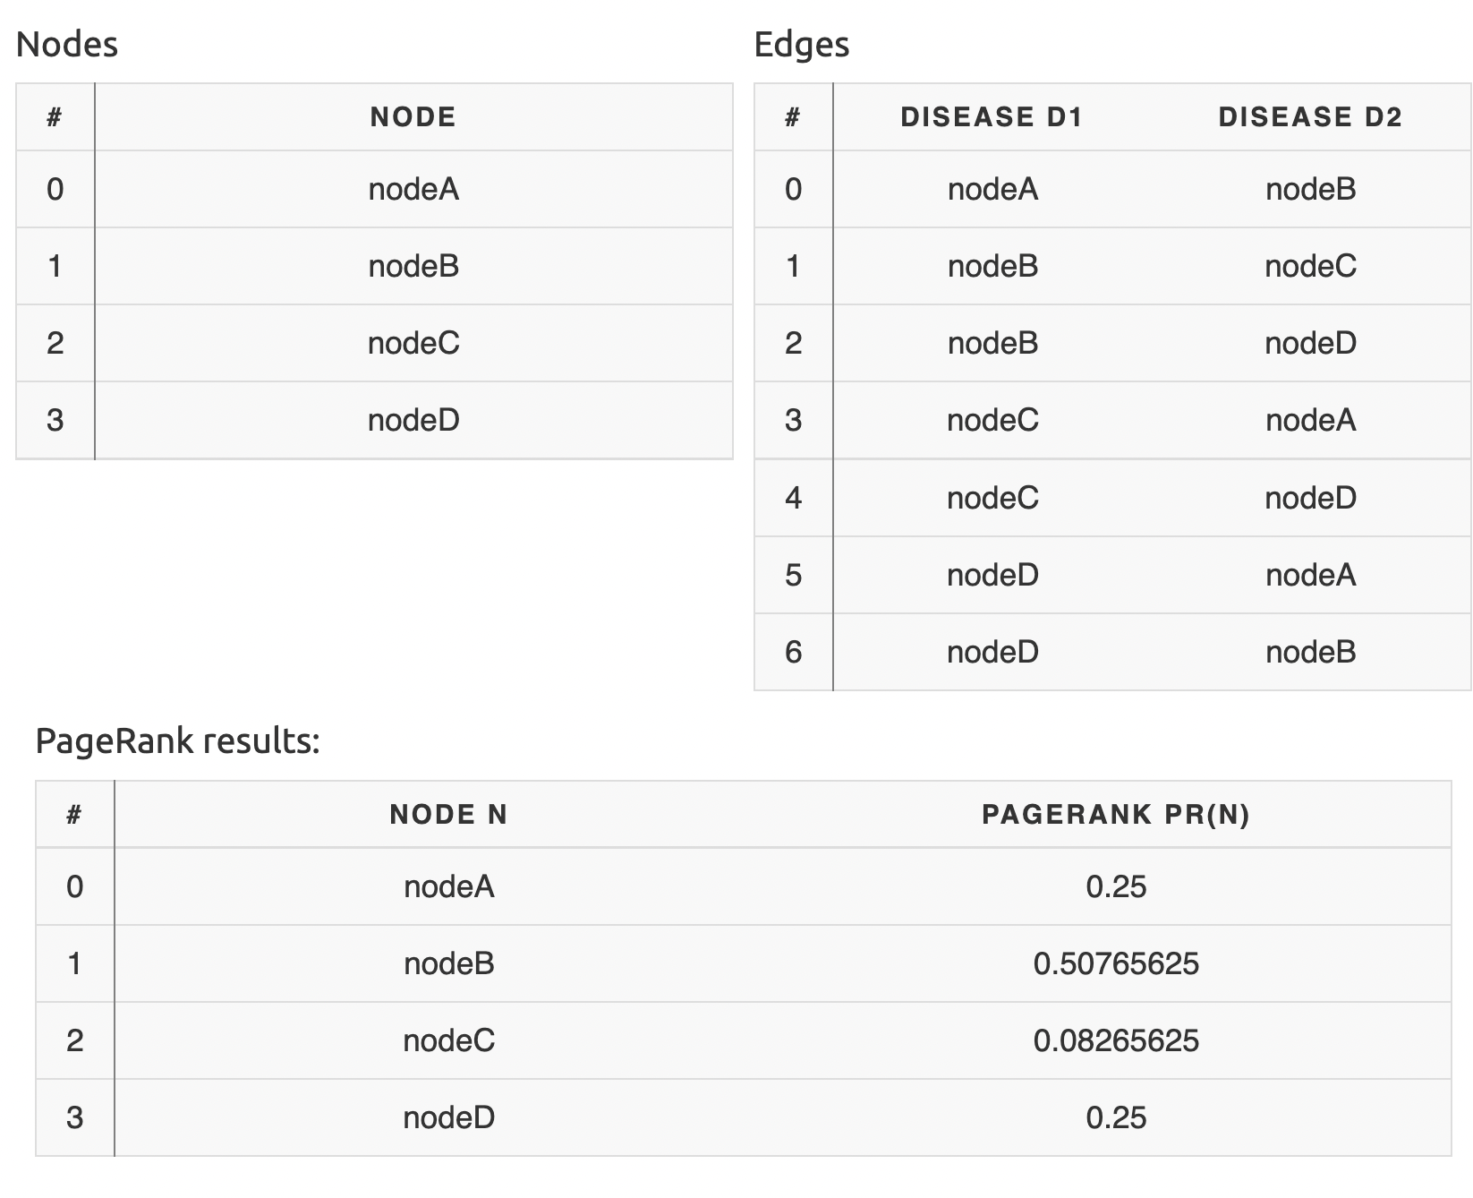
Notes:
Assume a small universe of four web pages: A, B, C, and D.
Links from a page to itself are ignored. Multiple outbound links from one page to another page are treated as a single link.
PageRank is initialized to the same value for all pages. We assume a probability distribution between 0 and 1. Hence the initial value for each page in this example is 0.25.
The PageRank transferred from a given page to the targets of its outbound links upon the next iteration is divided equally among all outbound links.
Source: https://en.wikipedia.org/wiki/PageRank

Slide 9
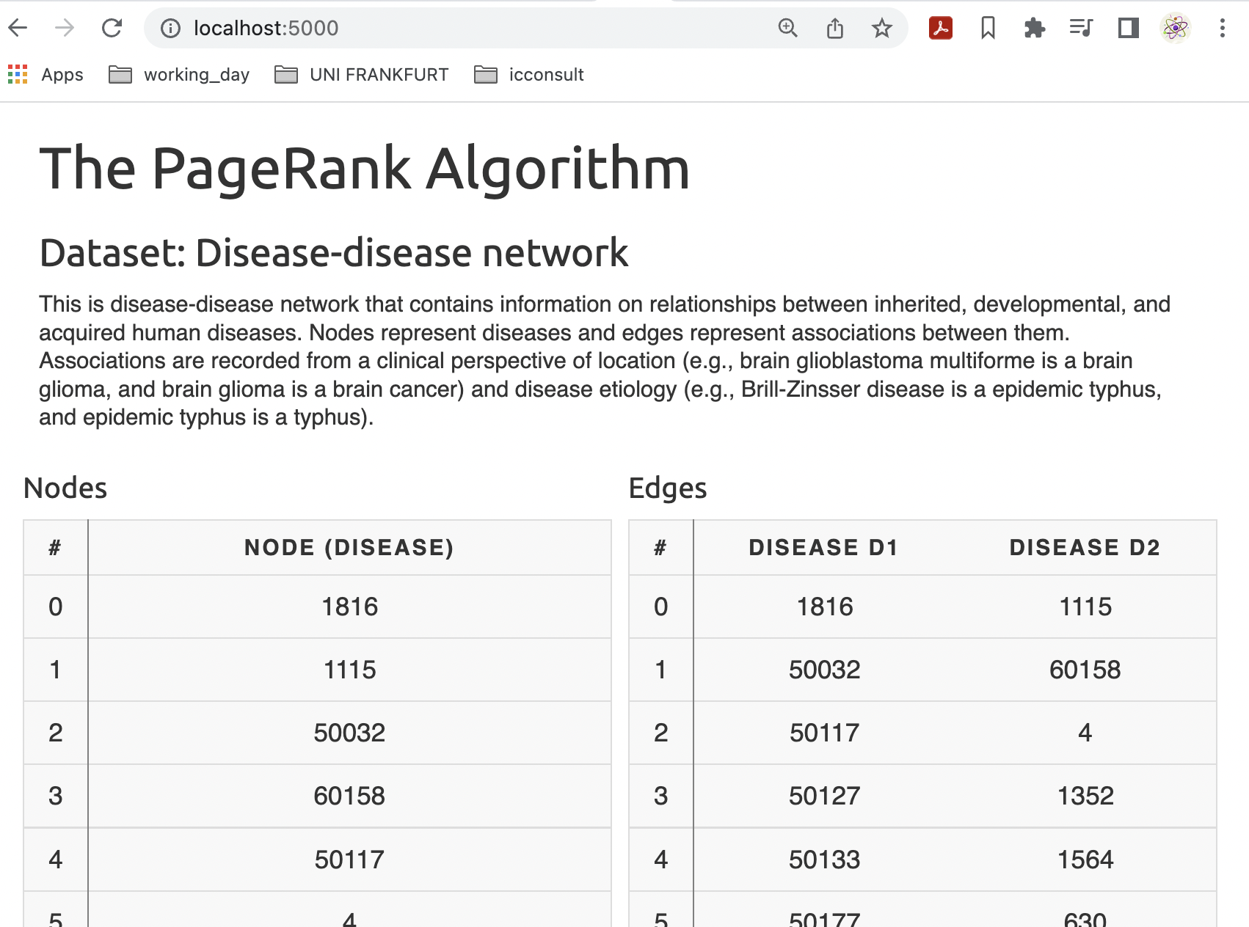
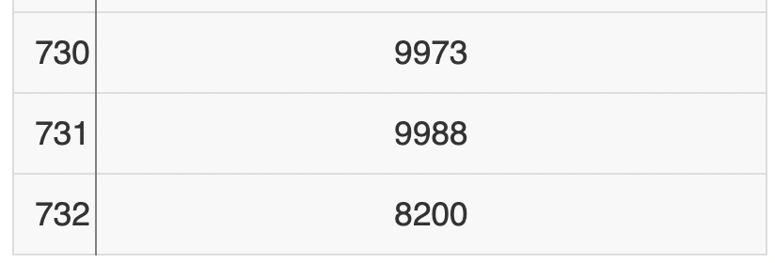
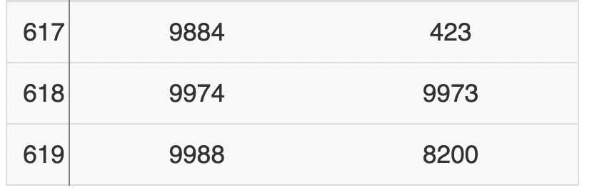
…
…

Slide 10
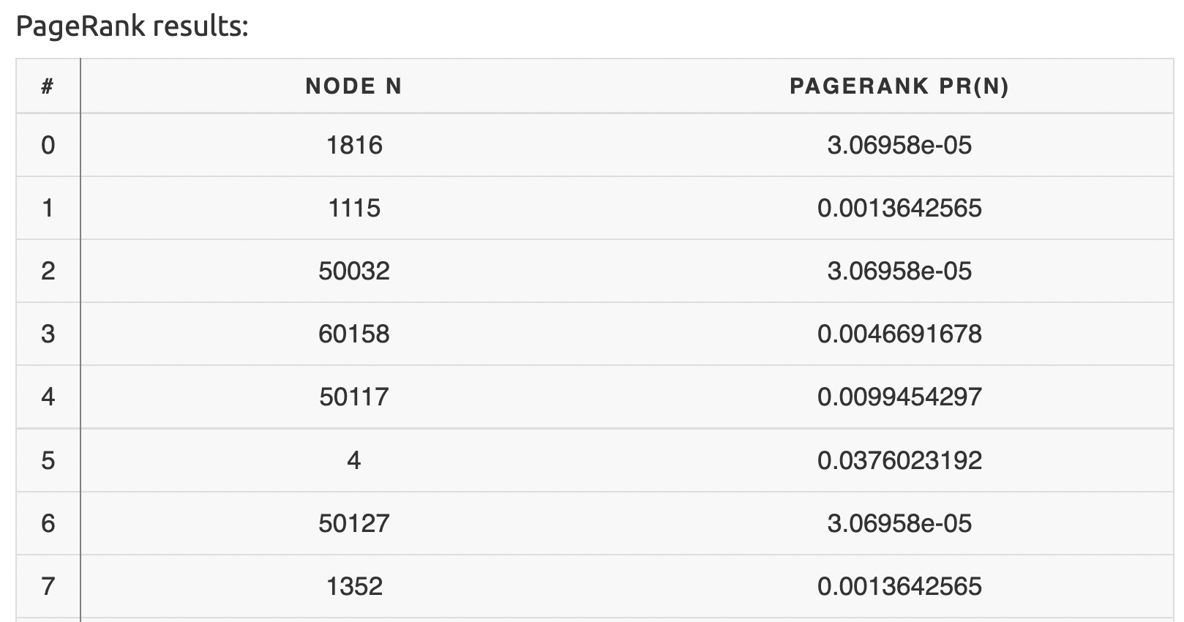
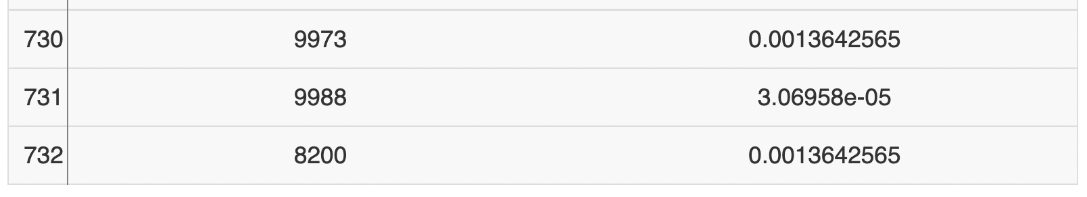
…

Slide 11
Resources and Links
Source Code for this project: - https://github.com/Aymen96/ds-project-pagerank
Paper: The PageRank Citation Ranking: Bringing Order to the Web - http://ilpubs.stanford.edu:8090/422/1/1999-66.pdf
Wiki Page: About PageRank and public Implementation in Python - https://en.wikipedia.org/wiki/PageRank
Youtube: The Algorithm that started Google - https://www.youtube.com/watch?v=qxEkY8OScYY&t=463s
Dataset used: - http://snap.stanford.edu/biodata/datasets/10006/10006-DD-Miner.html

Slide 12
Thanks for Listening Questions?

