Slide 1
Machine Learning for online shopping intentions
The goal of this project is to create a python model that uses machinee learning techniques to predict with the highest amount of accuracy if an online costumer will buy or not a product

Slide 2
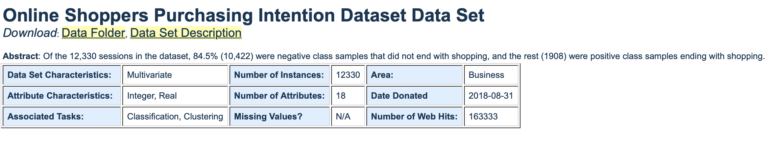
ins and outs of the problem
We are given quite a “RAW” dataset, meaning that is full of unnecessary data that can compromise the learning and training of our model.
The first thing we need to do is to look at the data to see whether it has a positive or negative impact (or no impact at all) on our model, and also to do some processing and harmonisation of the format of the data.
Dataset : Sakar, C.O., Polat, S.O., Katircioglu, M. et al. Neural Comput & Applic (2018). [Web Link]

Slide 3
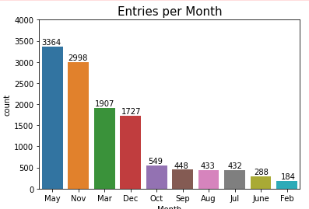
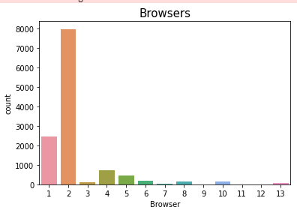
Initial analysis
In the first diagram we see that two months are missing and 6 out of thee 10 months that we have very low entry counts。
As with the second diagram most people use Google, this could create a bias in our model that favors the data that he is Abundant in. Knowing that is cand of variables are not important (using Google does not impact your shopping intention).
We will remove this variables from the dataframe.

Slide 4
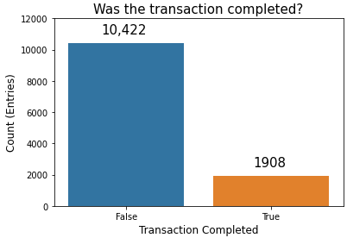
INS AND OUTS OF THE PROBLEM
The next problem is way more “problematic”, the Disproportionality off our labels is very concerning,this may create a bias in our model the favors a statistical approach rather than a feature's one, reducing the overwhelming data labeled “False” will reduce the Generalization capacity of our model.
To solve this, we will use an ROC/AUC metric to include The false positives and negatives, and also used a "stratified shuffle split"method.
(See code for details）

Slide 5
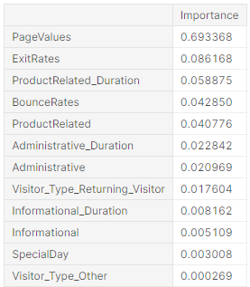
Analysis and selection of variables
It is true that we are given a multitude of variables to help in the training of our model, but reading their description.
We notice that some of them are just useless in the context of This project, so removing them is advised.

Slide 6
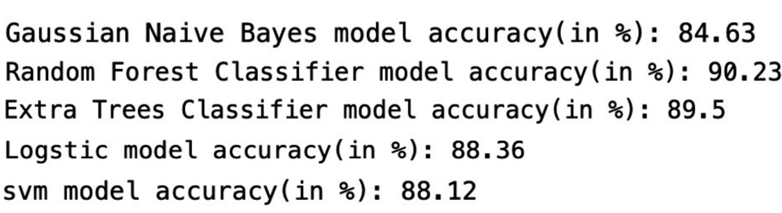
Models and training
Given that this project is about a classification problem we will use ：
Gaussian naïve bayes
Random Forest
Extra Trees
Logstic Model
Support Vector Machines（SVM）
Deep Learning
A good model is not only determined by the model itself, but also by the setting of the parameters. For model types with a large number of parameters and a large impact on the model, we use GridSearch to automatically adjust the parameters to select the best ones.

Slide 7
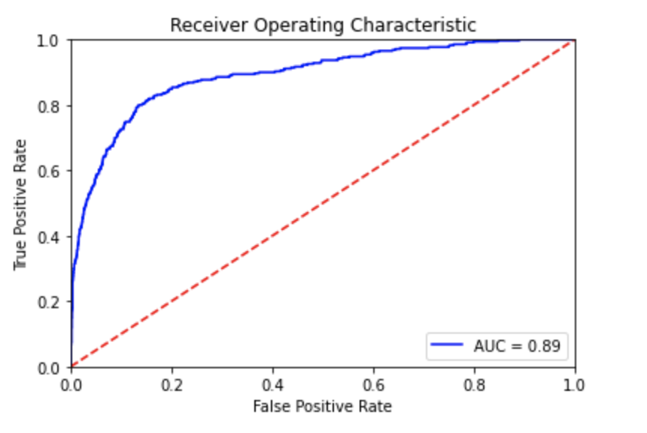
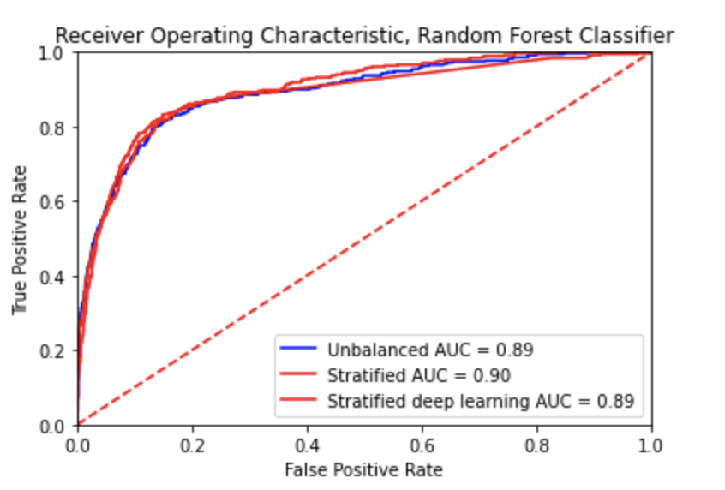
Evaluation of the model
we will not consider the accuracy metric because of the severe disproportionality of the data's labels but will rather refer to the area under the ROC curve score.
Also add a dummy model to compare with only guessing (stratified dataset)
单

Slide 8
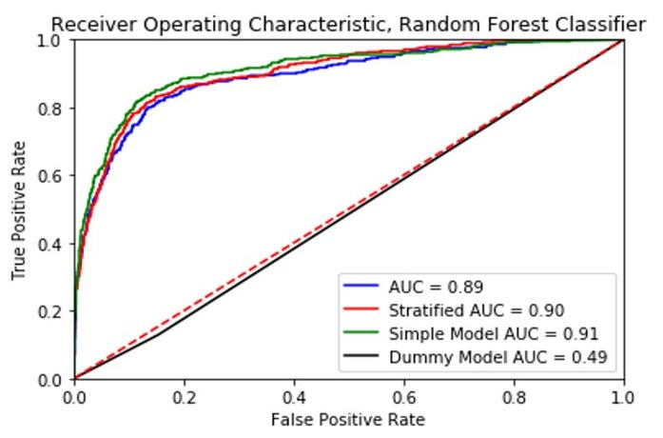
Results
The model seems to be much more accurate than guessing by using a random forest classifier,it is able to achieve approximately 90% accuracy.
The dummy classifier seems to be right about 50% of the time, which was expected to see, as it is making guesses based on the distribution of a stratified dataset. If we were to deploy this model, the most efficient model to select would be our simple model.
The simple model performs similarly to our other models,and only bases its classification by five features.

