Slide 1

2nd Supervision Meeting
13.November.2020
Afram Afrem, Andreas Mäkilä, Victor Nicholas Ebirim, Lukas Johannes Dust, Aymen Nouidha

Slide 2

Agenda
Schedule and Tasks of the Week
1. Aymen Nouidha
3. Victor Ebirim
4. Andreas Mäkilä
2.Lukas Dust and Afram Afrem

Slide 3

Schedule for the Week
Weekday | Activity
Monday | Taskmeeting: → Set the goals for the week, create and assign the tasks and responsibilities (Read API Design Suggestions) 11:30 – 12:00
Tuesday | API Design Seminar 15:15-18:00
Wednesday | Status Meeting / Presentation of API Design → Talking about the APIs → Setting of responsibilities
Thursday | Summary Meeting: Present and discuss the results of the Week Summarize the outcomes Prepare supervision meeting
Friday | Supervision Meeting: Presentation of the start of the design phase

Slide 4
Aims / Assigned Tasks / Responsibilities
Person | Assigned Task / Responsibility
Aim for the Week | →API Design Start Design Phase Start assigning responsibilities for Design parts
Person | API DESIGN | Software Design
Andreas Mäkilä | Semaphores
Aymen Nouidha | Scheduling
Victor Ebirim | Tasks
Lukas Dust and Afram Afrem | Clock

Slide 5
1. Aymen Nouidha / Scheduling
Prerequisites for scheduling:
Ready_queue
Blocked_queue
When a task finishes executing it should be put back into the ready or blocked queue in the proper order depending on its order
Task_PriorityAssignement(TCB* task, queue)
TCB struct needs to be modified to include Period and Deadline??
→API Seminar
The scheduling of tasks happens in the time interrupt, so we should modify it
Timer_ISR()
In this function we initialize and start scheduling
start_Schedular()

Slide 6
1. Aymen Nouidha / Scheduling
There are two methods for context switching in the ROSA kernel.
Voluntary context switch from a task (cooperative mode).
Timer interrupts (preemptive mode).
With some tweaks cooperative and preemptive modes can be used simultaneously in ROSA.
Are we supposed to keep both modes??

Slide 7
2. Lukas Dust and Afram Afrem / Clock
Prerequisites:
Timer initialization and creation is already implemented (AVR Timer 0)
Timer values (and Interrupt) needs to be initialized and can be used then
Requirements:
Track the System time
Relative Delay Function
Absolute Delay Function
API suggestion:
Int ROSA_getSystemTickCount(); → returns the system tick time –> API Seminar?
Void ROSA_sysTickWait(int ticks); → Relative Delay function
Void ROSA_sysTickWaitUntil(int Ticktime); → Absolute delay Function

Slide 8
2. Lukas Dust and Afram Afrem / Clock
Question: Do we provide APIs for delaying other Tasks? –> API Seminar
Void ROSA_sysTickWait(int ticks, tcb *task); → Relative Delay function
Void ROSA_sysTickWaitUntil(int Ticktime, tcb *task); → Absolute delay Function

Slide 9
3. Victor Ebirim / Tasks
Requirements:
Dynamic creation and termination of tasks
Prerequisites:
Static creation of tasks
What do we need to implement?
We need to re-implement the task creation sub-routine to support dynamic creation
We need to implement a delete task function
We should include a task priority property on the tcb structure and also include as a parameter on the taskcreate function
We can implement the task suspension and activation

Slide 10
3. Victor Ebirim / Tasks
Suggested API
ROSA_tcbKill
Prototype:
unsigned char ROSA_tcbKill(tcb *TCB);
ROSA_start (re-implementation)
Prototype:
void ROSA_start(tcb *TCB, char *id, void *taskFunc, unsigned char taskPrio, int *stack, int stackSize)

Slide 11
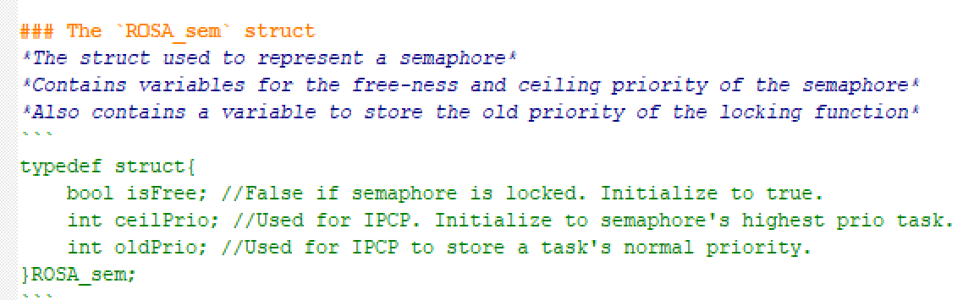
4. Andreas Mäkilä / Semaphores

Slide 12
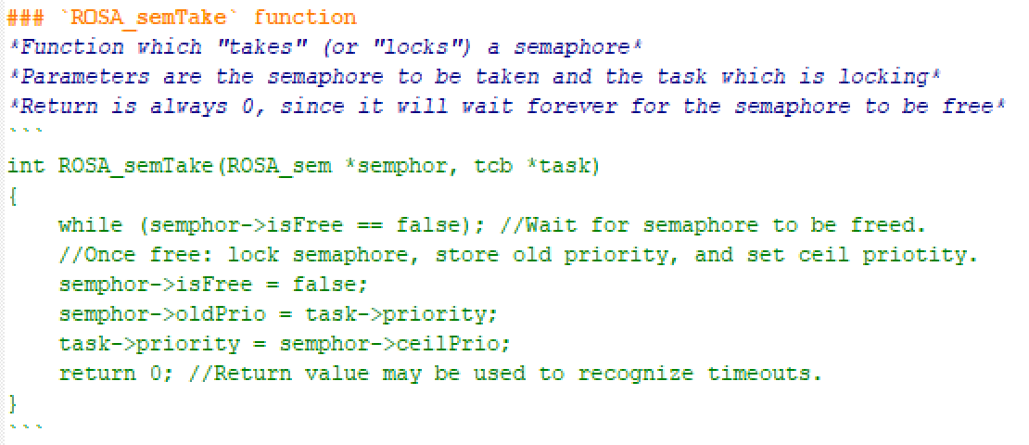
4. Andreas Mäkilä / Semaphores

Slide 13
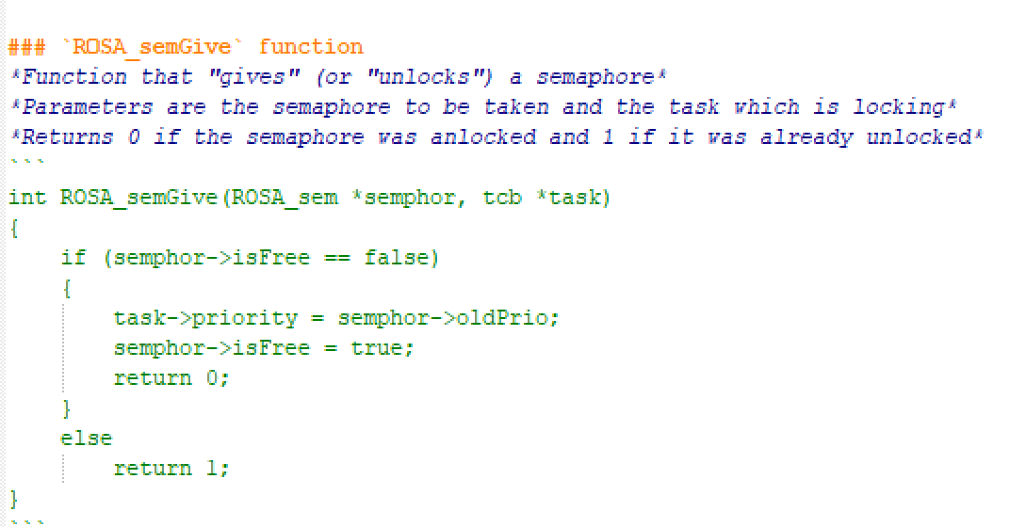
4. Andreas Mäkilä / Semaphores

Slide 14
Forecast / Questions
Sunday: API Suggestion Deadline
Question: incl. Motivation, what does it include?
Next Week: API-Seminar and start of Design Phase

Slide 15
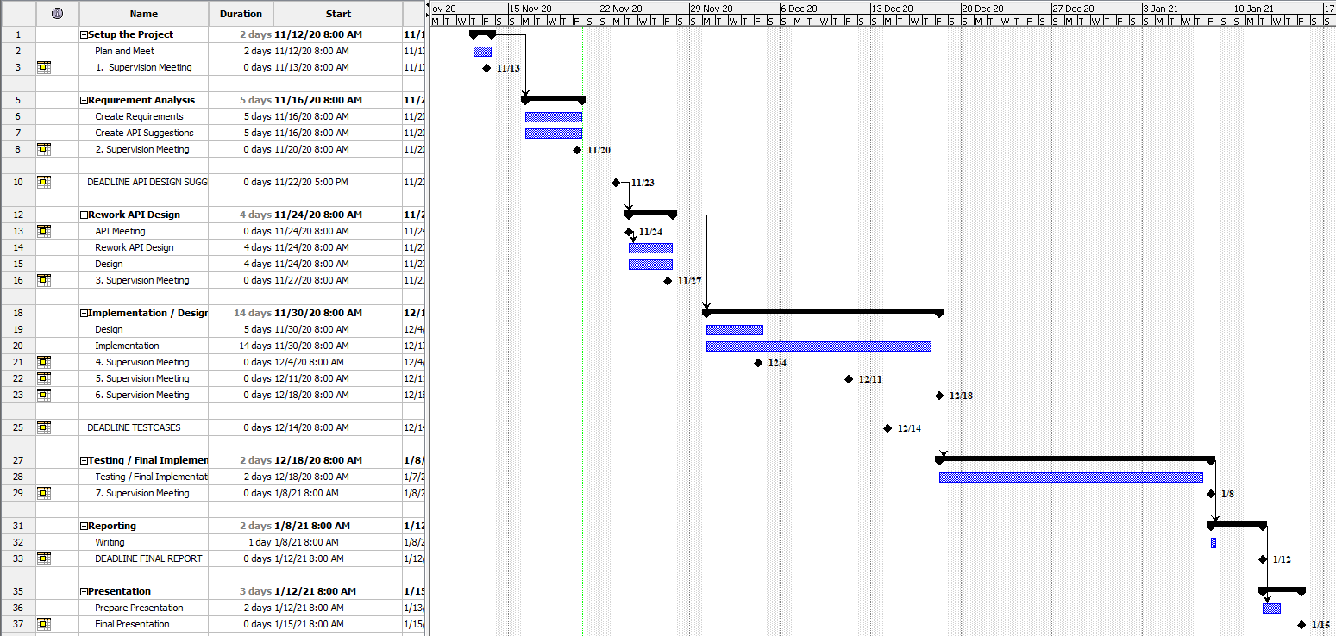
Appendix: Timeplan

Slide 16
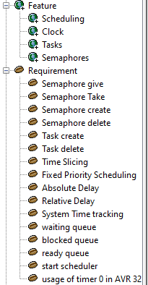
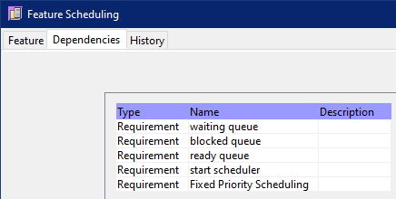
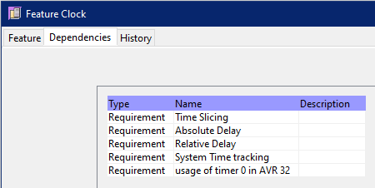
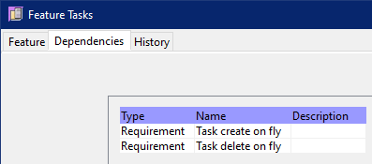
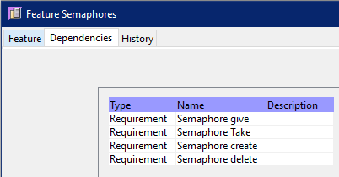
Appendix: Requirements Analysis

Slide 17
Appendix: Selected Tools
Project Management / Timeplan / Todos
Leantime
Github Project
Requirments / Testcases / Design
OSRMT
Versioning
Git
Reporting / Writing Reports
Overleaf -> Andreas is the host
Programming
Tera Term (Terminal)
Atmel Studio
Local Computer of Andreas -> setup with RDP
Communication
Virtual Whiteboard: Mural
Troubleshooting: Microsoft Teams
Talking/Meeting: Discord

Slide 18
Appendix: Roles and Rotation
Role | Responsibilities | Startperson | Rotation
Project Leader | Kanban Master, Schedule, keep track over the tools | Lukas Dust | None
Customer Contact | Contact to the Customer regarding requirements and questions Mailperson | Andreas Mäkilä | None
Developer |  | Afram Afrem | None
Developer |  | Victor Nicholas Ebirim | None
Developer |  | Aymen Nouidha

