Slide 1

3rd Supervision Meeting
04.December.2020
Afram Afrem, Andreas Mäkilä, Victor Nicholas Ebirim, Lukas Johannes Dust, Aymen Nouidha

Slide 2

Agenda
Schedule and Tasks of the Week
Design Sheet
Next Steps

Slide 3

Schedule for the last Week
Weekday | Activity
Monday | Taskmeeting: → Set the goals for the week, create and assign the tasks and responsibilities (Read API Design Suggestions) 11:30 – 12:00
Tuesday | API Design Seminar 15:15-18:00
Wednesday | Status Meeting / Presentation of API Design → Talking about the APIs → Setting of responsibilities
Thursday | Summary Meeting: Present and discuss the results of the Week Summarize the outcomes Prepare supervision meeting
Friday | Supervision Meeting: Presentation of the start of the design phase

Slide 4
Schedule for theWeek
Weekday | Activity
Monday | Taskmeeting: → Set the goals for the week, create and assign the tasks and responsibilities (Read API Design Suggestions)
Tuesday | Design Meeting
Wednesday | Design Meeting
Thursday | Design Meeting
Friday | Supervision Meeting: Presentation of the start of the design

Slide 5
Design sheet
Excel sheet
Visio Drawing

Slide 6
Aims / Assigned Tasks / Responsibilities
Person | Assigned Task / Responsibility
Aim for the Week | →API Design Start Design Phase → Finish first Design
Person | API DESIGN | Software Design
Andreas Mäkilä | Semaphores | Software Design
Aymen Nouidha | Scheduling | Software Design
Victor Ebirim | Tasks | Software Design
Lukas Dust and Afram Afrem | Clock | Software Design

Slide 7
Forecast / Questions
Next Week:
Go into dynamic implementation
Take tasks and do the implementation of the functions in cut set groups
Groupmeeting on Monday and Thursday to discuss implementation issues and review functions

Slide 8
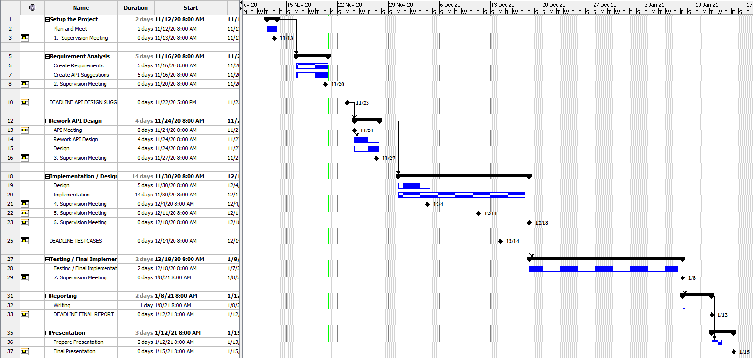
Appendix: Timeplan

Slide 9
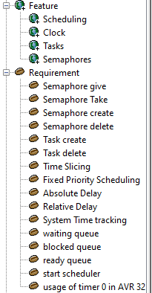
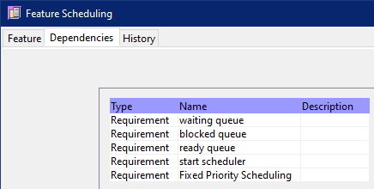
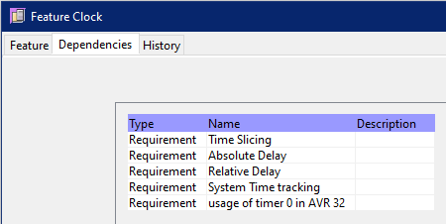
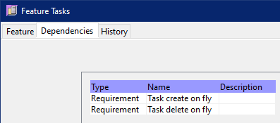
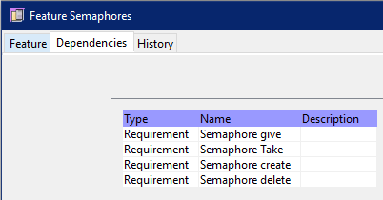
Appendix: Requirements Analysis

Slide 10
Appendix: Selected Tools
Project Management / Timeplan / Todos
Leantime
Github Project
Requirments / Testcases / Design
OSRMT
Versioning
Git
Reporting / Writing Reports
Overleaf -> Andreas is the host
Programming
Tera Term (Terminal)
Atmel Studio
Local Computer of Andreas -> setup with RDP
Communication
Virtual Whiteboard: Mural
Troubleshooting: Microsoft Teams
Talking/Meeting: Discord

Slide 11
Appendix: Roles and Rotation
Role | Responsibilities | Startperson | Rotation
Project Leader | Kanban Master, Schedule, keep track over the tools | Lukas Dust | None
Customer Contact | Contact to the Customer regarding requirements and questions Mailperson | Andreas Mäkilä | None
Developer |  | Afram Afrem | None
Developer |  | Victor Nicholas Ebirim | None
Developer |  | Aymen Nouidha

