Slide 1

4th Supervision Meeting
04.December.2020
Afram Afrem, Andreas Mäkilä, Victor Nicholas Ebirim, Lukas Johannes Dust, Aymen Nouidha

Slide 2

Agenda
Schedule and Tasks of the Week
Questions
Next Steps

Slide 3

Schedule for theWeek
Weekday | Activity
Monday | Taskmeeting: → Set the goals for the week, create and assign the tasks and responsibilities (Read API Design Suggestions)
Tuesday
Wednesday
Thursday | Discussion about changes in the design → adaption of the List, Tcb, Semaphores Create Testcases
Friday | Supervision Meeting Software Review, Final setup of TCB and SCB, rosa_utils library (for list management) Set Testcases

Slide 4
Status
Leantime

Slide 5
Questions
Is SCB part of the API / May we add prevPrio to it ? (we can remove running priority)
Add pointer in scb to tcb which blocks the semaphore
Do we need to implement test cases in .c files?
Name convention for tcb?

Slide 6
Forecast / Questions
Next Week:
Continue dynamic implementation
Merge all functions
Groupmeeting on Monday, Tuesday, Wednesday and Thursday to discuss implementation issues and review functions

Slide 7
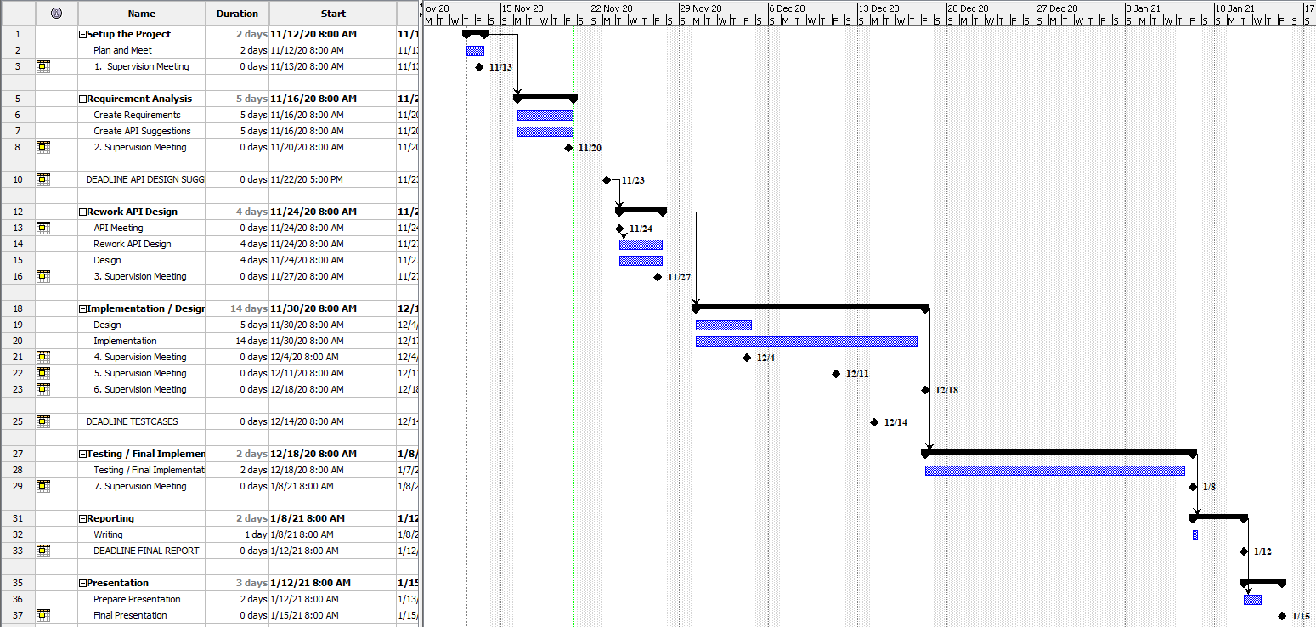
Appendix: Timeplan

Slide 8
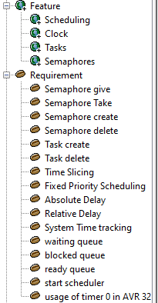
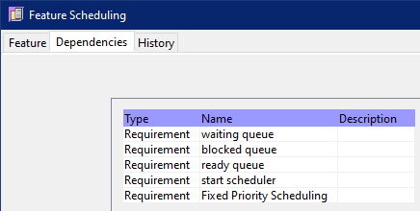
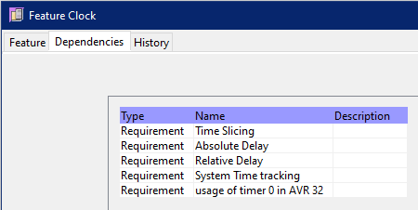
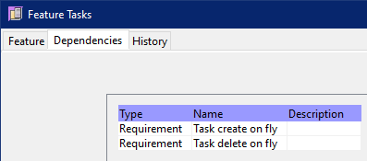
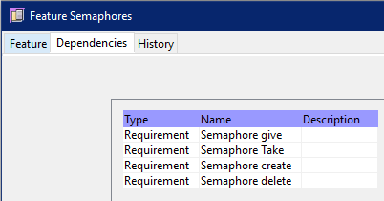
Appendix: Requirements Analysis

Slide 9
Appendix: Selected Tools
Project Management / Timeplan / Todos
Leantime
Github Project
Requirments / Testcases / Design
OSRMT
Versioning
Git
Reporting / Writing Reports
Overleaf -> Andreas is the host
Programming
Tera Term (Terminal)
Atmel Studio
Local Computer of Andreas -> setup with RDP
Communication
Virtual Whiteboard: Mural
Troubleshooting: Microsoft Teams
Talking/Meeting: Discord

Slide 10
Appendix: Roles and Rotation
Role | Responsibilities | Startperson | Rotation
Project Leader | Kanban Master, Schedule, keep track over the tools | Lukas Dust | None
Customer Contact | Contact to the Customer regarding requirements and questions Mailperson | Andreas Mäkilä | None
Developer |  | Afram Afrem | None
Developer |  | Victor Nicholas Ebirim | None
Developer |  | Aymen Nouidha

