Slide 1

5th Supervision Meeting
04.December.2020
Afram Afrem, Andreas Mäkilä, Victor Nicholas Ebirim, Lukas Johannes Dust, Aymen Nouidha

Slide 2

Agenda
Schedule and Tasks of the Week
Questions
Next Steps

Slide 3

Schedule for theWeek
Weekday | Activity
Monday | Taskmeeting: →Testcases and get USART Working
Tuesday | Meeting to upload and discuss the testcases
Wednesday
Thursday | Discussion about the basic system and adoptions
Friday | Supervision Meeting Adoptions of the system

Slide 4
Questions
Two tasks with same priority and yield/interrupt, should the other one execute?
Fixed priority (Victor)?
Sem?
Periodically check for getting sem or just giving up?

Slide 5
Forecast / Questions
Next Week:
Releasing of semaphores while deleting tasks
Time slicing? Not needed
Semaphore nesting
Semaphore get cyclic wait
FPPS algorithm, scheduling regarding systickdelay, delayuntil→ Waiting for the response
Yield problem?
Testing with Testcases

Slide 6
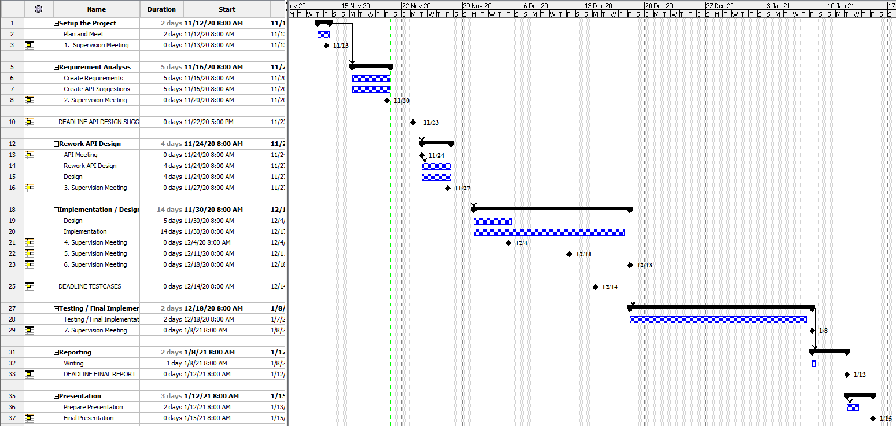
Appendix: Timeplan

Slide 7
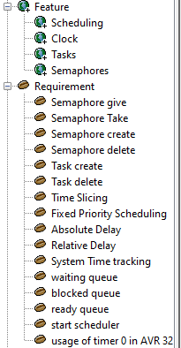
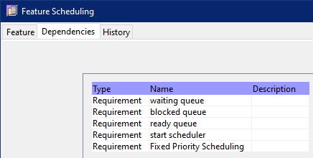
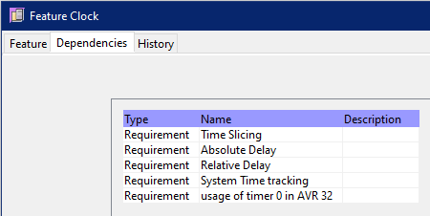
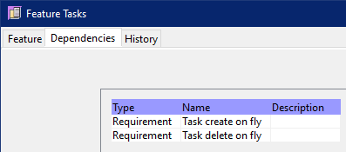
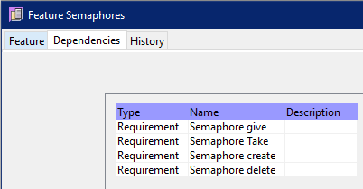
Appendix: Requirements Analysis

Slide 8
Appendix: Selected Tools
Project Management / Timeplan / Todos
Leantime
Github Project
Requirments / Testcases / Design
OSRMT
Versioning
Git
Reporting / Writing Reports
Overleaf -> Andreas is the host
Programming
Tera Term (Terminal)
Atmel Studio
Local Computer of Andreas -> setup with RDP
Communication
Virtual Whiteboard: Mural
Troubleshooting: Microsoft Teams
Talking/Meeting: Discord

Slide 9
Appendix: Roles and Rotation
Role | Responsibilities | Startperson | Rotation
Project Leader | Kanban Master, Schedule, keep track over the tools | Lukas Dust | None
Customer Contact | Contact to the Customer regarding requirements and questions Mailperson | Andreas Mäkilä | None
Developer |  | Afram Afrem | None
Developer |  | Victor Nicholas Ebirim | None
Developer |  | Aymen Nouidha

