Slide 1

Consomi Tounsi
Beji Abdallah, Ben Mansour Khawla , Dekhili sarra, Mattoussi Manel, Ouertani Aymen

Slide 2
TABLE OF CONTENTS
01
04
Introduction
Demonstration
02
Product presentation
05
Marketing
03
06
Promise
Conclusion

Slide 3

01
Introduction
Notes:
Bech na7ki 3ala les e commerce elli kima consomi tounsi w chniya machekilhom (les points faibles mte3hom )

Slide 4

02
Product presentation
Notes:
Bech na7ki 3ala les e commerce elli kima consomi tounsi w chniya machekilhom (les points faibles mte3hom )

Slide 5

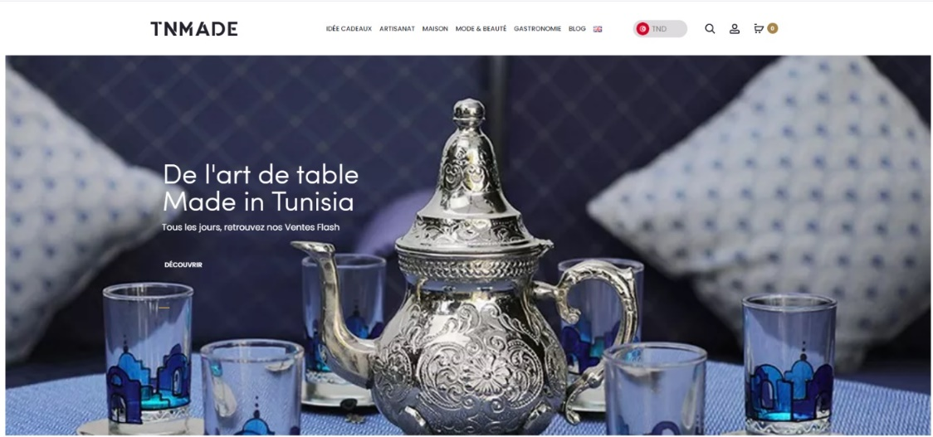

Study of existing

Slide 6

Problematic
No chance of shining and being recognized by local communities
In Tunisia, this development is still advancing so slowly and incomparable with what is happening in other more developed countries.

Slide 7

Client requirment
Online shopping application
100% Tunisian products
Home delivery
Variety of product
Availibility 24/7

Slide 8
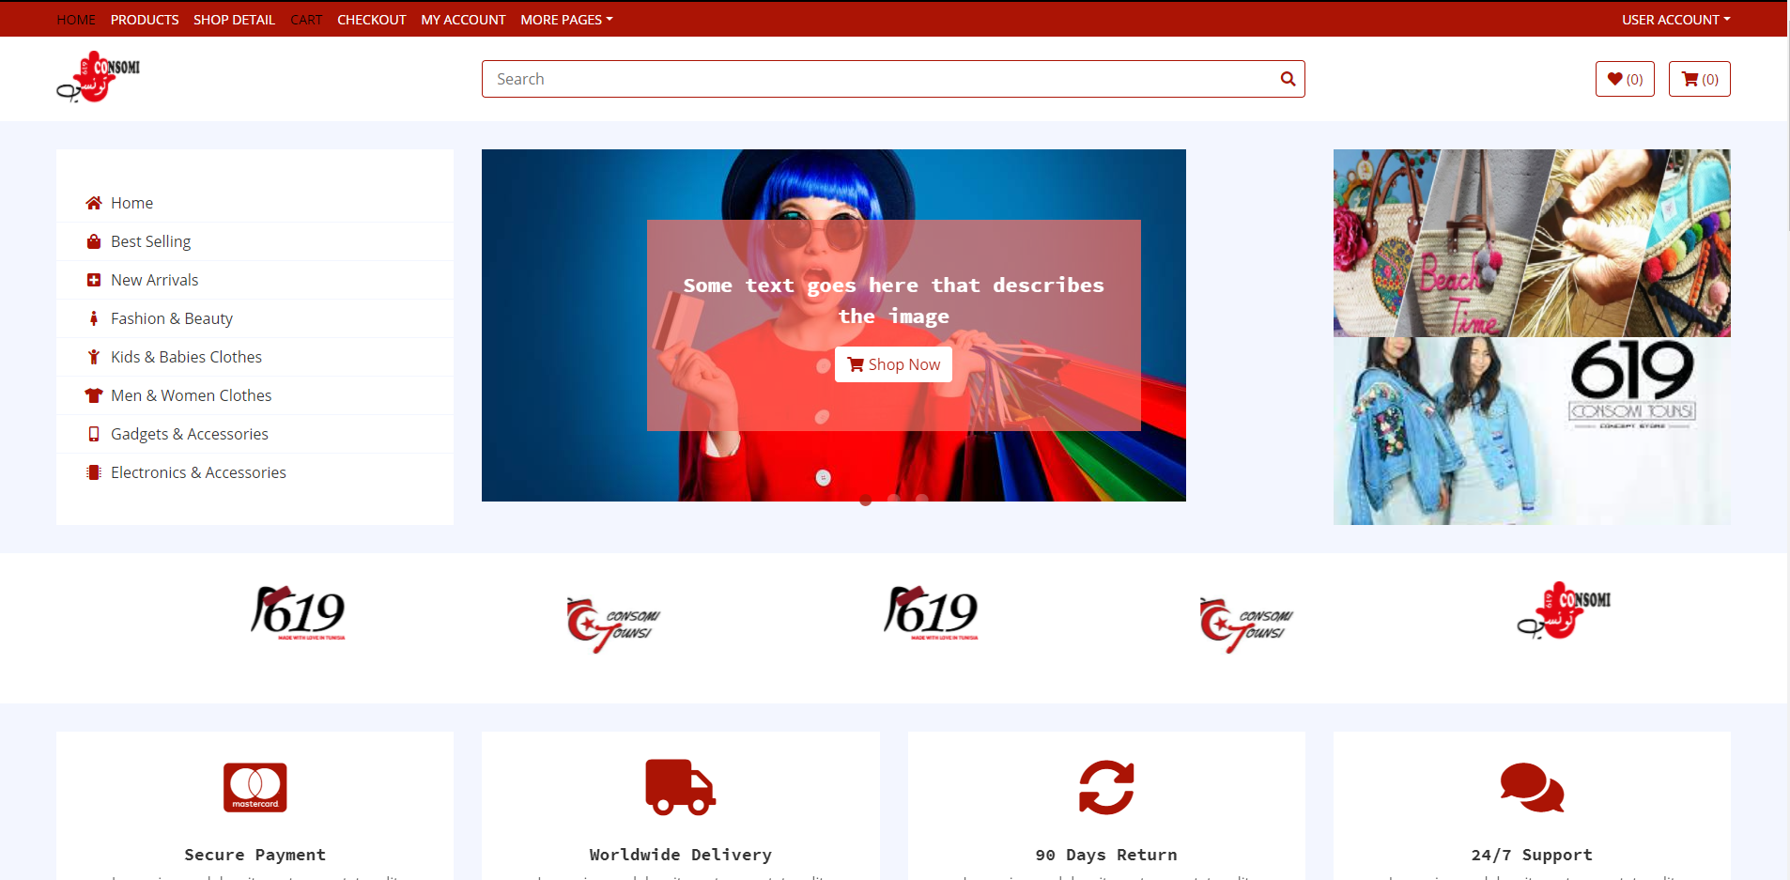
Solution

Slide 9

Promise
sale 100% tunisian product
Ensure the online sale
Customer loyalty
Ensuring permanent, communication with the client

Slide 10

04
Demonstration
Notes:
Bech na7ki 3ala les e commerce elli kima consomi tounsi w chniya machekilhom (les points faibles mte3hom )

Slide 11

Delivery Management

Slide 12

Claim Management

Slide 13
User Management

Slide 14

Sale Management

Slide 15
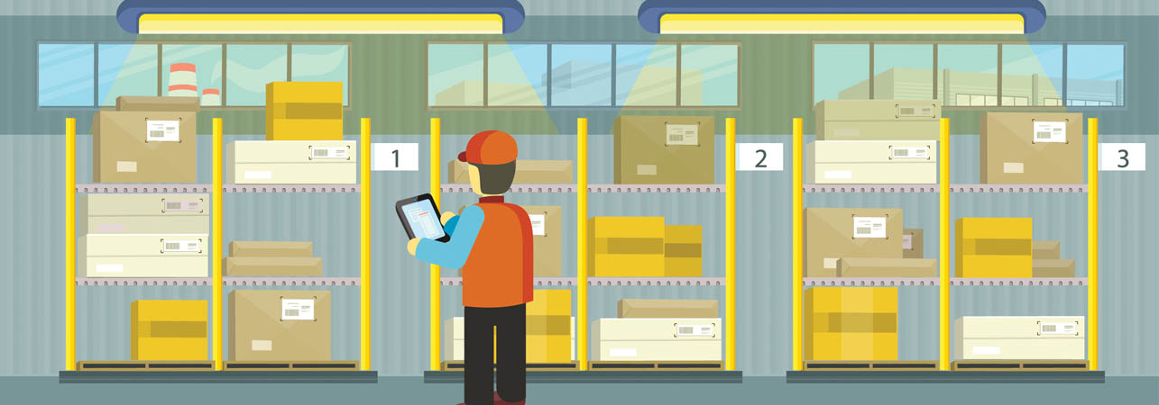
Stock Management

Slide 16
Aisel Management

Slide 17
Product Management

Slide 18
Ads Management

Slide 19
Event Management

Slide 20

05
Marketing
Notes:
Bech na7ki 3ala les e commerce elli kima consomi tounsi w chniya machekilhom (les points faibles mte3hom )

Slide 21

Poster

