Slide 1


Hyper representations for Effecient Continual Learning
Keywords :
-Persistent Homology
-Optimal Transport
-Pruning / Distillation
-Automated Machine Learning
-Meta learning
-Category theory
1st year phD student:
Aymen Tlili
Supervising Professor : Bassem Ben Hamed
Thanks to the hosting Lab:

Slide 2
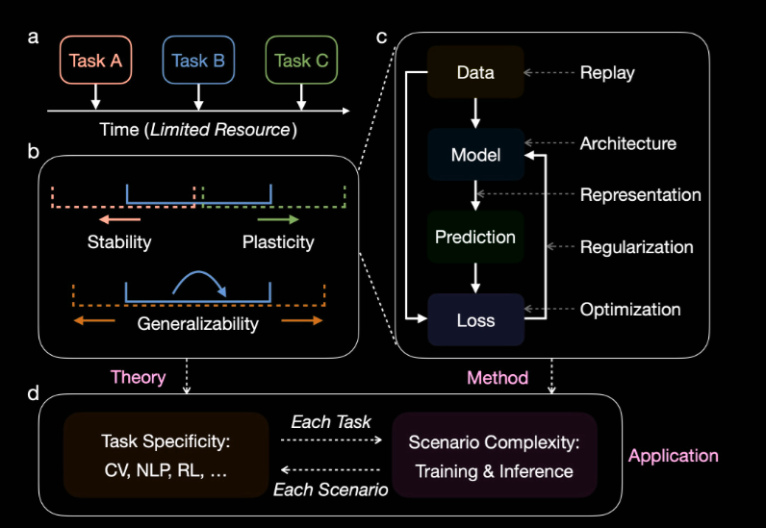
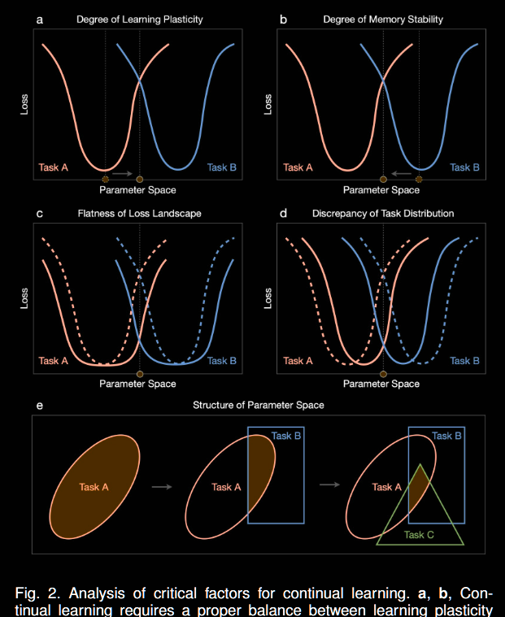
Table of content
What are hyper –representations
Current Methodology
Classical Topological Data Analysis
Optimal Transport relevance
Multi parameter Persistent Homology
Loss Functions and effects on Training
Other Approachs:
Rnadom matrix Theory
Neural Tangeant Kernel
Fourrier analysis of gradients
Time-series Segmentation

Slide 3
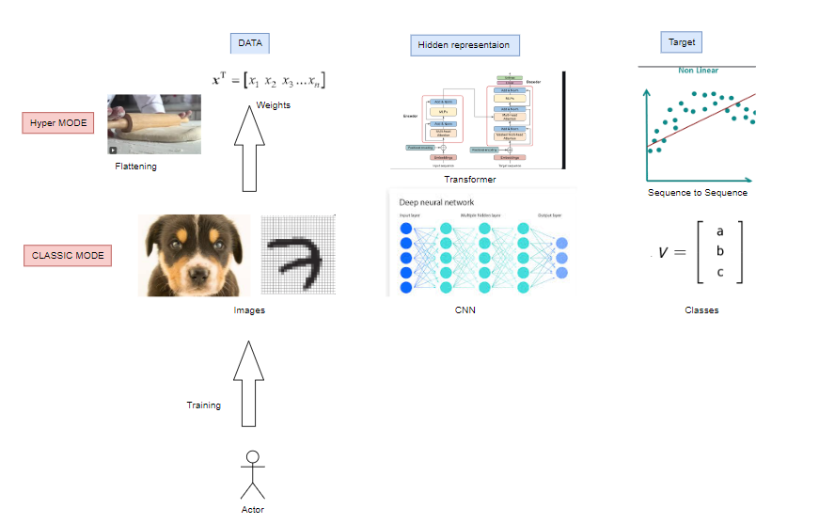
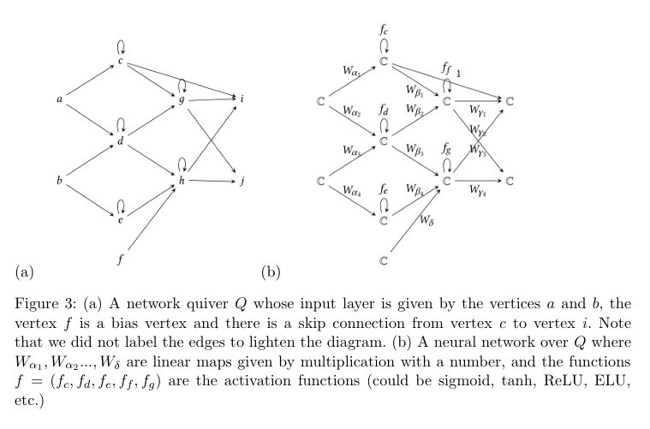
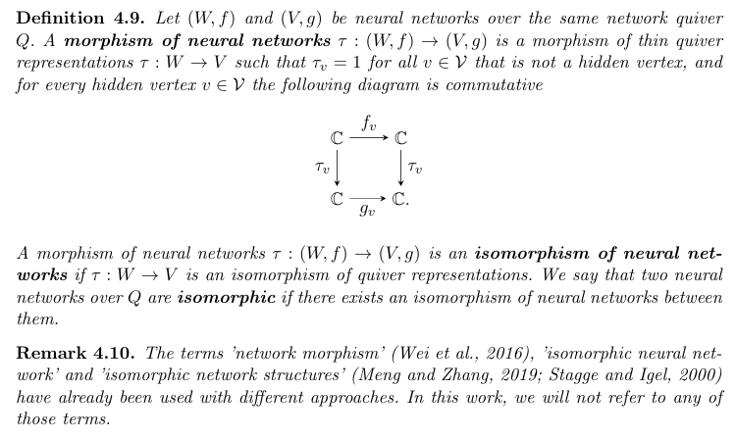
What are hyper –representations

Slide 4
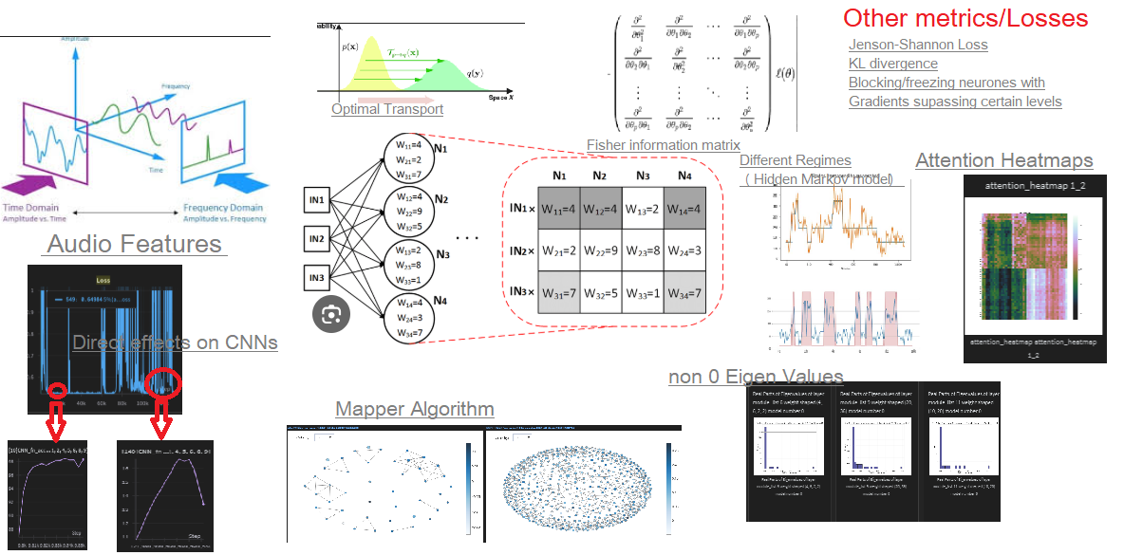

Slide 5
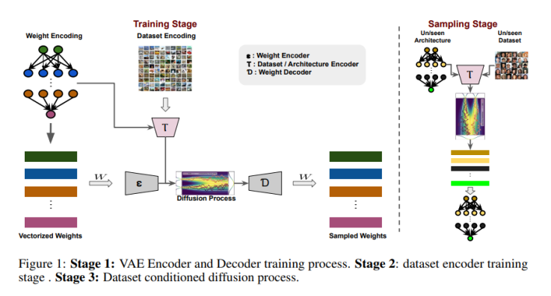
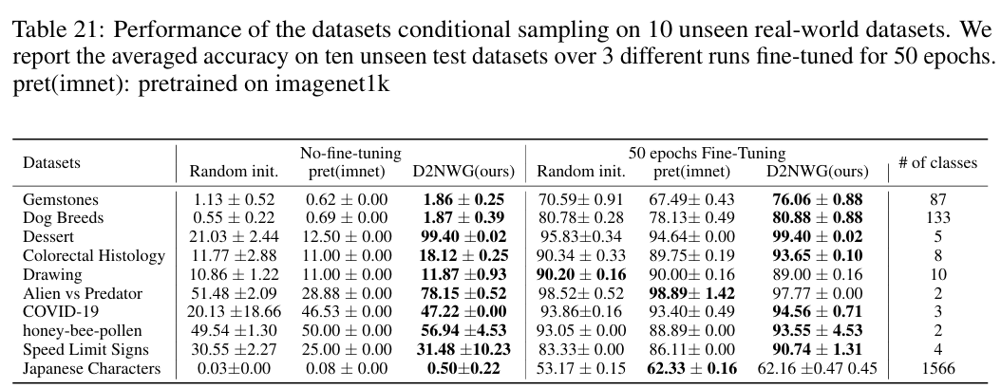
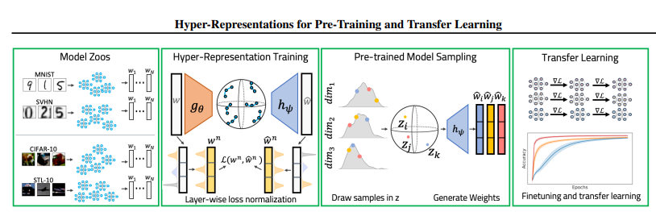
Current Methodology
DIFFUSION-BASED NEURAL NETWORK
WEIGHTS GENERATION ( Soro Bedionita1 2024)
(Konstantin Schurholt 2022)

Slide 6
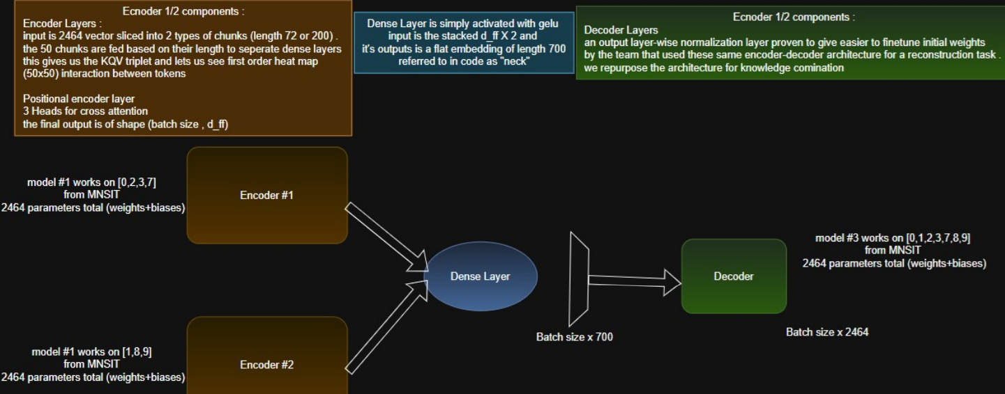
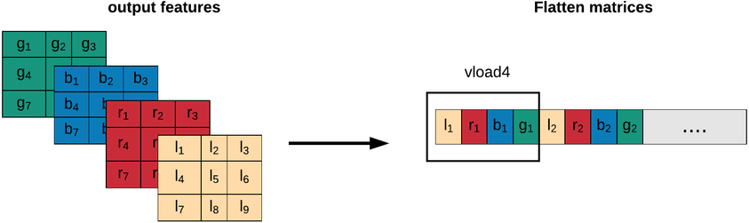


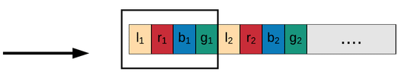

Slide 7
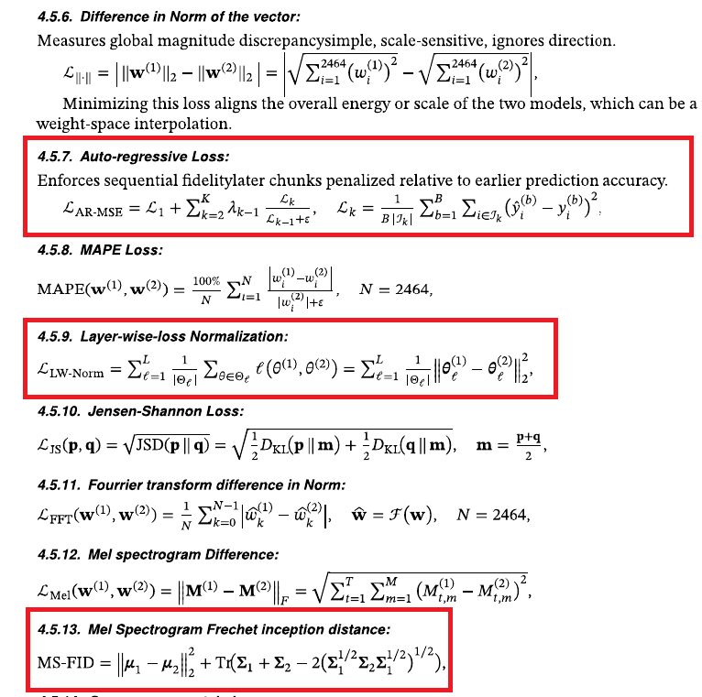
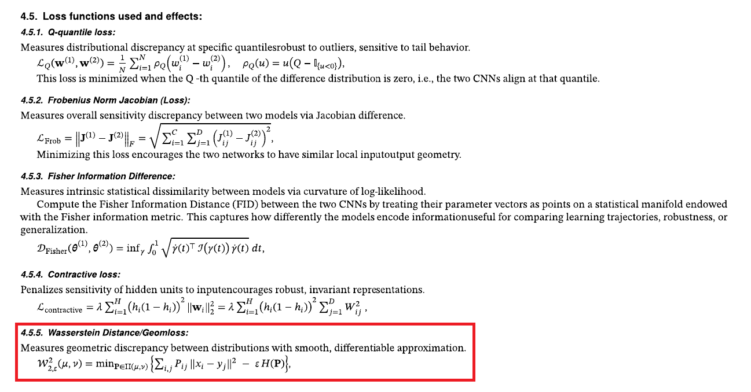

Slide 8
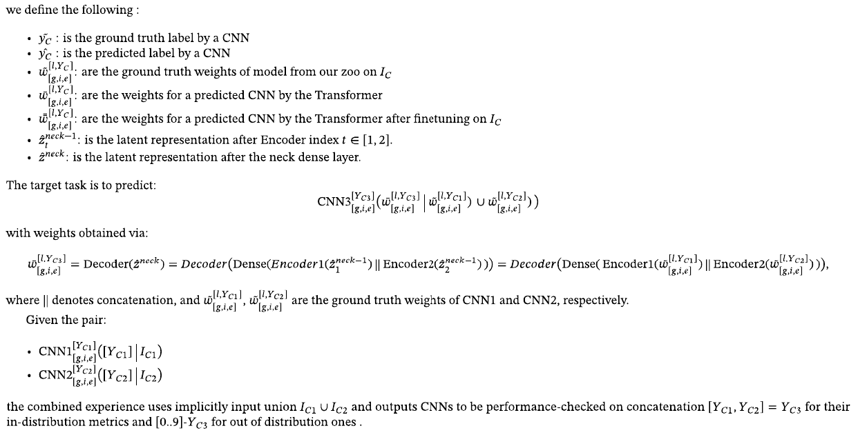

Slide 9
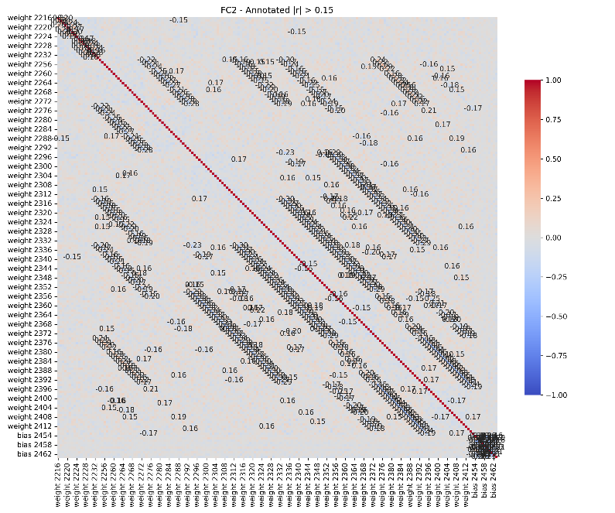
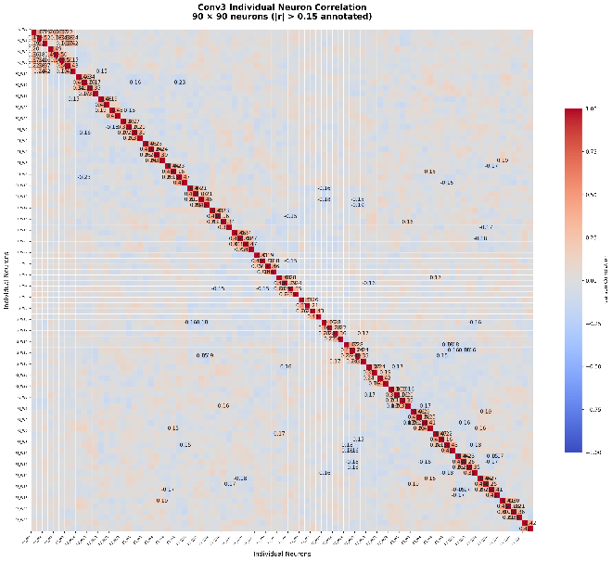
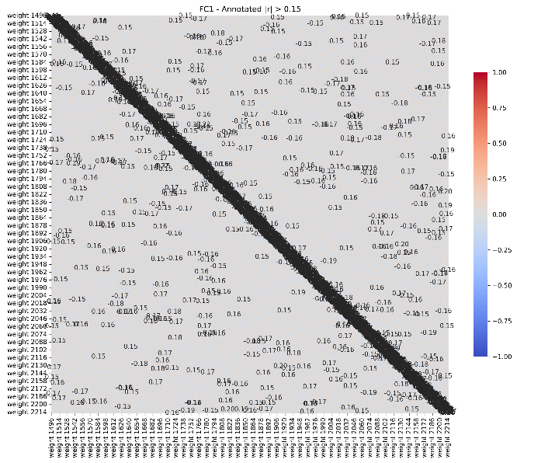
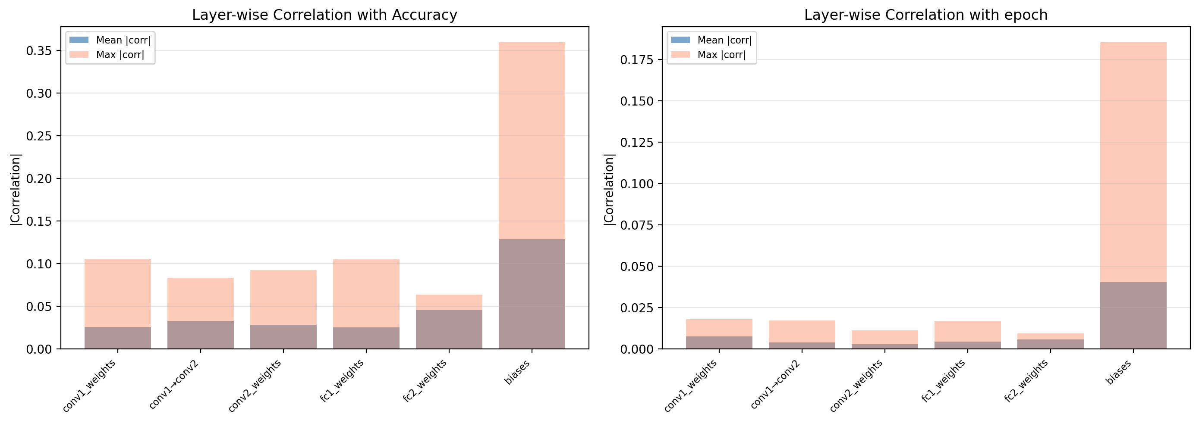
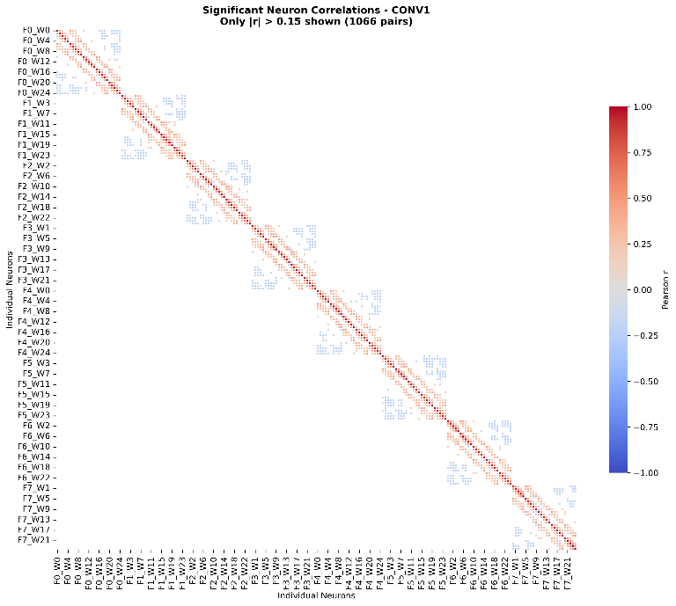
Pearson correlation for Dense layer weights

Slide 10
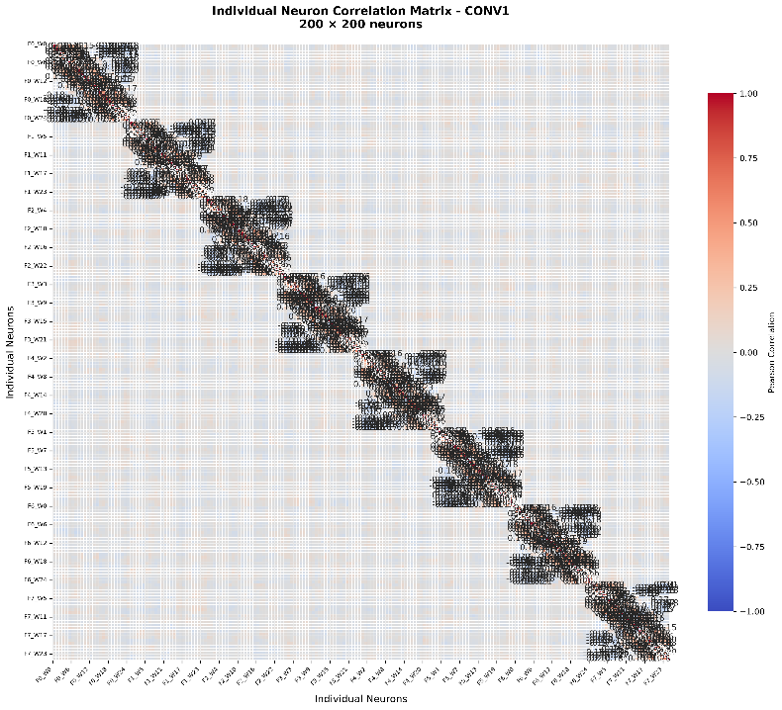
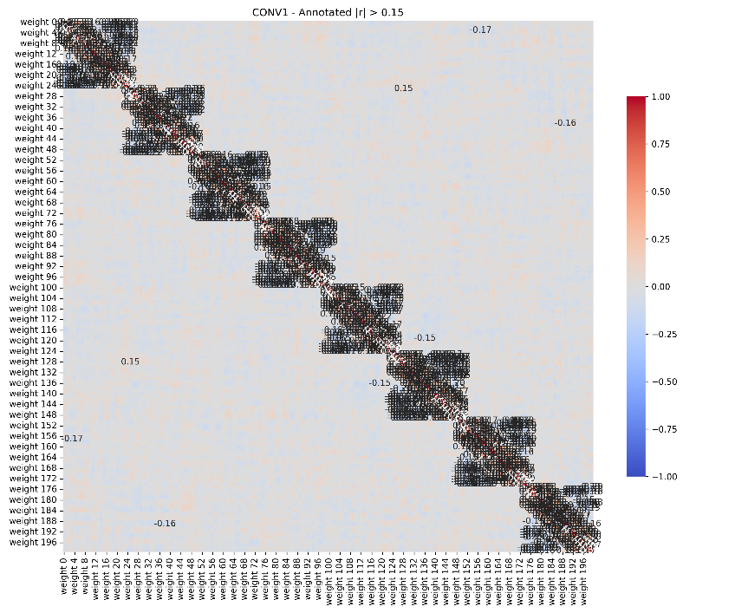
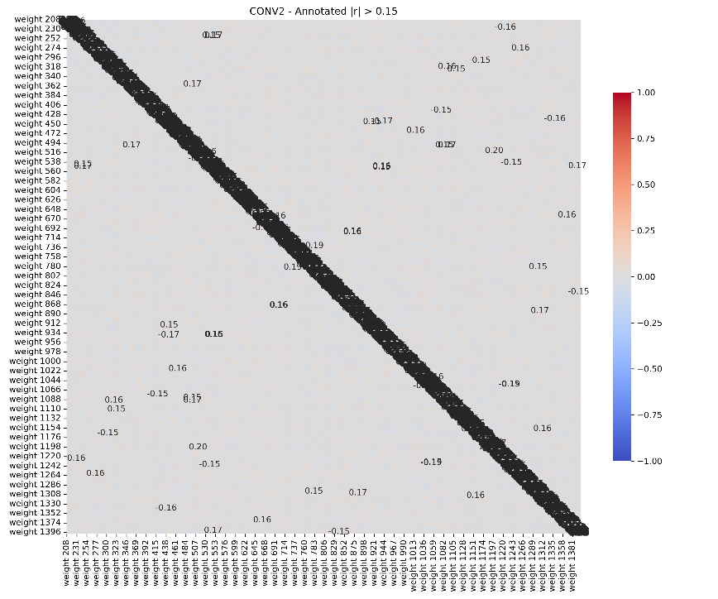
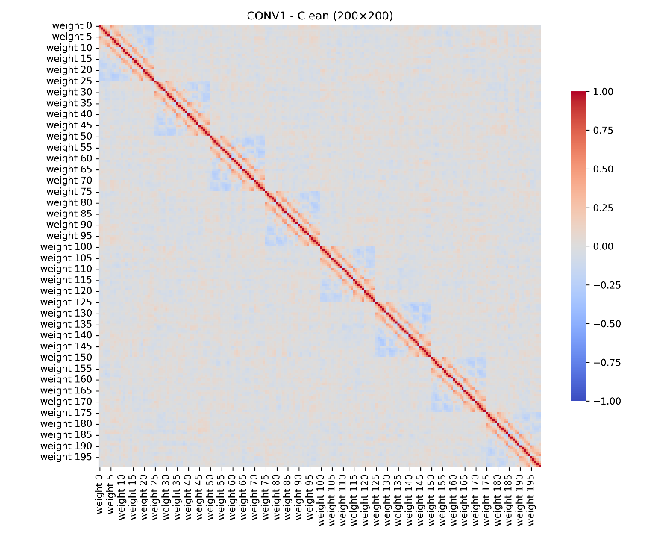
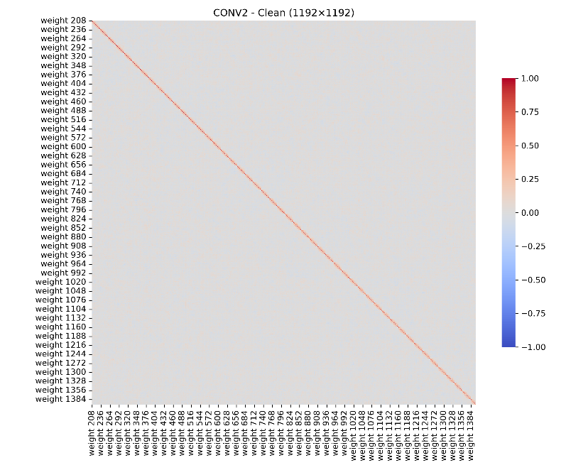

Slide 11
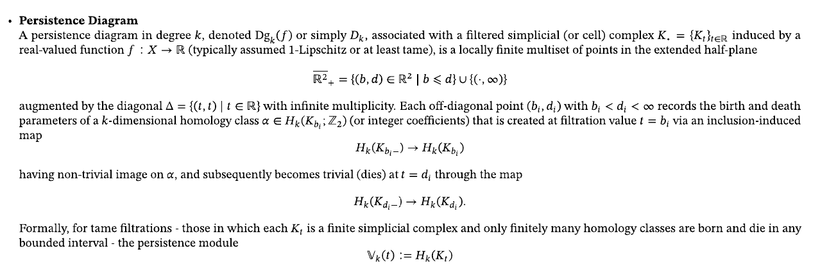
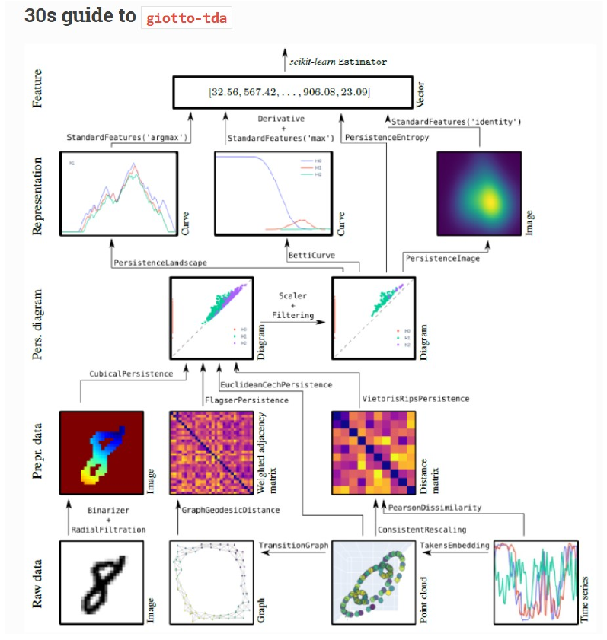
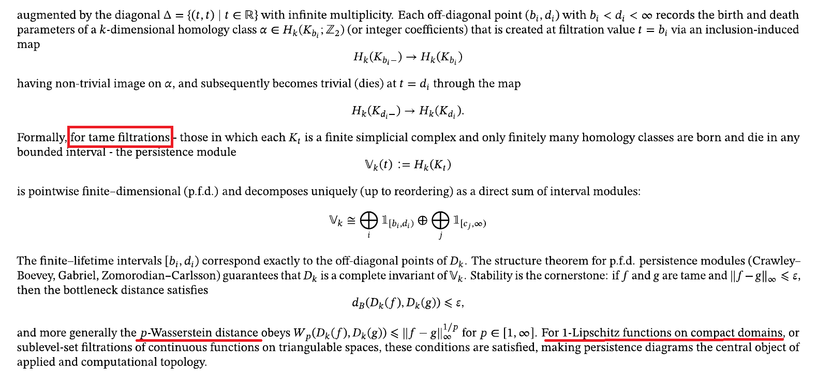
Classical Topological Data Analysis

Slide 12
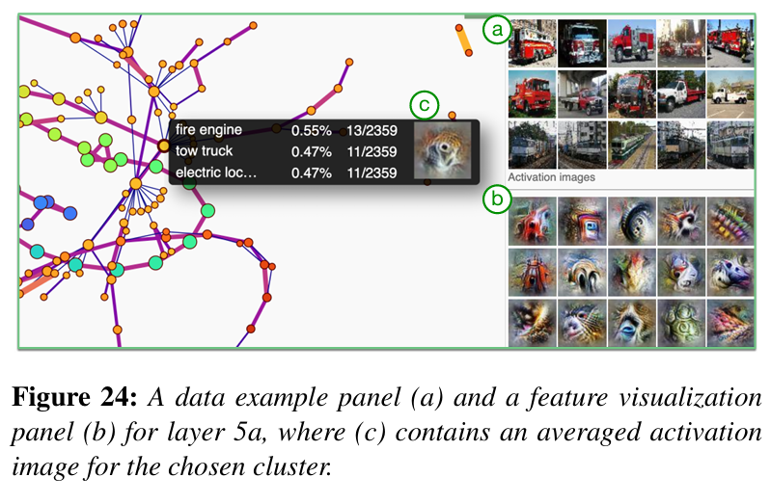
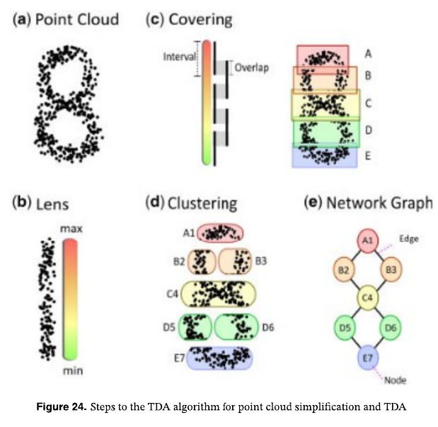
Mapper algorithm

Slide 13
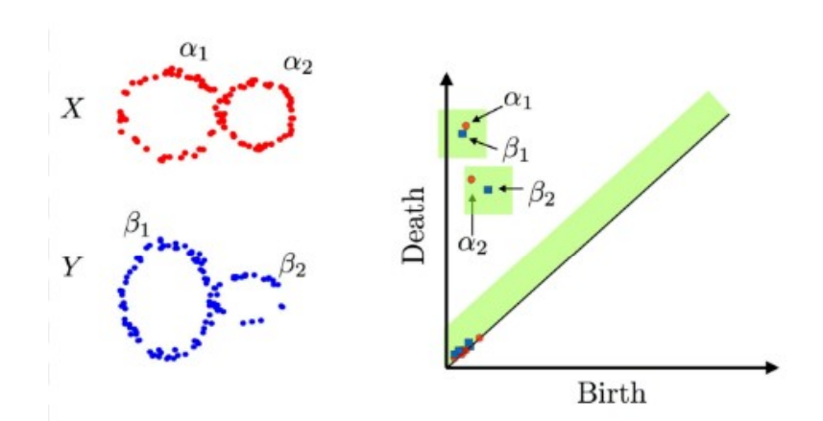
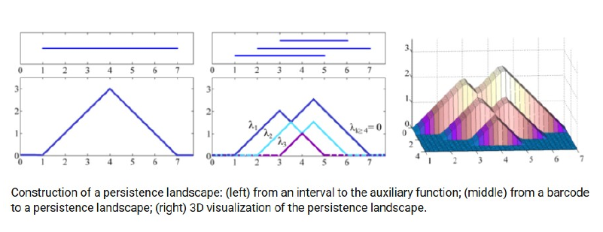
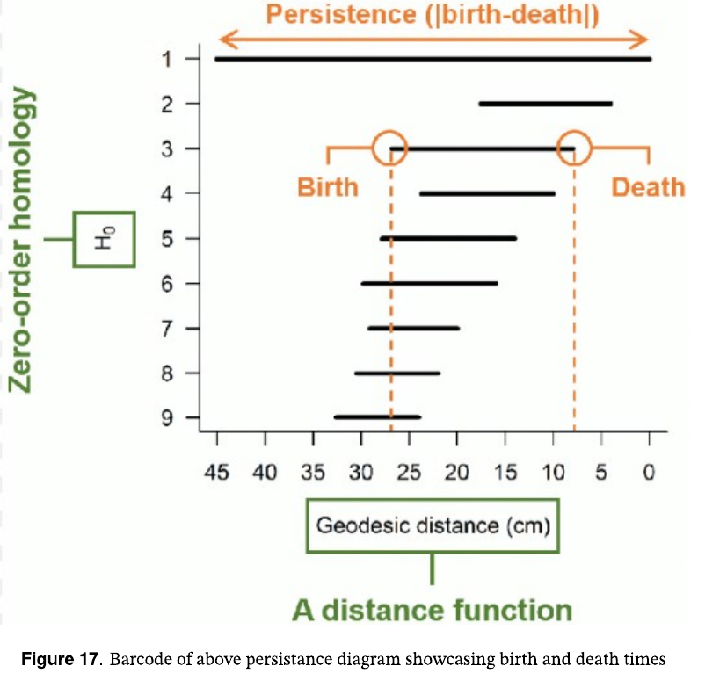
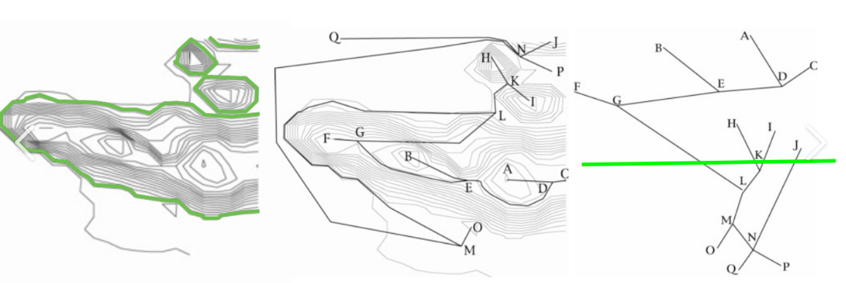
(1)Persistance Diagrams
(2)Barcode diagrams
(3)Peristance Landscape
(4)Contour Trees

Slide 14
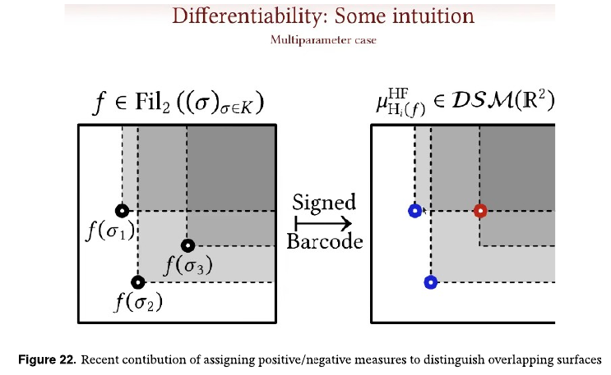
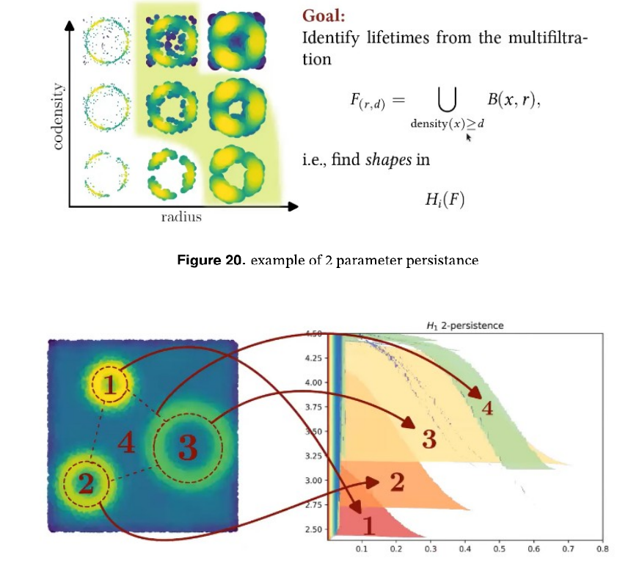
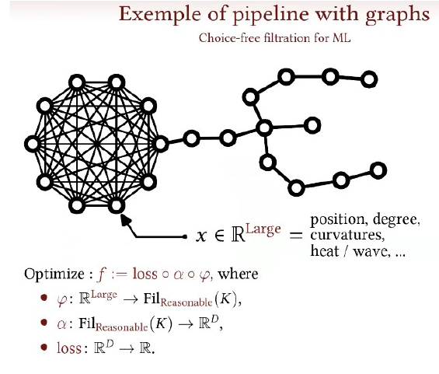
Multi parameter Persistent Homology

Slide 15
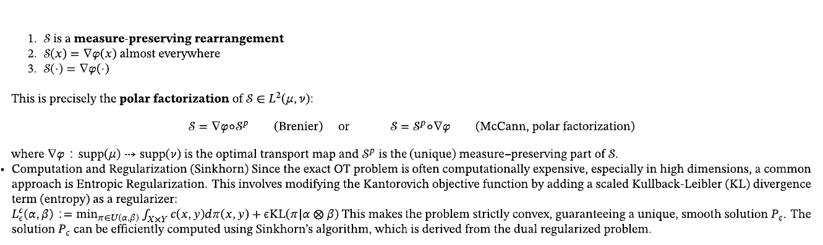
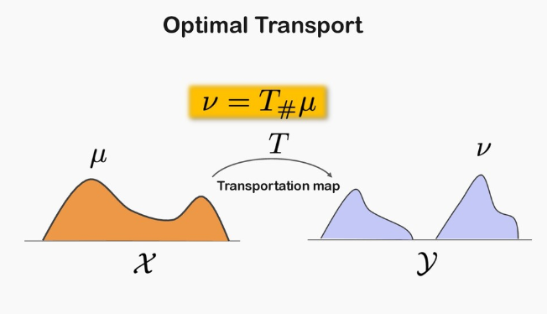
Optimal Transport relevance

Slide 16
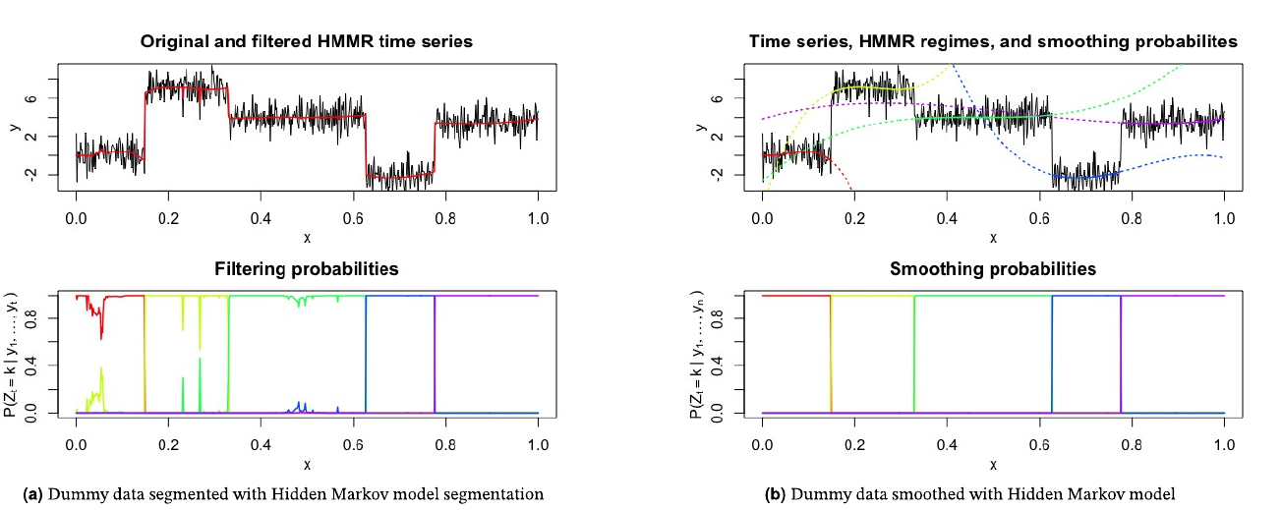
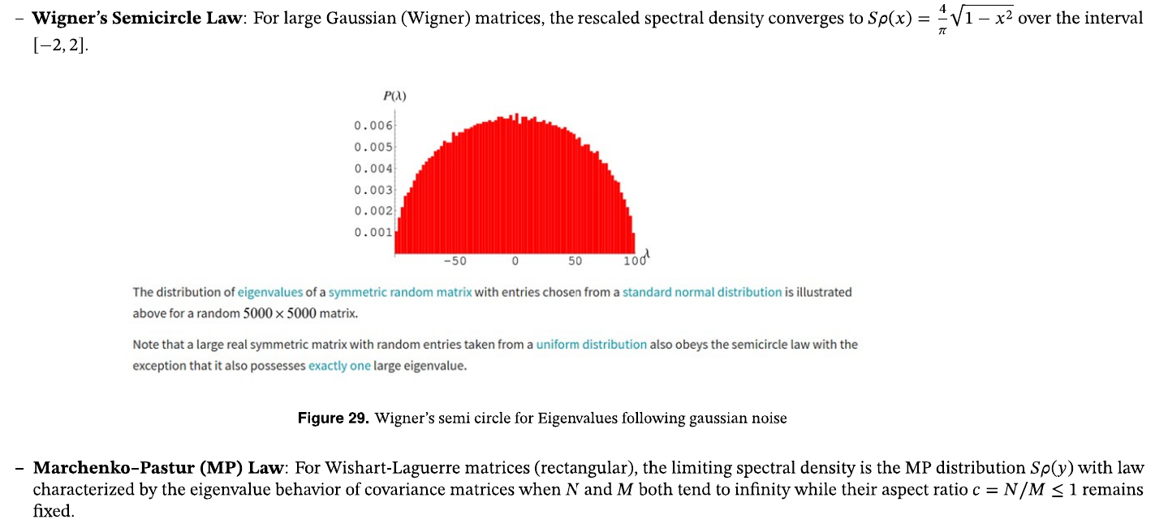
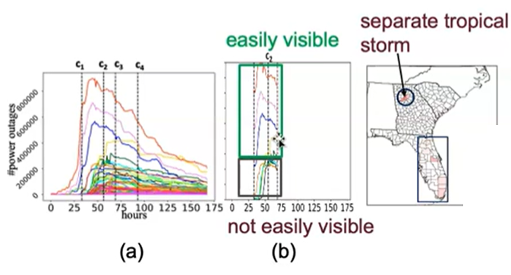
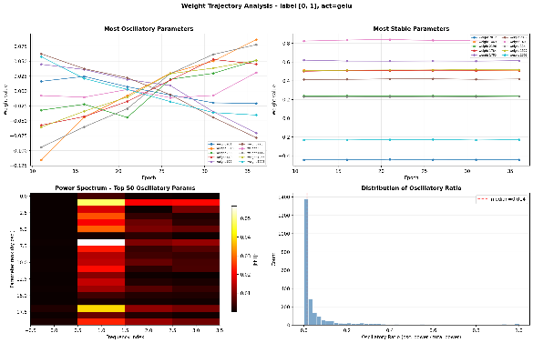
Other Approachs:
Rnadom matrix Theory
Neural Tangeant Kernel
Time-series Segmentation
Fourrier analysis of gradients

Slide 17
Thank You for your attention
and Ramadhan Mubarak !

Slide 18
Refrences
Y. Brenier, “Polar factorization and monotone rearrangement of vector-valued functions”, Communications on Pure and Applied Mathematics, vol. 44, no. 4, pp. 375-417, Jun. 1991, IsSN: 0010-3640, 1097-0312. DOT: 10.1002/cpa. 3160440402
G. Carlsson and R. B. Gabrielsson, Topological Approaches to Deep Learning, Nov. 2018. DOT: 10.48550/arXiv.1811.01122 arXiv: 1811.01122 [cs]. Accessed: Nov. 24,2025.
C.Chen, X. Ni, Q. Bai, and Y. Wang, A Topological Regularizer for Classifiers via Persistent Homology, Oct. 2018. DOI: 10.48550/arXiv.1806.10714 arXiv: 1806.10714 [cs].
B Rieck et al., “Neural Persistence: A Complexity Measure for Deep Neural Networks Using Algebraic Topology”, in International Conference on Learning Representations, Sep. 2018. Accessed: Nov. 16, 2025.
D. Loiscaux, L. Scoccola, M. Carrire, M. B. Botnan, and S. Oudot, Stable Vectorization of Multiparameter Persistent Homology using Signed Barcodes as Measures, Comment: 26 pages, 4 figures, 9 tables; v2: final version in NeurIP$ 2023, Feb. 2024. DOI: 10.48550/arXiv.2306.03801 arXiv: 2306.03801 [cs]. Accessed: Nov. 16, 2025.
Optimal Transport - Weak Solutions of Monge-Ampere - YouTube, htps:/ /www.youtube.com/watch?v=mmpyxStCoqUélist=PLI6garKOIK2qKVhRm6UwveQ46wK- ciHbl&index=13,

Slide 19
R.B. Gabrielsson and G. Carlsson, Exposition and Interpretation of the Topology of Neural Networks, Oct. 2019. DOI: 10.48550/arXiv.1810.03234 arXiv: 1810.03234 [cs]. Accessed: Sep. 20, 2024.
G. Naitzat, A. Zhitnikov, and L.-H. Lim, Topology of deep neural networks, Comment: 34 pages, 22 figures, Apr. 2020. DOI: 10.48550/arXiv.2004.06093 arXiv: 2004.06093 [cs].
M. Gabella, “Topology of Learning in Feedforward Neural Networks”, IEEE Transactions on Neural Networks and Learning Systems, vol. 32, no. 8, PPp. 3588-3592, Aug. 2021, ISSN: 2162-2388. DOI: 10.1109/TNNLS.2020.3015790
Stanford Online, Stanford CS224N NLP with Deep Learning | Winter 2021 | Lecture 9 - Self- Attention and Transformers, Oct. 2021.
S. Zhou, E. Zelikman, F. Lu, A. Y. Ng, G. Carlsson, and S. Ermon, Evaluating the Disentanglement of Deep Generative Models through Manifold Topology, Mar. 2021.
D. Loiseaux, L. Scoccola, M. Carriére, M. B. Botnan, and S. Oudot, “Stable Vectorization of Multiparameter Persistent Homology using Signed Barcodes as Measures”,

