Slide 1

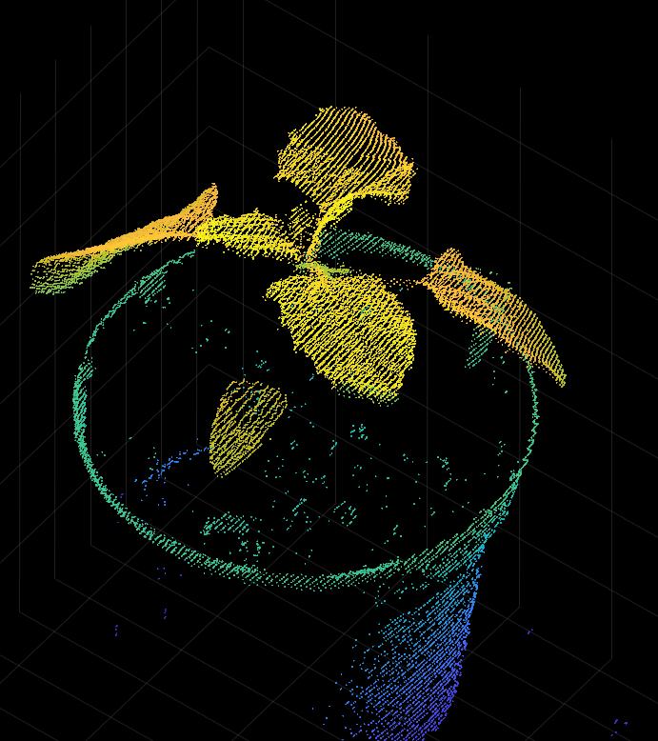
Constructing leaf and plant models from scanned 3d point cloud data
-Washim S. Neupane

Slide 2
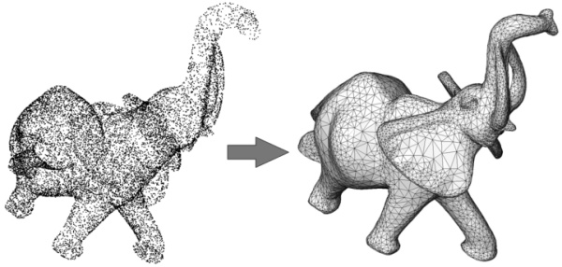
Introduction
Many applications in engineering and science need to build accurate digital models of real-world objects defined in terms of point cloud data, i.e. a set of scattered points in 3D
Using modern 3D scanners, it is possible to acquire point clouds containing millions of points sampled from an object. The process of building a geometric model from such point clouds is usually referred to as surface reconstruction.

Slide 3
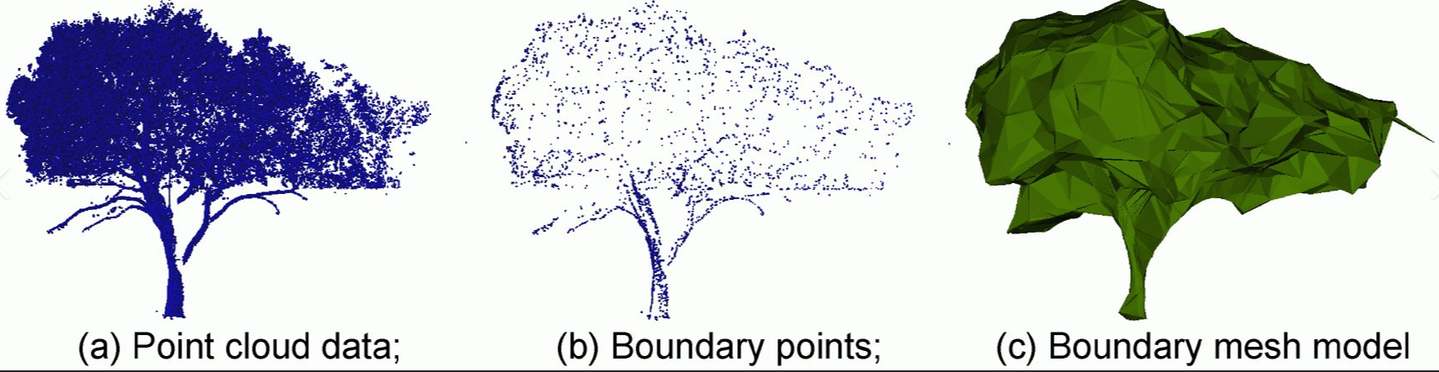
Problem description
For this project, we are particularly working on surface reconstruction of plant models.
Producing realistic plant models is important for several applications in plant science. For instance, in order to understand and improve agrichemical spray efficacy, simulated drops can be sprayed on virtual leaves, and the droplet impaction, spreading and absorption behaviors can be studied.
This requires that the mathematical surfaces of our virtual plant is very similar to the real plant on which it is based.

Slide 4
OBJECTIVES of this research
MAJOR: Investigate the use of Radial Basis Functions(RBF’s) to generate an interpolating surface from the scanned point cloud data of several plant species.
MAJOR: Test different methods for pre-processing of the data and investigate the factors that would result in the most realistic surface reconstruction.
PRIORITY: Generate a full surface reconstruction for at least one of the species of plants based on the tested methods.
MINOR: Generate realistic stems for the virtual plant models.
MINOR: Generate realistic branches for the virtual plant models.

Slide 5
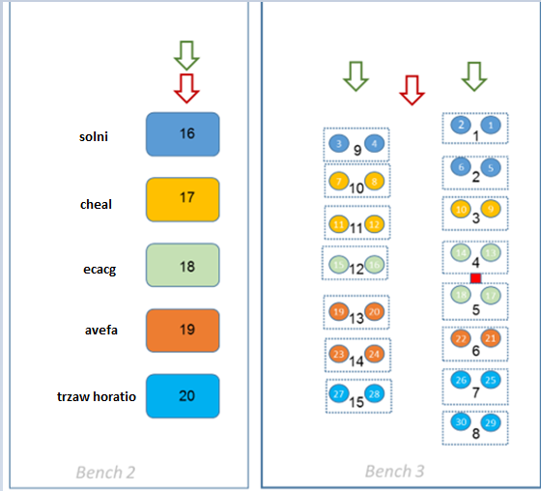
About THE DATASET
Dataset provided by: Cranfield University, School of Water, Energy and Environment, Cranfield, MK43 0AL
Data was captured using Agri-EPI LemnaTec sensor gantry with 3D laser scan point cloud, high resolution RGB and VNIR hyperspectral (380-1000 nm with 935 spectral bands).
6 replicates of each species were scanned, plus the remaining plants in the tray. Plants where initially laid out on a single bench in the following configuration:
The plants where spaced due to their height. This allowed improved capture from the angled laser scanner:

Slide 6
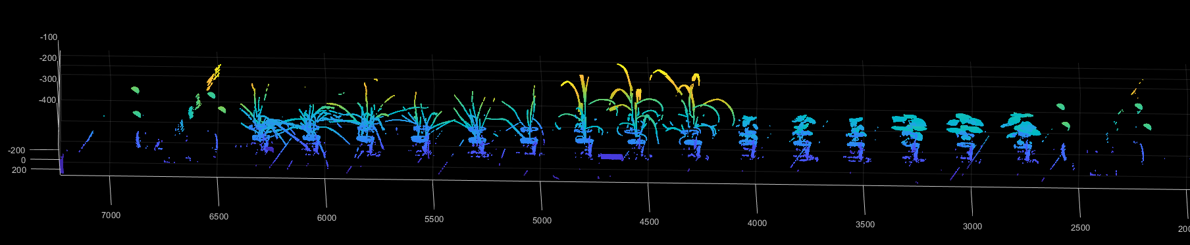
ABOUT THE DATASET
For this project, we only focus on one species in particular as a priority. However, it was unsure if methodology used for this species would be applicable across all species and must be further investigated.
The data-set used is the LASER scan of the plants species ‘Chenopodium’ scanned on 2018-7-19.
Two sets of scanned laser data (scanned from front and back) are available. The first step in pre-processing of the data is to combine these two dataset.

Slide 7
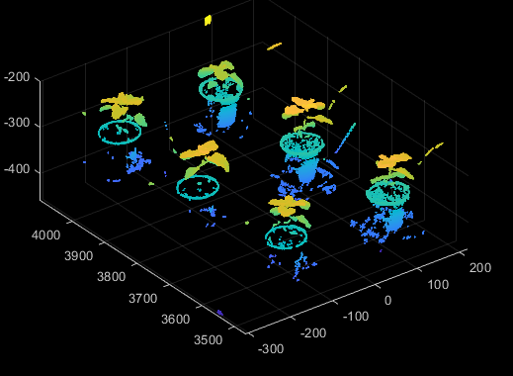
REGION OF INTEREST (ROI)
The species ‘Chenopodium’ is the plant that we want to prioritize . This plant is provided for in the region x=3450 to 4100.
One way of defining this region is to simply manually get the segment
i.e. ROI = Species(3450<X<4100, all Y , all Z).
Another method was also tested with K-means algorithm using another test dataset. However, we identified issues where some dataset get mislabeled because of the structure of the leaves.

Slide 8
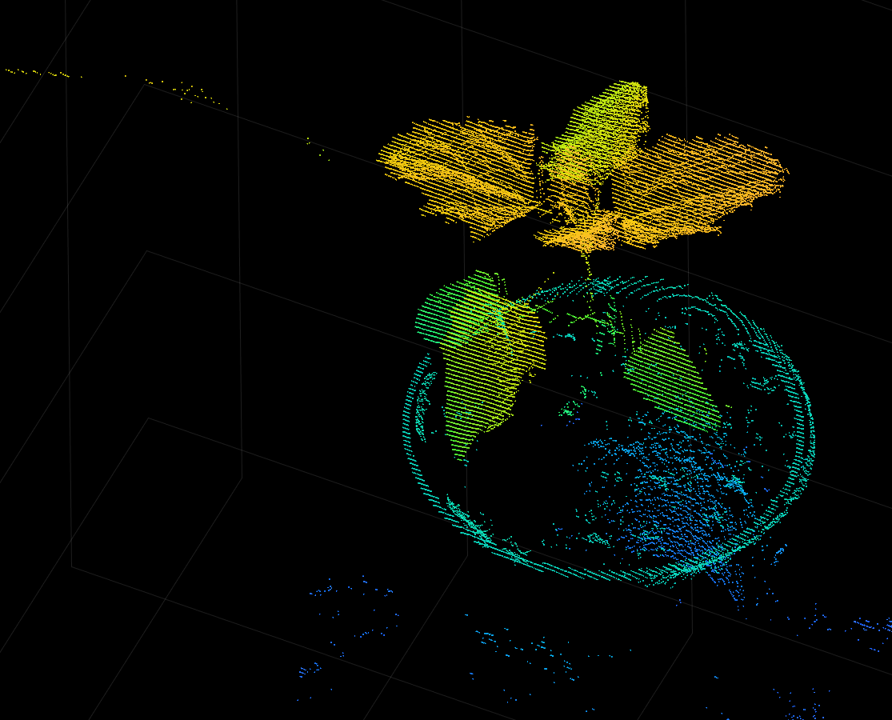
Separating each plant within rOI
The plant has relatively broad and flat leaves which makes it easier for pre-processing.
Ideally, each of the 6 plants are classified and stored in a separate array. This array should contain as less amount of anomalous data points as possible. This is essential because when reconstructing the surface, the interpolation tries to incorporate this unwanted data which leads to badly reconstructed leaf surface.
Two different algorithms were used(Euclidian distance based) which were kmeans and minimumDistance.

Slide 9
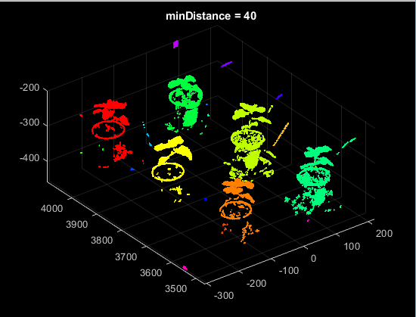
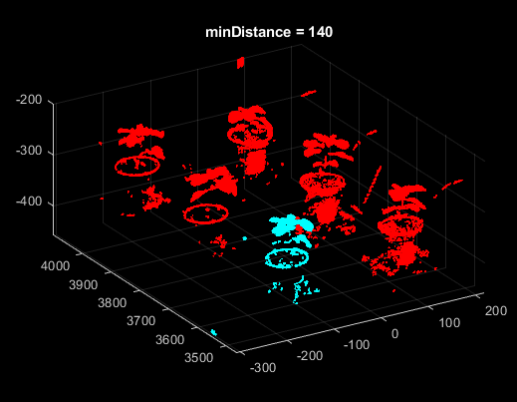
Minimum distance algorithm
labels = pcsegdist(ptCloud,minDistance) segments a point cloud into clusters, with a minimum Euclidean distance of minDistance between points from different clusters. pcsegdist assigns an integer cluster label to each point in the point cloud and returns the labels of all points.
The algorithm is unsupervised so returns a different number of clusters as the parameter ‘minDistance’ is changed. Therefore, there is a need to tune this parameter to get optimal results.
Even after parameter tuning, it is difficult to get good results that forms around 6 clusters. For example, with minDistance = 40, we get 24 clusters. All clusters with N<1000 are considered unwanted data points and removed. The rest of the data points are saved.

Slide 10
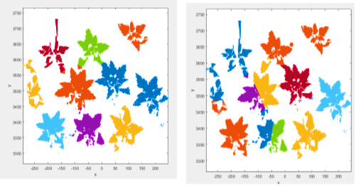
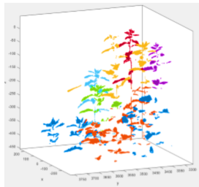
K-means Algorithm
PSEUDOCODE: Initialises N number of centers. Each data point is then assigned a label corresponding to the nearest center. After all data is assigned, new centers = mean of each clusters.
This algorithm ensures that we get a specified number of clusters which is an advantage since we do not have to filter out the unnecessary clusters which we saw in earlier algorithm,
However, the output is dependent on the initial centers which need to be optimized if we want to get correct classification of individual plant.
Also , the classification is done in 2d (Y,Z) axis. K-means in 3 dimensions do not give clusters of individual plant which is obvious from the pseudocode.

Slide 11
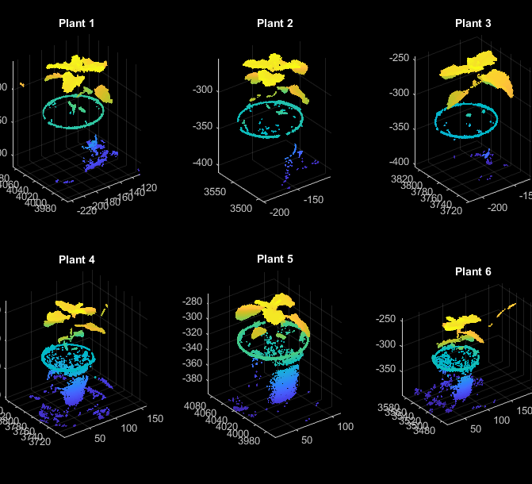
OUTPUT FROM CLUSTERING ALGORITHM ON PLANT LEVEL
The output from the clustering earlier should give us an array of 6 plants. If there are more than 6 arrays, then it means that the classification is incorrect. Each array needs to be tested to see if each cluster represents an actual plant.
Given that the figure alongside shows correct clusters, we now proceed with the preprocessing at leaf level. Each of these plants are stored in the Plant{} cell.

Slide 12
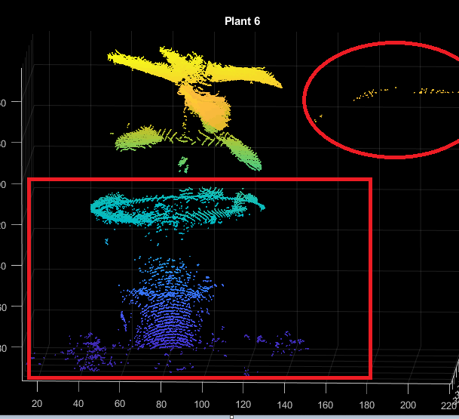
CLUSTERING OF INDIVIDUAL LEAVES
For a given plant, we can identify some data points that are not exactly a part of the leaf. For example, the pot generates several data points as well which is not required in our surface reconstruction. Also, there are a number of data points that lie outside the plant(considered as anomalous points).These data have to be removed.
Since there are no explicit features that can be used to separate the unnecessary points from the necessary plant data, we have to manually remove most of these data. However, before we do that , we carry out another clustering algorithm on the leaf level and remove all clusters that do not represent a leaf.
The leaves were classified based on several algorithms.

Slide 13
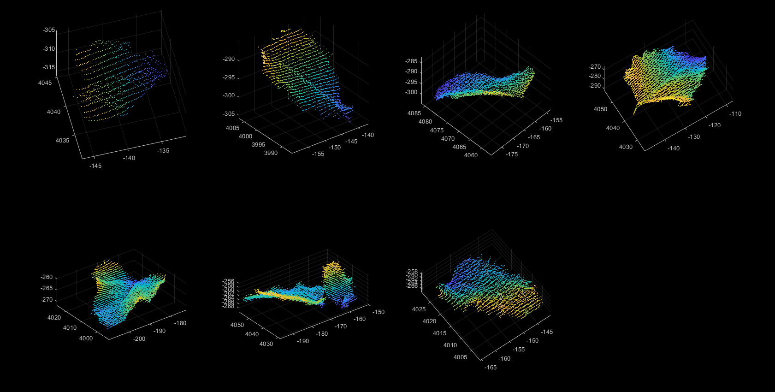
Minimum Distance Algorithm
This is the same algorithm that we used to cluster on plant level.
This method of clustering seems to work well with the species we are working with. However, we will encounter issues when other species try to implement this algorithm to cluster on leaf level.
Additional filtering is required as some clusters contain multiple leaves, or cluster from vase, or other anomalous points.

Slide 14
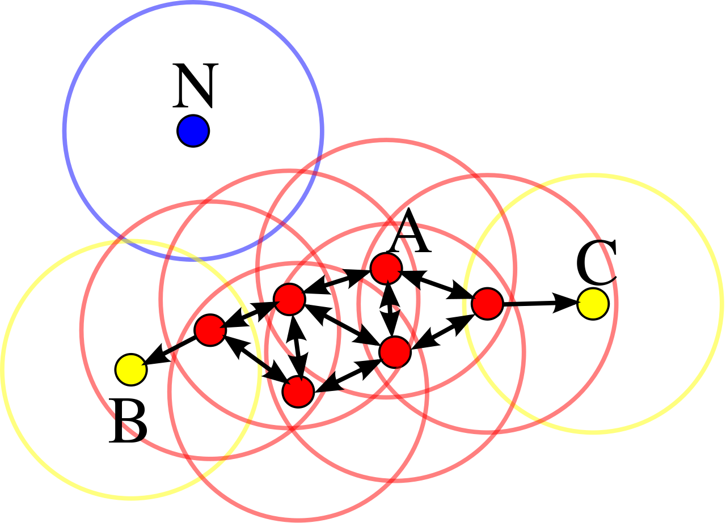
DENSITY BASED CLUSTERING
Consider a set of points in some space to be clustered. Let ε be a parameter specifying the radius of a neighborhood with respect to some point. For the purpose of DB clustering, the points are classified as core points, (density-)reachable points and outliers, as follows:
• A point p is a core point if at least minpts points are within distance ε of it (including p).
• A point q is directly reachable from p if point q is within distance ε from core point p. Points are only said to be directly reachable from core points.
• A point q is reachable from p if there is a path p1, ..., pn with p1 = p and pn = q, where each pi+1 is directly reachable from pi. Note that this implies that all points on the path must be core points, with the possible exception of q.
• All points not reachable from any other point are outliers or noise points.
Red point = core points
Core points have minpts=4 datapoints surrounding it within a radius ε.

Slide 15
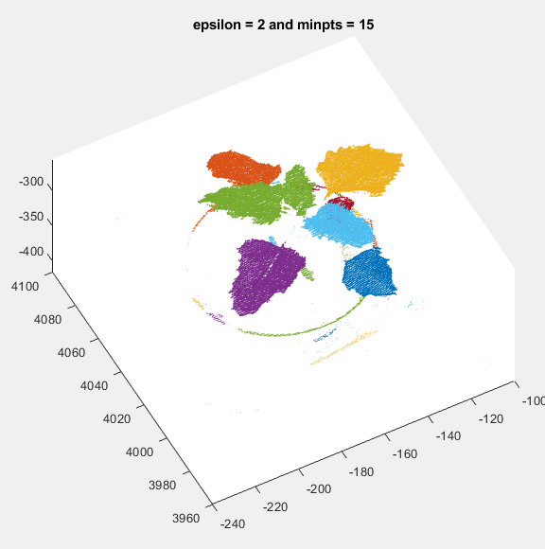
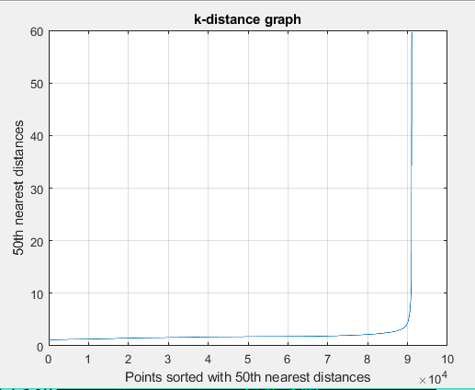
DENSITY BASED CLUSTERING
The input parameters are minpts, epsilon
MinPts: As a rule of thumb, minPts = 2·dim can be used, but it may be necessary to choose larger values for very large data, for noisy data or for data that contains many duplicates.
ε: The value for ε can then be chosen by using a k-distance graph, plotting the distance to the k = minPts-1 nearest neighbor ordered from the largest to the smallest value.Good values of ε are where this plot shows an "elbow“.if ε is chosen much too small, a large part of the data will not be clustered; whereas for a too high value of ε, clusters will merge and the majority of objects will be in the same cluster.

Slide 16
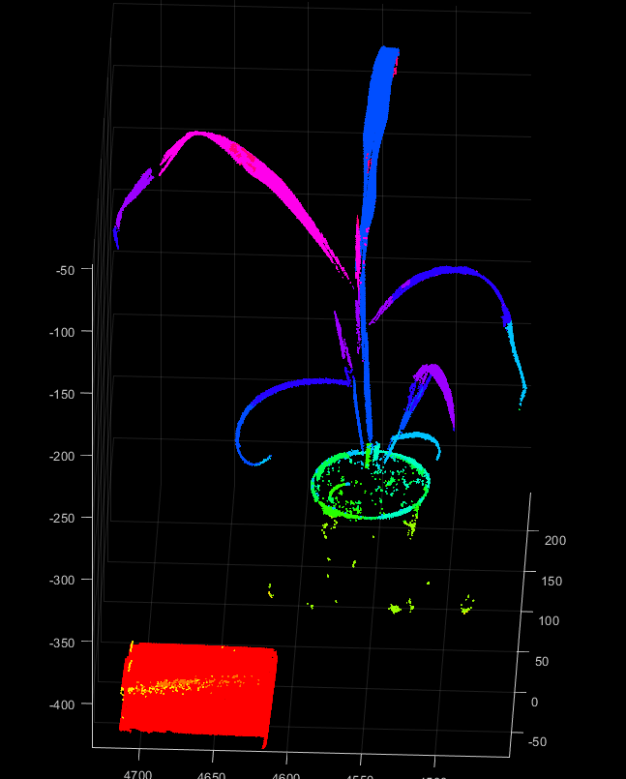
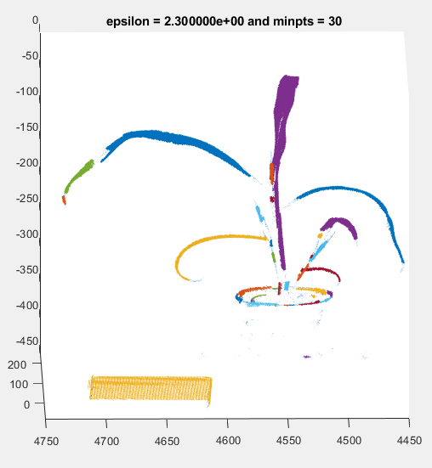
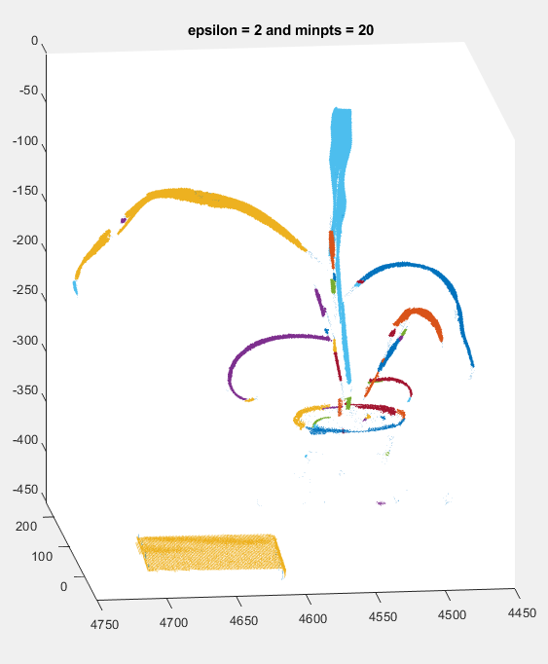
COMPARISION
The two algorithms produce similar results for the species that we are working with.
However, for some other species, DBCluster produces more realistic results compared to Minimum Distance Algorithm.

Slide 17
Advantages/disadvantages of the two algorithms
Minimum Distance | DB Cluster
Only one parameter requires tuning. | There are 2 parameters that need to be tuned. Changing these parameters heavily influences the type of clusters we get.
Only works well with leaves that are not elongated/curvy. | Works well with all kinds of leaves given that the parameters have been tuned appropriately.
Easy to choose the parameter given the data is well understood. | If the data and scale are not well understood, choosing a meaningful distance threshold ε can be difficult.
Faster than the DBCluster algorithm for high dimensional data of the same size. | Especially for high-dimensional data, this metric can be rendered almost useless due to the so-called "Curse of dimensionality", making it difficult to find an appropriate value for ε.
Creates a more realistic number of clusters. | Creates too many clusters in optimal conditions.

Slide 18
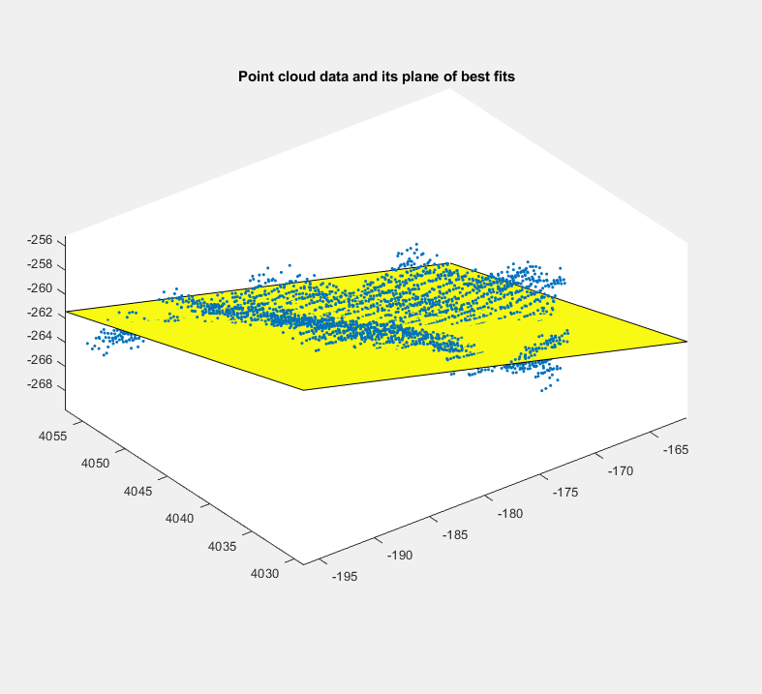
POINT cLOUD TRANSFORMATION
Now that we have an array of leaves for each plant, the pre-processing is now complete.
In the next process, we pass a plane of best fit through the leaf. The leaf is then transformed into a function z= f(x,y) i.e. z direction orthogonal to the best fit plane.
The transformed coordinates for the leaf can now be passed into the RBFSolver function to compute the RBF coefficients.

Slide 19

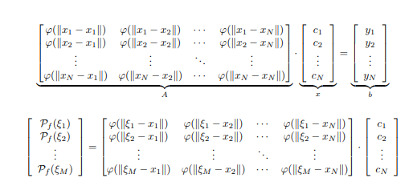
Radial basis functions
Using this technique, an implicit surface is constructed by calculating the weights of a set of radial basis functions whose linear combination interpolates the given data points.(see figure alongside).
The RBF interpolant determination consists to solve a linear system of equations Ax = b. For this project, RBF kernel used is called thin-plate spline.
Thin Plate Spline(TPS) fit tend to resist bending, implying a penalty involving the smoothness of the leaf surface. This requires transformation in z direction orthogonal to plane which we already have done.
The RBF applicability is hindered by its computational demand, since these methods require the solution of a linear system of size equal to the number of data points and current 3D data scanners allow acquisition of tens of millions points of an object surface. Thus, we need to downsample in certain cases to reduce the overall computational resources being consumed.

Slide 20
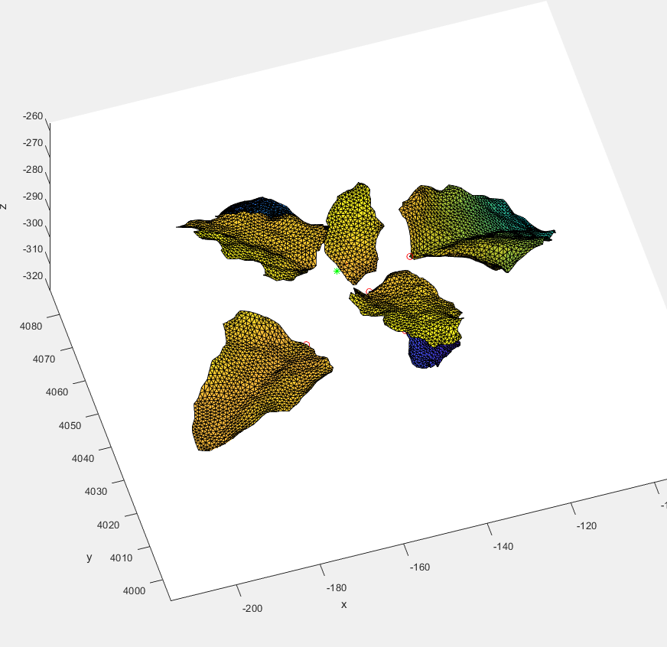
SURFACE INTERPOLATION USING RBF’s
Thus, using RBF’s, a function is generated that approximates the surface.
A mesh is created, and an output is computed by calling the surface interpolation function for each nodes on this mesh.
This new output z is then transformed back from best fit plane into the xy plane. This output is our reconstructed surface.
A triangulation is then carried out over this newly reconstructed surface.

Slide 21
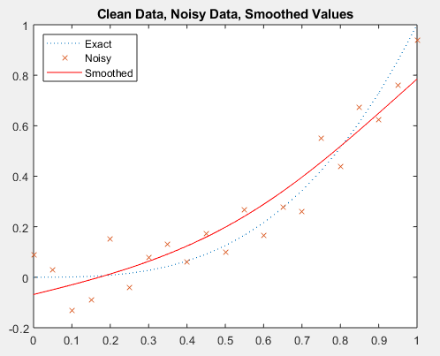

Stem generation
The function csaps() returns the cubic smoothing spline interpolation to the given data (x,y) in piecewise form. The value of spline f at the data site x(j) approximates the data value y(:,j) for j = 1:length(x)
This smoothing spline minimizes:
Here, n is the number of entries of x and the integral is over the smallest interval containing all the entries of x. y_{j} and x_{j} refer to the jth entries of y and x, respectively. D²f denotes the second derivative of the function f.
The parameter p is the regularization parameter which takes the value between 0 and 1 and defines how much the approximated spline fits the exact solution. When p =1, the spline passes through all data points.
The image alongside shows how this function generates a smoothing spline for f(x) = x^3.

Slide 22
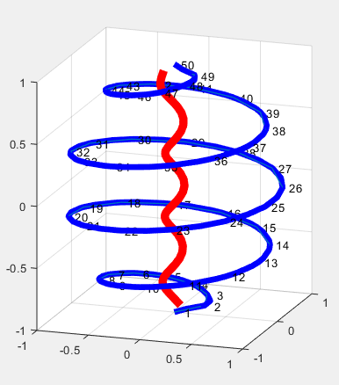
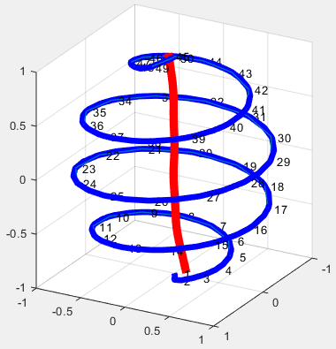
Stem Generation
For a 3d interpolation, we can modify how the csaps function is implemented by declaring z as an independent variable. Thus, the spine is approximated for a set of points in z. As an example, a helix is generated through which we pass a smoothing spline.
The regularization parameter p can define how much curvy the spline can get.
In the example, we have points [1] and [50] that clearly define the start and end of the spline approximation. However, if some points are missing that would prevent us from getting a spline with the correct orientation/structure.
Figure: Left image shows {p=0.99} whereas Right image shows {p=0.70}.

Slide 23
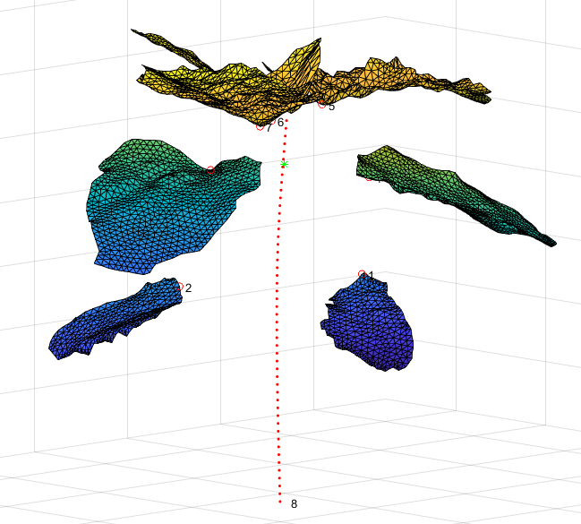
STEM generation
In case of the point cloud data that we are using, it is necessary to obtain the coordinates of the points in the leaves where the stem or the branch attaches to. This is determined by the stem_find function.
The first issue at hand is to define at what z-value the stem attaches to. For our point cloud data, we find the centroid of the stems and the stem_root is defined as the point (c1,c2,-320) where c1,c2 = x,y coordinates of the centroid.
A spline is fitted through all the stem coordinates with a certain regularization parameter p = 10^-4 for this image shown alongside.

Slide 24
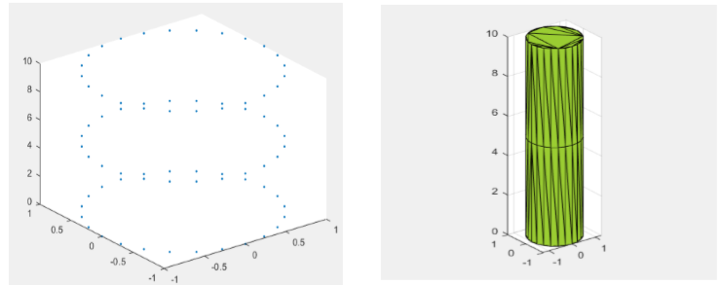
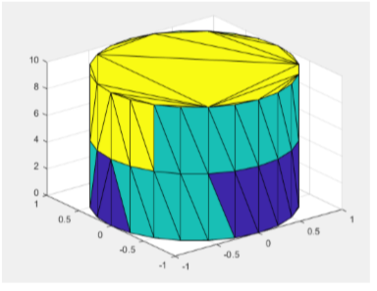
Stem GENERATION
For a given set of points in 3d space, an alphaShape can be generated that encloses the set of points. An example is provided with a set of cylindrical points in the figure below.
The function boundaryFacets(shp ) returns a matrix representing the facets that make up the boundary of the alpha shape. The facets represent edge segments in 2-D and triangles in 3-D. When applied to alphaShape, we get the following output:

Slide 25
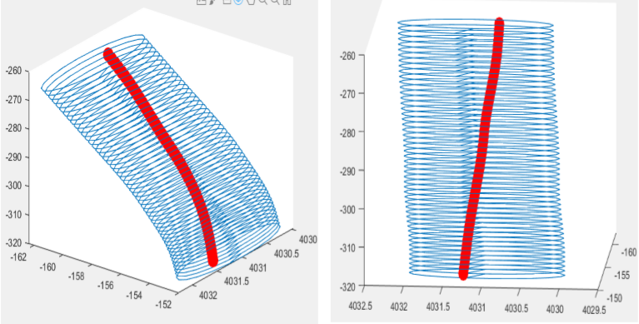
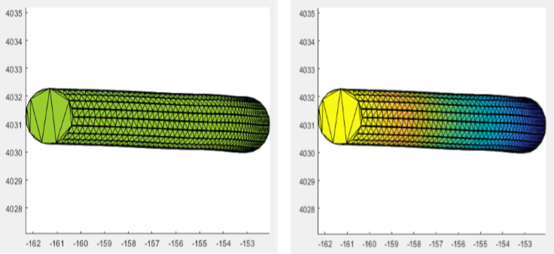
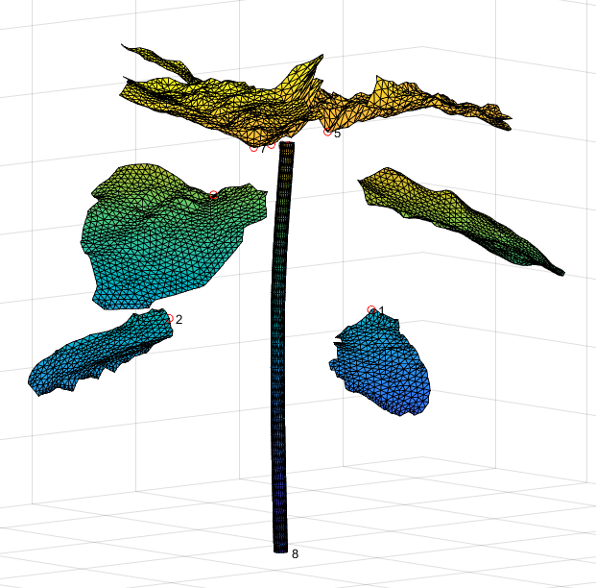
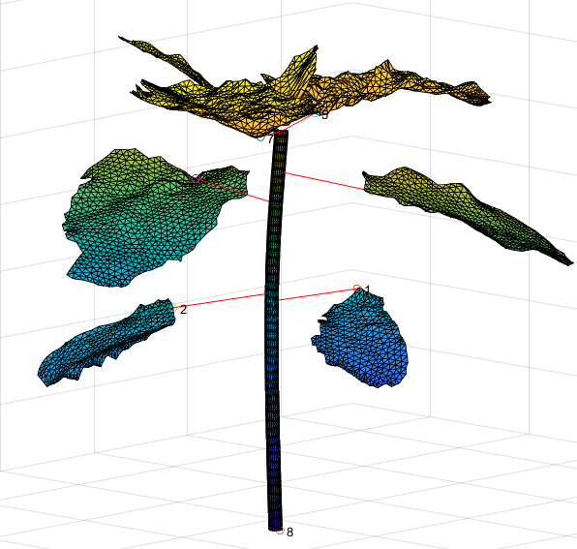
Stem GENERATION
In case of the spline we generated, a set of points in a circle around the spline are first created. This set of points are then finally enclosed by an alpha shape.
Finally, the stem coordinates are then connected to the nearest point on the spline using a nearest neighbour search algorithm.

Slide 26
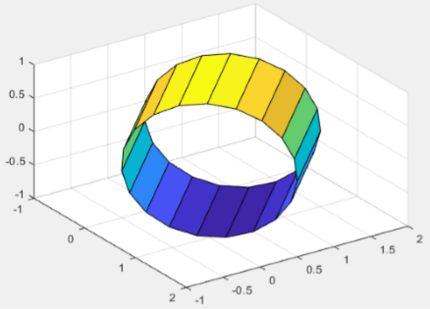
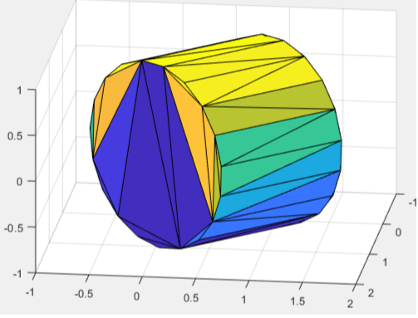
BRANCH GENERATION
The branch generation is carried out in the same way the stem was generated. However, instead of data around a circle with radius ‘r’ , a N sided polygon with radius ‘r’ is created between he stem coordinates and nearest neighbor on the stem spline.
When alphashape is applied to this polygon, we get a bounded 3d cylindrical object that will represent the branch of the plant.
Applying boundaryfacets() gives us the bounded surface with the triangulation.

Slide 27
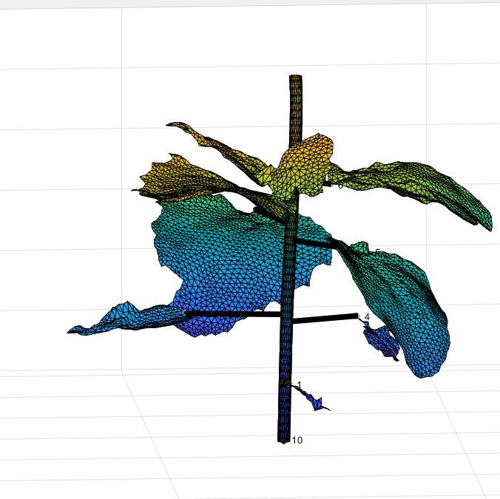
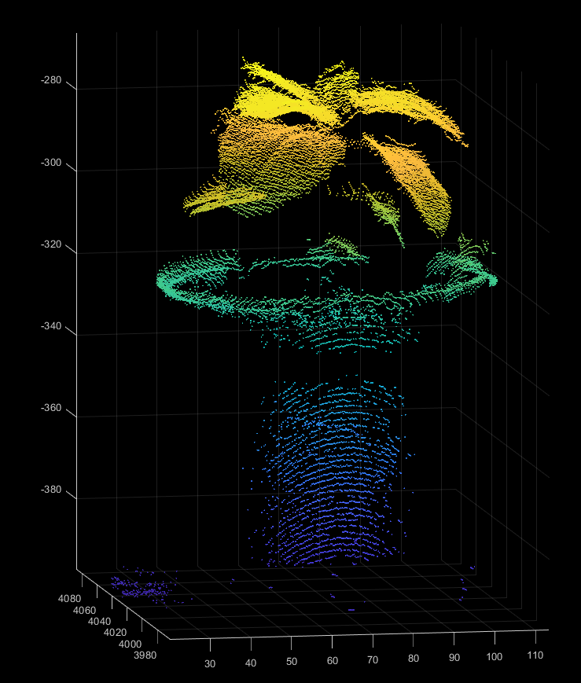
Final result- plant 5 SURFACE RENGENERATED WITH 5000 SAMPLES PER LEAF

Slide 28
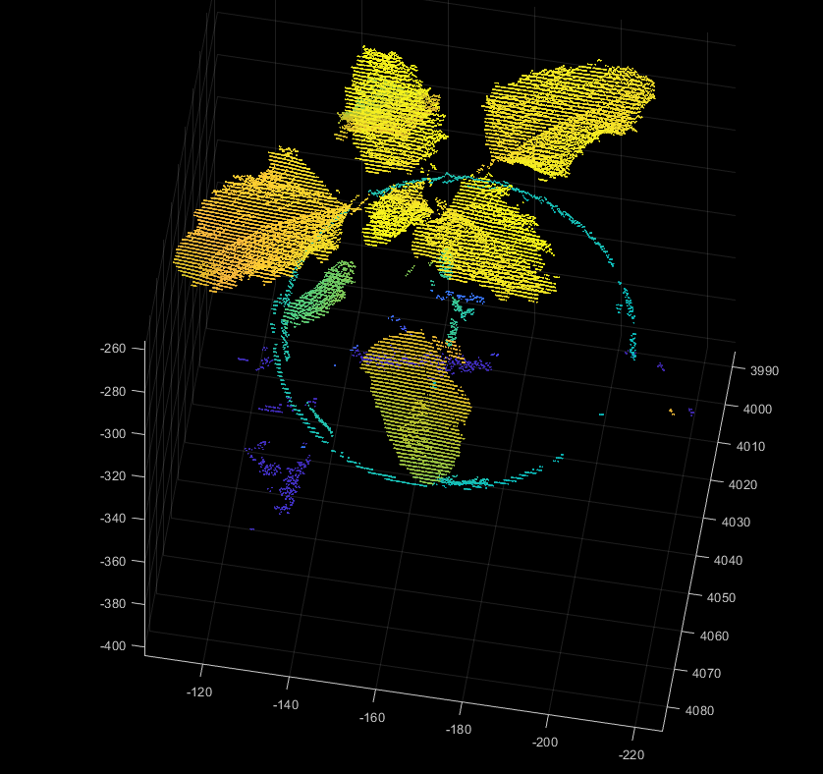
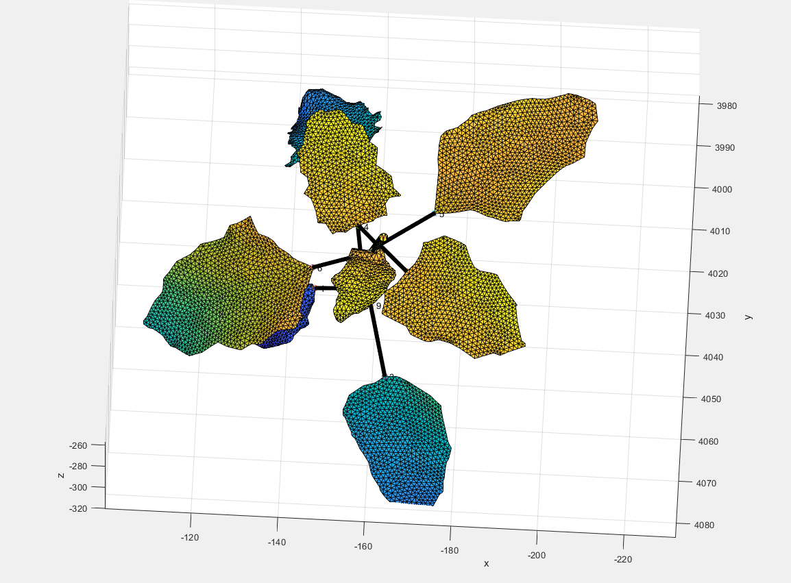
Final result – plant 2 SURFACE RENGENERATED WITH 1000 SAMPLES PER LEAF

Slide 29
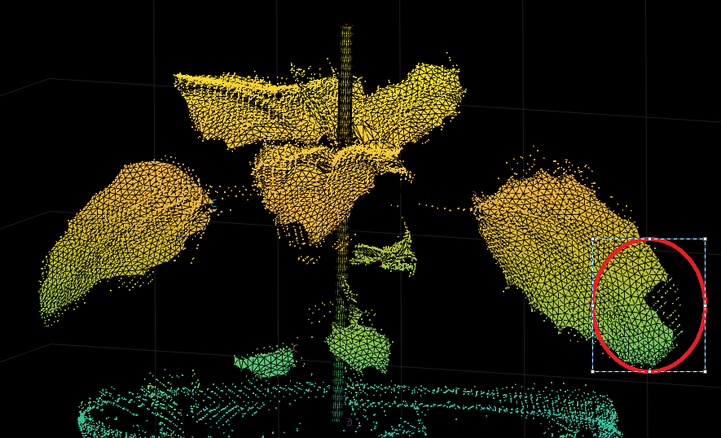
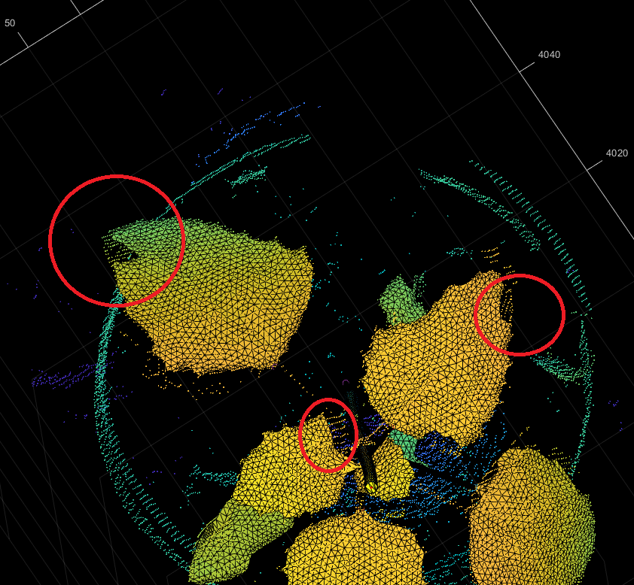
ERRORS- PLANT 5 SURFACE RENGENERATED WITH 5000 SAMPLES PER LEAF

Slide 30
Recommendation for future works
Currently, most of the parameter tuning is done by trial and error. There are no clear insights to how these parameters can be tuned for optimal number of good clusters.
Clustering at leaf level is highly sensitive to the resulting surface reconstruction as evident from the errors. Need to add metrics that measure what percentage of the leaf is being broken off during clustering.
The methods employed in the surface reconstruction of this particular species may not be applicable to certain other plant species. Although we did look into some examples where an algorithm performs better or worse with different species, a more thorough research needs to be done before any recommendation is made.

