Slide 1


PANIMALAR ENGINEERING COLLEGE
Department of Computer Science and Engineering
ODIS – Orderly Demeanor Inspection System
Project Guide:
Team Members:
Mr. C.THIYAGARAJAN ASSISTANT PROFESSOR DEPARTMENT OF CSE
PANIMALAR ENGINEERING COLLEGE
AYNGARAN K (211417104028)
BALAJI V (211417104030)
BHAVAN KUMAR (211417104033)

Slide 2
INTRODUCTION
In recent times as we could notice there are many situations where we have to leave back loved ones even though when we want to be with them, or when they need special care. This has gone to an extent where security cams that were once used for guarding the house has evolved into cams we use today to make sure the person is doing good. But the fact no matter what we do we can never make the person left behind feel our presence or help them when they need emotional support via watch cams. What if we said that we can indeed create a software to help as an emotional support for users in need. The project we propose is one of it’s kind emotional support system ODIS which creates a conversation to help the user gain emotional balance.

Slide 3
LITERATURE SURVEY
TITLE | AUTHOR | YEAR | MERITS
A Review paper on emotional intelligence: Models and relationship with other constructs | Dr. Sandhya Mehta Namrata Singh | 2013 | It provides us with the information of collective papers which performed research on emotional intelligence in custom scenarios.
A Study on Emotional Intelligence At Work Place | Dr. Desti Kannaiah Dr. R. Shanthi | 2015 | This paper gives us a overview on emotional status of individual in work places. Giving a better understanding in designing datasets .
A study on emotion recognition method and its application using face image | Hyeon-Jung Lee Kwang-Seok Hong | 2017 | In this we get know a proper method of face image capturing and analysing the emotions of individuals. Aids as a base for emotion identification concept.
EEG-Based Emotion Recognition Using Regularized Graph Neural Networks | Peixiang Zhong Di Wang Chunyan Miao | 2019 | This paper provides us with a best emotion recognition method with its accuracy of 79.37% respectively utilizing the concept of Graph Neural Networks.

Slide 4
PROBLEM STATEMENT
The worlds we live in require a society which withholds mental equilibriums rather than a group of sociopaths. The reason we tend to move towards contradiction of a proper society is lack of human interactions and spending time with people.
These types of serious conditions can be viewed in scenarios like children who have working parents or lost them tragically, people trying to maintain work-life balance, etc.
But the fact no matter what we do we can never make the person left behind feel our presence or can we? What if we said yes we can indeed with the help of some software and IoT combination and we named the software as ODIS

Slide 5
TECHNOLOGY STACK
Domain
Technologies
Machine Learning
Image processing
Voice Processing
Data Processing
Basic Software Development

Slide 6
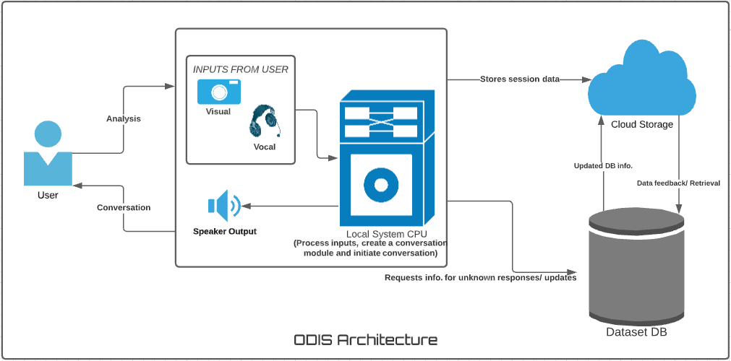
SYSTEM ARCHITECTURE

Slide 7
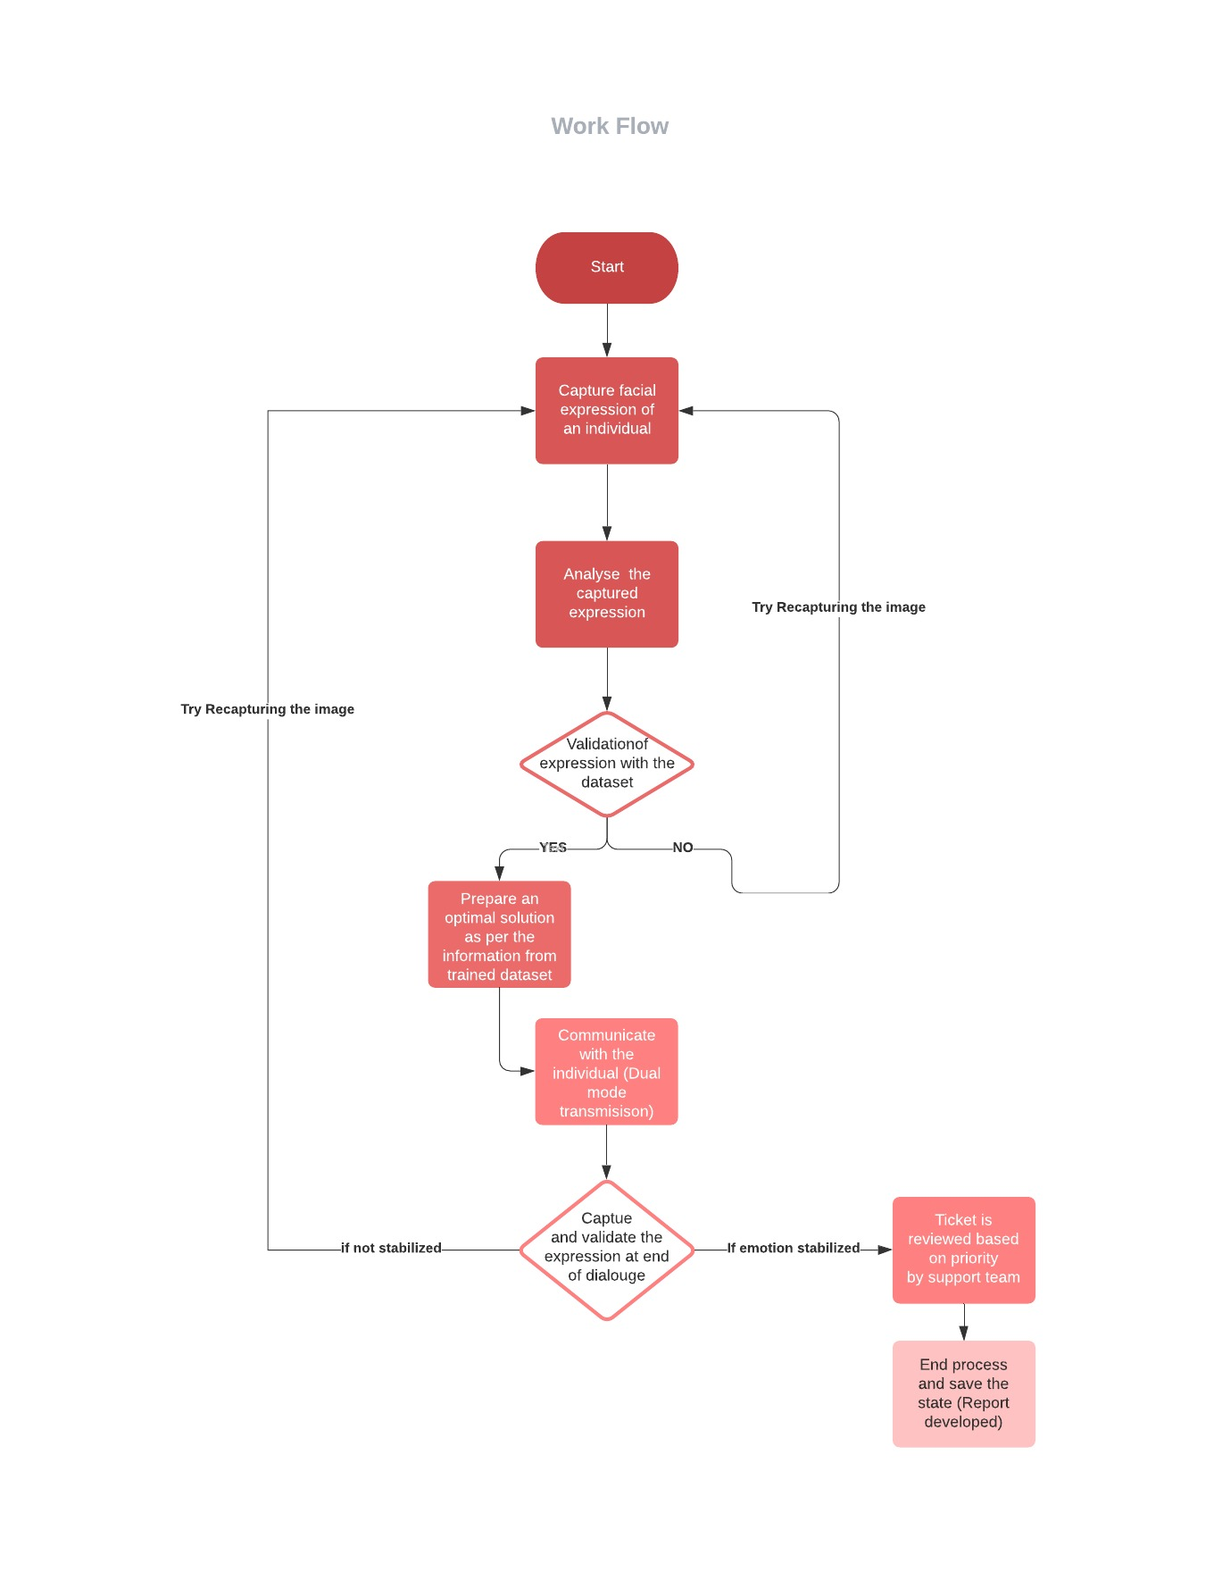
WORK FLOW

Slide 8
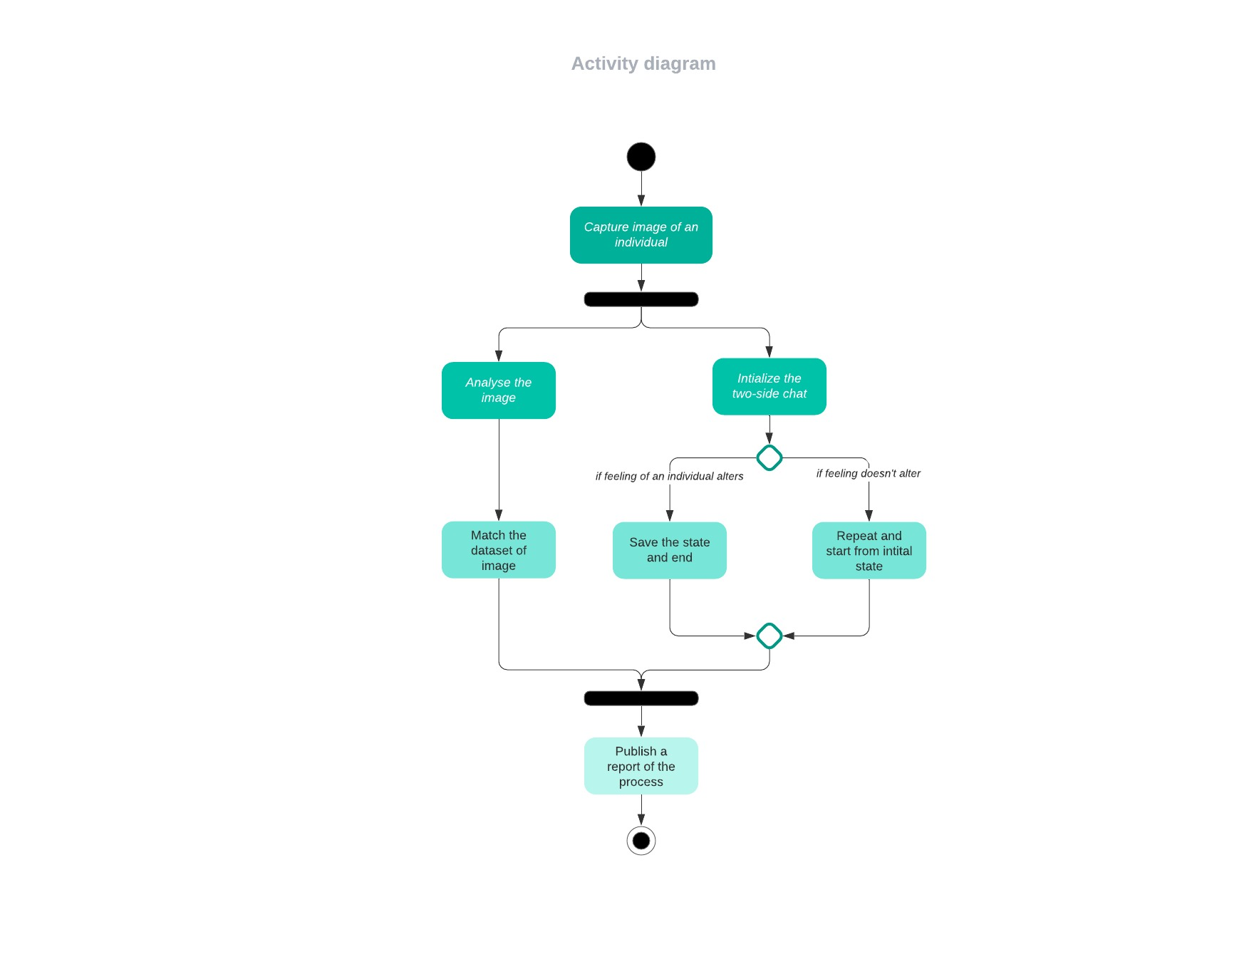
ACTIVITY DIAGRAM

Slide 9
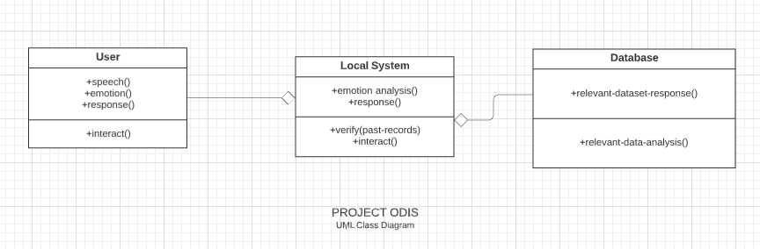
UML DIAGRAM

Slide 10
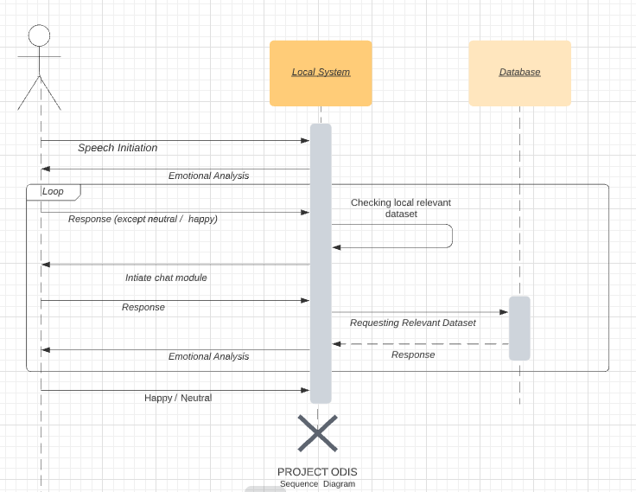
SEQUENCE DIAGRAM

Slide 11
MODULES AND FUNCTIONALITES
This project holds two key modules namely, emotion recognition and voice assistance.
Emotion Recognition
Voice Assistance
Back-end Cloud Database
These two above concepts constitutes of every required mechanism feasible to develop a design of working prototype.
A brief discussion about these modules are mentioned in following slides.

Slide 12
TYPES OF EMOTIONS
SAD
HAPPY
NEUTRAL
SURPRISE
ANGER

Slide 13
EMOTION RECOGNITION
For this concept to be feasible we require to capture and analyse an individual’s facial changes. Every alteration made on the human face results into diverse outcome of analysis.
The concept of Image processing is utilized here to analyze a person’s facial features.
For image processing we use aid of open cv libraries in python.

Slide 14
VOICE ASSISTANCE
The title of this module might seem familiar to the current day gadgets like Alexa, Google voice assistant, etc but the functionalities of these two are quite well distinguished. This voice assistance is provided to the individual according to the predicted mood or emotion of that person facial processing.
Dialogues are designed in a manner which in term learn from the user inputs and alter based on input changes from user.
We provide an user-friendly and dual side communication passage.

Slide 15
IMPLEMENTATION OF ALGORITHM (Emotion Recognition)
Supervised machine learning is the construction of algorithms capable of generating general patterns and hypotheses by using externally delivered instances to predict future instances
KNN is used to compare the test data with the data previously trained.
Classification is very commonly carried out in data science issues.
We are focussing on the respiratory as training the data before test is very vital part as accuracy plays a major role in the project. Speech processing recognizes keywords from the conversation to produce better results as it’s accuracy increases with regard to processing the keyword rather than processing the entire text response.

Slide 16
IMPLEMENTATION OF ALGORITHM (Speech Analysis)
It will convert speech to text, and text to speech will be present from pyaudio and pyttsx3 of function.
Then the training modules present from the import of TensorFlow from Keras to implement the algorithm
Then training module is trained by nltk method from WordNetLemmatizer function and also from NumPy import of JSON file etc to create the training module It will be split into classes and words pickle method
In chatbot, It will get a response from the trained module from clean up the sentence and It will evaluate the training module and NumPy function of lambda.
And finally, check all the module then it will get the response from the training module

Slide 17
DATASET COLLECTION AND TRAINING
The dataset used for emotion recognition is fer2013 emotional classifier dataset. The dataset is a challenge dataset consists of 28,709 examples and the public test set consists of 3,589 examples..
The dataset is initially trained using train.py to teach the system what to look for in a frame and how to classify it.
The dataset contained in speech module has a set of response and requests, these response-request are classified based on the model and the model uses keywords from sentences by the user.

Slide 18
TESTING AND RESULTS
Test Case Id | Test Cases | Priority | Input Test Data | TestCase Description | Expected Results | Actual Results | Pass/ Fail
TU0 1 | Frame Capture and analysis | A | Webcam feed. | Capturing a frame from the live video feed and analyse it. | Analyzed Pixels | Pixels analyzed successfully. | Pass
TU0 2 | Predict emotion | A | Pixel matrix. | Analyzed frame data used to predict emotion. | Should predict emotion from data. | Emotion Predicted successfully | Pass
TU0 3 | Conversa tion Initiation | A | Emotion | Select the assigned model for emotion captured and initiate conversation. | Conversation from the emotion model. | Model identified and conversation initiated succesfully. | Pass
TU0 4 | Speech Analysis | A | Response from user | Clean up the response and identify the sentence. | Appropriate system response for user response. | Appropriate response generated | Pass

Slide 19
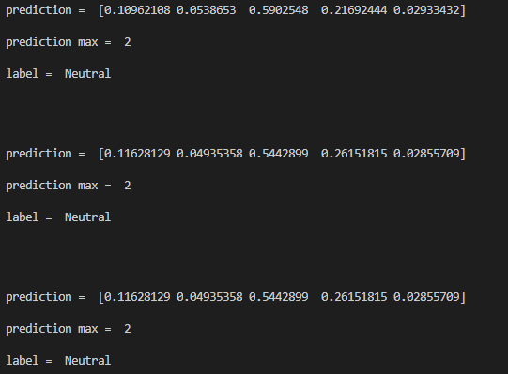
SCREENSHOTS(1)

Slide 20
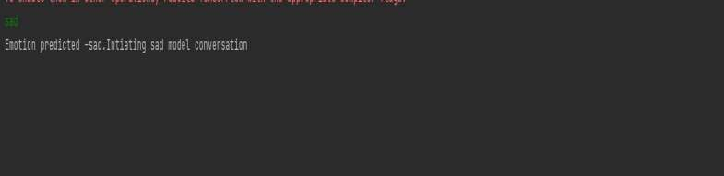
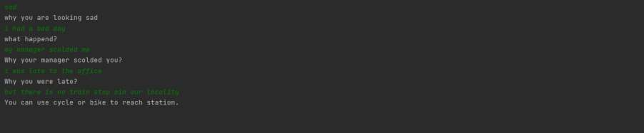
SCREENSHOTS(2)

Slide 21
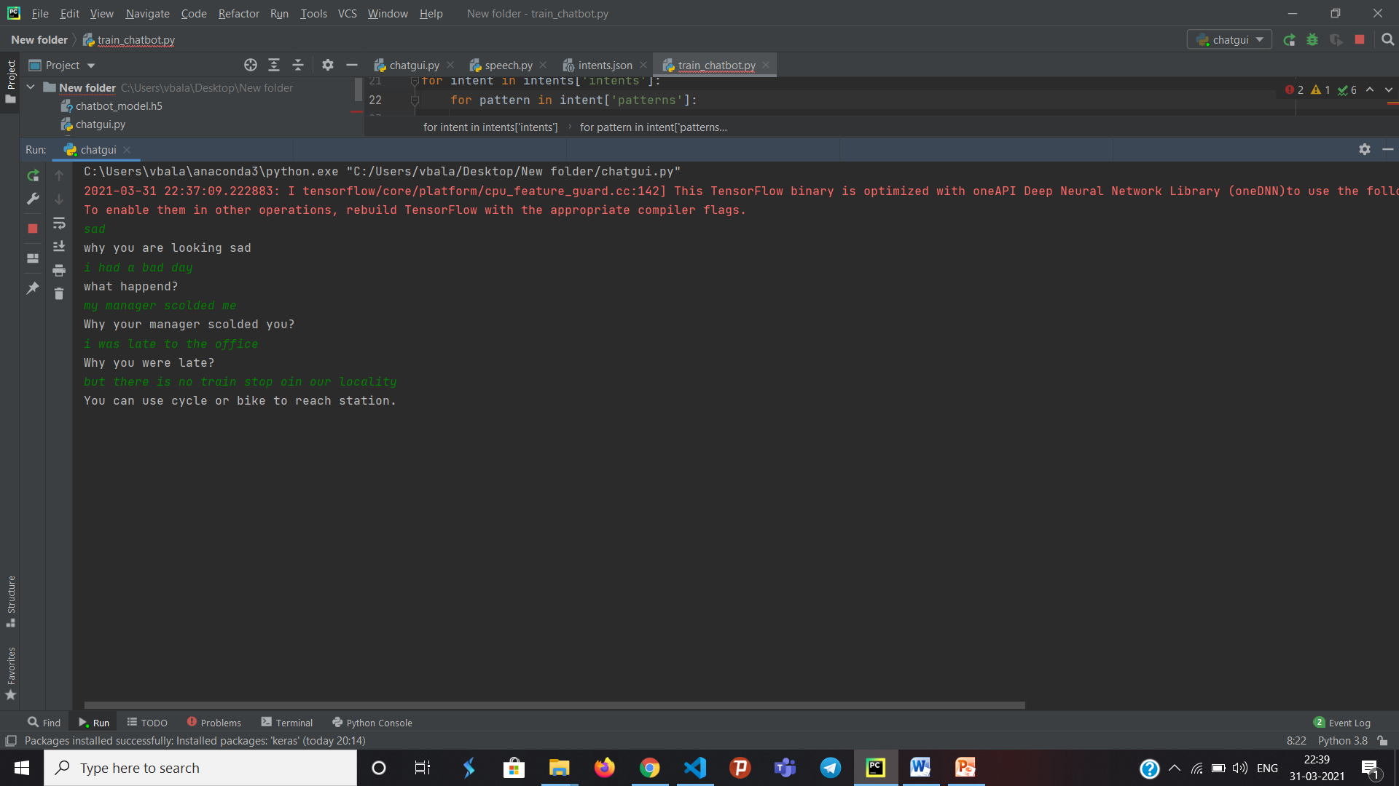
SCREENSHOTS(3)

Slide 22
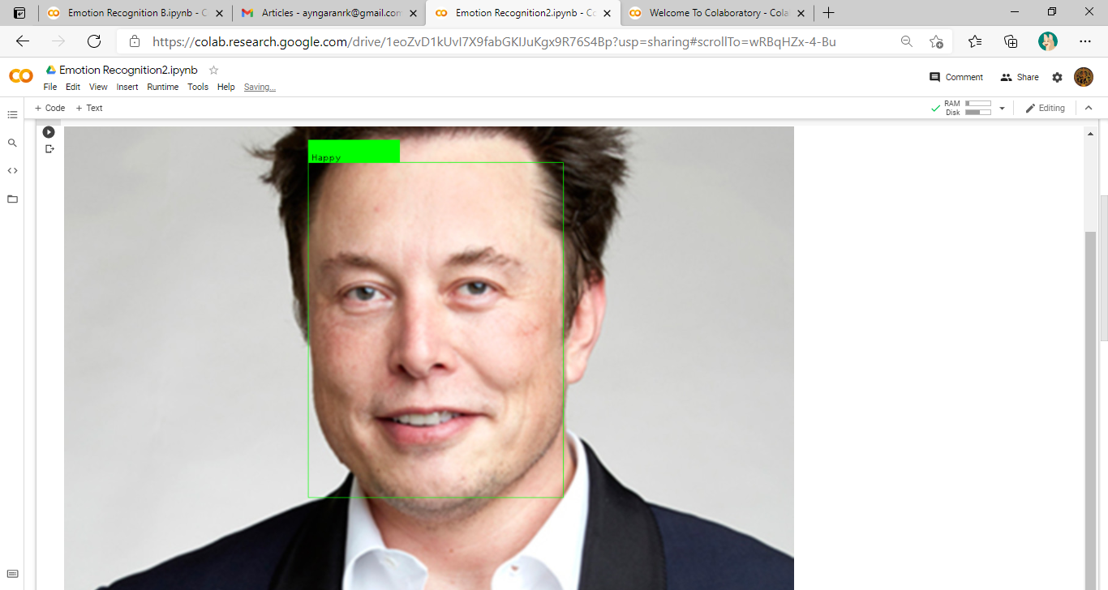
SCREENSHOTS(4)

Slide 23
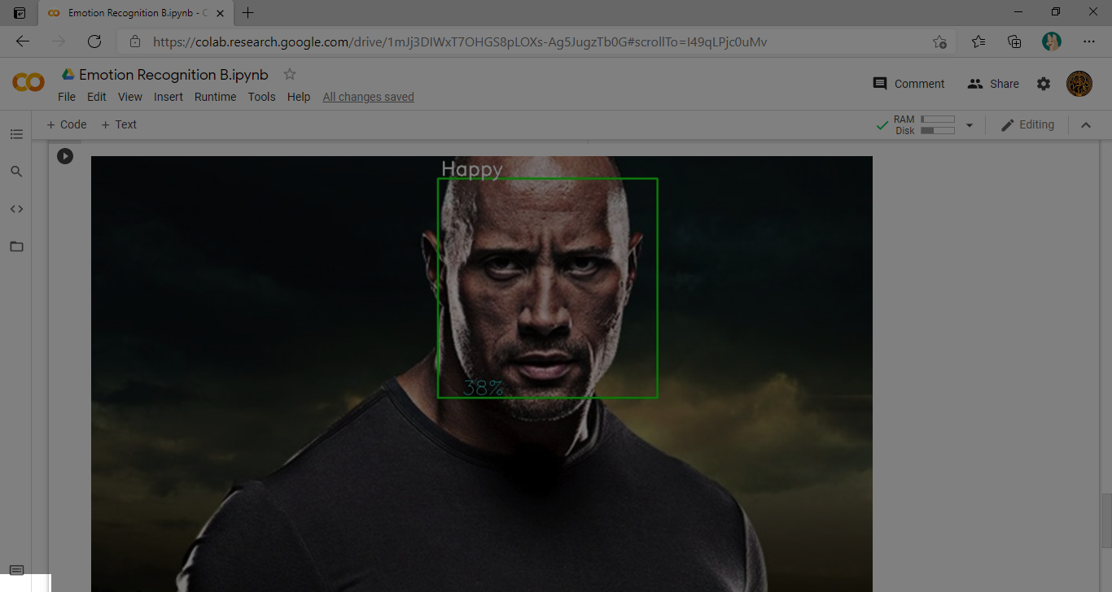
SCREENSHOTS(5)

Slide 24
CONCLUSION
We conclude by stating that no machine in this world is capable to match and replace a living being especially a human, but we try to consolidate this matter by giving the system a single human task which is to understand a person feeling and respond accordingly in a way to make him feel better and secure. We here using this system attempt to fixate a lack of emotional connection of a person and loneliness with help of key technologies like Machine Learning, Image processing. In a whole we perform a scientific study on the technologies and its benefits with the fact that the way we are going to utilize them in building of our system.

Slide 25
REFERENCES
A Review paper on emotional intelligence:Models and Relationships with otherconstructs,Dr.SandhyaMehata,NamrataSingh,2013,https://www.researchgate.net/publication/331082949_A_Review_paper_on_emotional_intelligence_Models_and_relationship_with_other_constructs,
A Study on Emotional Intelligence At Work Place,Dr.DestiKannaiah,Dr.R.Shanthi,2015,https://researchonline.jcu.edu.au/40340/1/40340%20Kannaiah%20and%20Shanthi%202015.pdf
A study on emotion recognition method and its application using face image, Hyeon-Jung Lee , Kwang-Seok Hong ,2017, https://ieeexplore.ieee.org/document/8191005A
Real-Time Analytics and Machine Learning by IBM. (https://www.ibm.com/it-infrastructure/z/capabilities/real-time-analytics)
An Introduction to Neural Networks by James A. Anderson.(ISBN:978-02-623-1588-3)
Fundamentals of Neural Networks by Lauren Fausett.(ISBN:978-81-317-0053-2, 813-17-0053-4)

