Slide 1

R - lecture notes 3
Lu Zou, Ph.D.
Postdoctoral Biostatistician
lu.zou@qmul.ac.uk
Kevin Blighe, Ph.D.
Postdoctoral Researcher (Bioinformatics)
k.blighe@qmul.ac.uk
Sharmila Rana, MRes
Junior Bioinformatician
sharmila.rana@qmul.ac.uk

Slide 2
Simple linear regression

Slide 3

Brief introduction
Definition (Wikipedia):
A simple linear regression is the least squares estimator of a linear regression model with a single explanatory variable
Why ‘simple’?
One dependent variable Y (also called response variable)
One independent variable X (also called regressor / predictor / experimental variable)
Assumptions:
Y and X has linear relationship → Assumption 1
Each point is independent → Assumption 2
Residuals are normally distributed with mean 0 and a constant variance → Assumption 3
*NB - X does not have to be normally-distributed. Due to assumption 1, the normal distribution of ε equals the normal distribution of Y

Slide 4
Example 1: Cats data
Enough theory! - the objective is to fit a straight line between X and Y
Let’s look at an example dataset in R, which records the gender and both the heart and body weight of 144 cats
library(MASS)
data(cats)
#Look at the information of the data
?cats
head(cats)
Body weight is X; heart weight is Y
Why look at heart and body weight? - body weight is easy to measure, and by measuring the body weight we can guess (or predict/infer) the heart weight
Underlying assumption:
larger body weight = larger heart
i.e., assumption 1, body and heart weights are linearly correlated

Slide 5
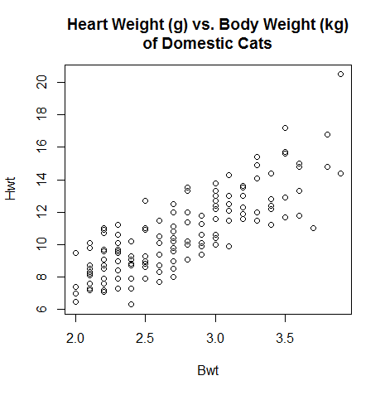
Pre-modelling examination
We can see that heart weight increases as body weight increases in the scatter plot
with(cats, plot(Bwt, Hwt))
title(main="Heart Weight (g) vs. Body Weight (kg)\nof Domestic Cats")
Assumption 1 is reasonable!
So, how strong is the correlation between body and heart weights?
We can answer this without fitting a regression line
Use Pearson’s correlation
with(cats, cor.test(Bwt, Hwt))
with(cats, cor.test(~ Bwt + Hwt))
Correlation coefficient is 0.804 (P value<0.001) –
significantly strong!

Slide 6
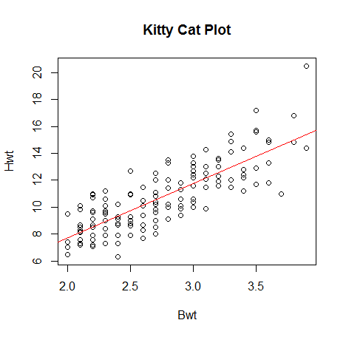
Model fitting
Now let’s fit the line!
lm.out = lm(Hwt ~ Bwt, data=cats)
summary(lm.out)
# shows an ANOVA table
anova(lm.out)
The fitted model can be summarised in words as:
1 unit increase in body weight (kilograms) will increase heart weight by 4.0341 units (grams)
*inferred from the ‘Estimate’, explained later on slide #18
Adjusted R-squared 0.644 indicates
adequate fitting by the model
plot(Hwt ~ Bwt, data=cats, main="Kitty Cat Plot")
abline(lm.out, col="red")

Slide 7
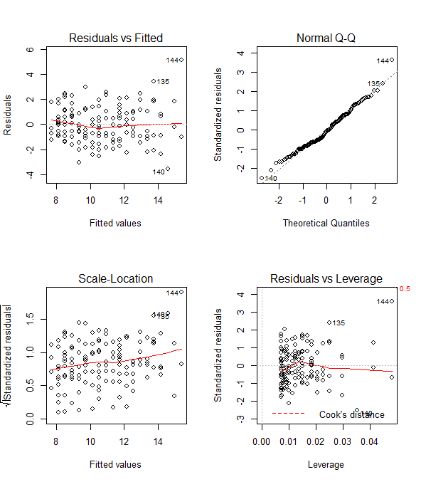
Model diagnosis
Is the straight line a good fit?
#Create a plotting structure of 2 rows X 2 columns
par(mfrow=c(2,2))
#Plot the graphs
plot(lm.out)
The top-left/bottom-left plots are standard residual plots, showing Residuals Vs Fitted values. Points that tend towards being outliers are labelled.
The top-right plot is a normal quantile plot of the residuals. We like to see our residuals normally distributed, i.e., mostly aligning with the dotted straight line.
The bottom-right plot shows Residuals Vs. Leverage (evidenced also by Cook’s Distance). Labelled points on this plot represent cases we may want to investigate as possibly having undue influence on the regression relationship.
Outlier Case 144:
This cat had the largest body weight and the largest heart weight in the data set.
cats[144,]
lm.out$fitted[144]
lm.out$residuals[144]

Slide 8
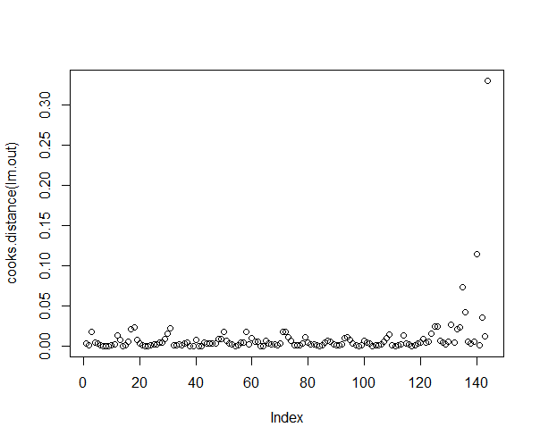
Outliers
Examine the possible outliers by looking at the leverage and influence of the points
Leverage is a measure of how far away one observation is from others (bottom-right plot on the previous slide)
Influence can be tested by Cook’s distance
plot(cooks.distance(lm.out))
#list cats with high influence
#Cook’s Distance cut-off, here, is 4/144=0.0278
cats[cooks.distance(lm.out)>(4/144),]
#Fit the straight line without cat 144
lm.without144 = lm(Hwt ~ Bwt, subset=(Hwt<20.5), data=cats)
The fitted line is now:
plot(Hwt ~ Bwt, subset=(Hwt<20.5), data=cats)
abline(lm.without144, col="red")
Adjusted R-squared is 0.635
summary(lm.without144)

Slide 9
Model comparison
Let’s compare several fittings
Simple linear with outlier
lm.out = lm(Hwt ~ Bwt, data=cats)
Simple linear without outlier
lm.without144 = lm(Hwt ~ Bwt, subset=(Hwt<20.5), data=cats)
Robust linear regression (adjusted for outliers)
robustlm = rlm(Hwt ~ Bwt, data=cats)
LOWESS curve (non-linear fitting)
LOWESSline = lowess(cats$Hwt ~ cats$Bwt)
In this case, the differences are not obvious, but in some cases, outliers may mislead the model fitness
plot(Hwt ~ Bwt, data=cats, main="Kitty Cat Plot", xlab="Body weight", ylab="Heart weight")
abline(lm.out, col="red")
abline(lm.without144, col="blue")
abline(robustlm,col='green')
lines(LOWESSline, col="black")
legend(2, 20, c("linear with outlier", "linear without outlier", "Robust linear", "LOWESS curve"), lty=1, col=c("red", "blue", "green", "black"), bty="n")

Slide 10
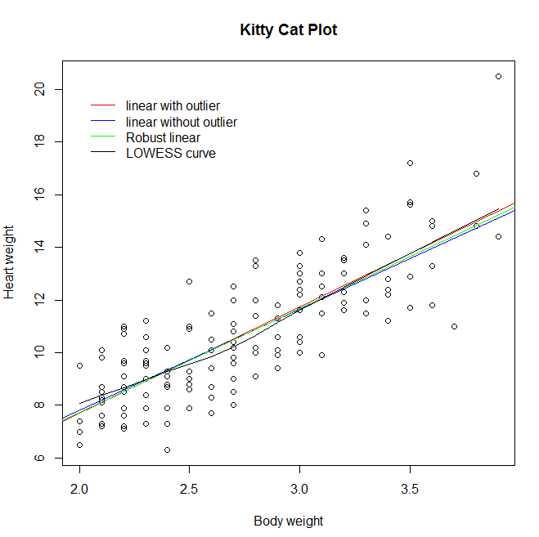
Model comparison

Slide 11
Multiple/General linear regression
Notes:
11

Slide 12
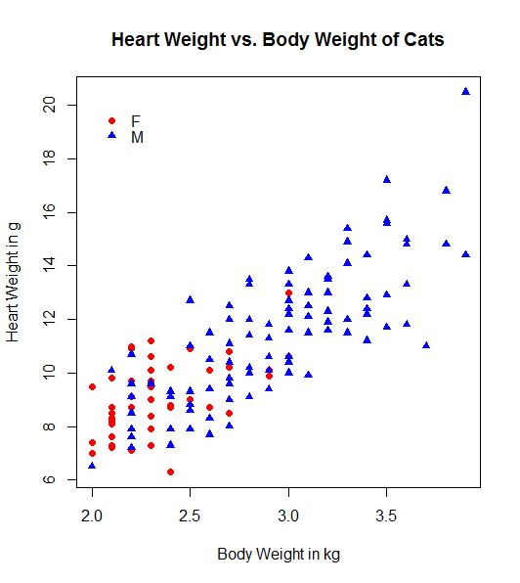
Data examination
Why multiple?
There is more than one independent/predictor variable in the linear regression
From simple to multiple linear regression it’s easy! - add more predictors!
Additional assumption: in the data, there is a lack of multi-collinearity between predictor variables, i.e., X’s do not have a high linear correlation
Cats example continued…
Is this true for both female and male cats?
with(cats, cor.test(~ Bwt + Hwt, subset=(Sex=="F")))
with(cats, cor.test(~ Bwt + Hwt, subset=(Sex=="M")))
Male cats had correlation coefficient 0.793
and 0.532 for female cats - both are significant,
P<0.001
Therefore, some difference exists between the
gender of the cats

Slide 13
Example 1 continued
Let’s add the gender in the model, excluding again the outlier (cat144)
lm.gder = lm(Hwt ~ Bwt+Sex, subset=(Hwt<20.5), data=cats)
summary(lm.gder)
Gender is a ‘categorical variable’, normally called a ‘factor’ in regression
A continuous variable, i.e., measured on a continuous scale (like gene expression or antibody titre), is called a ‘covariate’
In R, you need to define the variable as a factor if it’s not specified - how can I tell if it’s a factor?
is.factor(cats$Sex)
## If it’s not a factor, you can define it by:
cats$Sex = as.factor(cats$Sex)
We can summarise the model in writing as:
Male cat has a lighter heart than the female heart, roughly 0.0186g less, on average
*inferred from the ‘Estimate’ value for male sex after summary(lm.gder)), explained later on slide #18
Gender is not a significant factor (P = 0.949) - you may, therefore, consider removing it from the model unless it’s very important
Comparing nested models lm.without144 and lm.gder, we confirm that gender is not significant (P value = 0.9492)
anova(lm.without144, lm.gder)

Slide 14
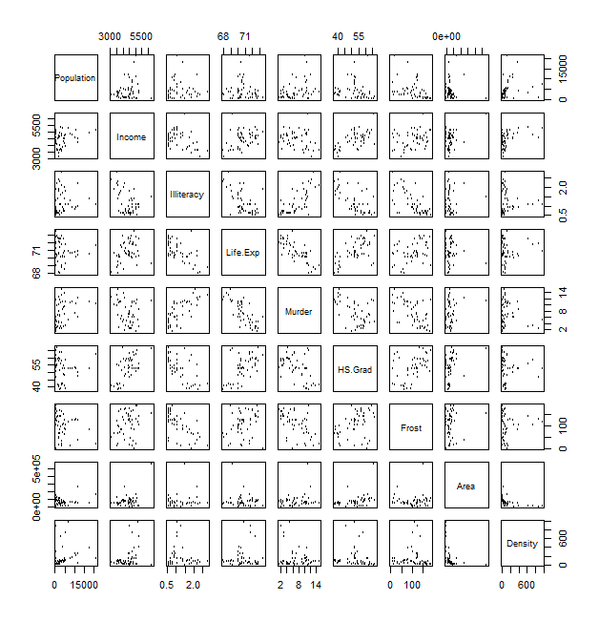
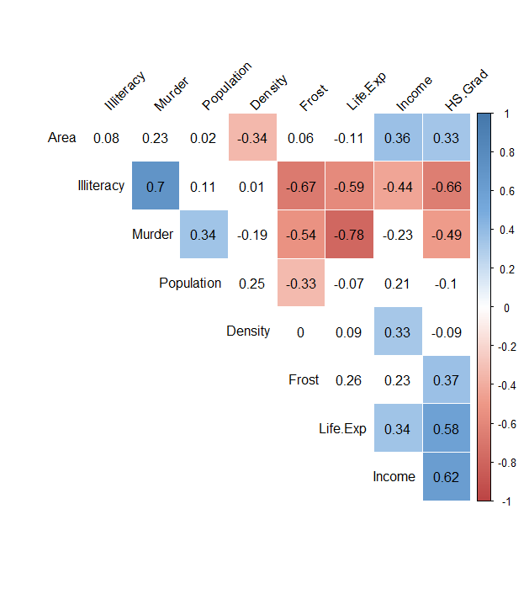
Example 2: USA states data
Now let’s look at another data containing more variables
Data on 50 US states
9 variables: population, income, illiteracy, life expectancy, murder rate, high-school graduates, mean number of days with min. temperature (frost), land area, and population density
data(state)
st = as.data.frame(state.x77)
# no spaces in variable names, please
colnames(st)[4] = "Life.Exp“
colnames(st)[6] = "HS.Grad“
#Calculate population density and add to the data
st$Density = st$Population * 1000 / st$Area
Study the correlation between variables
Scatter plot
pairs(st, cex=0.8)
Correlation coefficient
*NB – for these, you’ll need to install and load corrplot, using:
source("https://bioconductor.org/biocLite.R")
biocLite("corrplot"); library(corrplot)
col <- colorRampPalette(c("#BB4444", "#EE9988", "#FFFFFF", "#77AADD", "#4477AA"))
corrplot(cor(st), method="color", col=col(200), type="upper", order="hclust", addCoef.col="black", tl.col="black", tl.srt=45, diag=FALSE)

Slide 15
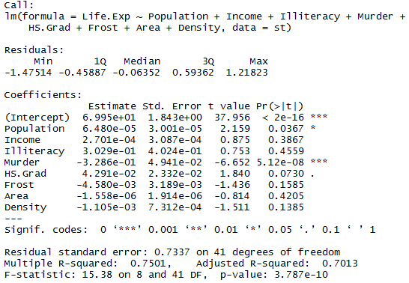
Fit the full model
Suppose that we want to know which variables affect life expectancy across states in USA…
Dependent/Response: life expectancy
Independent/Predictor: all other variables in the dataset
The full model will be:
model1 = lm(Life.Exp ~ Population + Income + Illiteracy + Murder + HS.Grad + Frost + Area + Density, data=st)
summary(model1)
Quick scan of model:
Population and murder rate are
significant
It seems that we don’t need all of the
independent variables, i.e., the
model has too much information
How to select the better model?
There is no correct/wrong model!
Whether it’s meaningful is important

Slide 16
Model selection (Approach 1)
Approach 1: Select manually
Start with the full model and remove one at a time (backward)…
…or start with the minimal model and add one at a time (forward)
With a large number of independent variables, you can apply Univariate Analysis and only consider the significant ones
Step 1: Remove ‘Area’ (not significant in full model and already used to calculate ‘Density’)
model2 = update(model1, .~.-Area)
anova(model1, model2)
summary(model2)
Step 2: Remove ‘Illiteracy’ (not sig. in model2)
model3 = update(model2, .~.-Illiteracy)
Step 3: Remove ‘Income’ (not sig. in model3)
model4 = update(model3, .~.-Income)
Step 4: Remove ‘Density’ (not sig. in model4)
model5 = update(model4, .~.-Density)
Step 5: Remove ‘Population’ (not sig. in model5)
model6 = update(model5, .~.-Population)
Final model is Life.Exp ~ Murder + HS.Grad + Frost with all significant independent variables, i.e., murder rate, high school graduation, and cold weather are significant predictors of life expectancy

Slide 17
Model selection (Approach 2)
Approach 2: Stepwise selection
R can do the work for you in one go!
First, insure that we have the package for the stepAIC function loaded:
library(MASS)
Backward selection - Starting from full model, and delete one independent variable at a time
step(model1, direction="backward")
stepAIC(model1, direction="backward")
Forward selection - Starting from the minimal model, and add one variable at a time
model.min = lm(Life.Exp ~ HS.Grad, data=st)
stepAIC(model.min, scope=list(upper= ~ Population + Income + Illiteracy + Murder + Frost + Area + Density + HS.Grad), direction="forward")
*NB - a maximal model still needs to be defined using the ‘scope’ parameter
Both of the selections reaches the same model:
Life.Exp ~ HS.Grad + Murder + Frost + Population
Important to note that some stepwise-selected variables may not actually be significant, e.g. Population P value=0.052

Slide 18
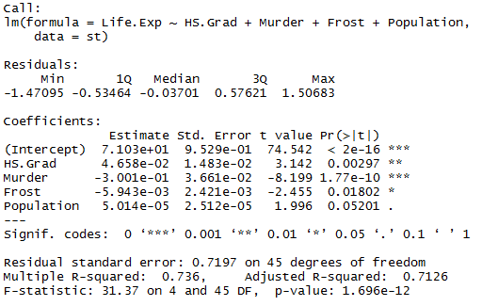
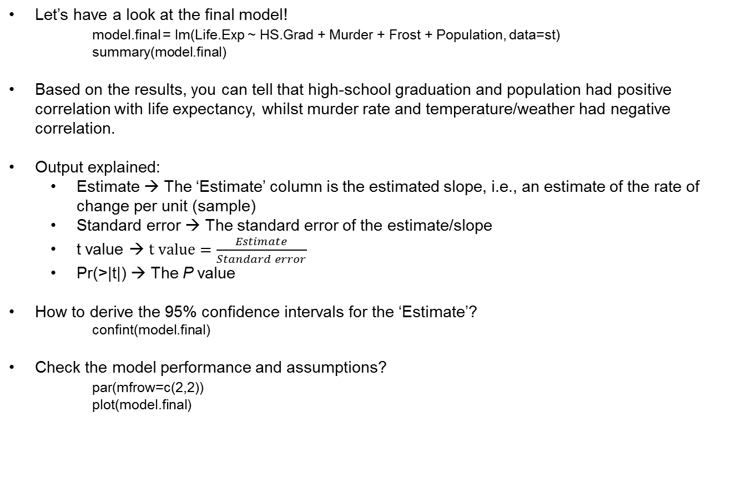
Model interpretation
Let’s have a look at the final model!
model.final = lm(Life.Exp ~ HS.Grad + Murder + Frost + Population, data=st)
summary(model.final)
Based on the results, you can tell that high-school graduation and population had positive correlation with life expectancy, whilst murder rate and temperature/weather had negative correlation.
Output explained:
Estimate → The ‘Estimate’ column is the estimated slope, i.e., an estimate of the rate of change per unit (sample)
Standard error → The standard error of the estimate/slope
t value → $t value=\frac{Estimate}{Standard error}$
Pr(>|t|) → The P value
How to derive the 95% confidence intervals for the ‘Estimate’?
confint(model.final)
Check the model performance and assumptions?
par(mfrow=c(2,2))
plot(model.final)

Slide 19
Model interpretation: cross validation
Make a ‘prediction’ on the dataset, i.e., test how well we can generalise our model to a larger population
This is called cross validation
Observe fitted and predicted values (of life expectancy) from the model
fitted(model.final)
predict(model.final)
They look they same! – if our model is a good linear fit to the data, then the fitted and predicted values will be equal
Double check by adding more decimal places (to output) and then subtracting predicted from fitted values
options(scipen=999)
fitted(model.final) - predict(model.final)
Not a perfect linear fit! …but this is expected - the model still looks good
Make a prediction (of life expectancy) by supplying new values to the data:
predict(model.final, list(Murder=10.5, HS.Grad=48, Frost=100, Population=8000))
Examine the predicted life expectancy and the original life expectancy
st$LifeExp.pred = predict(model.final)
library(ggplot2)
p1 = ggplot(st, aes(x=Life.Exp, y=LifeExp.pred)) +
geom_point() +
geom_smooth(method='lm',formula=y~x)
plot(p1)

Slide 20
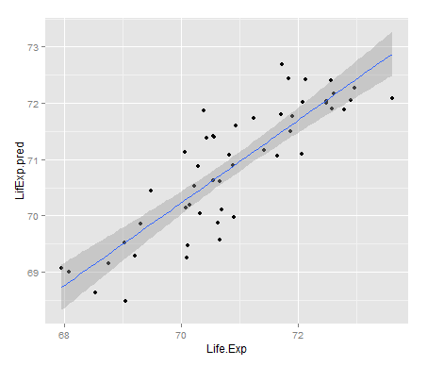
Model interpretation: cross validation
Pretty good fit to me! - we have successfully modelled life expectancy using the US data
*NB – for this plot, you may need to install ggplot2
source("https://bioconductor.org/biocLite.R")
biocLite(“ggplot2”); library(ggplot2)

Slide 21
Logistic regression
Notes:
21

Slide 22

Brief introduction
Now consider a situation that X and Y are not linearly correlated - what can we do?
The generalised linear model (GLM) deals with non-linear relationships by transforming response variables using different ‘link’ functions
NB - GLM is not the same as general linear regression.
Logistic regression is one type of GLM that follows a binomial distribution and link function
The link function is normally ‘logit’, but it can also be ‘probit’. The difference is small, but the results of logit are easier to interpret.
The logit link function transforms the response variables (binary outcomes such as success/failure, control/disease, etc.) so that they are linearly correlated with X values.
Then multiple linear regression can be applied.
The formula is:
or
where ‘P’ is the probability of the dependent variable equalling an event

Slide 23
Example 3: binary response
A researcher is interested in how variables, such as GRE (graduate record exam), GPA (grade point average), and prestige of the undergraduate institution, affect admission into graduate school.
The response variable, admit/don't admit, is a binary variable.
gre and gpa are continuous variables.
Rank takes on the values 1 to 4 - rank 1 has the highest prestige and 4 the lowest
Examine the data!
mydata <- read.csv("http://www.ats.ucla.edu/stat/data/binary.csv")
head(mydata)
summary(mydata)
#Get the mean, standard deviation, and variance of the variables
sapply(mydata, mean)
sapply(mydata, sd)
sapply(mydata, var)
It looks like ‘rank’ should be a categorical variable
mydata$rank <- factor(mydata$rank)
Notes:
23

Slide 24
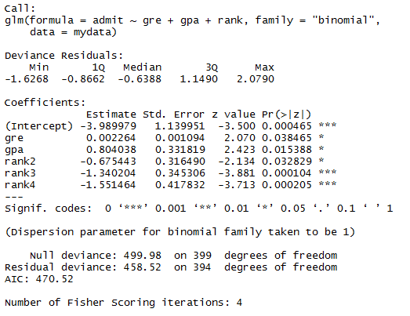
Model fitting
Now we can fit the model!
mylogit <- glm(admit ~ gre + gpa + rank, data=mydata, family="binomial")
summary(mylogit)
Because the data is artificial, the results are very pretty - all are significant! This won’t normally be the case when you apply it to your own data!
For ‘rank’, there are 3 coefficients - rank1 is the base (or reference) level
The ‘Estimate’ of the ‘Coefficients’ shows the average difference between the reference (rank1) and each other rank (rank2 - rank4)
For example, if gre and gpa are fixed, rank 2 causes a reduction of 0.68 on average when compared to rank1
P is the probability of admission

Slide 25
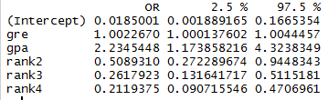
Model interpretation
A reduction/increase of Logit (P) is difficult to explain!
The odds ratio is much easier to understand, so let’s interpret the coefficients as odds ratios by exponentials
exp(cbind(OR=coef(mylogit), confint(mylogit)))
The ‘cbind’ (column bind) function combines vectors (or data-frames) - they need to have the same length (or number of rows, if data-frames)
What can we say about these?
1 unit of gre increase enhances the chance to admission by 0.23%
*Odds ratio of 1.0023, which is 0.23% increase
1 unit of gpa increase enhances the chance to admission by 124%
*Odds ratio of 2.24, which is 124% increase
Compared to rank1, rank4 reduces the chance to admission by 78.8%
*Odds ratio decrease of 1 - 0.212 = 0.788, which is 78.8% decrease
How do I get one P value for categorical variables like ‘rank’?
source("http://bioconductor.org/biocLite.R")
biocLite("aod"); library(aod)
wald.test(b=coef(mylogit), Sigma=vcov(mylogit), Terms=4:6) #Terms are the coefficients, including the intercept)

Slide 26


Model interpretation
Fixing gre and gpa; varying rank
If we want to know how ‘rank’ affects admission alone, then we need to fix gre and gpa
Let’s create a new model of 4 people who have the average gre and gpa (from the original dataset) but with different ranks:
newdata1 <- with(mydata, data.frame(gre=mean(gre), gpa=mean(gpa), rank=factor(1:4)))
Now, using the original and new data, we can use the model to predict the probability of admission for these 4 new people
newdata1$rankP <- predict(mylogit, newdata=newdata1, type="response")
Therefore, the first person has the highest chance of being admitted (52%)

Slide 27



Model interpretation
Fixing gpa; varying gre and rank
Let’s just fix the value of gpa but vary the values of gre, say from 200 to 800 - also vary the rank levels
newdata2 <- with(mydata, data.frame(gre=rep(seq(from=200, to=800, length.out=100), 4), gpa=mean(gpa), rank=factor(rep(1:4, each=100))))
Now predict the probabilities of admission to graduate school
newdata3 <- cbind(newdata2, predict(mylogit, newdata=newdata2, type="link", se=TRUE))
newdata3 <- within(newdata3,
{
PredictedProb <- plogis(fit)
LowerLimit <- plogis(fit - (1.96 * se.fit))
UpperLimit <- plogis(fit + (1.96 * se.fit))
})

Slide 28
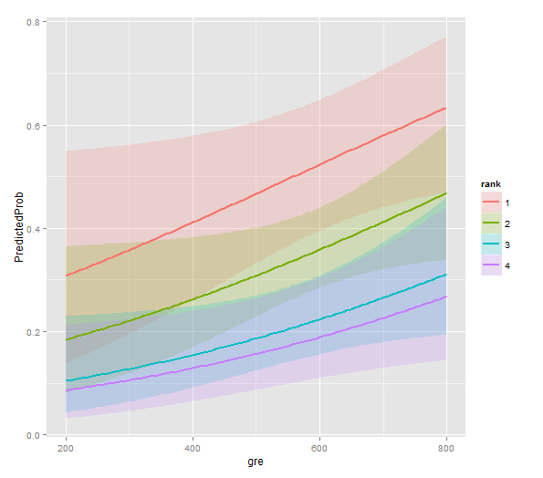
Model interpretation
Let’s have a look at the prediction, graphically
source("http://bioconductor.org/biocLite.R")
biocLite("ggplot2"); library(ggplot2)
ggplot(newdata3, aes(x=gre, y=PredictedProb)) +
geom_ribbon(aes(ymin=LowerLimit, ymax=UpperLimit, fill=rank), alpha=0.2) +
geom_line(aes(colour=rank))
What can we infer from the plot?
gre has a positive effect on the admission, regardless the ranks
rank1 has a higher chance of
admission, while rank4 has the lowest
Based on the confidence intervals,
it’s clear how different the chance of
admission can be across the rank and
gre values

Slide 29
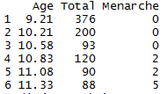
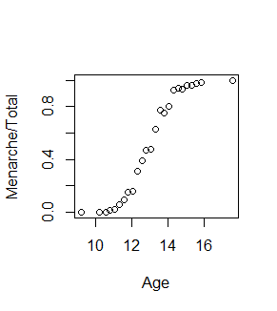
Example 4: rate/proportion response
This is another situation in which you can apply GLM with binomial distribution and the logit link function
Here, the response is proportional and the data is non-linear
Example data is from MASS package in R
library(MASS)
data(menarche)
head(menarche)
Twenty-five (25) groups of girls were included, with the measures being average age, total number of children, and the number who have reached menarche
Have a look at the correlation between proportion of girls who had menarche and age
plot(Menarche/Total ~ Age, data=menarche)
Obviously non-linear!

Slide 30
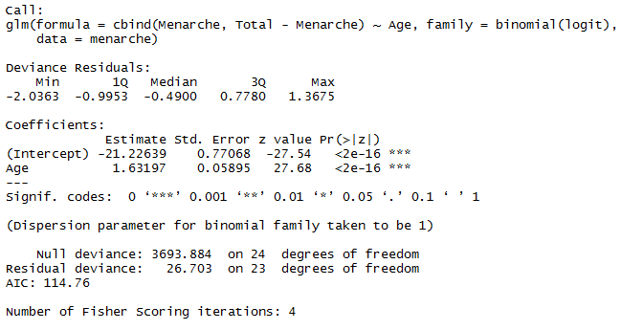
Model fitting
Let’s fit the GLM model
glm.out = glm(cbind(Menarche, Total-Menarche) ~ Age, family=binomial(logit), data=menarche)
summary(glm.out)
The response variable, here, assumes the format of two vectors:
Counts of girls with menarche (Menarche)
Counts of girls without (Total-Menarche)
As expected, group age is a significant factor on menarche rate
Age increases the rate by 5 times (exponential of 1.63 is 5.1)

Slide 31
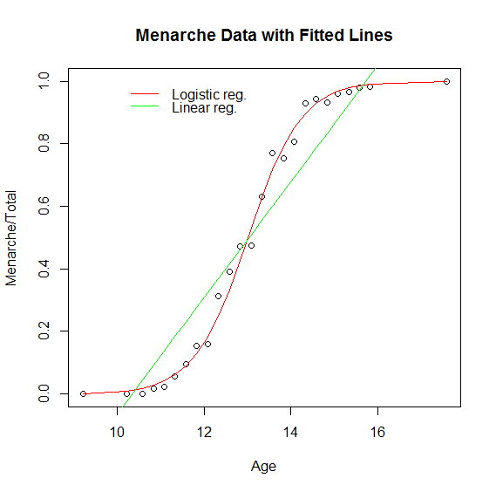
Model fitness
How does this model fit the data?
We can plot the predicted line to see this
For comparison, let’s also fit the linear model to see why logistic model is better for this data
lm.out=lm(I(Menarche/Total) ~ Age, data=menarche)
plot(Menarche/Total ~ Age, data=menarche)
lines(menarche$Age, glm.out$fitted, type="l", col="red")
title(main="Menarche Data with Fitted Lines")
lines(menarche$Age, lm.out$fitted, type="l", col="green")
legend('topleft', c('Logistic reg.','Linear reg.'), col=c('red','green'), lty=1, bty='n')
Now you know why!

Slide 32
The end!

