Slide 1
Statistical Analysis of COVID-19 Dataset
Ayorinde Ayomide David

Slide 2
Importing the dependencies
if(!require(pacman)) install.packages("pacman") # Installing the package manager pacman::p_load(tidyverse, # Metapackage here, # R library for coercing Rmarkdown into reading dataset from a seperate folder visdat, # R library for graphical inspection of dataset inspectdf, # R library for the distribution of variables gtsummary, ggplot2 )

Slide 3
Loading the COVID-19 dataset into R
covid <- read_csv(here("Data/COVID19_line_list_data.csv"))

Slide 4
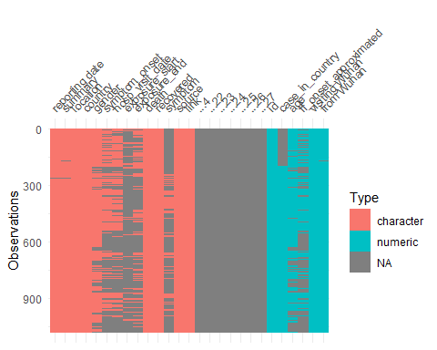
Exploring and inspecting the dataset
# Exploring the dataset dim(covid)
## [1] 1085 27
head(covid, n = 10)
## # A tibble: 10 × 27 ## id case_in_country `reporting date` ...4 summary location country gender ## <dbl> <dbl> <chr> <lgl> <chr> <chr> <chr> <chr> ## 1 1 NA 1/20/2020 NA First c… Shenzhe… China male ## 2 2 NA 1/20/2020 NA First c… Shanghai China female ## 3 3 NA 1/21/2020 NA First c… Zhejiang China male ## 4 4 NA 1/21/2020 NA new con… Tianjin China female ## 5 5 NA 1/21/2020 NA new con… Tianjin China male ## 6 6 NA 1/21/2020 NA First c… Chongqi… China female ## 7 7 NA 1/21/2020 NA First c… Sichuan China male ## 8 8 NA 1/21/2020 NA new con… Beijing China male ## 9 9 NA 1/21/2020 NA new con… Beijing China male ## 10 10 NA 1/21/2020 NA new con… Beijing China male ## # ℹ 19 more variables: age <dbl>, symptom_onset <chr>, ## # If_onset_approximated <dbl>, hosp_visit_date <chr>, exposure_start <chr>, ## # exposure_end <chr>, `visiting Wuhan` <dbl>, `from Wuhan` <dbl>, ## # death <chr>, recovered <chr>, symptom <chr>, source <chr>, link <chr>, ## # ...22 <lgl>, ...23 <lgl>, ...24 <lgl>, ...25 <lgl>, ...26 <lgl>, ## # ...27 <lgl>
tail(covid, n = 10)
## # A tibble: 10 × 27 ## id case_in_country `reporting date` ...4 summary location country gender ## <dbl> <dbl> <chr> <lgl> <chr> <chr> <chr> <chr> ## 1 1076 14 2/25/2020 NA new COV… Bahrain Bahrain male ## 2 1077 15 2/25/2020 NA new COV… Bahrain Bahrain male ## 3 1078 16 2/25/2020 NA new COV… Bahrain Bahrain female ## 4 1079 17 2/25/2020 NA new COV… Bahrain Bahrain female ## 5 1080 1 2/25/2020 NA new COV… Innsbru… Austria <NA> ## 6 1081 2 2/25/2020 NA new COV… Innsbru… Austria <NA> ## 7 1082 1 2/24/2020 NA new COV… Afghani… Afghan… <NA> ## 8 1083 1 2/26/2020 NA new COV… Algeria Algeria male ## 9 1084 1 2/25/2020 NA new COV… Croatia Croatia male ## 10 1085 1 2/25/2020 NA new COV… Bern Switze… male ## # ℹ 19 more variables: age <dbl>, symptom_onset <chr>, ## # If_onset_approximated <dbl>, hosp_visit_date <chr>, exposure_start <chr>, ## # exposure_end <chr>, `visiting Wuhan` <dbl>, `from Wuhan` <dbl>, ## # death <chr>, recovered <chr>, symptom <chr>, source <chr>, link <chr>, ## # ...22 <lgl>, ...23 <lgl>, ...24 <lgl>, ...25 <lgl>, ...26 <lgl>, ## # ...27 <lgl>
# Inspecting the dataset vis_dat(covid)

Slide 5
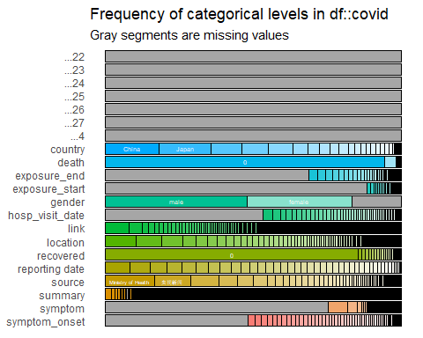
inspect_cat(covid) %>% show_plot()

Slide 6
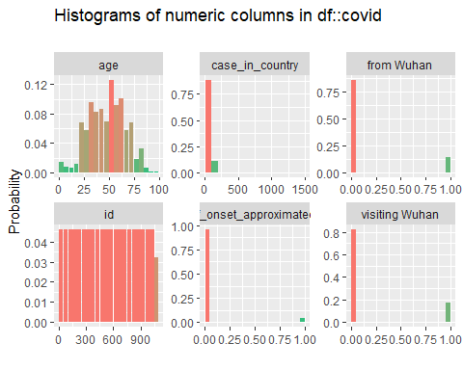
inspect_num(covid) %>% show_plot()

Slide 7
Selecting, cleaning, transformation and manipulation of the variables of interest
covid_selected <- covid %>% select(id, reporting_date = 'reporting date', # The initial variable name has to go into quote because it has a whitespace which is unconventional for variable name in R gender, death, age, country)
covid_selected %>% select(death) %>% unique()
## # A tibble: 14 × 1 ## death ## <chr> ## 1 0 ## 2 1 ## 3 2/14/2020 ## 4 2/26/2020 ## 5 2/13/2020 ## 6 2/28/2020 ## 7 2/27/2020 ## 8 2/25/2020 ## 9 2/23/2020 ## 10 2/24/2020 ## 11 2/22/2020 ## 12 02/01/20 ## 13 2/19/2020 ## 14 2/21/2020
covid_selected <- covid_selected %>% mutate(death = as.integer(covid$death != 0)) # This overwrite the initial death column by leaving entries as 0 or converting not zero entries to 1 covid_selected %>% # checking to confirm if the changes has been effected select(death) %>% unique()
## # A tibble: 2 × 1 ## death ## <int> ## 1 0 ## 2 1
covid_selected <- covid_selected %>% mutate(reporting_date = mdy(reporting_date)) # This overwrite the initial reporting date by converting the variable class to Date
covid_selected <- covid_selected %>% mutate(month = month(reporting_date, label = T), month = replace_na(month,"Feb")) # The first mutate chunk create a new column for month and the second replaces na in the month variable with Feb
covid_selected <- covid_selected %>% # Creating a column for continent mutate(continent = case_when( country %in% c("USA", "Canada") ~ "North America", country %in% c("France", "Germany", "Italy", "Russia", "UK", "Finland", "Spain", "Sweden", "Belgium", "Austria", "Croatia", "Switzerland") ~ "Europe", country %in% c("China", "Japan", "Malaysia", "Nepal", "Singapore", "South Korea", "Taiwan", "Thailand", "Vietnam", "Cambodia", "Sri Lanka", "UAE", "Hong Kong", "India", "Phillipines", "Iran", "Israel", "Lebanon", "Kuwait", "Bahrain", "Afghanistan") ~ "Asia", country %in% c("Australia") ~ "Oceania", country %in% c("Egypt", "Algeria") ~ "Africa", TRUE ~ "Other"))

Slide 8
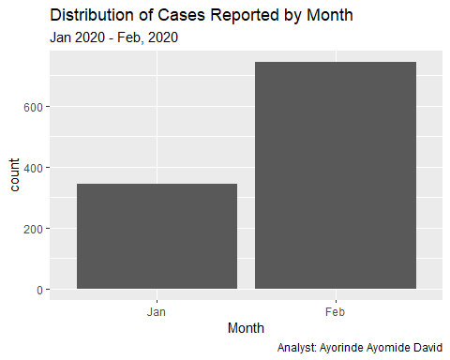
Visualizing some of the variables of interest
ggplot(covid_selected, mapping = aes(x = month)) + geom_bar() + labs(title = "Distribution of Cases Reported by Month", subtitle = "Jan 2020 - Feb, 2020", x = "Month", caption = "Analyst: Ayorinde Ayomide David")

Slide 9
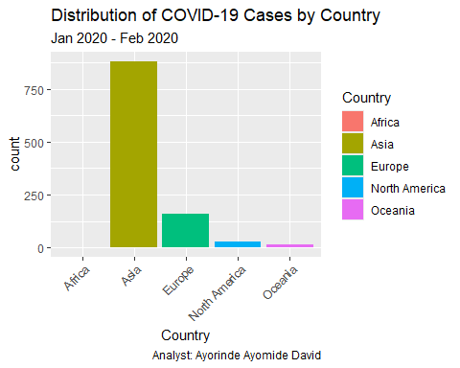
ggplot(covid_selected,mapping = aes(x = continent, fill = continent)) + geom_bar() + theme(axis.text.x = element_text(angle = 45, hjust = 1)) + labs(title = "Distribution of COVID-19 Cases by Country", subtitle = "Jan 2020 - Feb 2020", x = "Country", caption = "Analyst: Ayorinde Ayomide David", fill = "Country")

Slide 10
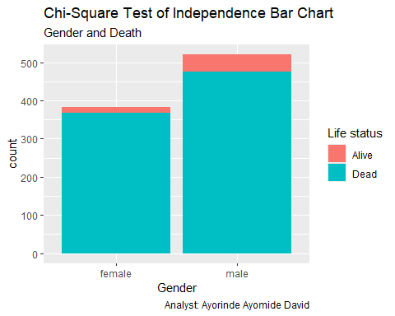
Statistical Analysis
Two-sample t-test
H₀: There is no significant difference between the age of those alive and dead ($μ_{1}=μ_{2}$)
H₁: There is a significant difference between the age of those alive and dead ($μ_{1}≠μ_{2}$)
covid_selected %>% group_by(death) %>% summarise(gender_death_mean = mean(age, na.rm = T))
## # A tibble: 2 × 2 ## death gender_death_mean ## <int> <dbl> ## 1 0 48.1 ## 2 1 68.6
We can see that there is a difference of about 20(in years) between the ages of those that are dead and alive. Now, the question:
Is this really significant?
Let’s confirm using t.test
dead <- covid_selected %>% filter(death == 1) alive <- covid_selected %>% filter(death == 0) t.test(alive$age, dead$age, conf.level = 0.95, alternative = "two.sided")
## ## Welch Two Sample t-test ## ## data: alive$age and dead$age ## t = -10.839, df = 72.234, p-value < 2.2e-16 ## alternative hypothesis: true difference in means is not equal to 0 ## 95 percent confidence interval: ## -24.28669 -16.74114 ## sample estimates: ## mean of x mean of y ## 48.07229 68.58621
Decision rule: If p-value is < 0.05, we reject null hypothesis, otherwise, we fail to reject null hypothesis
Conclusion: Since the p-value is < 0.05, we reject null hypothesis and conclude that there is a significant difference between the age of those that are dead and those that are alive. In order words, older people are more likely/prone to death if tested positive for COVID-19
Test of Independence
covid_selected <- covid_selected %>% drop_na(gender) %>% mutate(gender_cov = factor(gender), death_cov = factor(case_when(death == 1 ~ "Alive", death == 0 ~ "Dead"))) ggplot(covid_selected, mapping = aes(x = gender_cov, fill = death_cov)) + geom_bar() + labs(title = "Chi-Square Test of Independence Bar Chart", subtitle = "Gender and Death", x = "Gender", caption = "Analyst: Ayorinde Ayomide David", fill = "Life status")

Slide 11
Are the proportions of gender independent of life status?
The question above leads us to the hypothesis below
H₀: The variables are independent i.e There is no relationship between the variables
H₁: The variables are not independent i.e There is a relationship between the variables
covid_selected %>% select(gender_cov, death_cov) %>% table() %>% chisq.test()
## ## Pearson's Chi-squared test with Yates' continuity correction ## ## data: . ## X-squared = 7.6428, df = 1, p-value = 0.0057
Decision rule: If p-value is < 0.05, we reject null hypothesis, otherwise, we fail to reject null hypothesis
Conclusion: Since the p-value is < 0.05, we reject null hypothesis and conclude that there is a relationship between the death and gender variable

