Slide 1
SPEECH THERAPY OS
Wulo
30 -> 5 min
The speech therapy operating system
home-practice review
+22%
clinical phoneme performance
Built with React, Python, realtime speech, Azure Speech, Azure Voice Live, and Azure OpenAI

Slide 2
EXECUTIVE SUMMARY
02
Wulo in one slide
Problem
Approach
Therapists lost up to 30 minutes reconstructing what happened between sessions.
Design a speech therapy OS that captures practice, analyses it, and presents it back to the therapist.
Implementation
Results
Real-time voice practice, phoneme-aware assessment, session summaries, review dashboards.
Review time reduced from 30 minutes to 5 minutes; clinical phoneme performance improved by 22%.

Slide 3
1. THE PROBLEM
03
A one-hour session was being consumed by missing context
Therapists were forced to reconstruct the week before they could treat the child in front of them.
The hidden cost
50%
Home practice was inconsistent, undocumented, and hard to verify.
Parents wanted to help but often lacked time, structure, or clinical confidence.
of a one-hour session could be spent reconstructing home practice
Children needed repeated practice, but not every home had someone available to coach it.
The first 30 minutes of a 60-minute session could disappear into catch-up and guesswork.
30 minutes lost before intervention could properly begin

Slide 4
PROBLEM QUANTIFIED
04
Where the inefficiency came from
1
2
3
4
Therapist sets targets
Home practice happens
Evidence is missing
Next session starts
>
>
>
Good clinical plan
Low structure
No reliable trace
30 min reconstruction
Automation target
Capture the practice evidence automatically, then compress it into something a therapist can review in minutes.

Slide 5
2. THE APPROACH
05
I designed Wulo as an operating system for therapist-led care
The question was not what can AI do? It was what should the OS run on behalf of the therapist, and what must the therapist still own?
Observed the workflow around session prep, home practice, review, and next-step planning.
Separated clinical judgement from repeatable evidence-capture tasks.
Prioritized automations with measurable time savings and low safety risk.
Designed human-in-the-loop checkpoints so generated outputs supported, rather than replaced, therapists.

Slide 6
AUTOMATION CHOICES
06
What the OS runs for the therapist
Guided home practice
Give the child structured repetitions without needing a parent to lead every turn.
Transcript capture
Preserve what happened instead of relying on memory or parent recall.
Pronunciation scoring
Turn audio into word and phoneme-level signals therapists can inspect.
Session summarisation
Compress raw interaction data into review-ready clinical context.
Next-session planning
Use saved evidence to draft a plan for therapist approval.

Slide 7
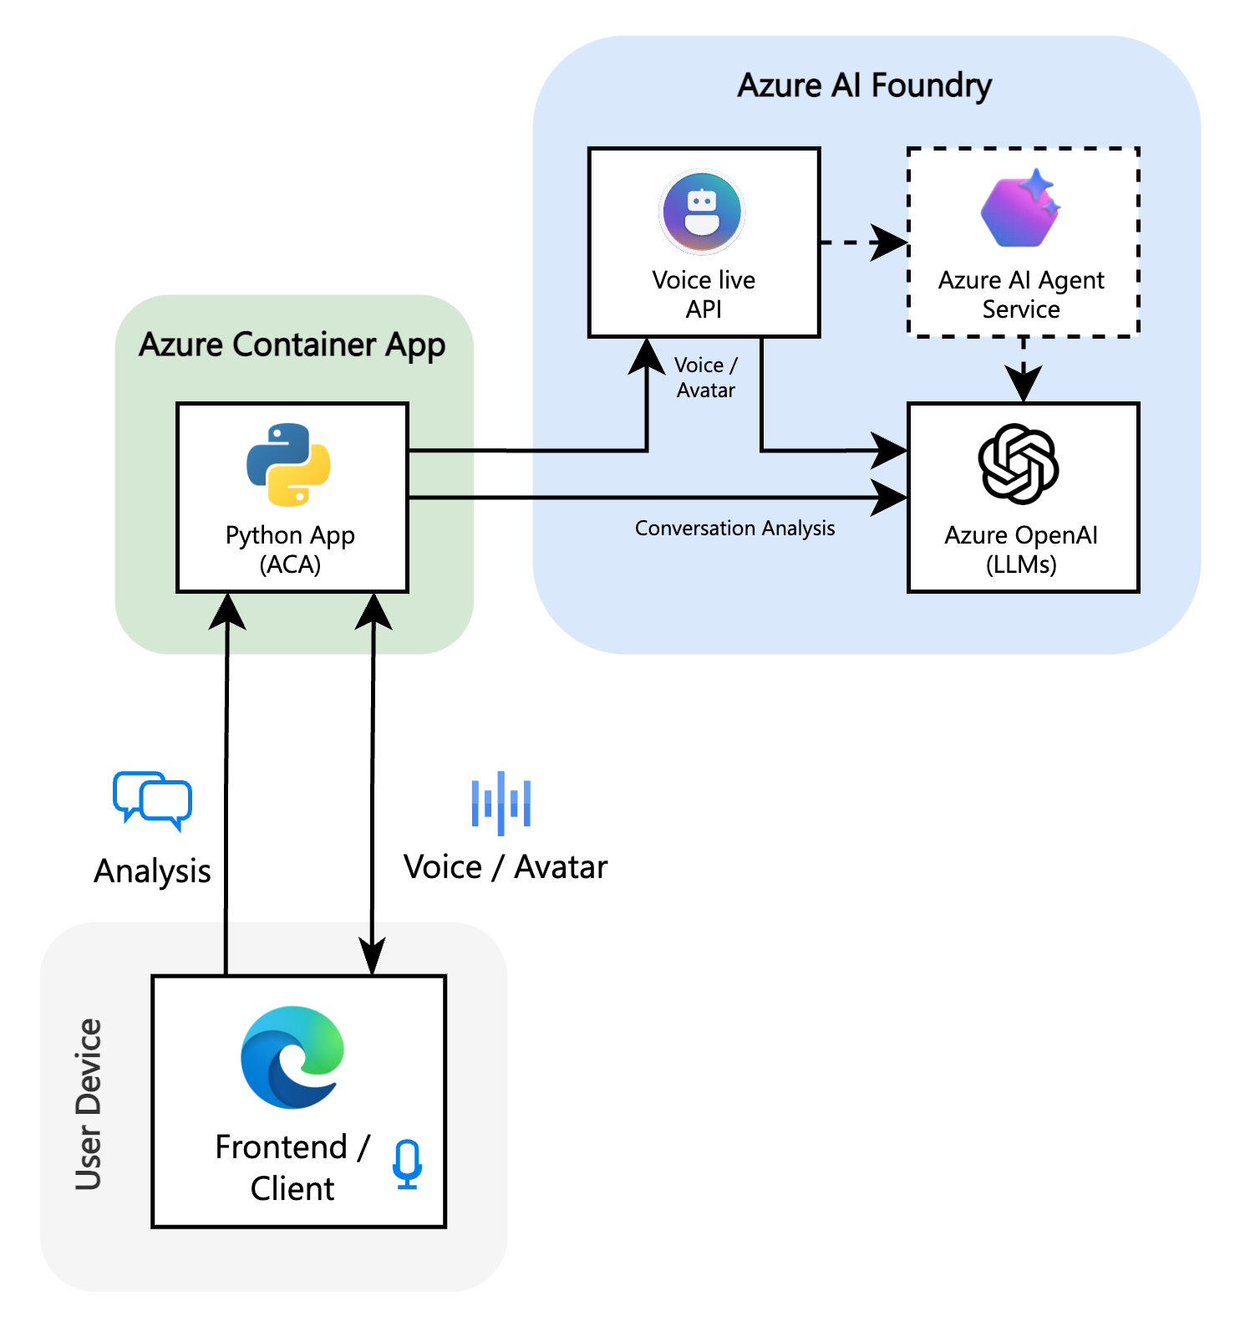
3. IMPLEMENTATION
07
OS architecture: realtime practice plus review intelligence
React and TypeScript frontend for child practice and therapist dashboard workflows.
Python Flask backend with WebSocket proxy for real-time audio and avatar sessions.
Azure Voice Live for guided conversation and avatar delivery.
Azure Speech for pronunciation assessment; Azure OpenAI for structured analysis and planning.
Persistence layer for session history, child memory, recommendations, and audit-friendly review.

Slide 8
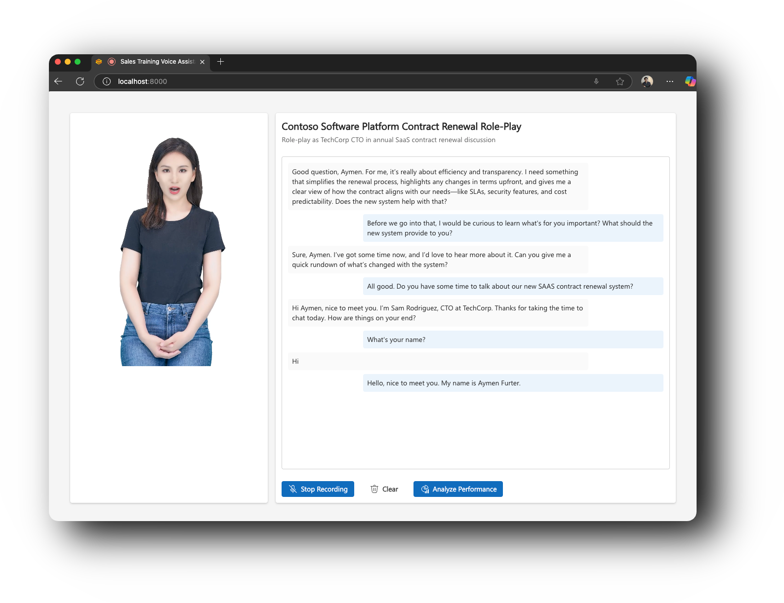
IMPLEMENTATION DETAIL
08
Realtime practice loop
The child gets a supportive practice partner; the therapist gets structured evidence back.
1
Audio capture streams from browser to backend over WebSocket.
2
Voice session returns assistant audio, avatar output, and transcriptions.
3
Session completion triggers analysis of transcript, target words, and pronunciation data.
4
Results are saved for therapist review before the next appointment.

Slide 9
IMPLEMENTATION DETAIL
09
Making speech AI work for clinical phonemes
Off-the-shelf speech models were not enough for therapy-specific pronunciation targets.
+22%
Built a target-sound layer around words, phonemes, repetitions, and child-appropriate prompts.
Used Azure Speech pronunciation assessment for word-level accuracy, fluency, and completeness signals.
Improvement over the off-the-shelf speech model on clinical phoneme pronunciation tasks
Added phoneme-aware content and lexicon support so clinical targets were pronounced and evaluated more reliably.
Compared baseline model behaviour against therapy-specific prompts and target lists on clinical phoneme examples.
Measured by comparing baseline speech behaviour with therapy-specific phoneme prompts and target lists.

Slide 10
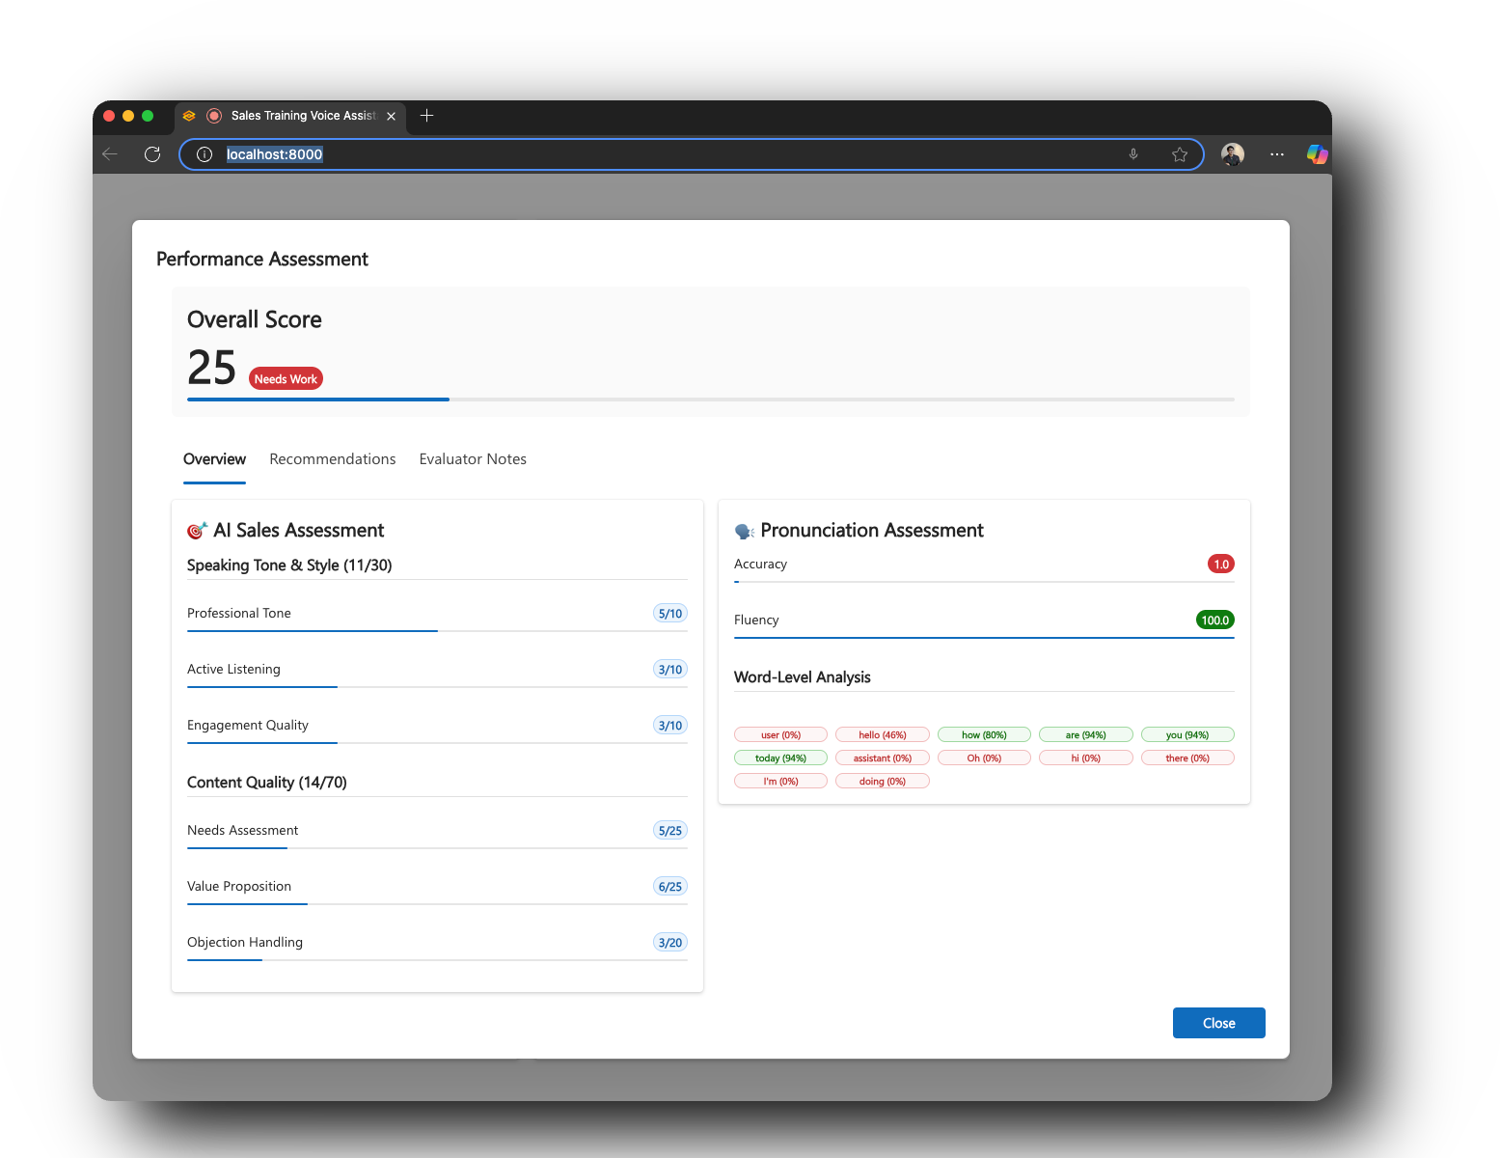
IMPLEMENTATION DETAIL
10
Therapist review dashboard
Raw practice becomes decision-ready evidence.
Per-session transcripts and assessment results are stored for review.
Pronunciation scores surface word-level strengths and failure cases.
AI-generated notes summarise effort, clarity, retries, and suggested practice focus.
Therapist feedback stays authoritative and can be added after review.

Slide 11
4. RESULTS
11
Measured impact
30 min
Before
5 min
After
Manual reconstruction at start of a 60-minute therapy session
Review using Wulo session evidence and summaries
83%
Faster review
+22%
Speech quality
25 minutes returned to therapy time
Improvement on clinical phoneme pronunciation tasks
Bottom line: Wulo returned 25 minutes of a 60-minute therapy session to active clinical work.

Slide 12
WHY IT MATTERS
12
The OS changed the economics of care delivery
The value was not just speed. It was better allocation of scarce clinical attention.
Performance: therapists start with evidence, not uncertainty.
Efficiency: 25 minutes per session moves from reconstruction to intervention.
Quality: phoneme-specific feedback improves the signal therapists use to adjust plans.
Scalability: parents no longer need to personally lead every practice repetition.
Safety: AI supports preparation and review while therapists retain clinical judgement.

Slide 13
CLOSING
13
The engineering lesson
A good speech therapy OS respects the expert workflow it runs on.
I did not build an AI therapist. I built the OS that surrounds the therapist.
It captures practice, analyses speech, summarises evidence, and proposes next steps.
The therapist remains the decision maker, but now enters the session with better data and more time.
Wulo is the speech therapy OS that turns between-session practice into measurable clinical progress.

