Slide 1

OFFICE SUPPLY ANALYSIS
BY
AYOMIDE BALOGUN

Slide 2

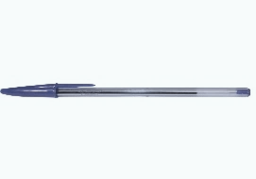
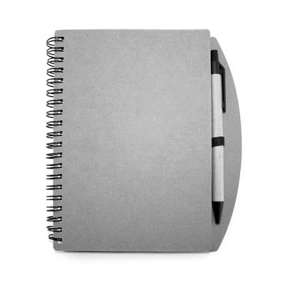

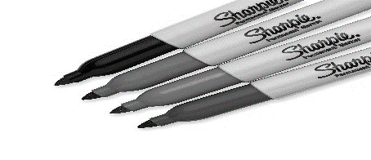
EXECUTIVE SUMMARY
This presentation is a summary of the financial analysis of Office Supply sales Q4 2013 and Q4 2014.
We’d look into the Key Findings and recommendations on the sales data of supply materials to best understand what drives the business market.
Analysis on business performance and key drivers of business.
OUR PRODUCTS
Biro
Markers
A4 Paper
Notepads
Pencil

Slide 3
Calculated Indices
127.93M
Sum of Gross Sales
121.22M
Sum of Revenue
-251.55K
Profit Margin
727.79K
Sum of Tax
38.20
Discount Rate
13.83M
Profit After Tax

Slide 4
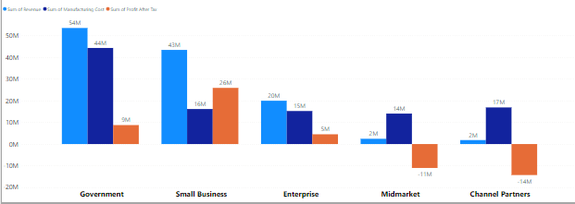
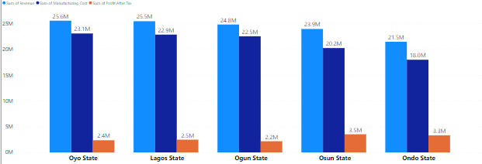
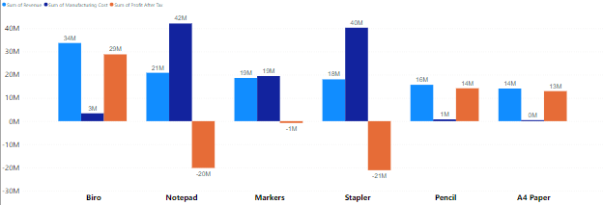
Overview of Performance by Segment, States and Product
Report Overview by Segment
Report Overview by State
Report Overview by Product
Small Business generated the highest profit after tax of 26 million following it’s low manufacturing cost to revenue ratio.
Government had the highest revenue and incurred the highest manufacturing cost with a total profit of 9M after tax.
A loss of 14million was recorded on Channel Partners and 11million on Midmarket as a result of it’s high manufacturing cost against revenue made.
Oyo State is our highest selling point. However, we make higher profit after Tax in Lagos.
Oyo, Lagos and Ogun state made more sales and revenue as compared to other states.
Osun state generated the highest profit after tax followed closely by Ondo State.
Biro generated the highest sales point in the Products overview.
Staplers and notepad are running at a loss of 20 & 21 million due to the high manufacturing cost of 42 & 40 million respectively.

Slide 5
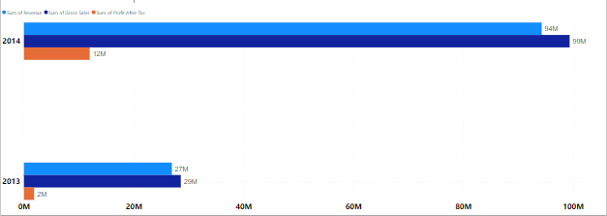
Q4 2014 vs Q4 2013
This analysis indicates that Year 2014 witnessed a massive growth in Revenue as compared with Year 2013. Gross sales, Revenue and Profit After Tax generated in Q4 2014 was much higher.

Slide 6
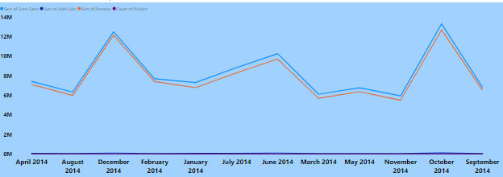
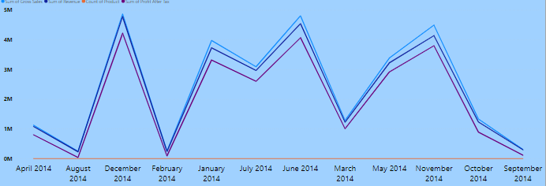
Overview of Products Performance for 2014
All Products
Biro
For year 2014, October recorded the highest sales and revenue with a figure of 12.69million.
Revenue generated by each product was volatile throughout the year but Biro had a continuous increase between August and December.
Biro experienced a growth in sales at the end of the year.

Slide 7
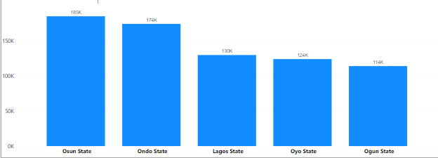
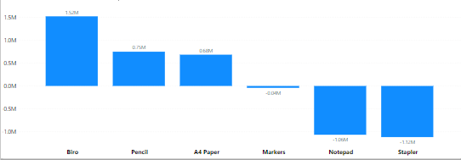
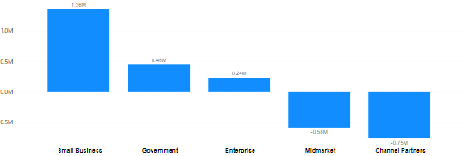
Sum of Tax by State, Products & Segments.
Biro is the most taxed Product across all states followed closely by Pencil.
The taxation from Ogun, Oyo and Lagos are favorable to the business. However, We pay the highest tax in Osun State followed closely by Ondo State even if we make least sales there.
Small Business pays the highest amount of tax and Enterprise Segment pays the least.

Slide 8
Key Findings
Office Supply generated a negative profit margin.
Biro, A4paper and Pencil are key business drivers.
Government and Small business segment makes more revenue for the business.
Small business pays the highest tax.
Lagos State has the highest sales for 2014 in Q4 2014 against Q4 2013.
For year 2014, there were more sales and revenue in month September.
Oyo state is our highest revenue point in business. Oyo, Lagos and Ogun State makes more sales compared to Osun and Ondo.
Products are heavily taxed in Osun and Ondo compared to other states.

Slide 9
Recommendations
It is recommended that Management should examine the manufacturing cost of Notepad, Staplers and Markers as the business is running at a loss with the sales.
Management should invest more on sales of Pencil as it requires low manufacturing cost but a higher Profit after tax.
The sales team should increase the marketing techniques used in the Small business and Government segment as it targets most of our end users.
The taxing of products in Osun and Ondo state should be reviewed as products are heavily taxed there.
Management should consider financing production of more A4paper and Pencils.
Due to loss in Stapler and Notepad, sales of these products should be discontinued until reduced cost in manufacturing.

Slide 10
THANK YOU

